Slide 1
Graph Optimization Problems and
Greedy Algorithms
Greedy Algorithms
  // Make the best choice now!
Optimization Problems
    Minimizing Cost or Maximizing Benefits
  Minimum Spanning Tree
    Minimum cost for connecting all vertices
  Single-Source Shortest Paths
    Shortest Path between two vertices

Slide 2
Greedy Algorithms:
Make the best choice now!
Making choices in sequence such that
  each individual choice is best
    according to some limited “short-term” criterion,
    that is not too expensive to evaluate
  once a choice is made, it cannot be undone!
    even if it becomes evident later that it was a poor choice
Make progress by choosing an action that
  incurs the minimum short-term cost,
  in the hope that a lot of small short-term costs
  add up to small overall cost.
Possible drawback:
  actions with a small short-term cost may lead to a situation, where further large costs are unavoidable.

Slide 3
Optimization Problems
Minimizing the total cost or
Maximizing the total benefits
  Analyze all possible outcomes and find the best, or
  Make a series of choices whose overall effect is to achieve the optimal.
Some optimization problems can be solved exactly by greedy algorithms
  Minimum cost for connecting all vertices
    Minimum Spanning Tree Algorithm
  Shortest Path between two vertices
    Single-Source Shortest Paths Algorithm

Slide 4
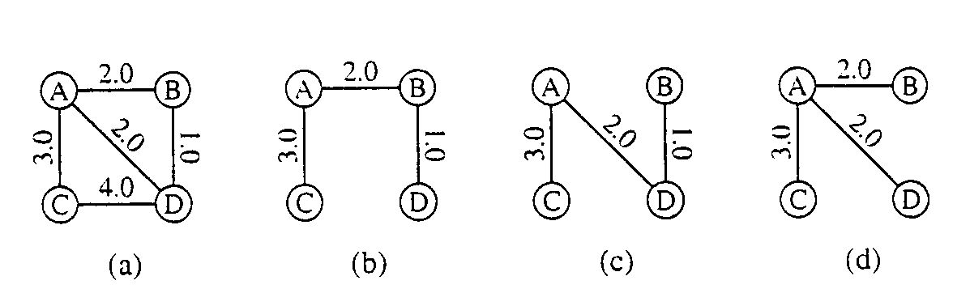
Minimum Spanning Tree
A spanning tree for a connected, undirected graph, G=(V,E) is
  a subgraph of G that is
  an undirected tree and contains
  all the vertices of G.
In a weighted graph G=(V,E,W), the weight of a subgraph is
  the sum of the weights of the edges in the subgraph.
A minimum spanning tree for a weighted graph is
  a spanning tree with the minimum weight.

Slide 5
Prim’s Minimum Spanning Tree Algorithm
Select an arbitrary starting vertex, (the root)
branches out from the tree constructed so far by
  choosing an edge at each iteration
  attach the edge to the tree
    that edge has minimum weight among all edges that can be attached
  add to the tree the vertex associated with the edge
During the course of the algorithm, vertices are divided into three disjoint categories:
  Tree vertices: in the tree constructed so far,
  Fringe vertices: not in the tree, but adjacent to some vertex in the tree,
  Unseen vertices: all others

Slide 6
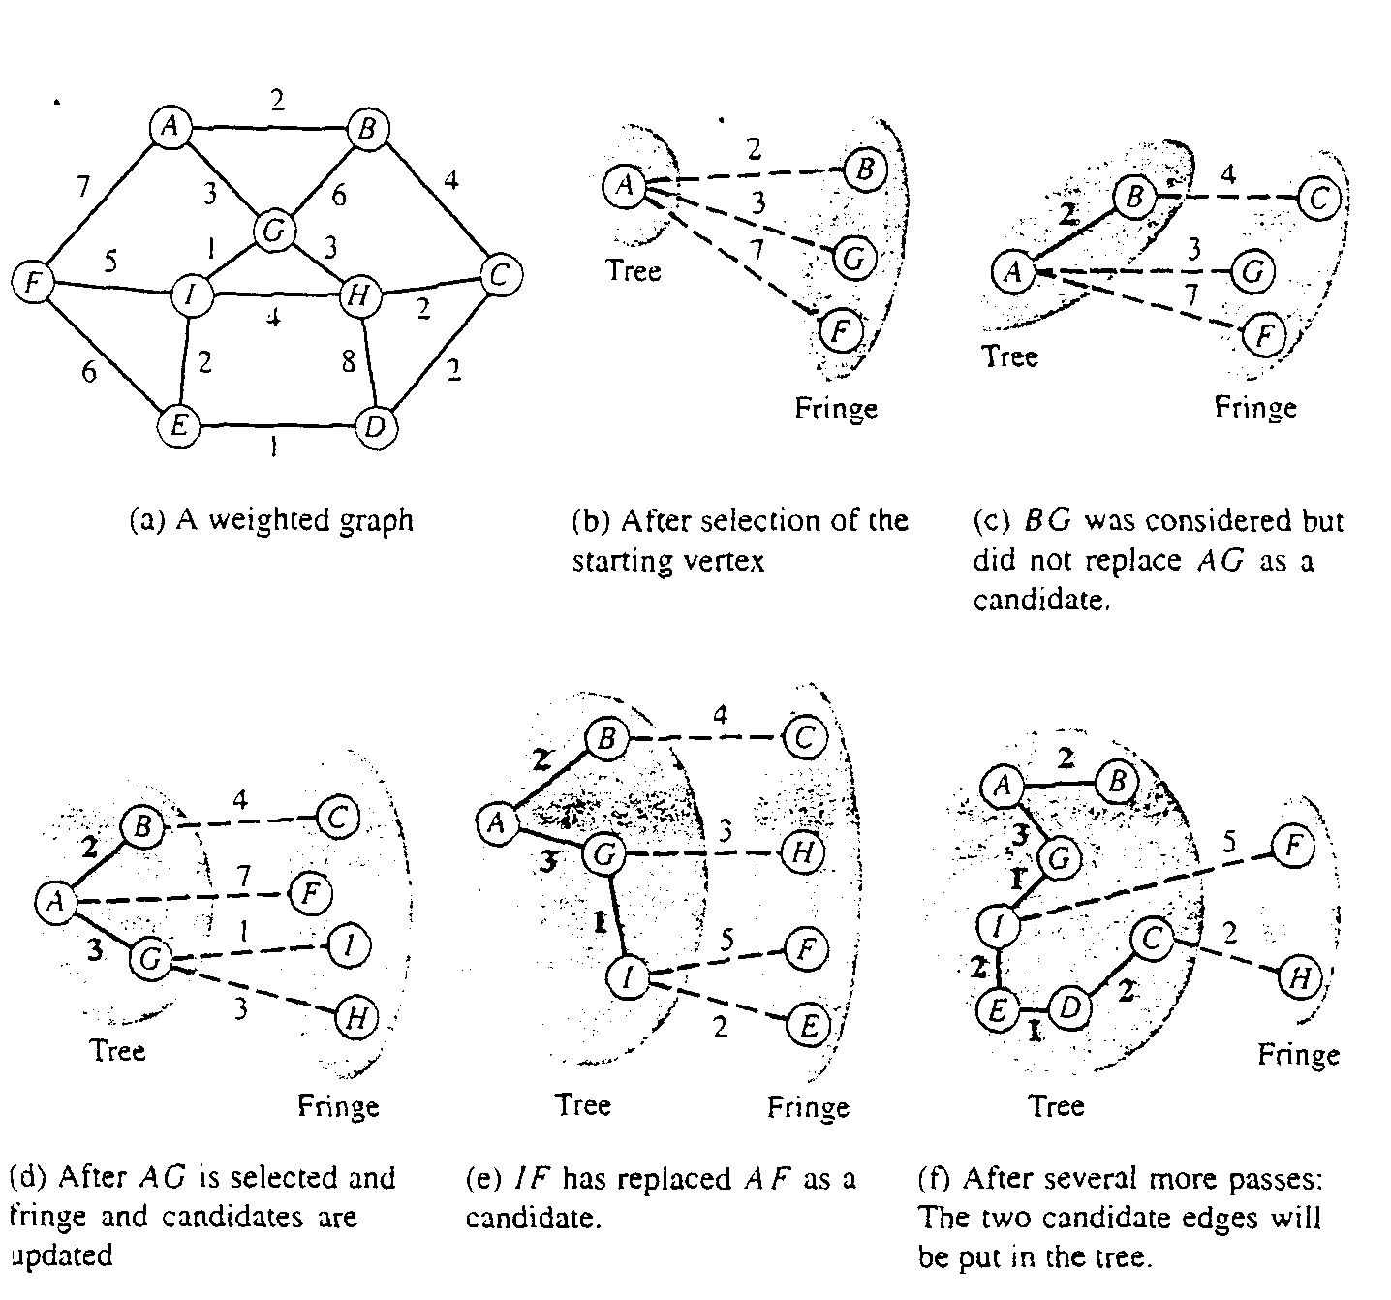
The Algorithm in action, e.g.

Slide 7
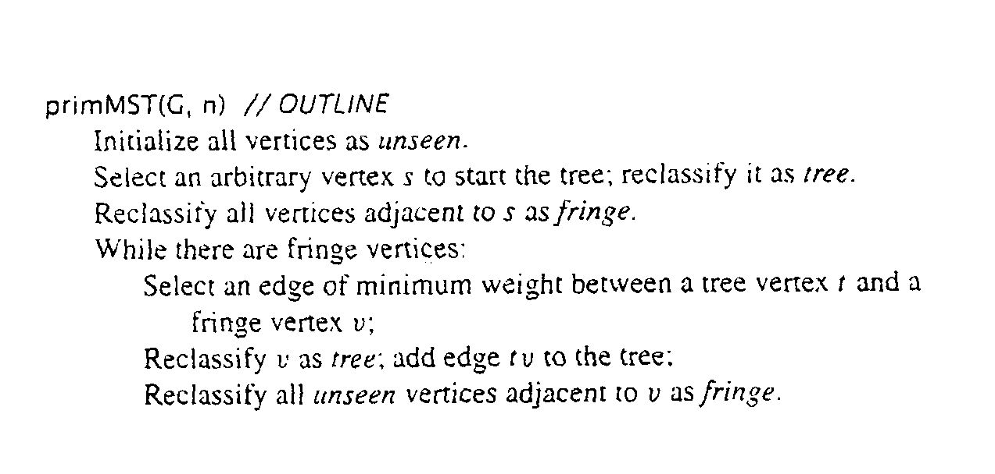
Prim’s Minimum Spanning Trees: Outline

Slide 8
Properties of Minimum Spanning Trees
Definition: Minimum spanning tree property
  Let a connected,weighted graph G=(V,E,W) be given,and let T be any spanning tree of G.
  Suppose that for every edge vw of G that is not in T,
  if uv is added to T, then it creates a cycle
  such that uv is a maximum-weight edge on that cycle.
  The the tree T is said to have the minimum spanning tree property.

Slide 9
Properties of Minimum Spanning Trees …
Lemma:
  In a connected, weighted graph G = (V, E, W),
  if T1 and T2 are two spanning trees that have the MST property,
  then they have the same total weight.
Theorem:
  In a connected,weighted graph G=(V,E,W)
  a tree T is a minimum spanning tree if and only if
  T has the MST property.

Slide 10
Correctness of Prim’s MST Algorithm
Lemma:
  Let G = (V, E, W) be a connected, weighted graph with n = |V|;
  let T_{k} be the tree with k vertices constructed by Prim’s algorithm, for k = 1, …, n; and
  let G_{k} be the subgraph of G induced by the vertices of T_{k} (i.e., uv is an edge in G_{k} if it is an edge in G and both u and v are in T_{k}).
  Then T_{k} has the MST property in G_{k}.
Theorem:
  Prim's algorithm outputs a minimum spanning tree.

Slide 11
Problem: Single-Source Shortest Paths
Problem:
  Finding a minimum-weight path between two specified vertices
  It turns out that, in the worst case, it is no easier to find a minimum-weight path between a specified pair of nodes s and t than
  it is to find minimum-weight path between s and every vertex reachable from s. (single-source shortest paths)

Slide 12
Shortest-Path
Definition: shortest path
  Let P be a nonempty path
  in a weighted graph G=(V,E,W)
  consisting of k edges xv₁,v₁v₂,....v_{k-1}y (possibly v₁=y).
  The weight of P, denoted as W(P) is
  the sum of the weights,W(xv₁),W(v₁v₂),...W(v_{k-1}y).
  If x=y, the empty path is considered to be a path from x to y. The weight of the empty path is zero.
  If no path between x and y has weight less than W(P),
  then P is called a shortest path,or minimum-weight path.

Slide 13
Properties of Shortest Paths
Lemma: Shortest path property
  In a weighted graph G,
  suppose that a shortest path from x to z consist of
  path P from x to y followed by
  path Q from y to z.
  Then P is a shortest path from x to y, and
  Q is a shortest path form y to z.

Slide 14
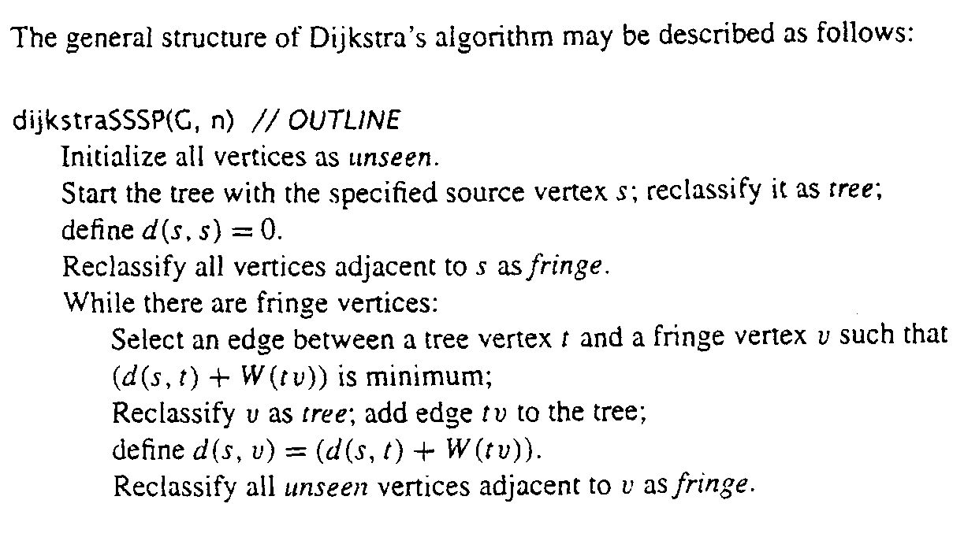
Dijkstra’s Shortest-Path Algorithm
    Greedy Algorithm
    weights are nonnegative

Slide 15
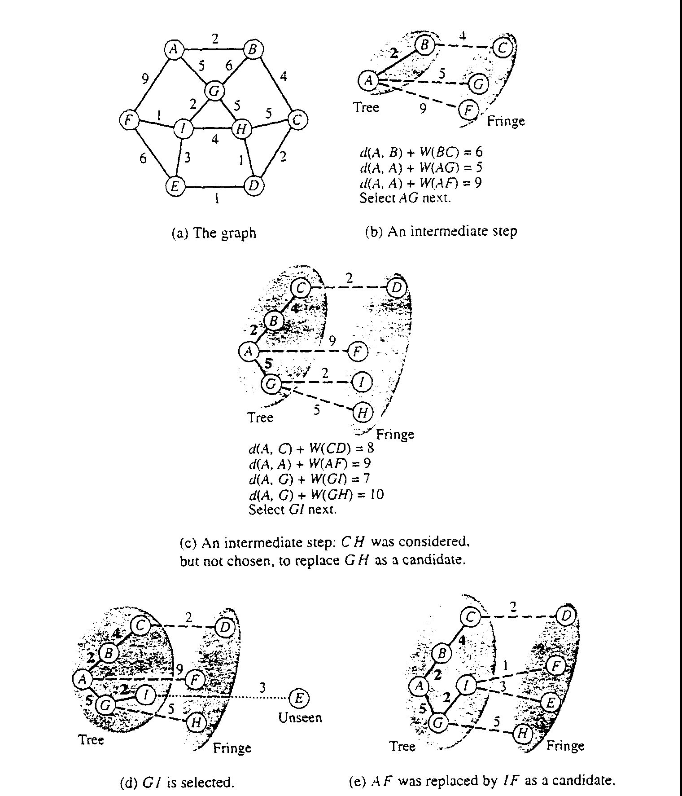
The Algorithm in action, e.g.

Slide 16
Correctness of
Dijkstra’s Shortest-Path Algorithm
Theorem:
  Let G=(V,E,W) be a weighted graph with nonnegative weights.
  Let V' be a subset of V and
  let s be a member of V'.
  Assume that d(s,y) is the shortest distance in G from s to y, for each y∈V'.
  If edge yz is chosen to minimize d(s,y)+W(yz) over all edges with one vertex y in V' and one vertex z in V-V',
  then the path consisting of a shortest path from s to y followed by the edge yz is a shortest path from s to z.
Theorem:
  Given a directed weighted graph G with a nonnegative weights and a source vertex s, Dijkstra's algorithm computes the shortest distance from s to each vertex of G that is reachable from s.

