Slide 1
Dynamic Programming
  An Algorithm Design Technique
  A framework to solve Optimization problems
Elements of Dynamic Programming
Dynamic programming version of a recursive algorithm
Developing a Dynamic Programming Algorithm
  Multiplying a Sequence of Matrices

Slide 2
A framework to solve Optimization problems
For each current choice:
  Determine what subproblem(s) would remain if this choice were made.
  Recursively find the optimal costs of those subproblems.
  Combine those costs with the cost of the current choice itself to obtain an overall cost for this choice
Select a current choice that produced the minimum overall cost.

Slide 3
Elements of Dynamic Programming
Constructing solution to a problem by building it up dynamically from solutions to smaller (or simpler) sub-problems
  sub-instances are combined to obtain sub-instances of increasing size, until finally arriving at the solution of the original instance.
  make a choice at each step, but the choice may depend on the solutions to sub-problems
Principle of optimality
  the optimal solution to any nontrivial instance of a problem is a combination of optimal solutions to some of its sub-instances.
Memoization (for overlapping sub-problems)
  avoid calculating the same thing twice,
  usually by keeping a table of know results that fills up as sub-instances are solved.

Slide 4
Memoization for Dynamic programming version of a recursive algorithm e.g.
Trade space for speed by storing solutions to sub-problems rather than re-computing them.
As solutions are found for suproblems, they are recorded in a dictionary, say soln.
  Before any recursive call, say on subproblem Q, check the dictionary soln to see if a solution for Q has been stored.
    If no solution has been stored, go ahead with recursive call.
    If a solution has been stored for Q, retrieve the stored solution, and do not make the recursive call.
  Just before returning the solution, store it in the dictionary soln.

Slide 5
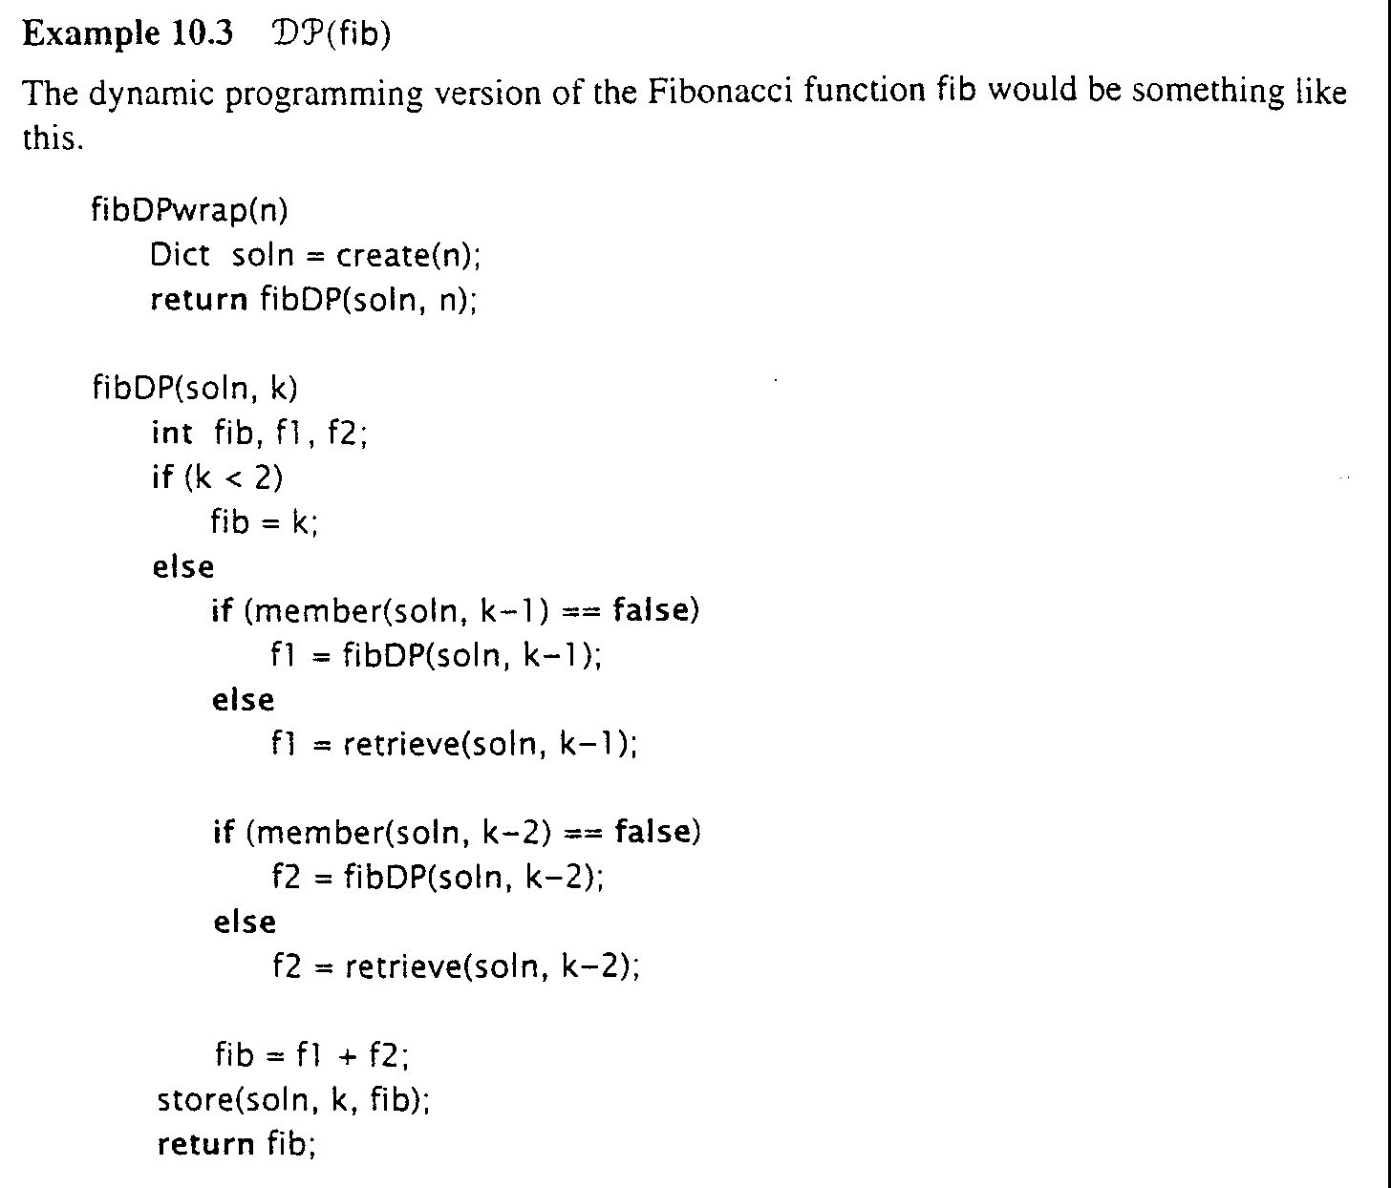
Dynamic programming version of the fib.

Slide 6
Development of a dynamic programming algorithm
Characterize the structure of an optimal solution
  Breaking a problem into sub-problem
  whether principle of optimality apply
Recursively define the value of an optimal solution
  define the value of an optimal solution based on value of solutions to sub-problems
Compute the value of an optimal solution in a bottom-up fashion
  compute in a bottom-up fashion and save the values along the way
  later steps use the save values of pervious steps
Construct an optimal solution from computed information

Slide 7
Dynamic programming, e.g.
Problem: Matrix-chain multiplication
  a chain of <A1, A2, …, An> of n matrices
  find a way that minimizes the number of scalar multiplications to computer the produce A1A2…An
Strategy:
Breaking a problem into sub-problem
  A1A2...Ak, A_{k+1}A_{k+2}…An
Recursively define the value of an optimal solution
  m[i,j] = 0 if i = j
  m[i,j]= min{i<=k<j} (m[i,k]+m[k+1,j]+p_{i-1}p_{k}p_{j})
  for 1 <= i <= j <= n

Slide 8
bottom-up approach
MatricChainOrder(n)
  for i= 1 to n
    m[i,i] = 0
  for l = 2 to n
    for i = 1 to n-l+1
      j=i+l-1
      m[i,j] = inf.
      for k=i to j-1
        q=m[i,k] + m[k+1,j] + pi-1pkpj
        if q < m[i,j]
        m[i,j] = q
        s[i,j] = k
  //At each step, the m[i, j] cost computed depends only on table entries m[i,k] and m[k+1, j] already computed

Slide 9
Construct an optimal solution from computed information
MatrixChainMult(A, s, i, j)
  if j>i
    x = MatricChainMult(A, s, i, s[i,j])
    y = MatrixChainMult(A, s, s[i,j]+1, j)
    return matrixMult(x, y)
  else return Ai
Analysis:
  Time Ω(n³) space θ(n²)
  Comparing to Time Ω(4^{n}/n^{3/2}) by brute-force exhaustive search.
>> see Introduction to Algorithms

