Slide 1
String Matching
  detecting the occurrence of a particular substring (pattern) in another string (text)
A straightforward Solution
The Knuth-Morris-Pratt Algorithm
The Boyer-Moore Algorithm

Slide 2
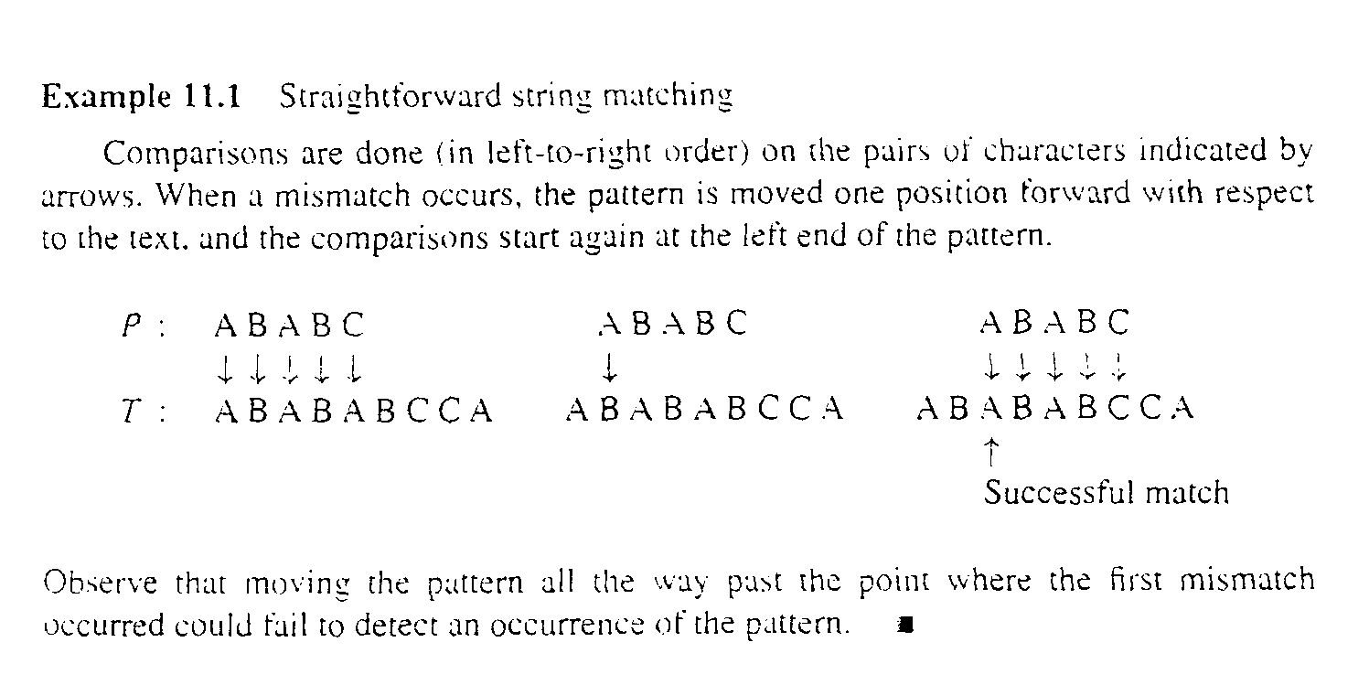
Straightforward solution
Algorithm: Simple string matching
Input: P and T, the pattern and text strings; m, the length of P. The pattern is assumed to be nonempty.
Output: The return value is the index in T where a copy of P begins, or -1 if no match for P is found.

Slide 3
int simpleScan(char[] P,char[] T,int m)
int match //value to return.
int i,j,k;
match = -1;
j=1;k=1; i=j;
while(endText(T,j)==false)
if( k>m )
match = i; //match found.
break;
if(t_{j} == p_{k})
j++; k++;
else
//Back up over matched characters.
int backup=k-1;
j = j-backup;
k = k-backup;
//Slide pattern forward,start over.
j++; i=j;
return match;

Slide 4
Analysis
Worst-case complexity is in θ(mn)
Need to back up.
Works quite well on average for natural language.

Slide 5
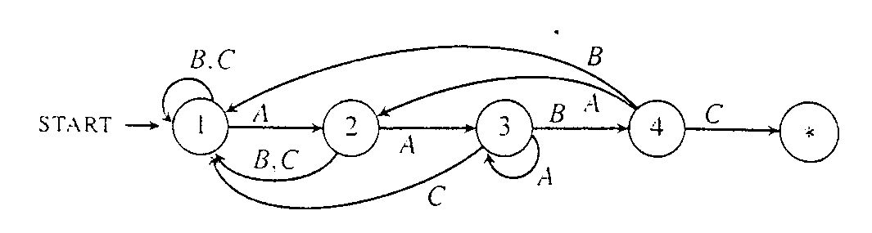
The Knuth-Morris-Pratt Algorithm
Pattern Matching with Finite Automata
  e.g. P = “AABC”

Slide 6
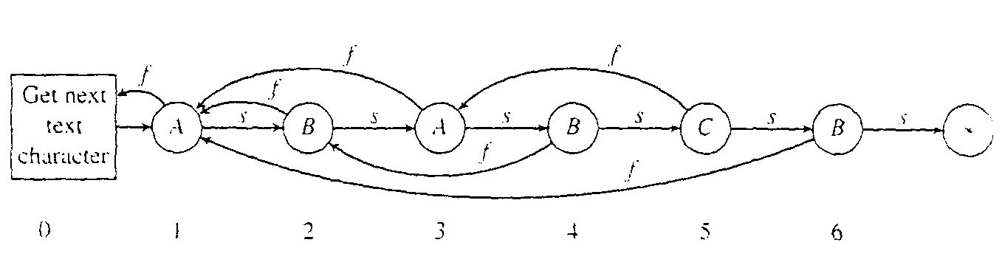
The Knuth-Morris-Pratt Flowchart
Character labels are inside the nodes
Each node has two arrows out to other nodes: success link, or fail link
next character is read only after a success link
A special node, node 0, called “get next char” which read in next text character.
    e.g. P = “ABABCB”

Slide 7
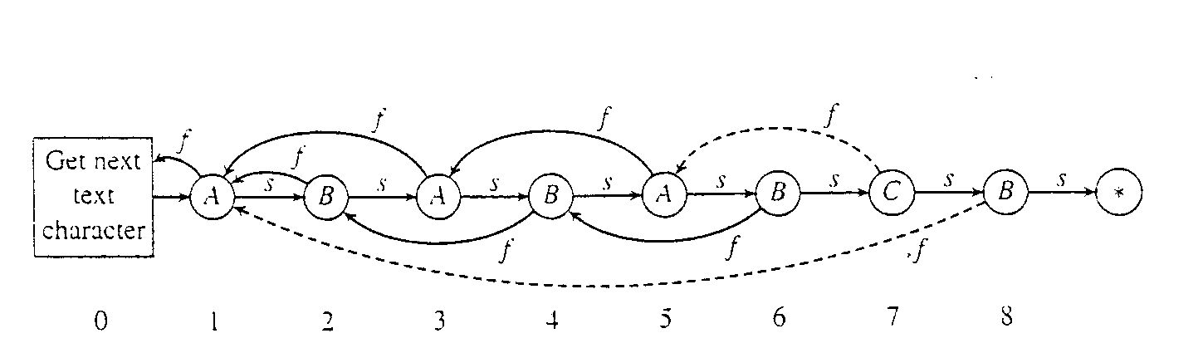
Construction of the KMP Flowchart
Definition:Fail links
  We define fail[k] as the largest r (with r<k) such that p_{1,..}p_{r-1} matches p_{k-r+1}...p_{k-1}.That is the (r-1) character prefix of P is identical to the one (r-1) character substring ending at index k-1. Thus the fail links are determined by repetition within P itself.

Slide 8
Algorithm: KMP flowchart construction
Input: P,a string of characters;m,the length of P.
Output: fail,the array of failure links,defined for indexes 1,...,m.The array is passed in and the algorithm fills it.
Step:
void kmpSetup(char[] P, int m, int[] fail)
int k,s
1. fail[1]=0;
2. for(k=2;k<=m;k++)
3. s=fail[k-1];
4. while(s>=1)
5. if(p_{s}==p_{k-1})
6. break;
7. s=fail[s];
8. fail[k]=s+1;

Slide 9
The Knuth-Morris-Pratt Scan Algorithm
int kmpScan(char[] P,char[] T,int m,int[] fail)
int match, j,k;
match= -1;
j=1; k=1;
while(endText(T,j)==false)
if(k>m)
match = j-m;
break;
if(k==0)
j++; k=1;
else if(t_{j}==p_{k})
j++; k++;
else
//Follow fail arrow.
k=fail[k];
//continue loop.
return match;

Slide 10
Analysis
KMP Flowchart Construction require 2m – 3 character comparisons in the worst case
The scan algorithm requires 2n character comparisons in the worst case
Overall: Worst case complexity is θ(n+m)

Slide 11
The Boyer-Moore Algorithm
The new idea
  first heuristic
    e.g. scan from right to left, jump forward …
  Find “must” in
    If you wish to understand you must…
must
1 1 1 1 1 111 1 1 1211
If you wish to understand you must…

Slide 12
Algorithm:Computing Jumps for the Boyer-Morre Algorithm
Input:Pattern string P:m the length of P;alphabet size alpha=|Σ|
Output:Array charJump,defined on indexes 0,....,alpha-1.The array is passed in and the algorithm fills it.
void computeJumps(char[] P,int m,int alpha,int[] charJump)
char ch; int k;
for (ch=0;ch<alpha;ch++)
charJump[ch]=m;
for (k=1;k<=m;k++)
charJump[p_{k}]=m-k;

Slide 13
If you wish to understand you must
…

