Slide 1
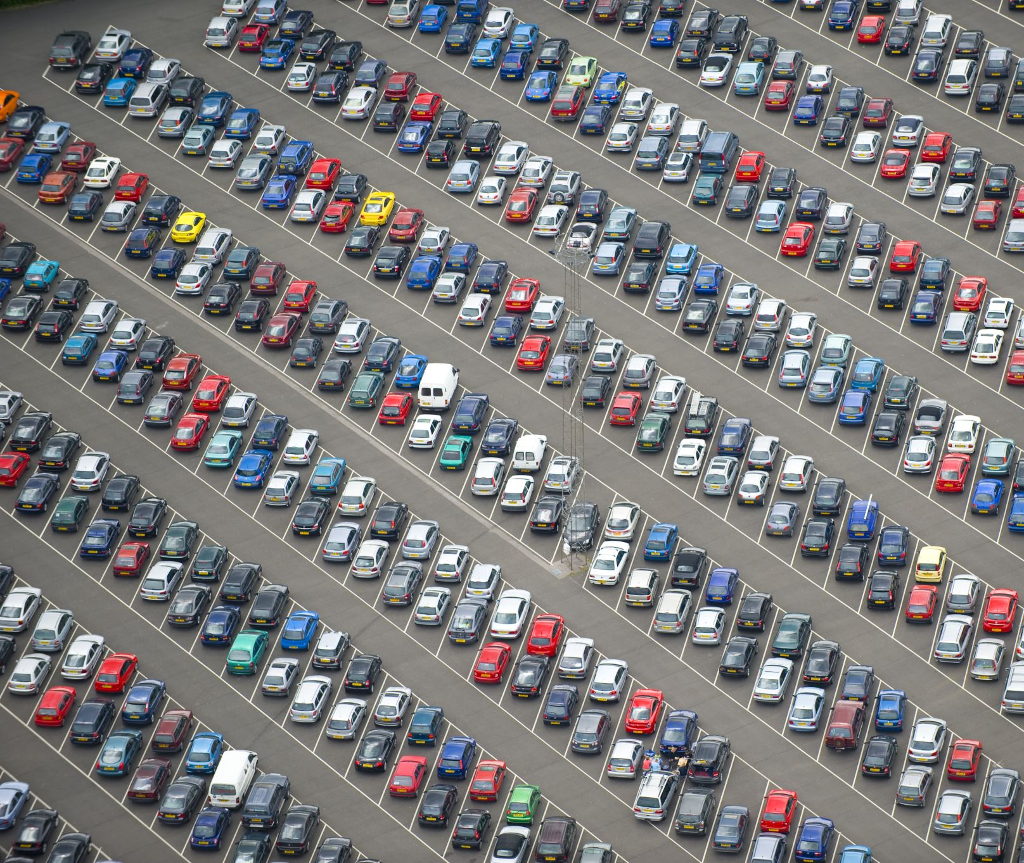
Pricing the Toyota correctly to balance sales volume and profits
n

Slide 2
The pricing method may look imposing, btu there is nothing to worry about!
The pricing method is a combination of factors that allows anyone using any spreadsheet or even a calculator and pen and paper to input the values and arrive at a fair price.

Slide 3
ITEM | Multipliers
year | 781.7191199
mileage | -0.063156619
tax | -3.779737437
mpg | -6.446746778
engineSize | 2895.071491
model_ Auris | -5789.368227
model_ Avensis | -4641.530564
model_ Aygo | -8606.806424
model_ C-HR | -313.8608961
model_ Camry | 1303.048003
model_ Corolla | -792.3829017
model_ GT86 | 562.9888925
model_ Hilux | 2840.74626
model_ IQ | -6401.889341
model_ Land Cruiser | 16612.44392
model_ PROACE VERSO | 5612.748563
model_ Prius | -876.0875666
model_ RAV4 | -747.1481199
model_ Supra | 24500.96135
model_ Urban Cruiser | -5680.892803
model_ Verso | -4628.898256
model_ Verso-S | -5562.060515
model_ Yaris | -7392.011375
transmission_Automatic | 371.2731855
transmission_Manual | -816.0077184
transmission_Semi-Auto | 444.7345329
fuelType_Diesel | -1955.623395
fuelType_Hybrid | 1340.653669
fuelType_Other | 893.9689993
fuelType_Petrol | -278.9992726

Slide 4
model_ PROACE VERSO | 5612.748563
model_ Prius | -876.0875666
model_ RAV4 | -747.1481199
model_ Supra | 24500.96135
model_ Urban Cruiser | -5680.892803
model_ Verso | -4628.898256
model_ Verso-S | -5562.060515
model_ Yaris | -7392.011375
transmission_Automatic | 371.2731855
transmission_Manual | -816.0077184
transmission_Semi-Auto | 444.7345329
fuelType_Diesel | -1955.623395
fuelType_Hybrid | 1340.653669
fuelType_Other | 893.9689993
fuelType_Petrol | -278.9992726
ITEM | Multipliers
year | 781.7191199
mileage | -0.063156619
tax | -3.779737437
mpg | -6.446746778
engineSize | 2895.071491
model_ Auris | -5789.368227
model_ Avensis | -4641.530564
model_ Aygo | -8606.806424
model_ C-HR | -313.8608961
model_ Camry | 1303.048003
model_ Corolla | -792.3829017
model_ GT86 | 562.9888925
model_ Hilux | 2840.74626
model_ IQ | -6401.889341
model_ Land Cruiser | 16612.44392
model Auris
year 2018
price 16970
transmission Automatic
mileage 35394
fuelType Hybrid
tax 135
mpg 65.6
engineSize 1.8
Please note that the year is the number of years since 1999, which is the earliest model in the data

Slide 5
For example:
A 2016 GT86 with manual transmission, 24.089 miles, burning Petrol, with tax of 265, mpg of 36.2 and 2.0 liter engine would price as:
781 * 17 + 562 - 816 - 24.089 * .063 – 278 - 265 * 3.77 - 36.2 * 6.44 + 2 * 2895 = £15785
Year GT86 manual Transmission mileage petrol tax MPG engine size
* The actual price was £16000
A 2016 Rav4 with auto trans 26128 miles, hybrid fuel, tax 20 2.5 liter engine and 57.6 mpg
781 * 17 - 747 + 371 - 26128*.063 +1340- 20 * 3.77 - 57.6 * 6.44 + 2.5* 2895 = £19386
Year Rav4 auto trans mileage diesel tax MPG engine size
* The actual price was £19990
Please note that the year is the number of years since 1999, which is the earliest model in the data

Slide 6
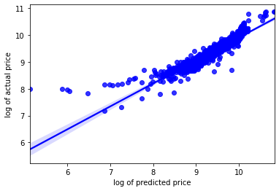
Can we trust the model? It’s a critical question. Overpricing leads to poor sales, or no sales at all if over the £1500 threshold. Underpricing leads to lower profits and low inventory.
Yes, We can trust the model. The actual price is for the most part is very close to the predicted price.

Slide 7
Thought and comment:
One criteria that might lead to better analysis would be a cosmetic condition rating for each vehicle;
‘excellent, good, fair, poor’ for example.
Classic cars such as older Land Cruiser or Supras are not going to price as accurately with this model
As the age doesn’t work against them the same way as most other vehicles. So it’s probably best to use
another pricing method: comparable for example.

Slide 8
Questions?

