Slide 1
RPD Building

Slide 3
Import Metadata Into Repository

Slide 4
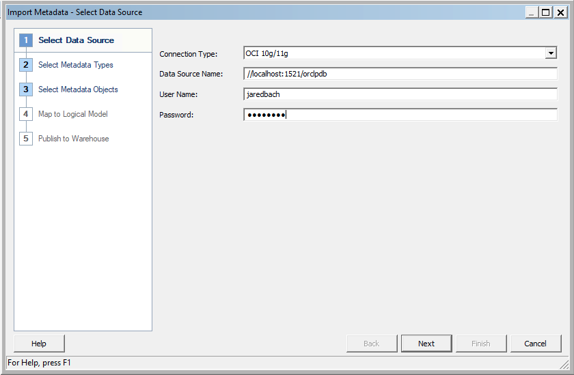
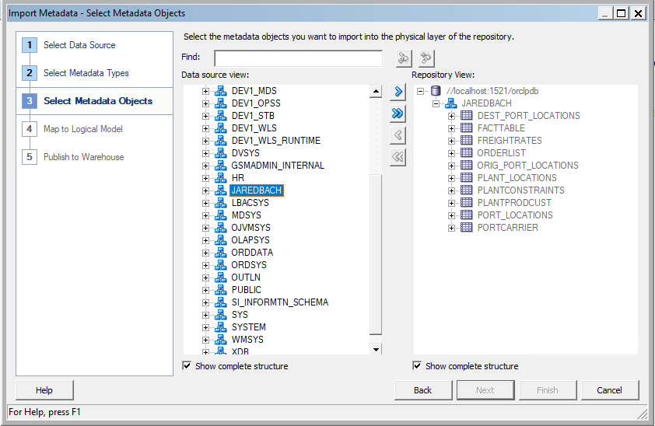

Slide 5
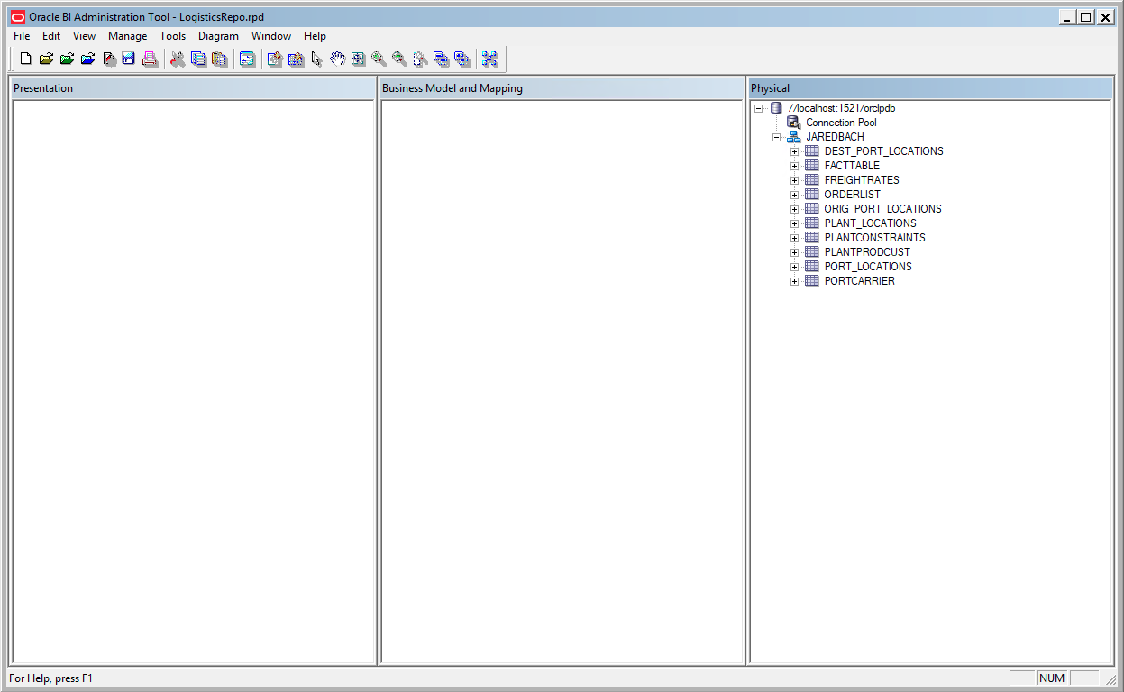

Slide 6
Create Business Model and Mapping Layer

Slide 7
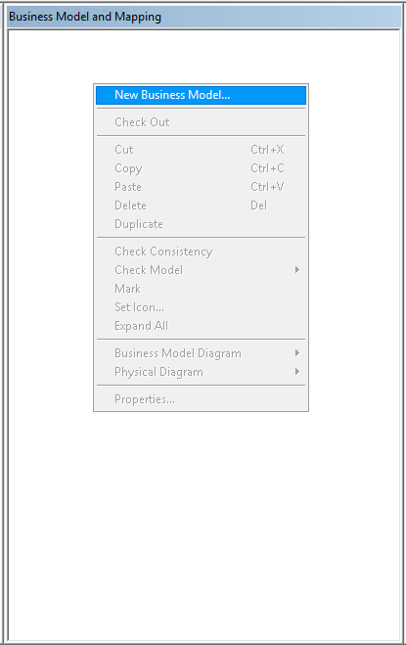
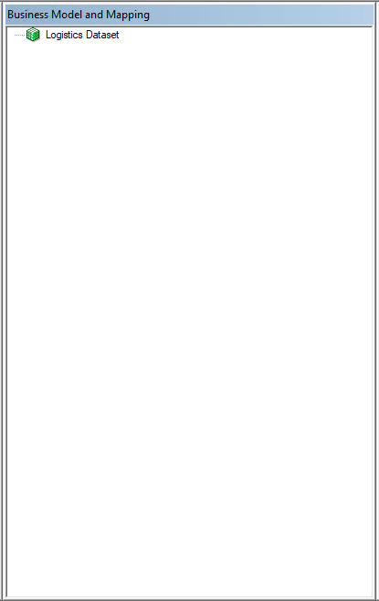
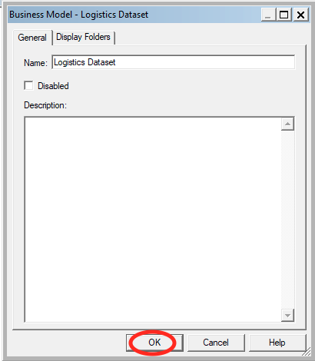

Slide 8
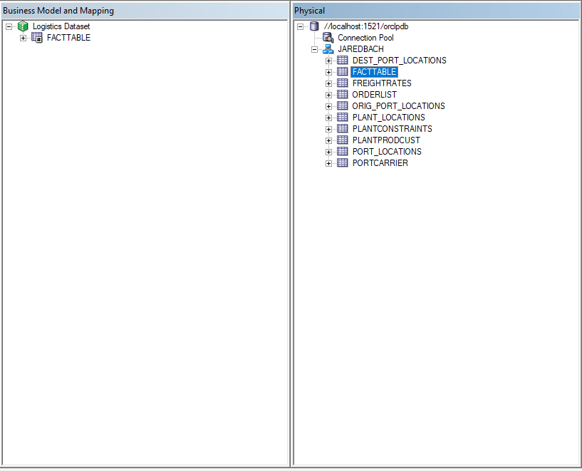
Drag FactTable onto BMM Layer

Slide 9
Melting the Snowflake

Slide 10
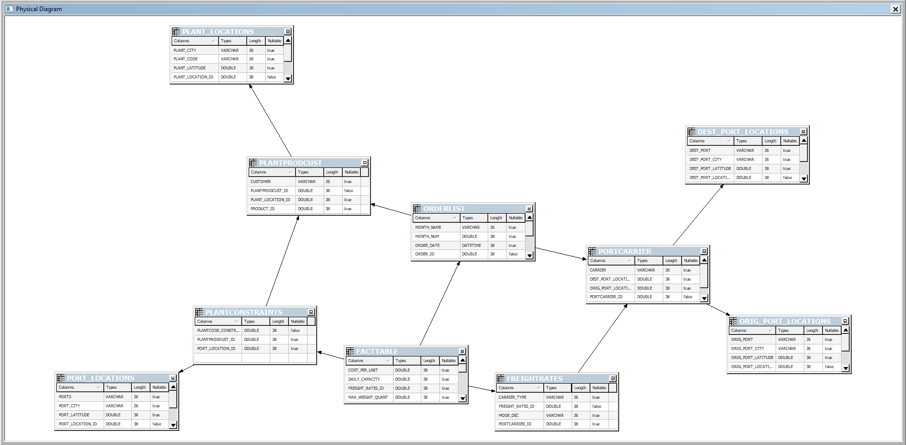
Join FreightRates, PortCarrier, Dest_Port_Locations, Orig_Port_Locations

Slide 11
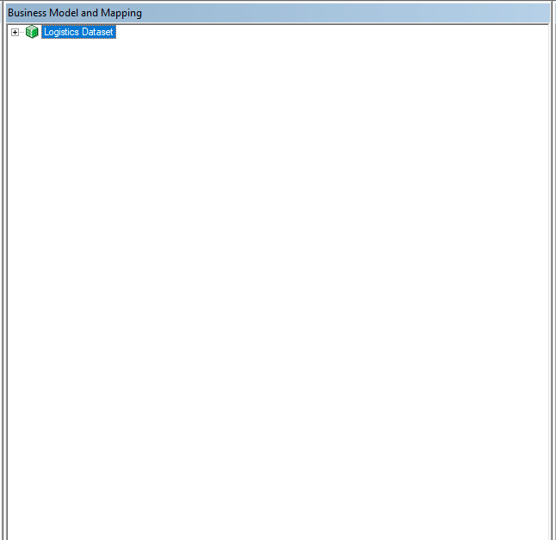
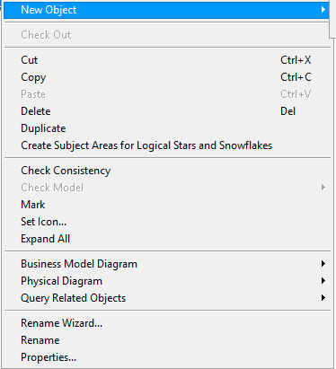

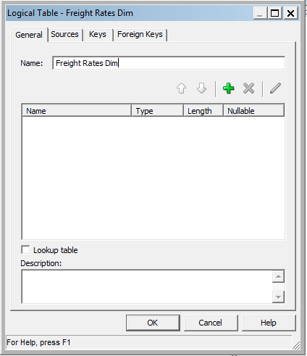

Slide 12
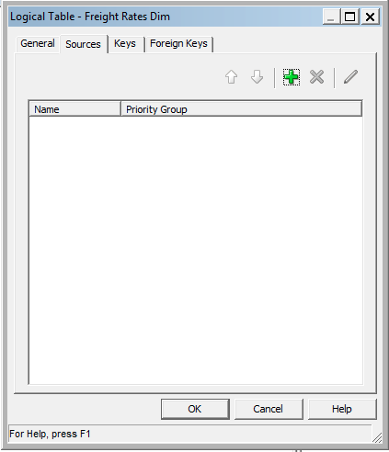

Slide 13
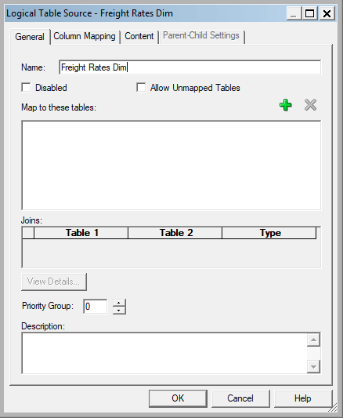
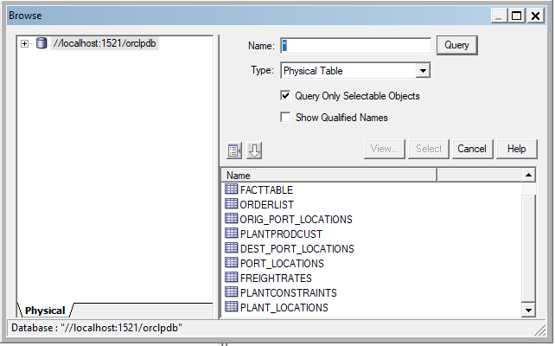
Add Tables to Map: FreightRates, PortCarrier, Dest_Port_Locations, and Orig_Port_Locations

Slide 14
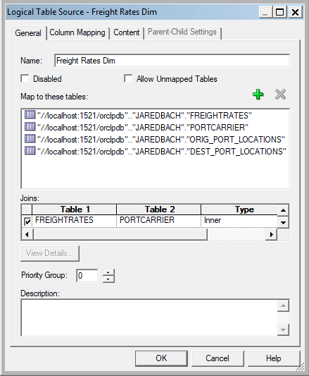
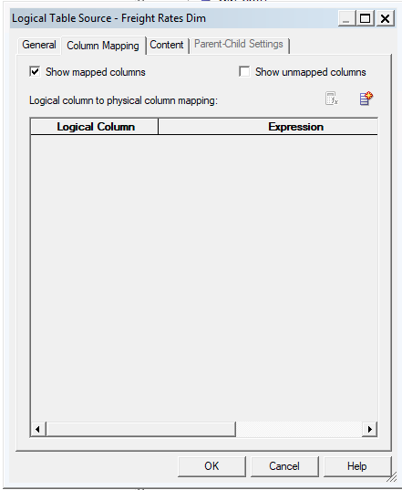

Slide 15
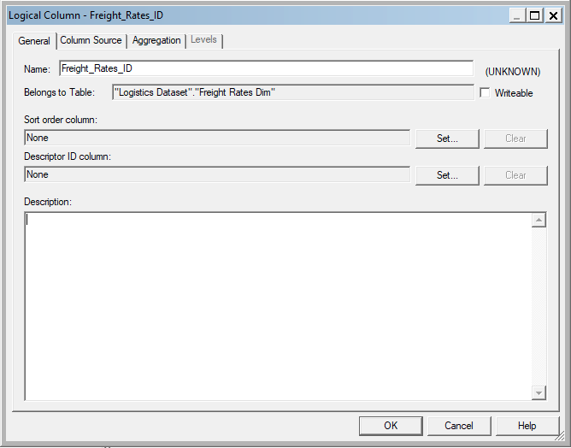

Slide 17
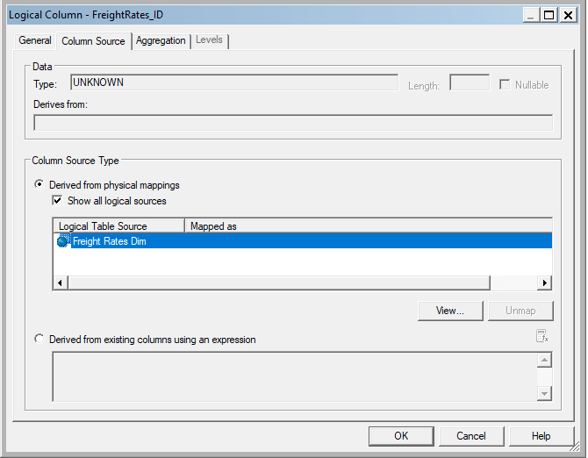


Slide 18
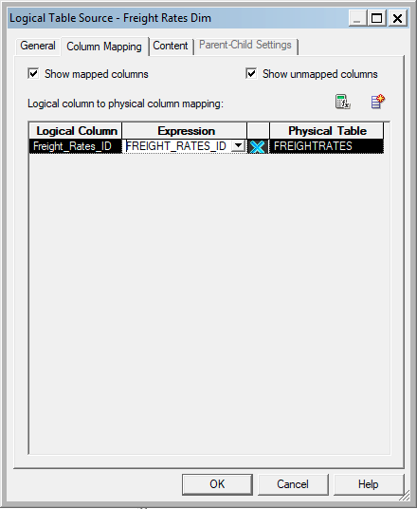

Slide 19
Repeat Steps For Rest of Columns
Mode_DSC, Carrier_Type, Carrier, Service_Level, Dest_Port, Dest_Port_City, Dest_Port_State_Name, Dest_Port_State, Dest_Port_Longitude, Dest_Port_Latitude, Orig_Port, Orig_Port_City, Orig_Port_State_Name, Orig_Port_State, Orig_Port_Longitude, Orig_Port_Latitude

Slide 20
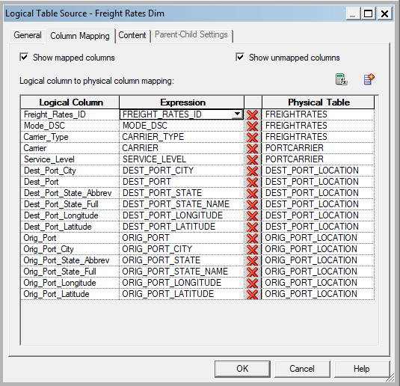
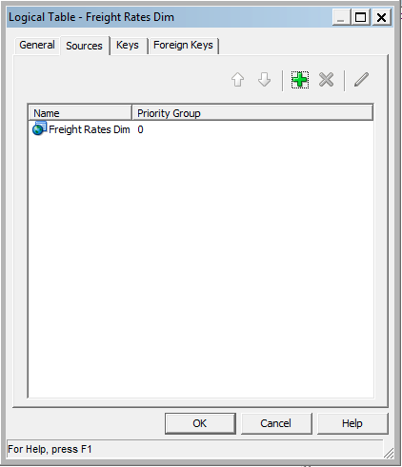

Slide 21
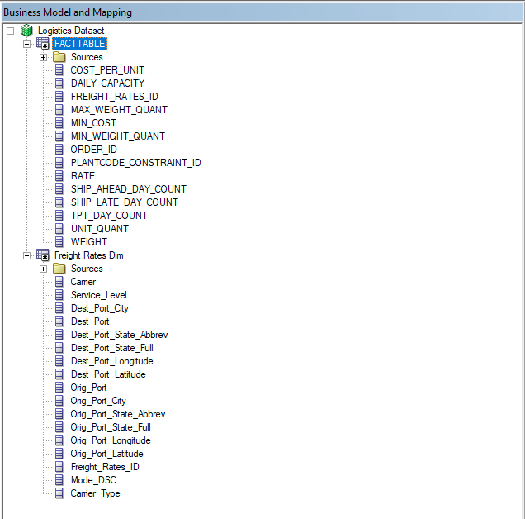
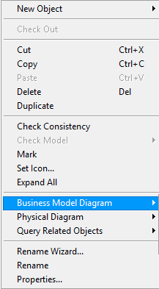


Slide 22

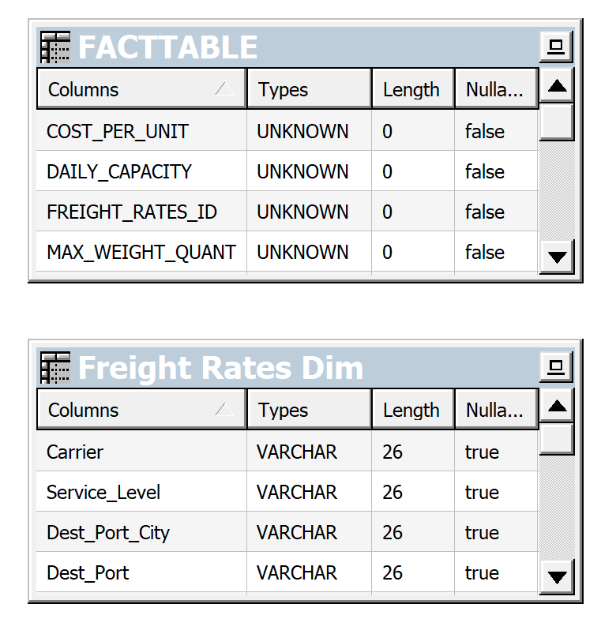
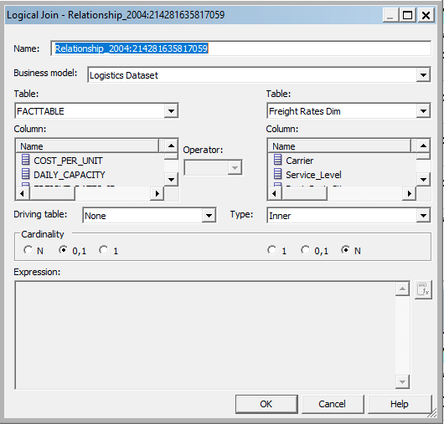
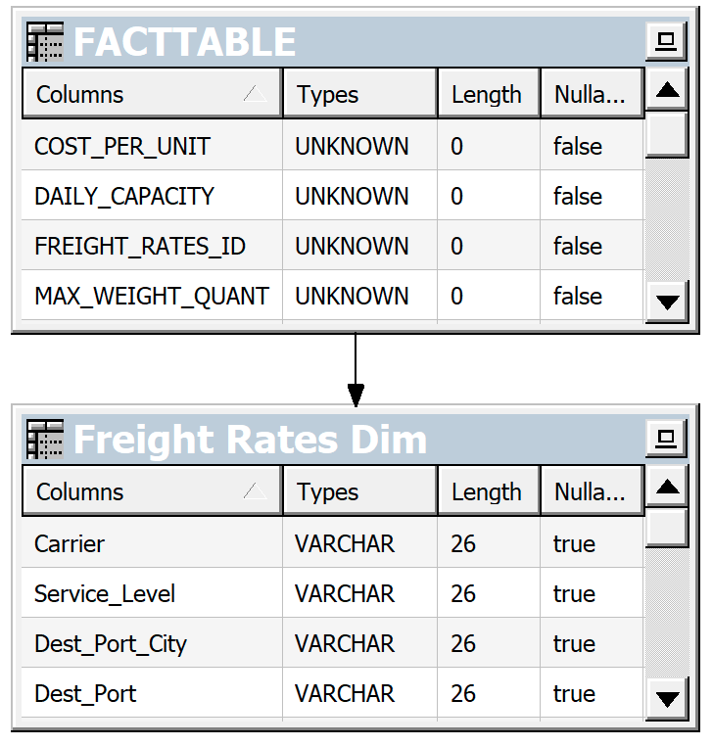

Slide 23
Repeat This Process To Create a Logical Dimension For OrderList and PlantConstraints

Slide 24
Join OrderList, PortCarrier, Dest_Port_Locations, Orig_Port_Locations, PlantProdCust, PlantLocations

Slide 25
Join PlantConstraints, Port_Locations, PlantProdCust, Plant_Locations

Slide 26
Final Mapping

Slide 27
