Slide 1
RPD Building

Slide 2
Import Metadata Into Repository

Slide 3
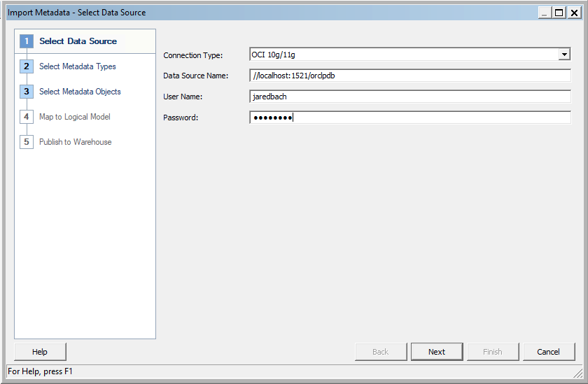
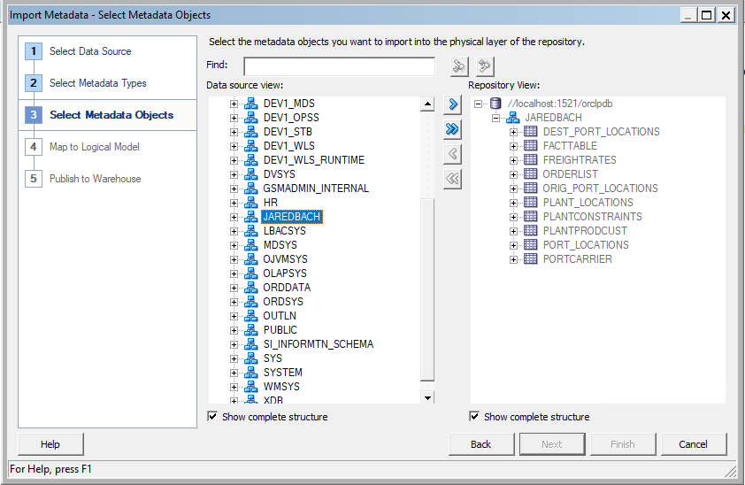

Slide 4
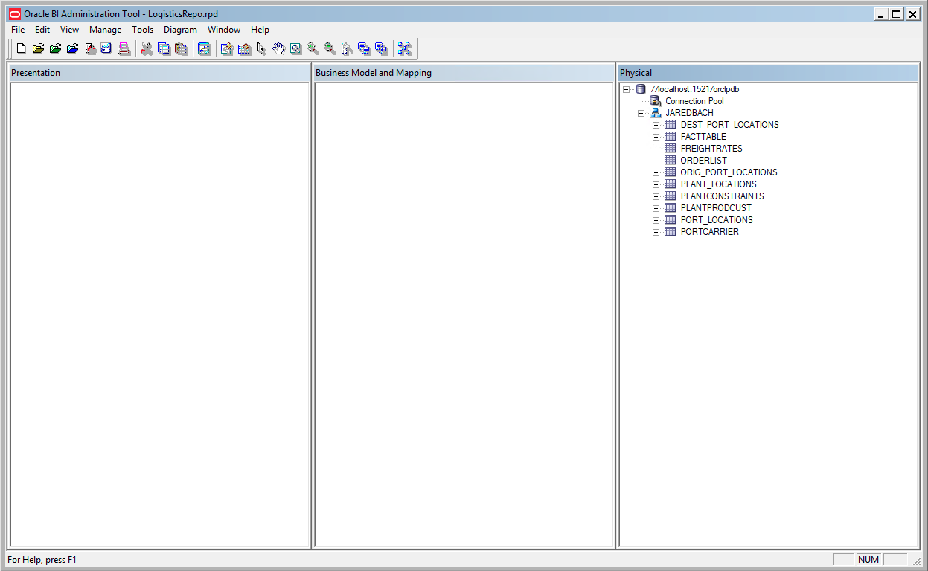

Slide 5
Create Business Model and Mapping Layer

Slide 6
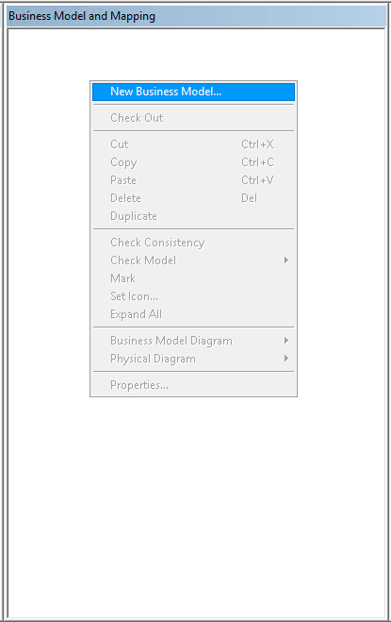
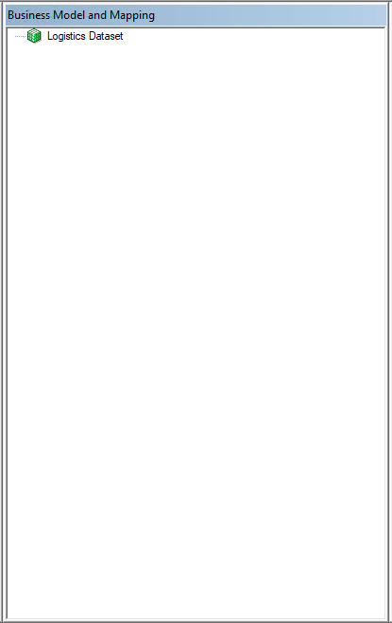
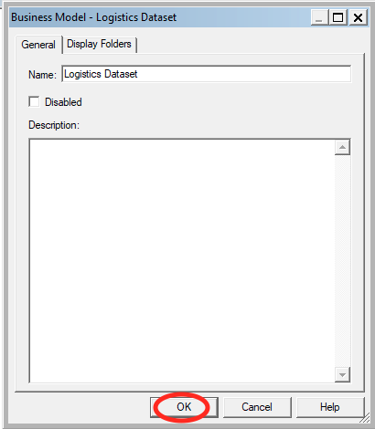

Slide 7
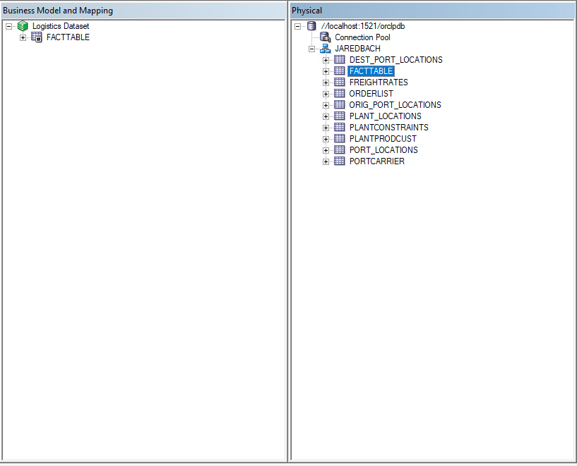
Drag FactTable onto BMM Layer

Slide 8
Melting the Snowflake

Slide 9
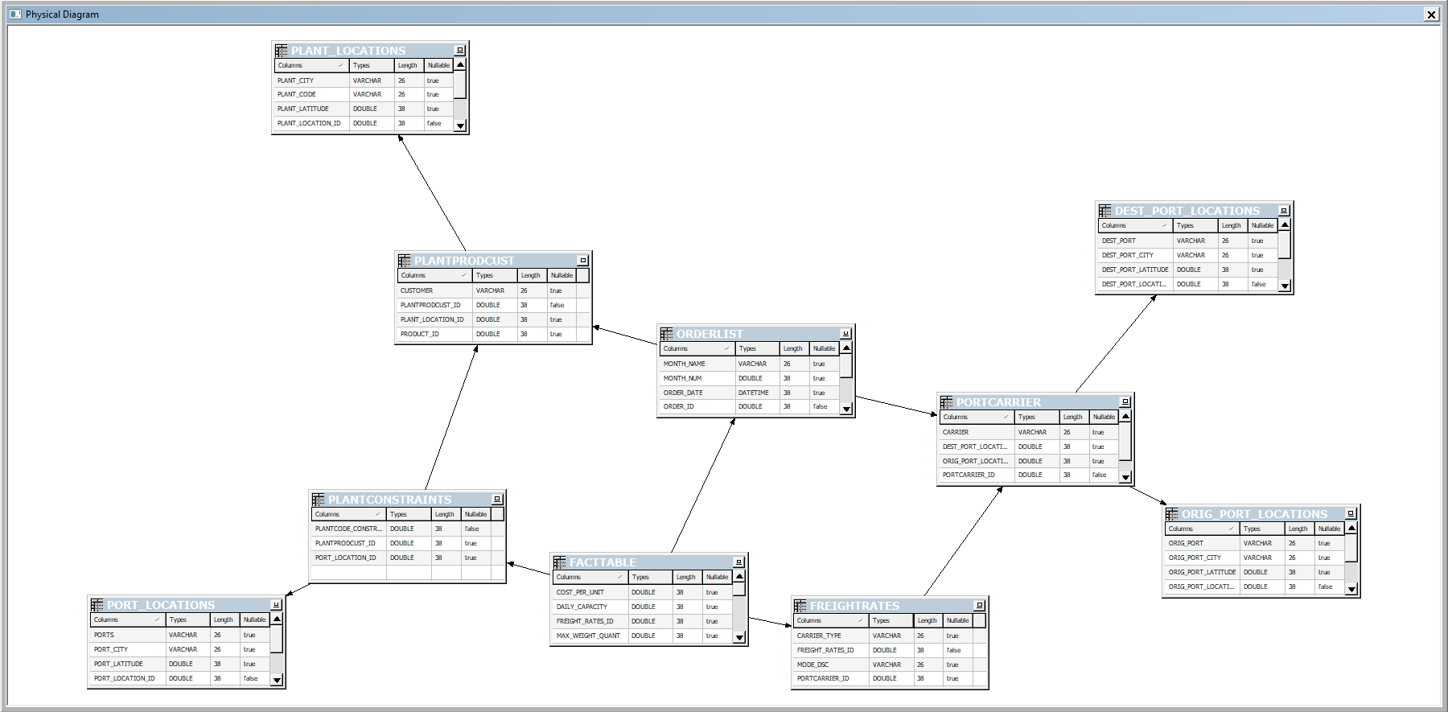
Join FreightRates, PortCarrier, Dest_Port_Locations, Orig_Port_Locations

Slide 10
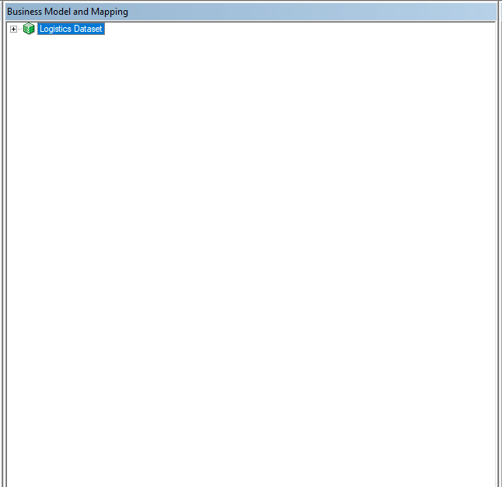
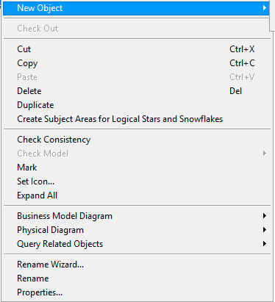

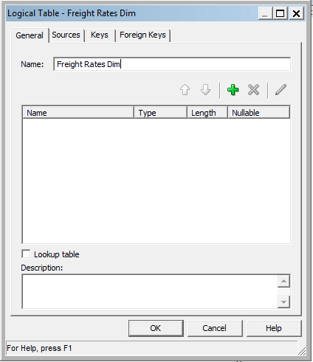

Slide 11
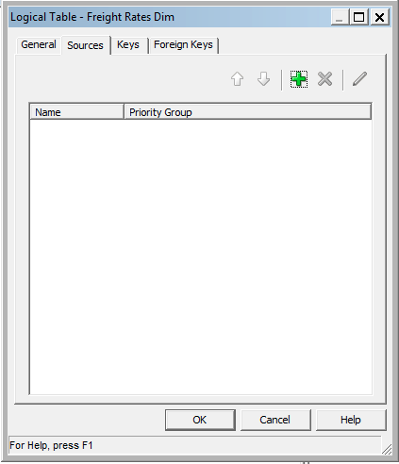

Slide 12
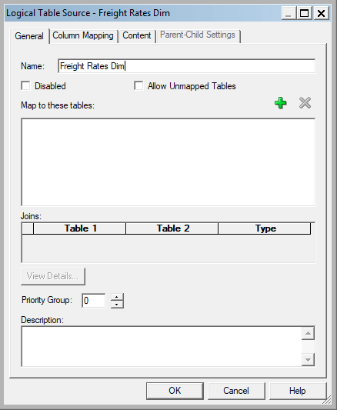
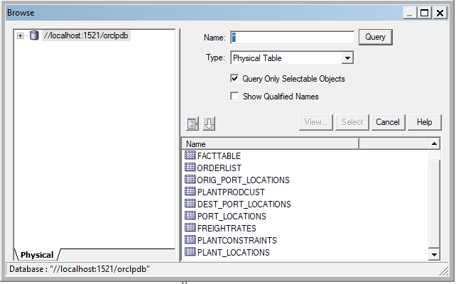
Add Tables to Map: FreightRates, PortCarrier, Dest_Port_Locations, and Orig_Port_Locations

Slide 13
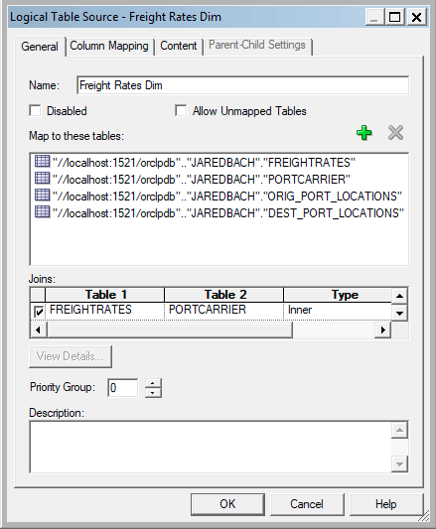
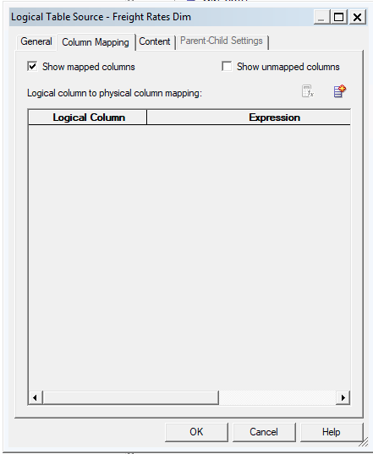

Slide 14
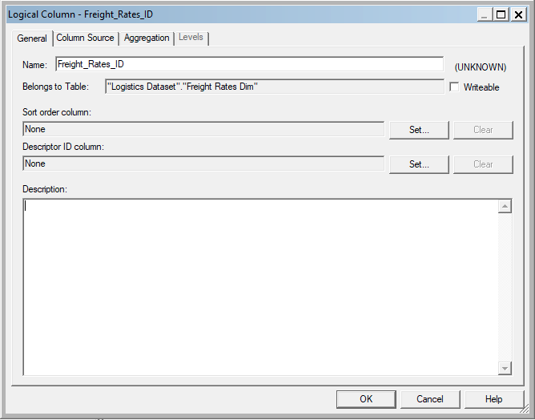

Slide 16
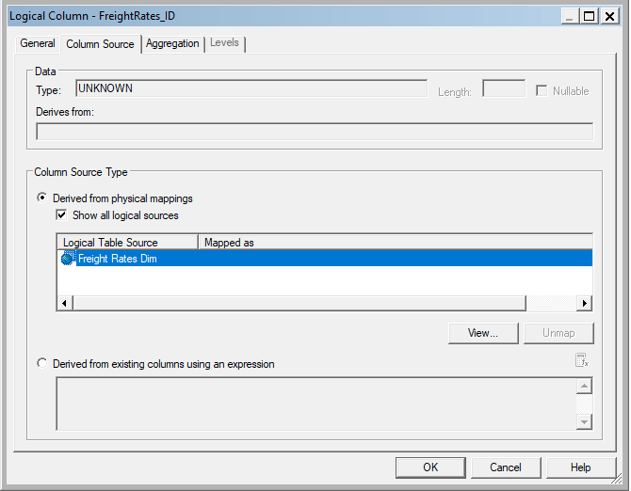


Slide 17
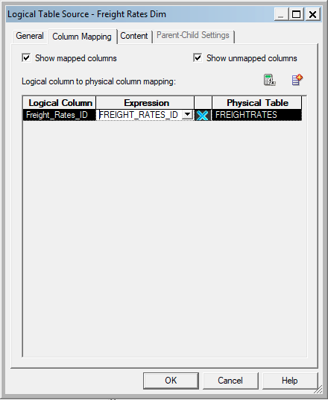

Slide 18
Repeat Steps For Rest of Columns
Mode_DSC, Carrier_Type, Carrier, Service_Level, Dest_Port, Dest_Port_City, Dest_Port_State_Name, Dest_Port_State, Dest_Port_Longitude, Dest_Port_Latitude, Orig_Port, Orig_Port_City, Orig_Port_State_Name, Orig_Port_State, Orig_Port_Longitude, Orig_Port_Latitude

Slide 19
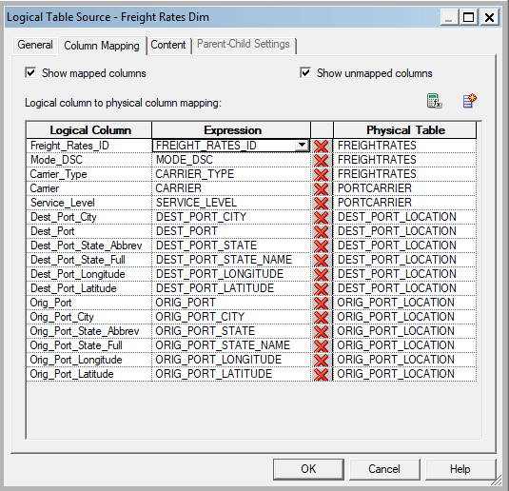
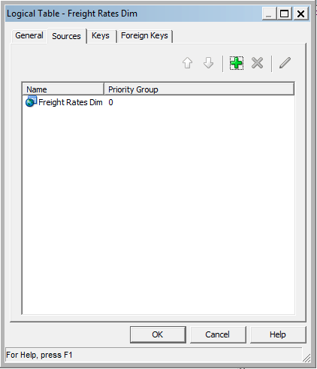

Slide 20
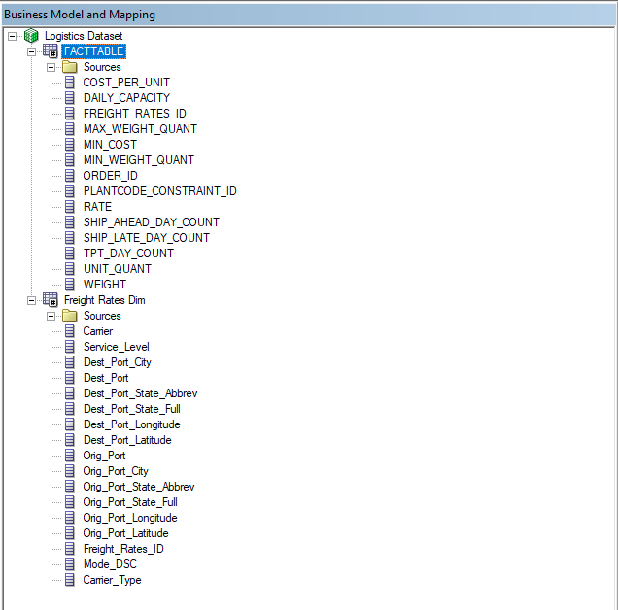
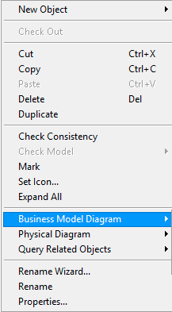


Slide 21

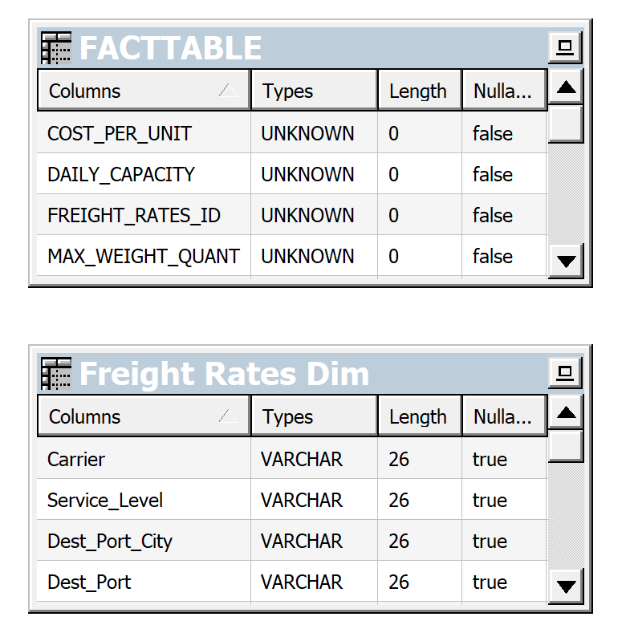
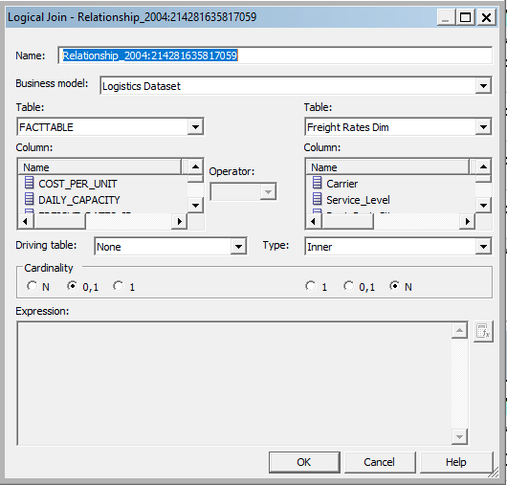
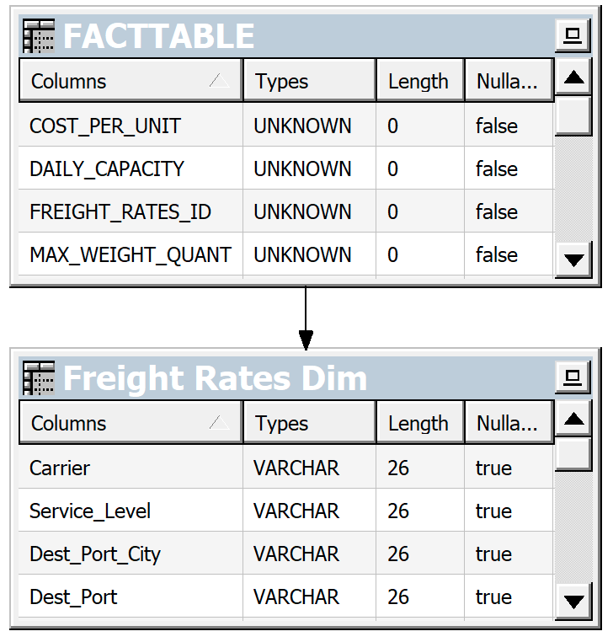

Slide 22
Repeat This Process To Create a Logical Dimension For OrderList and PlantConstraints

Slide 23
Join OrderList, PortCarrier, Dest_Port_Locations, Orig_Port_Locations, PlantProdCust, PlantLocations

Slide 24
Join PlantConstraints, Port_Locations, PlantProdCust, Plant_Locations

Slide 25
Final Mapping

Slide 26
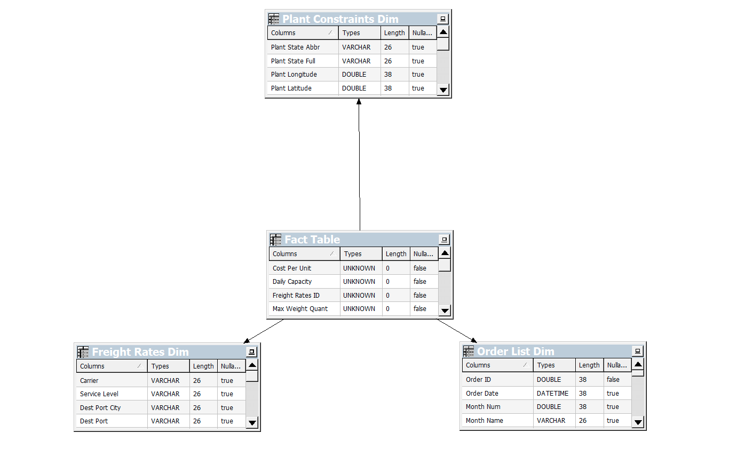

Slide 27
Added Date_ID and Customer_Name to Fact Table, Created New Dimensions
First Imported Physical Tables, Then Created Logical Tables in BMM

Slide 28
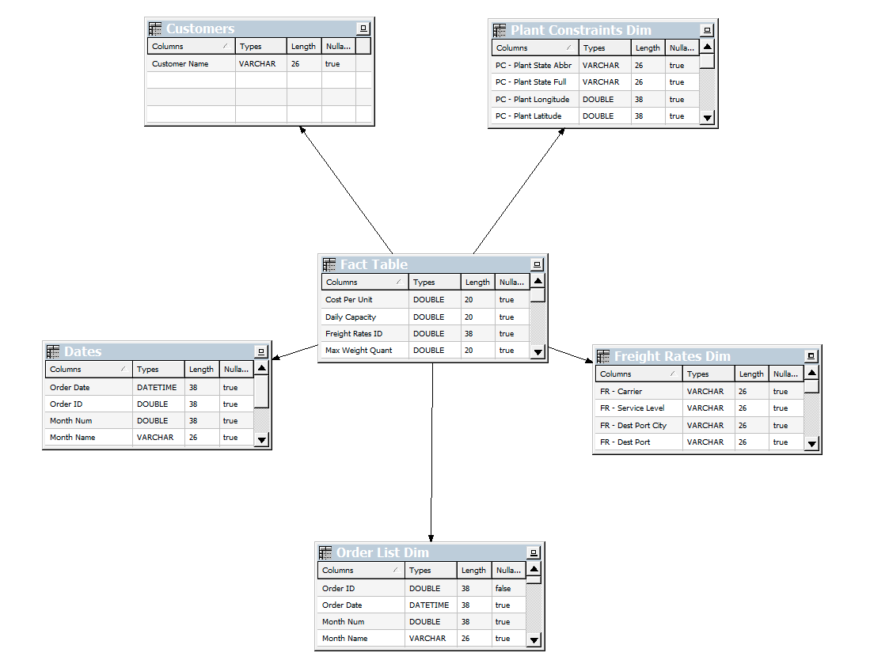

Slide 29
Created 5 Hierarchies in BMM

Slide 30
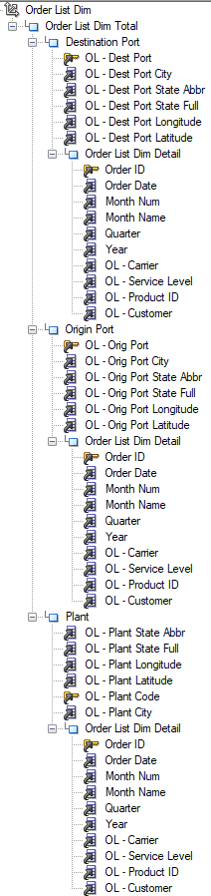
Order List Dim

Slide 31
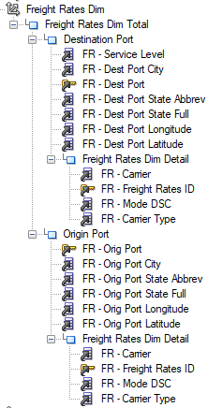
Freight Rates Dim

Slide 32
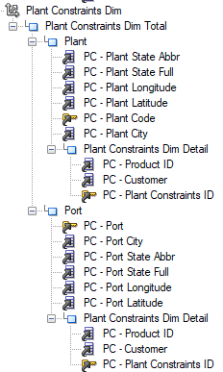

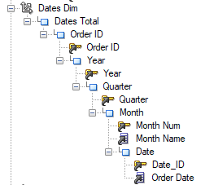
Plant Constraints Dim
Customers Dim
Dates Dim

Slide 33
Aggregate Facts as Averages

Slide 34
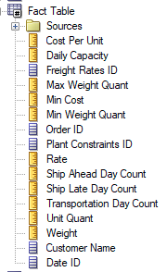
Facts Aggregated

Slide 35
Final RPD

Slide 36
