Slide 1
Mini Project 2 – Line ‘em Up with Minimax and Alpha Beta
By: Jared Cohen, Ryan Feher, Jason Forte

Slide 2
Heuristics
We implemented 2 heuristic functions
def simple_heuristic()
def complex_heuristic()

Slide 3
def simple_heuristic()
For each row, column and diagonal
If it’s our piece, add 2 to the total score
If it’s the opponent piece, subtract 2 from the total score

Slide 4

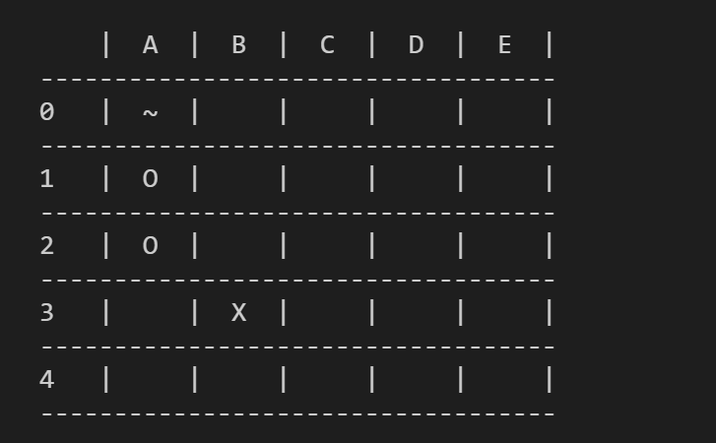
def simple_heuristic() (s=4)
For each row, column and diagonal
If it’s our piece, add 2 to the total score
If it’s the opponent piece, subtract 2 from the total score
0

Slide 5
def simple_heuristic() (s=4)
For each row, column and diagonal
If it’s our piece, add 2 to the total score
If it’s the opponent piece, subtract 2 from the total score
0 + 2

Slide 6
def simple_heuristic() (s=4)
For each row, column and diagonal
If it’s our piece, add 2 to the total score
If it’s the opponent piece, subtract 2 from the total score
0 + 2 + 2

Slide 7
def simple_heuristic() (s=4)
For each row, column and diagonal
If it’s our piece, add 2 to the total score
If it’s the opponent piece, subtract 2 from the total score
0 + 2 + 2 - 2

Slide 8
def simple_heuristic() (s=4)
For each row, column and diagonal
If it’s our piece, add 2 to the total score
If it’s the opponent piece, subtract 2 from the total score
0 + 2 + 2 – 2 + 0 = 2

Slide 9
def simple_heuristic() (s=4)
For each row, column and diagonal
If it’s our piece, add 2 to the total score
If it’s the opponent piece, subtract 2 from the total score
2 + 4

Slide 10
def simple_heuristic() (s=4)
For each row, column and diagonal
If it’s our piece, add 2 to the total score
If it’s the opponent piece, subtract 2 from the total score
2 + 4 – 2 + 0

Slide 11
def simple_heuristic() (s=4)
For each row, column and diagonal
If it’s our piece, add 2 to the total score
If it’s the opponent piece, subtract 2 from the total score
2 + 4 – 2 + 0 + 0

Slide 12
def simple_heuristic() (s=4)
For each row, column and diagonal
If it’s our piece, add 2 to the total score
If it’s the opponent piece, subtract 2 from the total score
2 + 4 – 2 + 0 + 0 + 0 = 4

Slide 13
def simple_heuristic() (s=4)
For each row, column and diagonal
If it’s our piece, add 2 to the total score
If it’s the opponent piece, subtract 2 from the total score
4 + 0

Slide 14
def simple_heuristic() (s=4)
For each row, column and diagonal
If it’s our piece, add 2 to the total score
If it’s the opponent piece, subtract 2 from the total score
4 + 0 + 2

Slide 15
def simple_heuristic() (s=4)
For each row, column and diagonal
If it’s our piece, add 2 to the total score
If it’s the opponent piece, subtract 2 from the total score
4 + 0 + 2 + 0

Slide 16
def simple_heuristic() (s=4)
For each row, column and diagonal
If it’s our piece, add 2 to the total score
If it’s the opponent piece, subtract 2 from the total score
4 + 0 + 2 + 0 + 0

Slide 17
def simple_heuristic() (s=4)
For each row, column and diagonal
If it’s our piece, add 2 to the total score
If it’s the opponent piece, subtract 2 from the total score
4 + 0 + 2 + 0 + 0 – 2

Slide 18
def simple_heuristic() (s=4)
For each row, column and diagonal
If it’s our piece, add 2 to the total score
If it’s the opponent piece, subtract 2 from the total score
4 + 0 + 2 + 0 + 0 – 2 + 0 = 4

Slide 19
def simple_heuristic() (s=4)
For each row, column and diagonal
If it’s our piece, add 2 to the total score
If it’s the opponent piece, subtract 2 from the total score
Total score = 4

Slide 20
def complex_heuristic()
For each row, column and diagonal
If we have a line with a potential winning combination, exponentially increase a total score by the winning length (s) subtracted by how many empty tiles are left
For example: Having one empty tile till you win is much more valuable than having 3 empty tiles
Streaks which are in favor of the opponent will multiply this score by -1
A win nets an increase of 100000000000

Slide 21
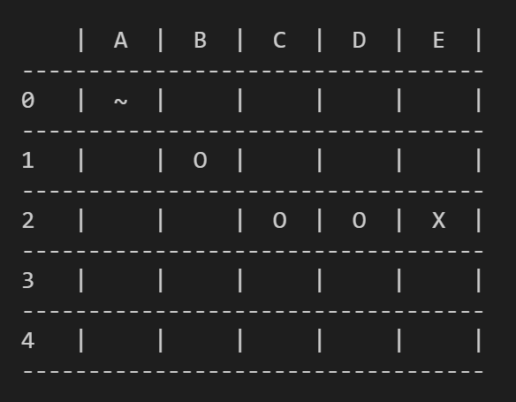
def complex_heuristic() (s=4)
For each row, column and diagonal
If we have a line with a potential winning combination, exponentially increase a total score by the winning length (s) subtracted by how many empty tiles are left by a power of 3
A win nets an increase of 100000000000
Rows
A1,B1,C1,D1 = win combination for O = 1
B1,C1,D1,E1 = win combination for O = 2
A2,B2,C2,D2 = win combination for O = 8
11

Slide 22
def complex_heuristic() (s=4)
For each row, column and diagonal
If we have a line with a potential winning combination, exponentially increase a total score by the winning length (s) subtracted by how many empty tiles are left by a power of 3
A win nets an increase of 100000000000
Columns
B0,B1,B2,B3 = win combination for O = 12
B1,B2,B3,B4 = win combination for O = 14
C0,C1,C2,C3 = win combination for O = 15
C1,C2,C3,C4 = win combination for O = 16
D0,D1,D2,D3 = win combination for O = 17
D1,D2,D3,D4 = win combination for O = 18
E0,E1,E2,E3 = win combination for X = 17
E1,E2,E3,E4 = win combination for X = 16
16

Slide 23
def complex_heuristic() (s=4)
For each row, column and diagonal
If we have a line with a potential winning combination, exponentially increase a total score by the winning length (s) subtracted by how many empty tiles are left by a power of 3
A win nets an increase of 100000000000
Diagonals
B1,C2,D3,E4 = win combination for O = 26
B0,C1,D2,E3 = win combination for O = 28
E0,D1,C2,B3 = win combination for O = 30
E1,D2,C3,B4 = win combination for O = 32
Total score = 32

