Slide 1
Mini Project 2 – Line ‘em Up with Minimax and Alpha Beta
By: Jared Cohen, Ryan Feher, Jason Forte

Slide 2
Heuristics
We implemented 2 heuristic functions
def simple_heuristic()
def complex_heuristic()

Slide 3
def simple_heuristic()
For each row, column and diagonal
If it’s our piece, add 2 to the total score
If it’s the opponent piece, subtract 2 from the total score

Slide 4

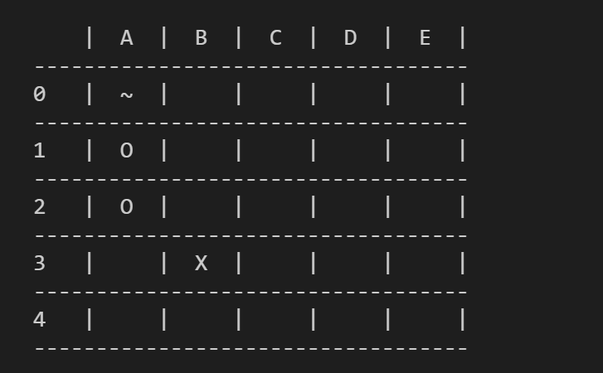
def simple_heuristic() (s=4)
For each row, column and diagonal
If it’s our piece, add 2 to the total score
If it’s the opponent piece, subtract 2 from the total score
0

Slide 5
def simple_heuristic() (s=4)
For each row, column and diagonal
If it’s our piece, add 2 to the total score
If it’s the opponent piece, subtract 2 from the total score
0 + 2

Slide 6
def simple_heuristic() (s=4)
For each row, column and diagonal
If it’s our piece, add 2 to the total score
If it’s the opponent piece, subtract 2 from the total score
0 + 2 + 2

Slide 7
def simple_heuristic() (s=4)
For each row, column and diagonal
If it’s our piece, add 2 to the total score
If it’s the opponent piece, subtract 2 from the total score
0 + 2 + 2 - 2

Slide 8
def simple_heuristic() (s=4)
For each row, column and diagonal
If it’s our piece, add 2 to the total score
If it’s the opponent piece, subtract 2 from the total score
0 + 2 + 2 – 2 + 0 = 2

Slide 9
def simple_heuristic() (s=4)
For each row, column and diagonal
If it’s our piece, add 2 to the total score
If it’s the opponent piece, subtract 2 from the total score
2 + 4

Slide 10
def simple_heuristic() (s=4)
For each row, column and diagonal
If it’s our piece, add 2 to the total score
If it’s the opponent piece, subtract 2 from the total score
2 + 4 – 2 + 0

Slide 11
def simple_heuristic() (s=4)
For each row, column and diagonal
If it’s our piece, add 2 to the total score
If it’s the opponent piece, subtract 2 from the total score
2 + 4 – 2 + 0 + 0

Slide 12
def simple_heuristic() (s=4)
For each row, column and diagonal
If it’s our piece, add 2 to the total score
If it’s the opponent piece, subtract 2 from the total score
2 + 4 – 2 + 0 + 0 + 0 = 4

Slide 13
def simple_heuristic() (s=4)
For each row, column and diagonal
If it’s our piece, add 2 to the total score
If it’s the opponent piece, subtract 2 from the total score
4 + 0

Slide 14
def simple_heuristic() (s=4)
For each row, column and diagonal
If it’s our piece, add 2 to the total score
If it’s the opponent piece, subtract 2 from the total score
4 + 0 + 2

Slide 15
def simple_heuristic() (s=4)
For each row, column and diagonal
If it’s our piece, add 2 to the total score
If it’s the opponent piece, subtract 2 from the total score
4 + 0 + 2 + 0

Slide 16
def simple_heuristic() (s=4)
For each row, column and diagonal
If it’s our piece, add 2 to the total score
If it’s the opponent piece, subtract 2 from the total score
4 + 0 + 2 + 0 + 0

Slide 17
def simple_heuristic() (s=4)
For each row, column and diagonal
If it’s our piece, add 2 to the total score
If it’s the opponent piece, subtract 2 from the total score
4 + 0 + 2 + 0 + 0 – 2

Slide 18
def simple_heuristic() (s=4)
For each row, column and diagonal
If it’s our piece, add 2 to the total score
If it’s the opponent piece, subtract 2 from the total score
4 + 0 + 2 + 0 + 0 – 2 + 0 = 4

Slide 19
def simple_heuristic() (s=4)
For each row, column and diagonal
If it’s our piece, add 2 to the total score
If it’s the opponent piece, subtract 2 from the total score
Total score = 4

Slide 20
def complex_heuristic() (s=4)
For each row, column and diagonal
If we have a line with a potential winning combination, exponentially increase a total score by the winning length (s) subtracted by how many empty tiles are left
For example: Having one empty tile until winning is much more valuable than having 3

Slide 21
def complex_heuristic() (s=4)
For each row, column and diagonal
If we have a line with a potential winning combination, exponentially increase a total score by the winning length (s) subtracted by how many empty tiles are left
For example: Having one empty tile until winning is much more valuable than having 3
A win nets an increase of 100000000000

