Slide 1
Mini Project 2 – Line ‘em Up with Minimax and Alpha Beta
By: Jared Cohen, Ryan Feher, Jason Forte

Slide 2
Heuristics
We implemented 2 heuristic functions
def simple_heuristic()
def complex_heuristic()

Slide 3
def simple_heuristic()
Simple and fast, but not the smartest at determining how good a board state is
For each row, column and diagonal
If it’s our piece, add 2 to the total score
If it’s the opponent piece, subtract 2 from the total score

Slide 4

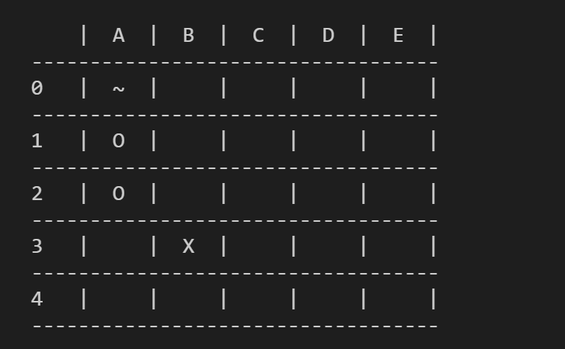
def simple_heuristic() (s=4)
For each row, column and diagonal
If it’s our piece, add 2 to the total score
If it’s the opponent piece, subtract 2 from the total score
Total score: 0
0

Slide 5
def simple_heuristic() (s=4)
For each row, column and diagonal
If it’s our piece, add 2 to the total score
If it’s the opponent piece, subtract 2 from the total score
Total score: 2
0 + 2

Slide 6
def simple_heuristic() (s=4)
For each row, column and diagonal
If it’s our piece, add 2 to the total score
If it’s the opponent piece, subtract 2 from the total score
Total score: 4
0 + 2 + 2

Slide 7
def simple_heuristic() (s=4)
For each row, column and diagonal
If it’s our piece, add 2 to the total score
If it’s the opponent piece, subtract 2 from the total score
Total score: 2
0 + 2 + 2 – 2

Slide 8
def simple_heuristic() (s=4)
For each row, column and diagonal
If it’s our piece, add 2 to the total score
If it’s the opponent piece, subtract 2 from the total score
Total score: 2
0 + 2 + 2 – 2 + 0

Slide 9
def simple_heuristic() (s=4)
For each row, column and diagonal
If it’s our piece, add 2 to the total score
If it’s the opponent piece, subtract 2 from the total score
Total score: 6
2 + 4

Slide 10
def simple_heuristic() (s=4)
For each row, column and diagonal
If it’s our piece, add 2 to the total score
If it’s the opponent piece, subtract 2 from the total score
Total score: 4
2 + 4 – 2

Slide 11
def simple_heuristic() (s=4)
For each row, column and diagonal
If it’s our piece, add 2 to the total score
If it’s the opponent piece, subtract 2 from the total score
Total score: 4
2 + 4 – 2 + 0

Slide 12
def simple_heuristic() (s=4)
For each row, column and diagonal
If it’s our piece, add 2 to the total score
If it’s the opponent piece, subtract 2 from the total score
Total score: 4
2 + 4 – 2 + 0 + 0

Slide 13
def simple_heuristic() (s=4)
For each row, column and diagonal
If it’s our piece, add 2 to the total score
If it’s the opponent piece, subtract 2 from the total score
Total score: 4
2 + 4 – 2 + 0 + 0 + 0

Slide 14
def simple_heuristic() (s=4)
For each row, column and diagonal
If it’s our piece, add 2 to the total score
If it’s the opponent piece, subtract 2 from the total score
Total score: 4
4 + 0

Slide 15
def simple_heuristic() (s=4)
For each row, column and diagonal
If it’s our piece, add 2 to the total score
If it’s the opponent piece, subtract 2 from the total score
Total score: 6
4 + 0 + 2

Slide 16
def simple_heuristic() (s=4)
For each row, column and diagonal
If it’s our piece, add 2 to the total score
If it’s the opponent piece, subtract 2 from the total score
Total score: 6
4 + 0 + 2 + 0

Slide 17
def simple_heuristic() (s=4)
For each row, column and diagonal
If it’s our piece, add 2 to the total score
If it’s the opponent piece, subtract 2 from the total score
Total score: 4
6 - 2

Slide 18
def simple_heuristic() (s=4)
For each row, column and diagonal
If it’s our piece, add 2 to the total score
If it’s the opponent piece, subtract 2 from the total score
Total score: 4
4 + 0

Slide 19
def simple_heuristic() (s=4)
For each row, column and diagonal
If it’s our piece, add 2 to the total score
If it’s the opponent piece, subtract 2 from the total score
Total score: 4
4 + 0

Slide 20
def simple_heuristic() (s=4)
For each row, column and diagonal
If it’s our piece, add 2 to the total score
If it’s the opponent piece, subtract 2 from the total score
Total score = 4

Slide 21
def complex_heuristic()
Complex and slow, but very good at determining how good a board state is
For each row, column and diagonal
If we have a line with a potential winning combination, exponentially increase a total score by the winning length (s) subtracted by how many empty tiles are left
For example: Having one empty tile till you win is much more valuable than having 3 empty tiles
Streaks which are in favor of the opponent will multiply this score by -1
A win nets an increase of 100000000000

Slide 22
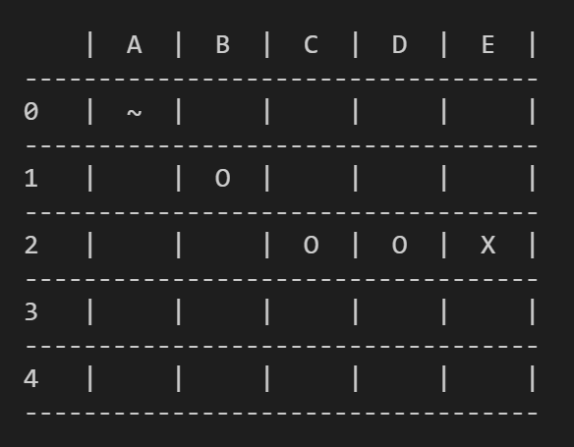
def complex_heuristic() (s=4)
For each row, column and diagonal
If we have a line with a potential winning combination, exponentially increase a total score by the winning length (s) subtracted by how many empty tiles are left by a power of 3
A win nets an increase of 100000000000
Rows
A1,B1,C1,D1 = potential win combination for O=1
B1,C1,D1,E1 = potential win combination for O=2
A2,B2,C2,D2 = potential win combination for O=8
11

Slide 23
def complex_heuristic() (s=4)
For each row, column and diagonal
If we have a line with a potential winning combination, exponentially increase a total score by the winning length (s) subtracted by how many empty tiles are left by a power of 3
A win nets an increase of 100000000000
Columns
B0,B1,B2,B3 = potential win combination for O=12
B1,B2,B3,B4 = potential win combination for O=14
C0,C1,C2,C3 = potential win combination for O=15
C1,C2,C3,C4 = potential win combination for O=16
D0,D1,D2,D3 = potential win combination for O=17
D1,D2,D3,D4 = potential win combination for O=18
E0,E1,E2,E3 = potential win combination for X=17
E1,E2,E3,E4 = potential win combination for X=16
16

Slide 24
def complex_heuristic() (s=4)
For each row, column and diagonal
If we have a line with a potential winning combination, exponentially increase a total score by the winning length (s) subtracted by how many empty tiles are left by a power of 3
A win nets an increase of 100000000000
Diagonals
B1,C2,D3,E4 = potential win combination for O=26
B0,C1,D2,E3 = potential win combination for O=28
E0,D1,C2,B3 = potential win combination for O=30
E1,D2,C3,B4 = potential win combination for O=32
Total score = 32

Slide 25
Game Result Analysis
Over all 80 games, E1 (Simple heuristic) won 6 games (7.5%).
E2 (Complex heuristic) won 74 games (92.5%).
Therefore it is clear that the complex heuristic E2 greatly outperforms the simple heuristic E1.
We can examine the configurations that allowed E1 to win games, to see what other parameters could have benefited it. The games were won in the following scoreboards (8555, 8551, 4435).
The scoreboards 8555 and 8551 are scoreboards where the depth of E1 is 2, and the depth of E2 is 6. Although you would expect the depth to be beneficial, we can look at the game-traces of these games to see why a lower depth is beneficial. The ARD for E1 is 2.0 for every move meaning that every state is explored, but for E2 the ARD is close to 1.0 meaning that a significant amount of states are left unexplored leading to low performance, this means that exploring all states at depth 2, can be better than exploring some states at depth 6, and some states at depth 1. It is likely that if the AI timeout was infinite, to allow for all states to be evaluated, E2 would win all of the games rather than 92.5%.

Slide 26
Game Result Analysis (Continued)
The scoreboards 4435 is the scoreboard where minimax is used in place of alpha-beta, like in the previous wins we have cases where the ARD of E2 is lower then the ARD of E1, the take away of this is that alpha-beta will benefit the slower running heuristic as less unnecessary states will have to be calculated.
To summarize, E2 significantly outperforms E1 even in cases where it has a lower ARD, this means that the complex heuristic is good enough to outperform the simple heuristic even with many states left un-evaluated. Despite this we can see that having an ARD as close to possible to your average depth is beneficial. Lastly alpha-beta is better than mini-max as it allows many unnecessary states to remain unexplored, this saves so much time that the ARD for 4431 was actually higher than that of 4435 meaning that one second when using alpha-beta explored more relevant states than five seconds when using mini-max.

