Slide 1

MP 3 Analysis
By Jason, Jared, and Ryan

Slide 2
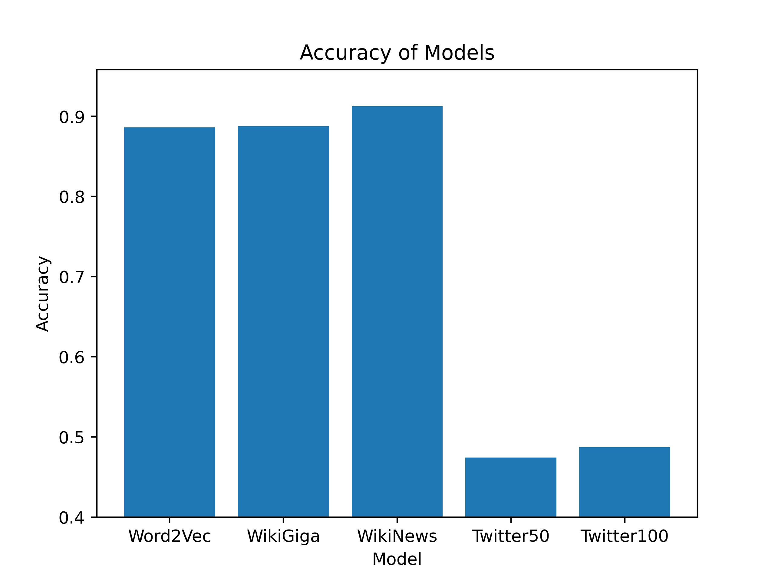
Accuracy of Models
When comparing the five models together, we can see that the fasttext-wiki-news-subwords-300 model has the highest accuracy, followed closely by word2vec-google-news-300 and glove-wiki-gigaword-300, and lagging far behind are glove-twitter-50 and glove-twitter-100.

Slide 3
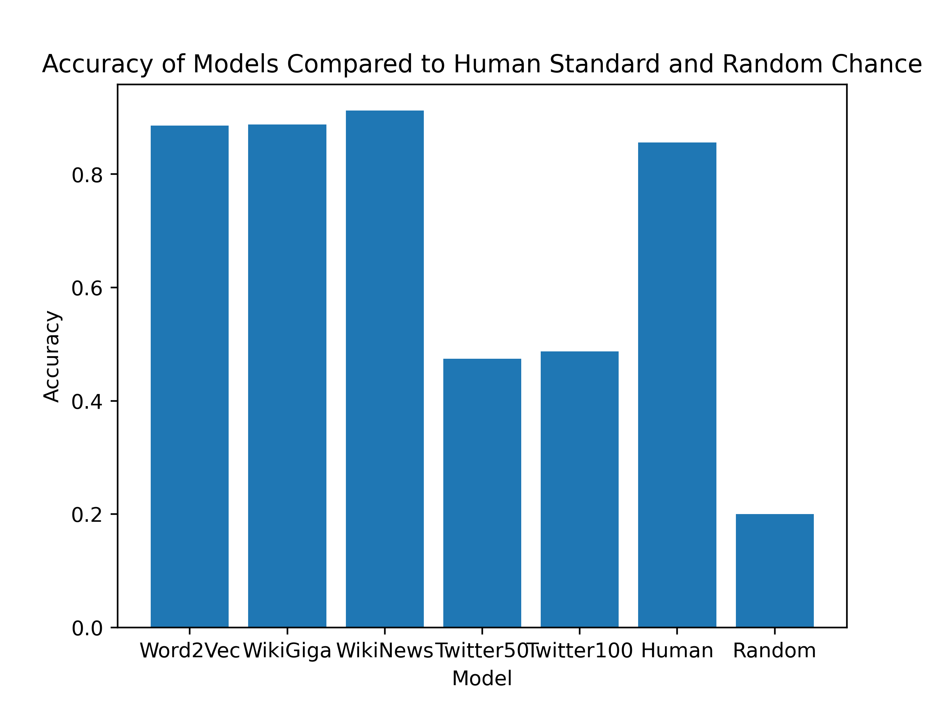
Comparison to Human Gold Standard and Random
As expected, random has the worst result, averaging at a 20% accuracy. Human gold standard falls just short of Word2Vec, WikiGiga, and WikiNews at 85.57%.

Slide 4
How to Improve Best Model
When Analyzing the accuracy of the models, WikiNews leads at 91%.

