Slide 1
CEB Biomass EJ Update
Briefing for Sharyn Lie
April 3, 2024

Slide 2
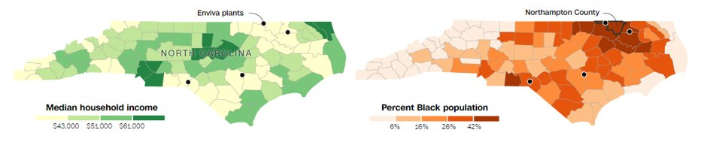
Background & Context
CCD has worked closely with colleagues including OAQPS, ORD, Region 4 on issues like wood pellet production for over a decade
In August 2022, OAP held a listening session with the Dogwood Alliance, the People’s Justice Council and residents concerning environmental justice (EJ) issues surrounding pellet mills in the Southeast
Concerns focused on Title V permits for pellet mills, and the conditions documented in EJ reports submitted by the applicant and documented by CNN and others
Source: CNN, How marginalized communities in the South are paying the price for ‘green energy’ in Europe (link)

Slide 3
Background (cont’d)
These meetings happened as CCD was developing technical capabilities in EJ analytics
Initial meetings with Dr. Greg Latta, developer of the LURA model, revealed that he shared our interest. He shared a spreadsheet with all the forest product mills (all types), their locations, and demographics from the Census block group where they were located.
Our work builds on Latta’s by including additional datasets describing health conditions, and other nearby emitters at multiple scales.
Our analysis is a work-in-progress
CCD has been working with Tom Casey, a UMD master’s student on his capstone project “Community assessments of pulp and paper mills in Georgia”. We are scheduling a brownbag for Tom on May 21st

Slide 4
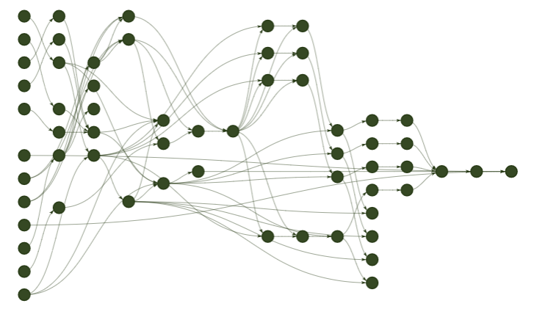
Automated Proximity Analysis
1. Input facility locations
2. Identify radii around facilities
3. Map census tracts to radii
4. Aggregate variable values
5. Output summary table

Slide 5
Data Sources
American Community Survey 2019 (ACS)*
Race and ethnicity demographics
Median household income
AirToxScreen 2019
Cancer risk
Respiratory illness risk
CDC PLACES, 2021 release*
Asthma
Heart disease
Access to health insurance
All surveys utilize 2010 census tract boundaries
*: More recent versions available

Slide 6
Summary Analysis Tables

Slide 7
Next Steps

