Slide 1
CEB Biomass & Proximity Analysis EJ Update
Briefing for Sharyn Lie
April 3, 2024

Slide 2
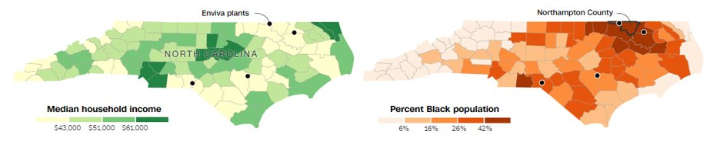
Background & Context
Proximity analysis code was originally developed by NCEE for HFC Facility Analysis.
New automated process allows for the easy-swapping of locations and tract-level data.
CCD has worked closely with colleagues including OAQPS, ORD, Region 4 on issues like biogenic CO2 emissions and wood pellet production for over a decade.
In August 2022, OAP held a listening session with the Dogwood Alliance, the People’s Justice Council and residents concerning environmental justice (EJ) issues surrounding pellet mills in the Southeast.
Concerns focused on Title V permits for pellet mills, and the conditions documented in EJ reports submitted by the applicant and reported by CNN and others.
Source: CNN, How marginalized communities in the South are paying the price for ‘green energy’ in Europe (link)

Slide 3
Background (cont’d)
CEB had previously (2020) started work with Dr. Greg Latta, developer of the LURA and FASOM models, on this topic and he shared a spreadsheet with all the forest product mills (all mill types), their locations, and demographics from the Census block group where they were located.
Our work builds on Latta’s by including additional datasets describing health conditions, and other nearby emitters at multiple scales.
Latta's "All Mills" dataset served as the first exploratory use-case for automation.
CCD has been working with Tom Casey, a UMD master’s student on his capstone project “Community assessments of pulp and paper mills in Georgia”. We are scheduling a brownbag for Tom on May 21st .

Slide 4
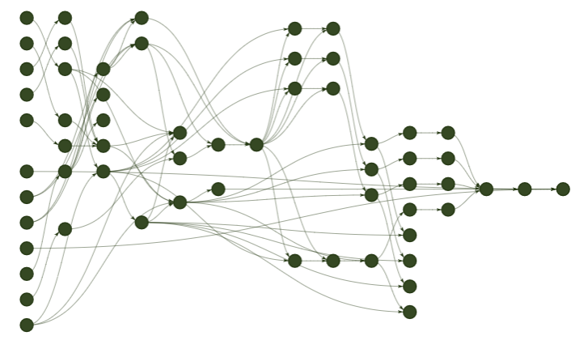
Automated Proximity Analysis using targets
Input facility coordinates
Create buffer zones and map census tracts
Calculate variable means and standard deviations for each buffer zone
Merge results into single table and export

Slide 5
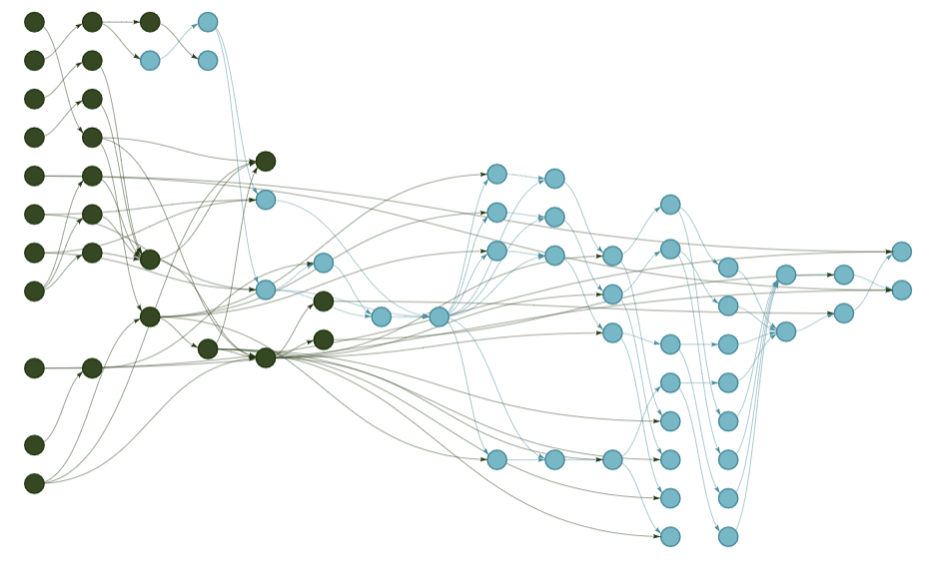

Automated Proximity Analysis using targets
Ex. Change facility inputs to pellet mills

Slide 6
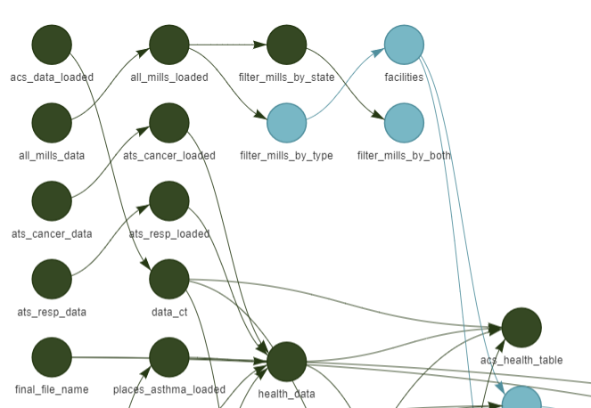
Automated Proximity Analysis using targets
Ex. Change facility inputs to pellets mills
1. Input facility coordinates

Slide 7
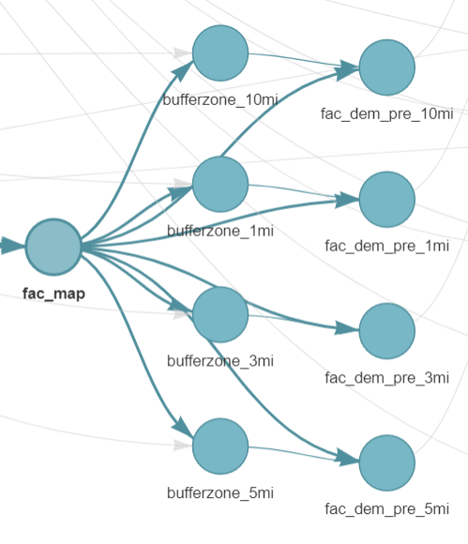
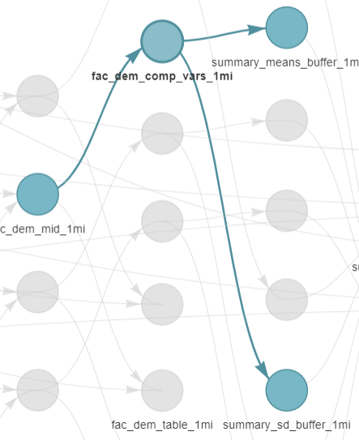
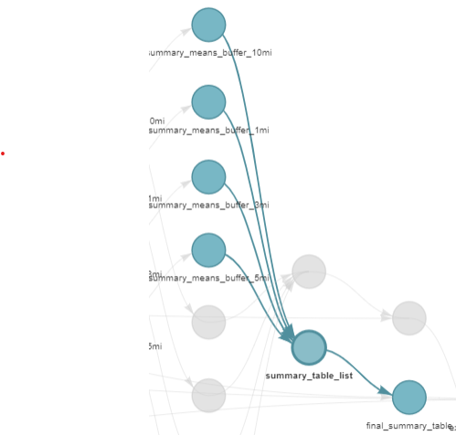
Automated Proximity Analysis using targets
Ex. Change facility inputs to pellets mills
2. Create buffer zones
and map census tracts based on intersection for each facility
3. Calculate variable means and standard deviations for each buffer zone
4. Combine results into summary table and export

Slide 8
Tract-Level Data Sources
American Community Survey 2019 (ACS)*
Race and ethnicity demographics
Median household income
AirToxScreen 2019
Cancer risk
Respiratory illness risk
CDC PLACES, 2021 release*
Asthma prevalence
Heart disease prevalence
Cancer (excl. Skin) prevalence
All sources utilize 2010 census tract boundaries
*: More recent versions available

Slide 9
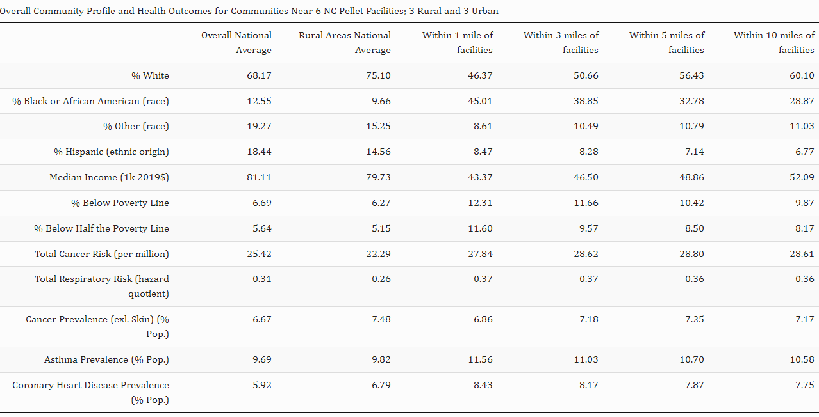
Summary Tables: NC Pellet Mills

Slide 10
Summary Tables: NC Pellet Mills

Slide 11
Next Steps & Potential Applications
Technical model improvements
Expand proximity analysis to include Census block groups within a generalized “blob” shape
Investigate effects of wind on air pollution dispersion patterns, focusing on EJ-related effects
Integrate demographic analysis within PE model
“Fused” data
Explore alternative tract-mapping
Research topics
Do EJ impacts of biomass differ by facility type (e.g., sawmill, pulp & paper)? Region? Age of facility?
Are there differences in air pollution volumes and related health effects between entities with Major vs Minor Title V permits?
Possible Applications
Explore the extent to which these findings and/or tools can be applied within EPA regulatory settings (e.g., in RIAs)
Augment work by R4 and ORD looking at HAPs in US Southeast

