Slide 1
Group Assignment 2
Group 2
Quin Dixon, Jared Darnell, Cole smith
CS 3550

Slide 2




Tools We Used
Slack
General communication
Track work progress
Lucidchart
Diagram creation
Google Sheets
Collaborative data collection
Google Sheets
Collaborative data collection

Slide 3
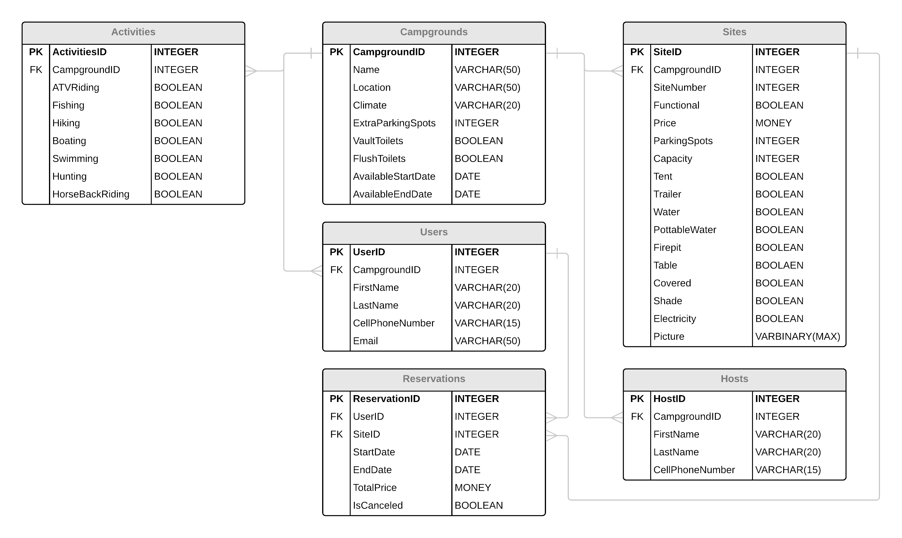
ERD

Slide 4
Unique Things
IsCanceled Boolean in Reservations table
To retain cancellation data
TotalPrice money in Reservations table
To help easily track revenue
Functional Boolean in Sites table
In case of individual campsite closures (construction, damage, etc.)
Hosts table to handle multiple hosts for an individual campground

Slide 5
Future Improvements
Handle data disposal better
Possibly DataDisposed date attribute

