Slide 1





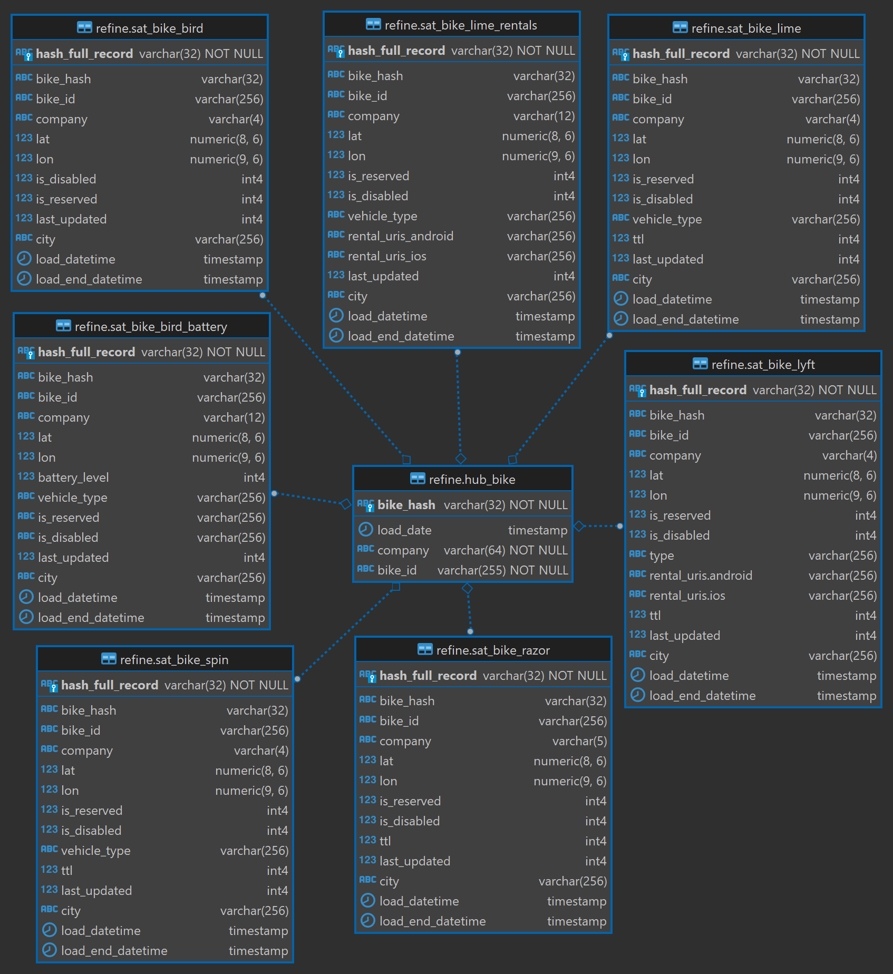
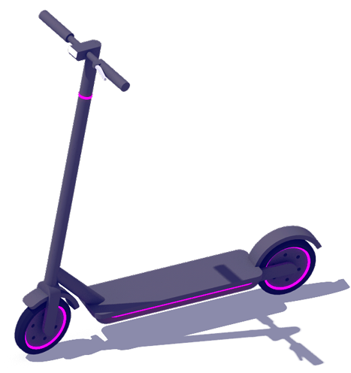








Cloud Watch
Redshift
Data Studio Report Emailed Daily
Data Vault Data Modeling
Data Studio
E-Scooter & E-Bike Status APIs
SNS
Lambda
S3

Slide 2
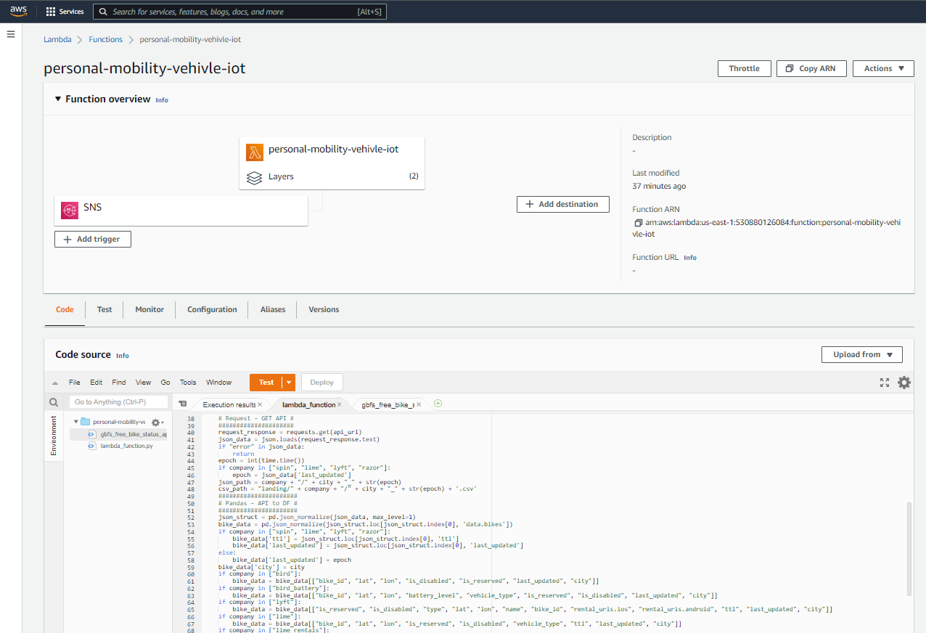

Slide 3
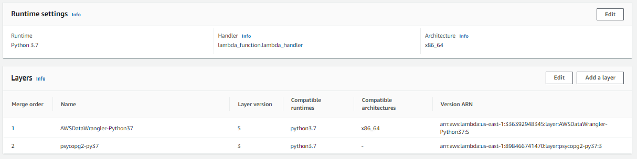

Slide 4
