Slide 1





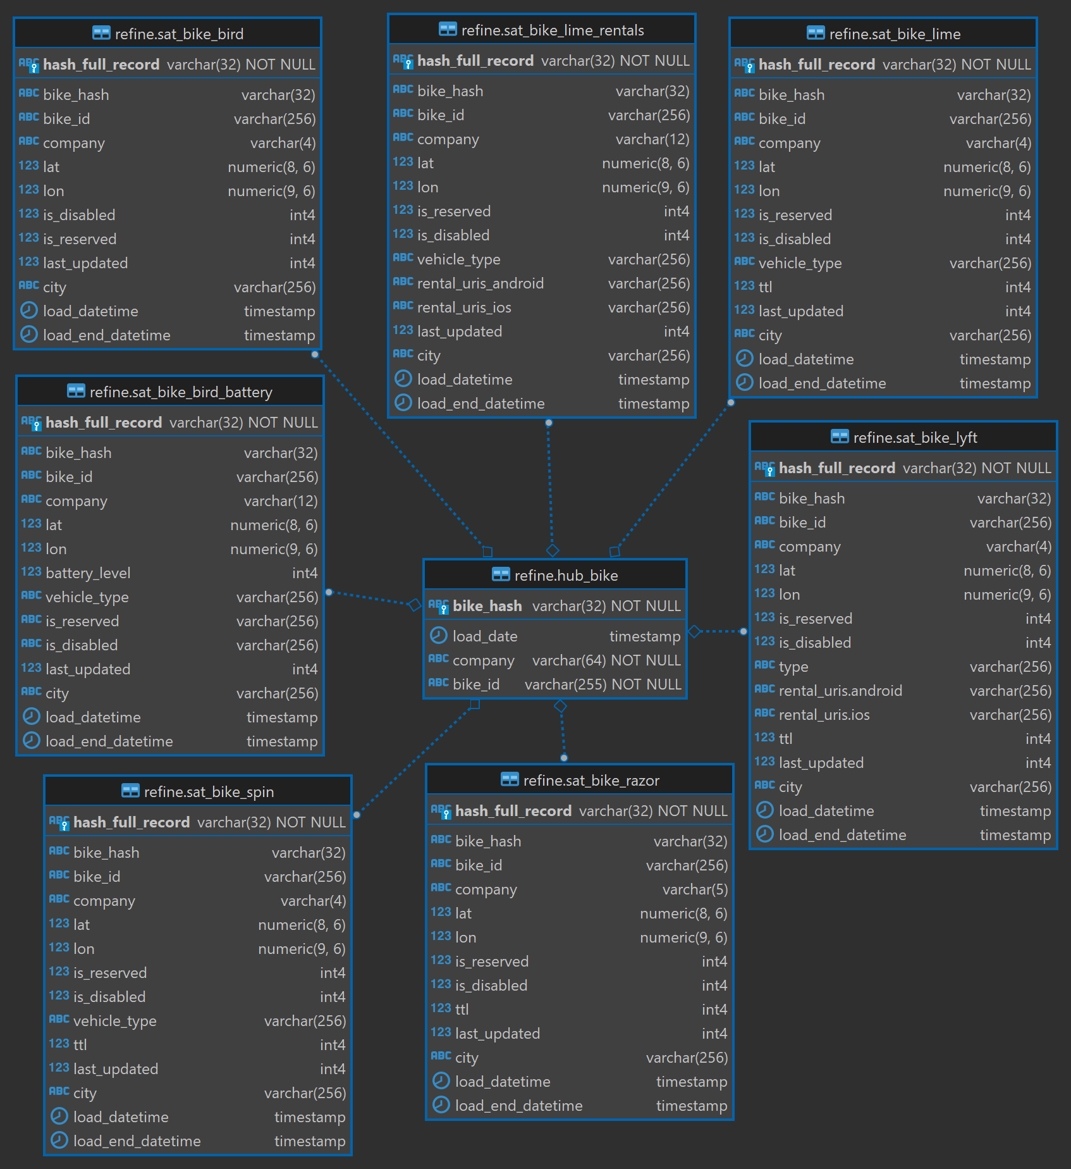









Redshift
Data Studio Report Emailed Daily
Cloud Watch
Schemas
Data Studio
Stage
Refine
Publish
Data Vault Data Modeling
E-Scooter & E-Bike Status APIs
S3
SNS
Lambda

Slide 2
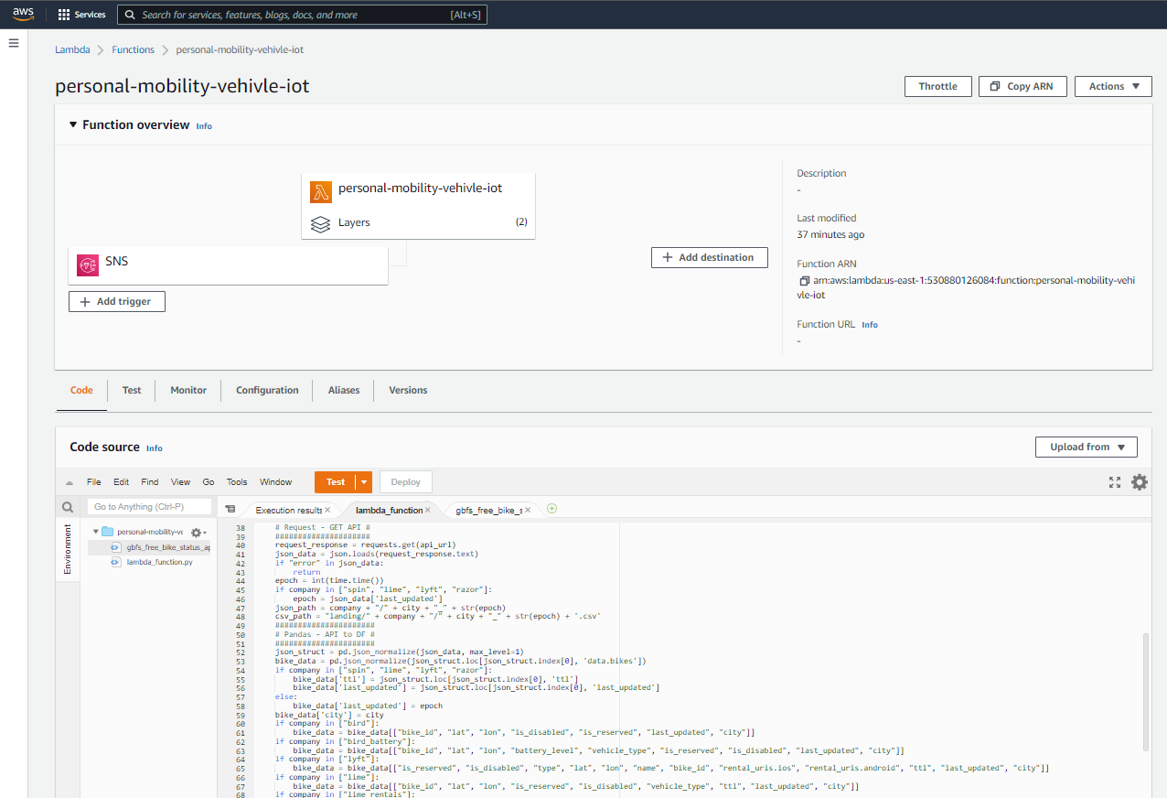

Slide 3
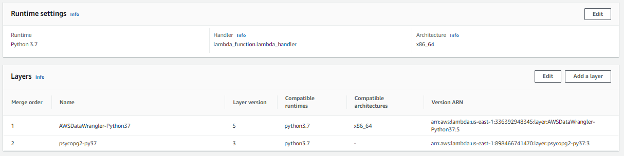

Slide 4
