Slide 1




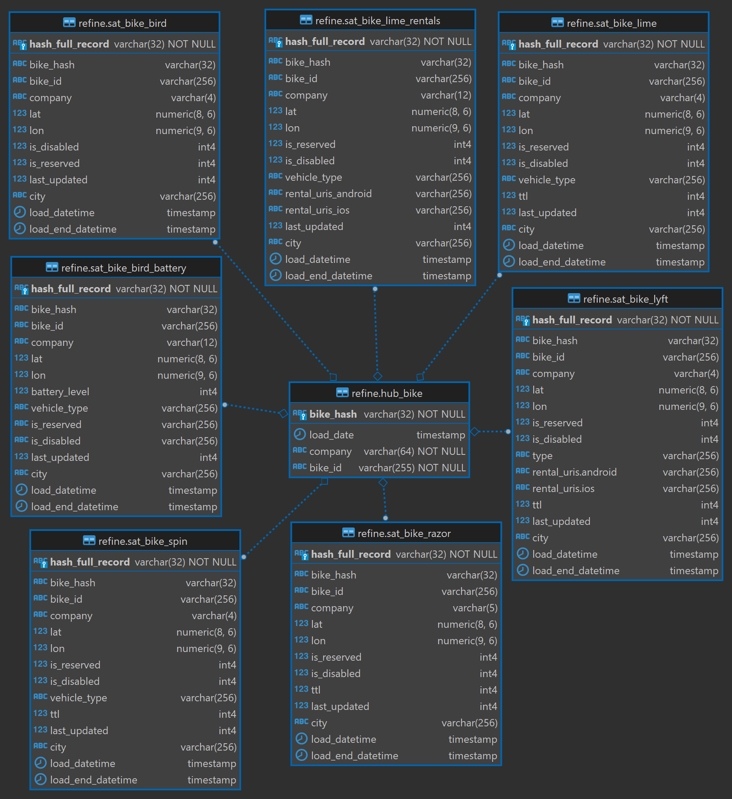

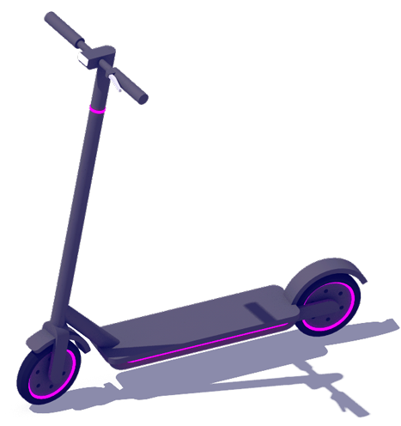








Data Vault Data Modeling
Redshift
Cloud Watch
Data Studio Report Emailed Daily
Data Studio
E-Scooter & E-Bike Status APIs
S3
SNS
Lambda

Slide 2
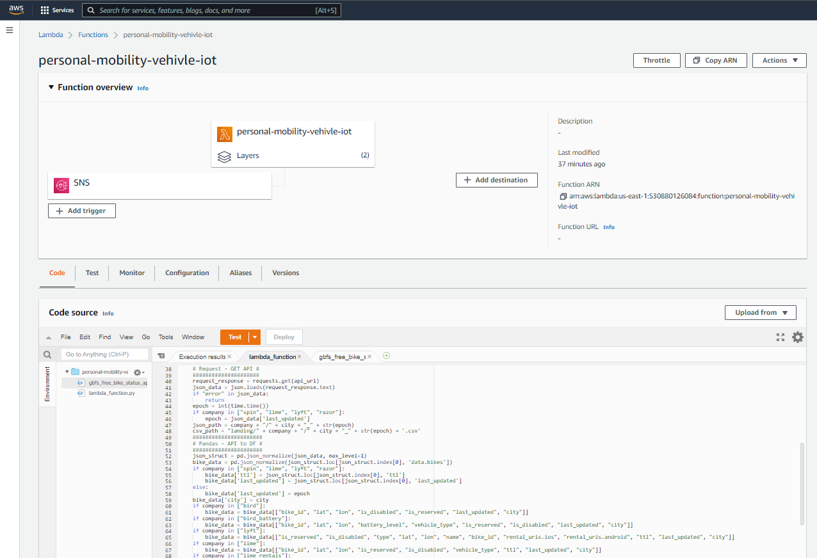

Slide 3
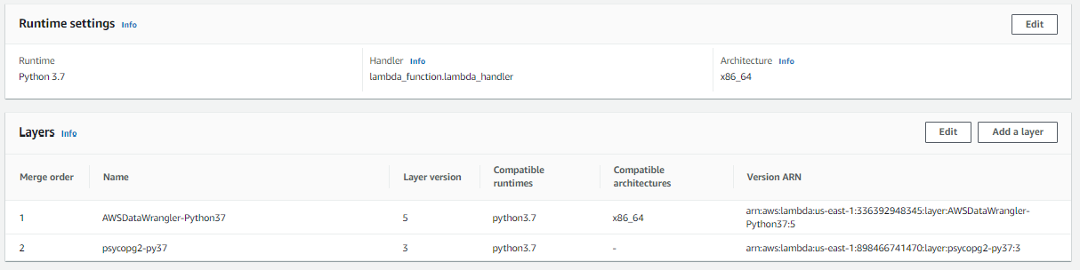

Slide 4
