Slide 1



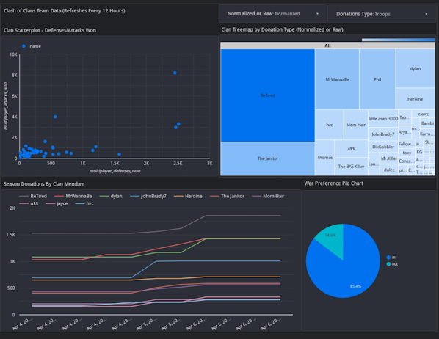


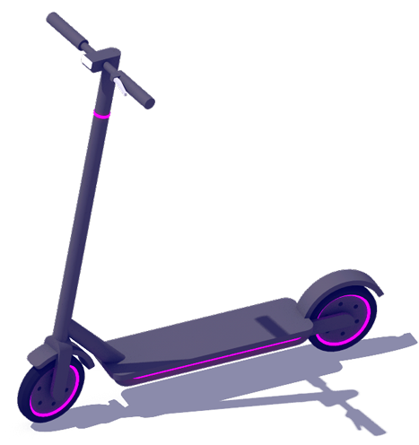








Redshift
Data Studio Report Emailed Daily
Cloud Watch
Data Studio
E-Scooter & E-Bike Status APIs
SNS
Lambda
S3

Slide 2
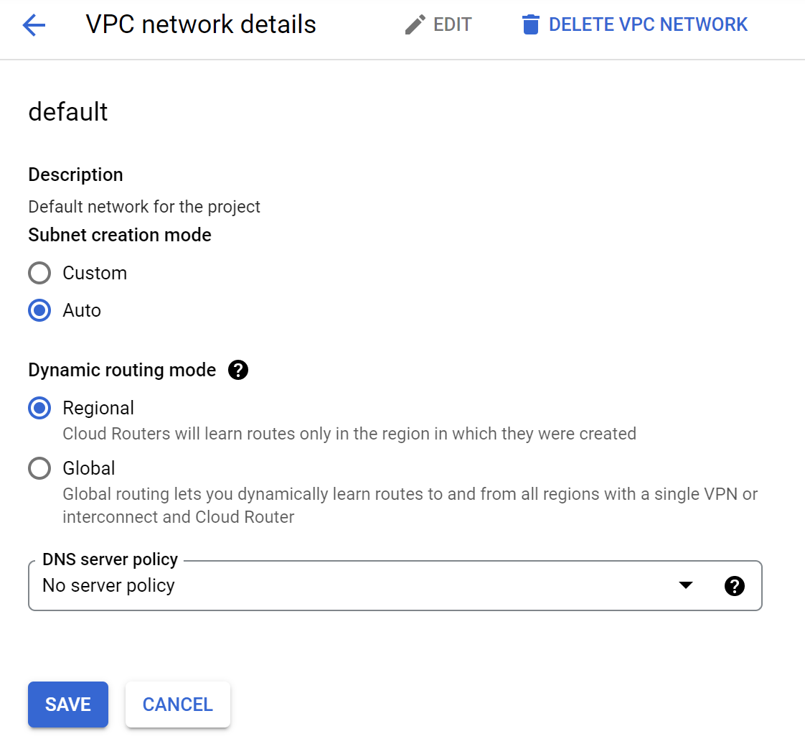

Slide 3
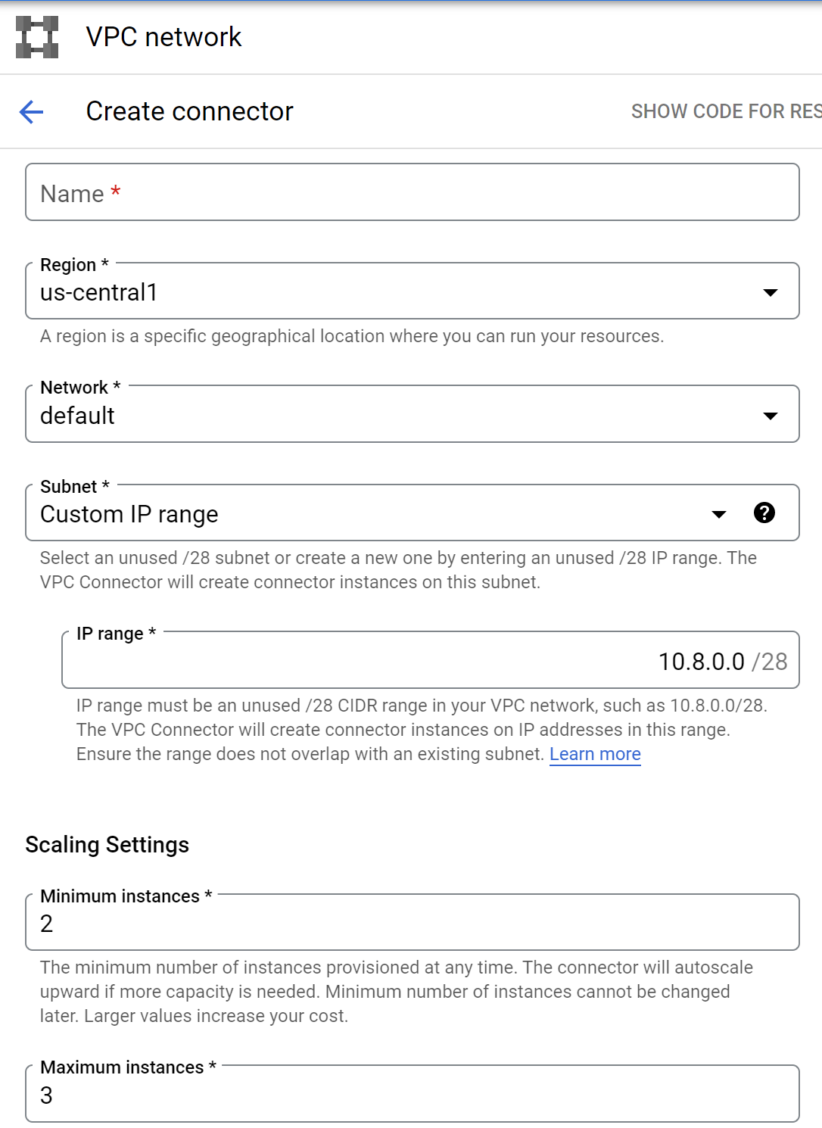
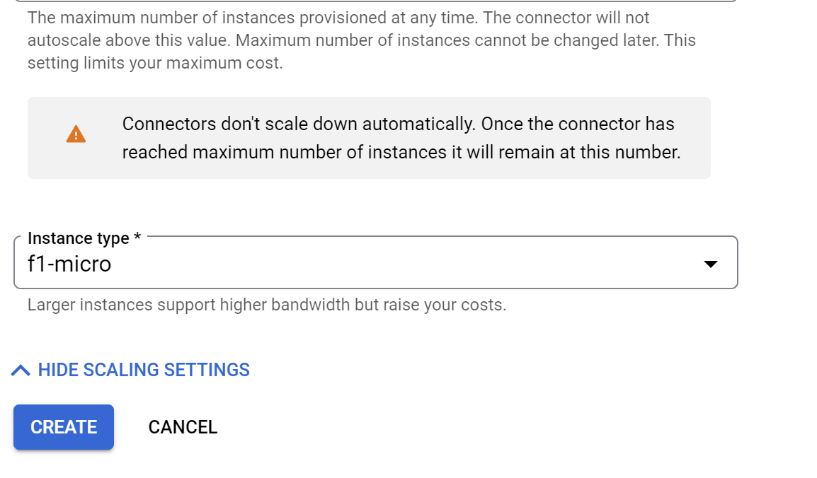

Slide 4
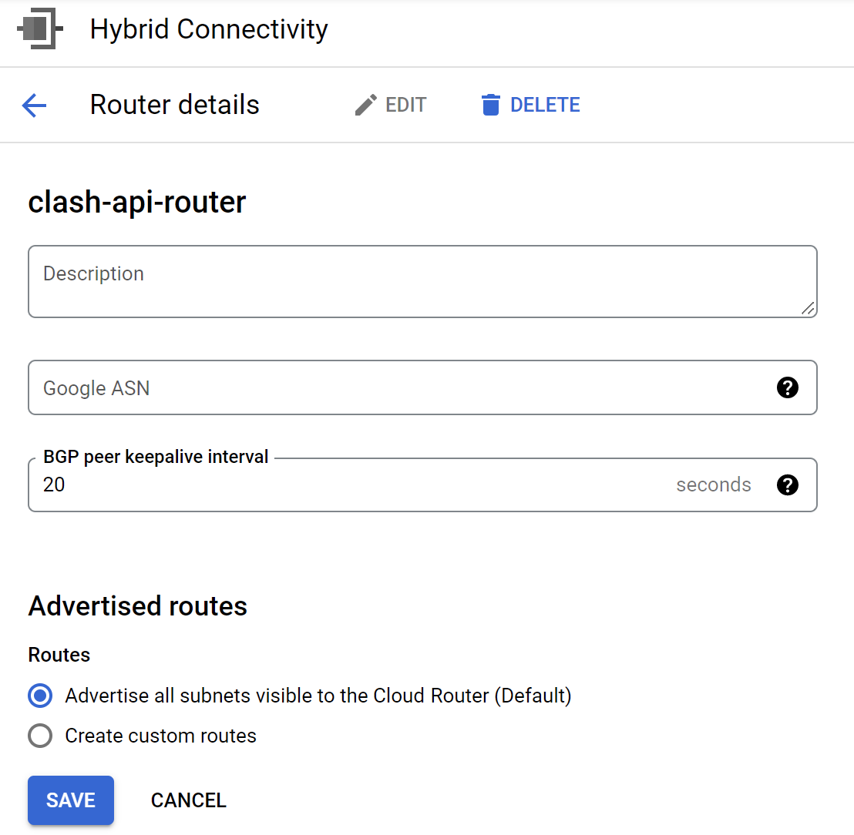

Slide 5
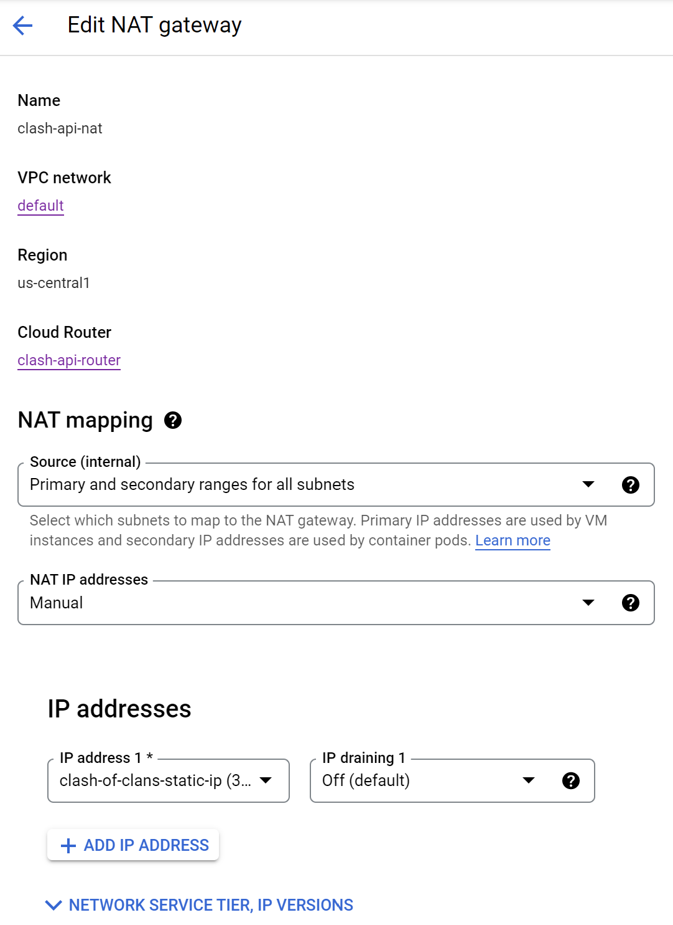

Slide 6
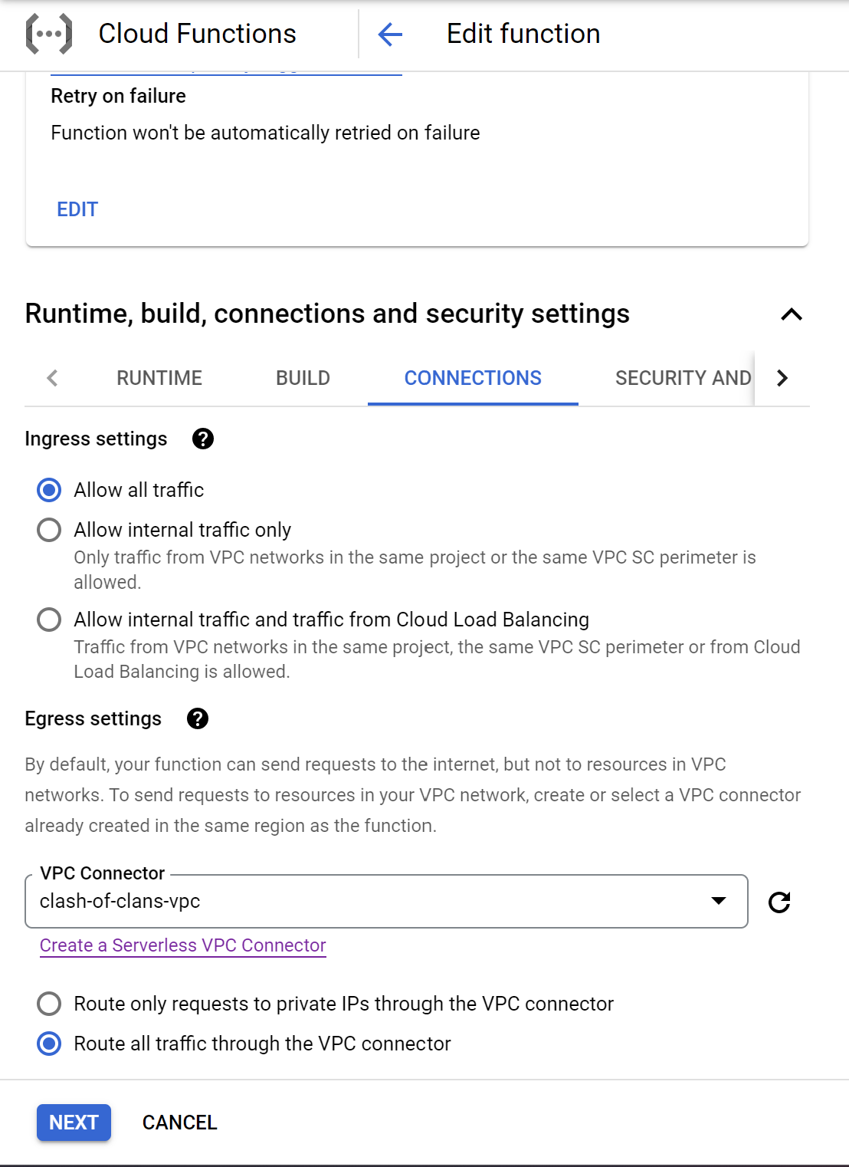
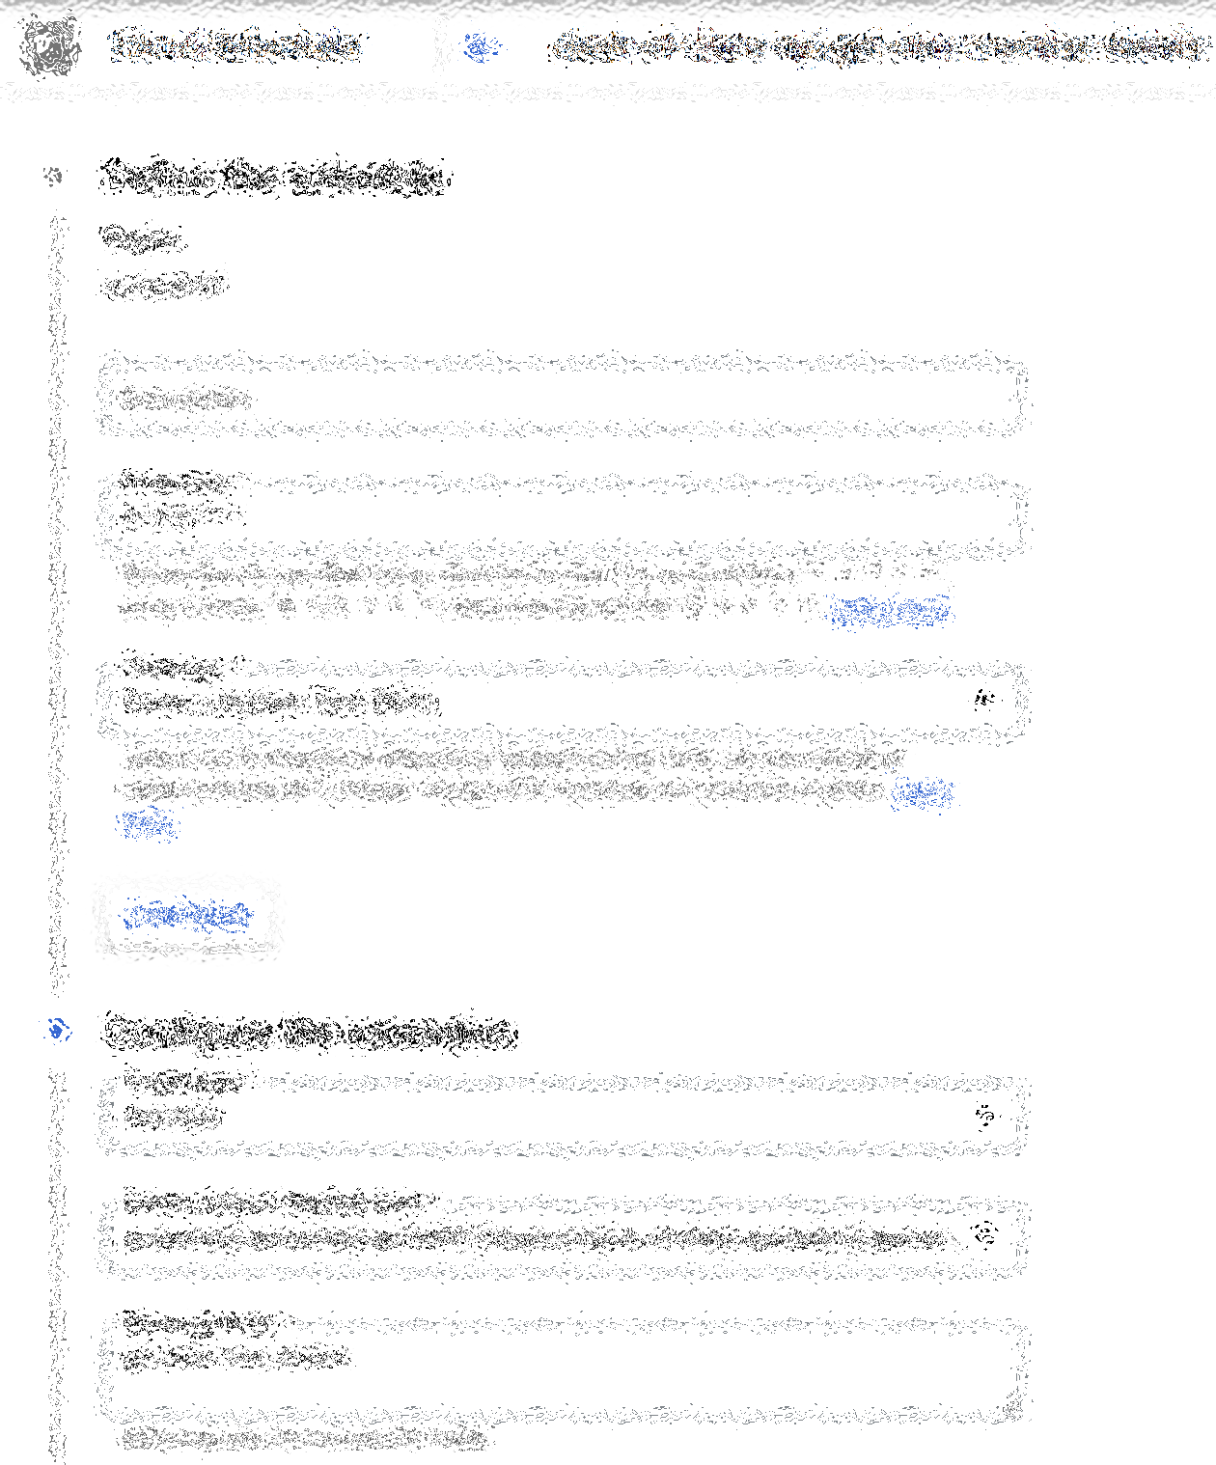

Slide 7
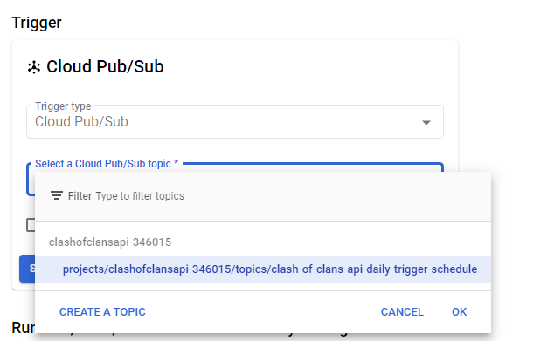

Slide 8
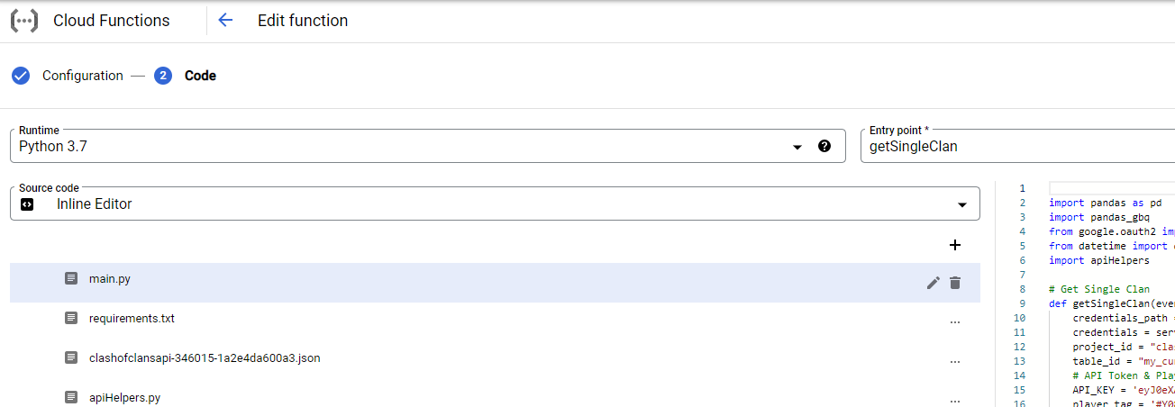

Slide 9
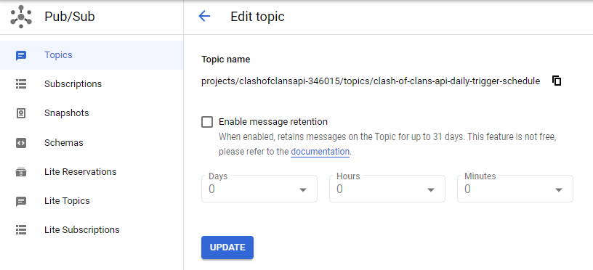

Slide 10


Slide 11
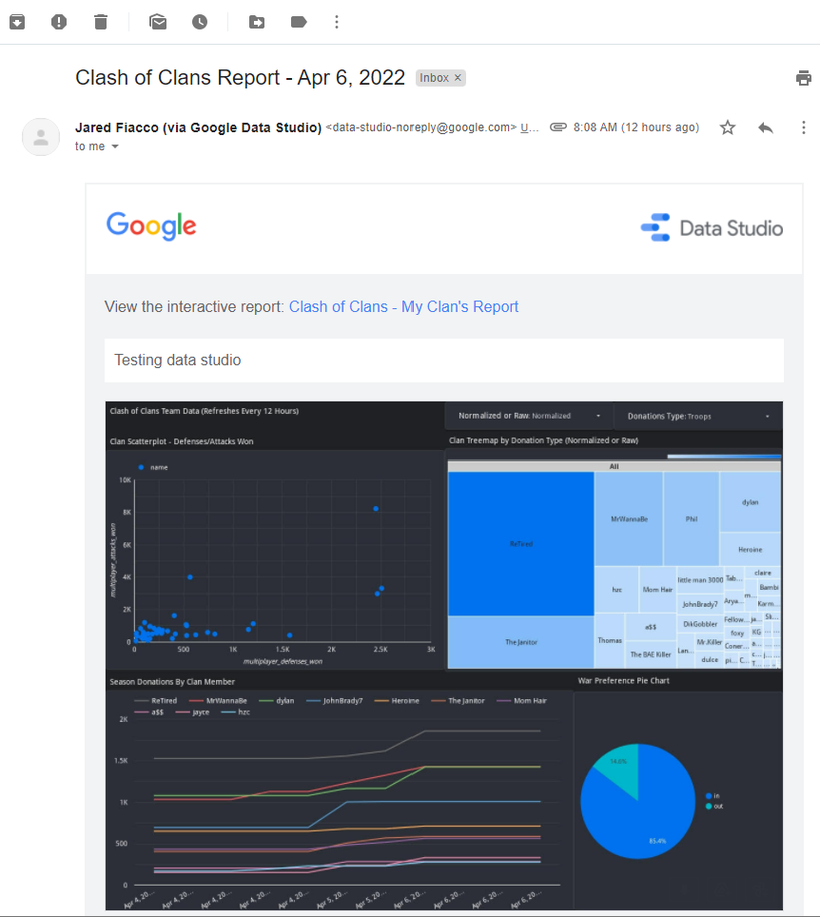

Slide 12
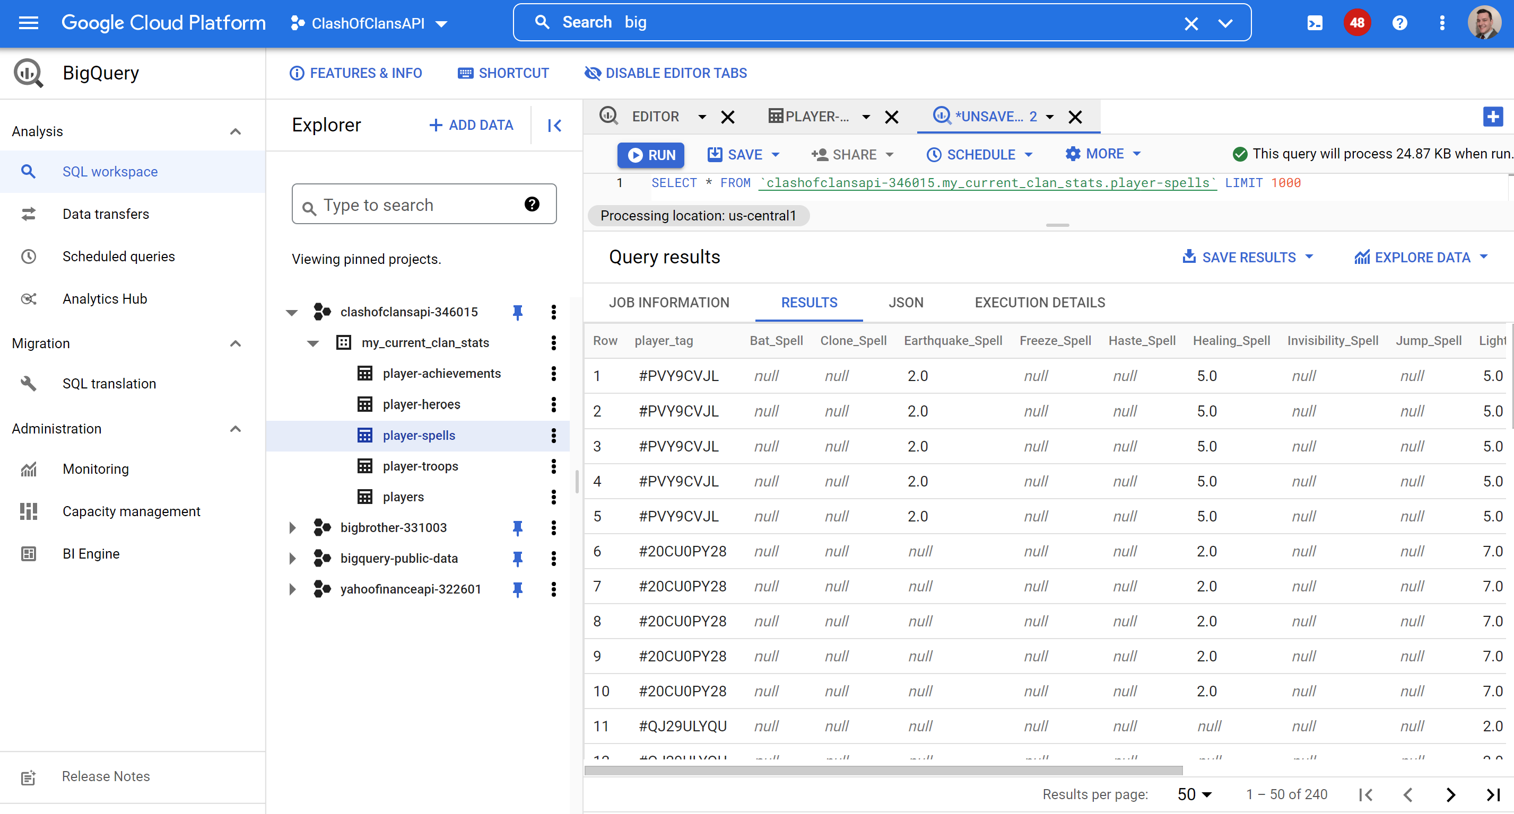
BigQuery:
Go to the [DATASET.TABLE_NAME] you chose in the cloud_function_event_prod.py. Go to BigQuery and query the table after publishing using the main.py script.

Slide 13
