Slide 1
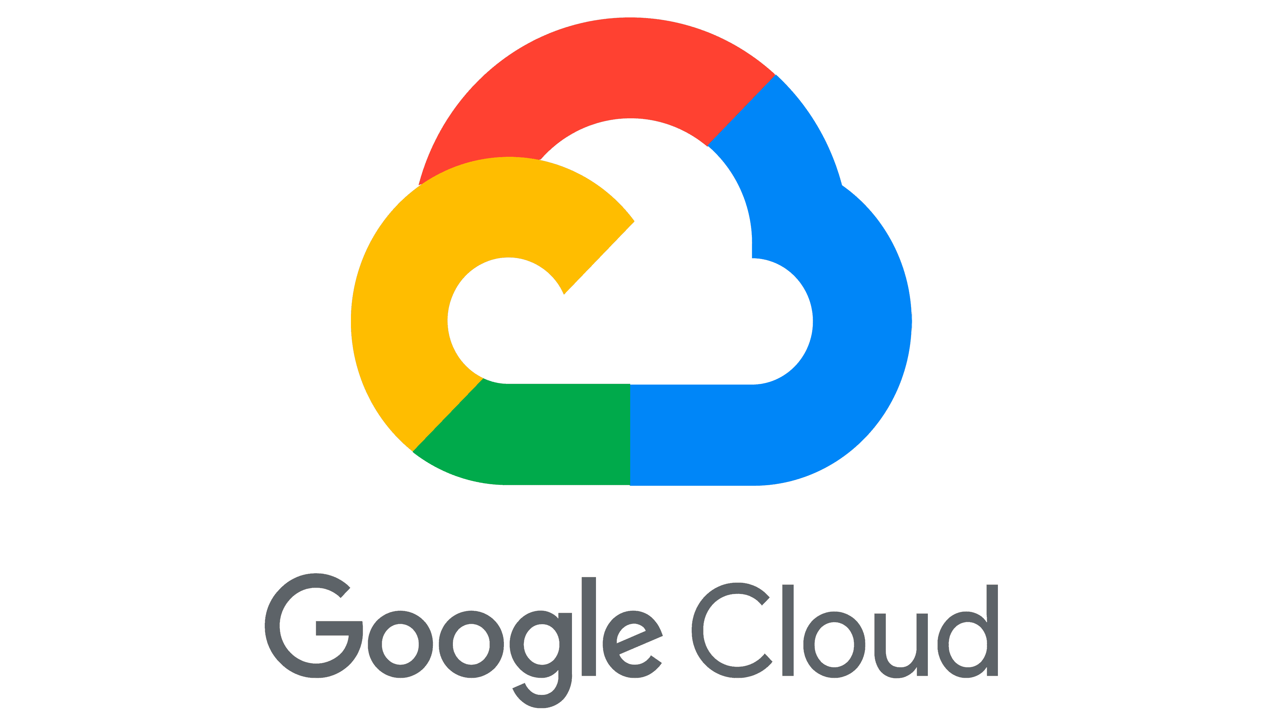

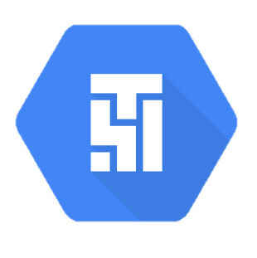

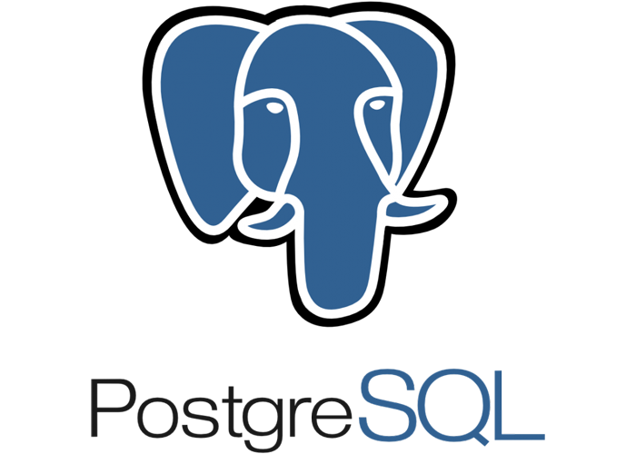
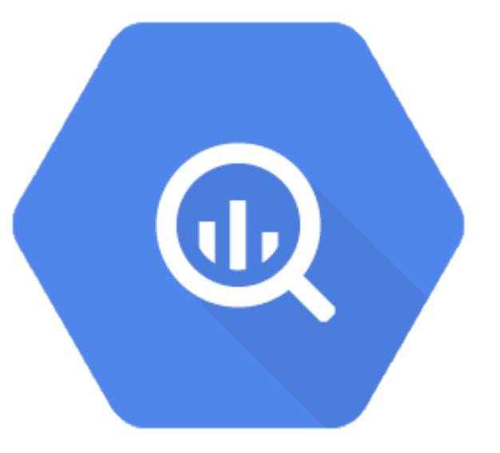
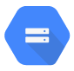

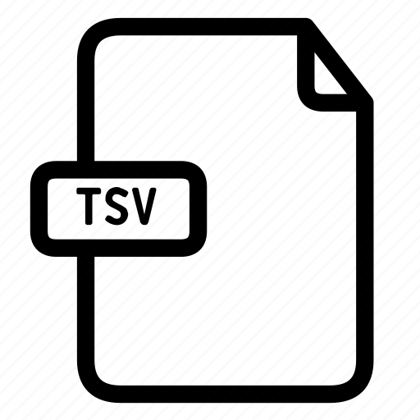

Cloud Compose
Cloud Composer Creates an instance of Airflow running on at least 3 Compute VMs, a storage bucket, and a database core
I tested this code by pulling from a Postgres Server I had running on AWS. But you should be able to pull from any productionalized Postgres server
Uses the dags in the Cloud Storage dags Folder to move data
BigQuery Can act as your data warehouse, bring in data from multiple Postgres Servers
BigQuery
Cloud Storage
Dags are located in the GCS dag folder, they are written in python and tell airflow what to do
Dags
The Dag uses a Postgres Hook and a Google Storage Operator or Hook to pull data from Postgres into GCS
TSV files cannot be loaded into BigQuery
CSV files can be loaded into BigQuery

