Slide 1


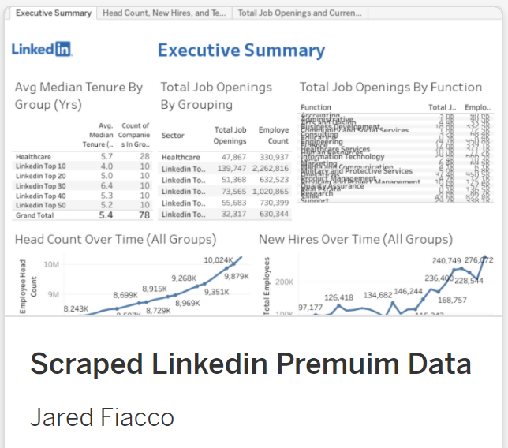
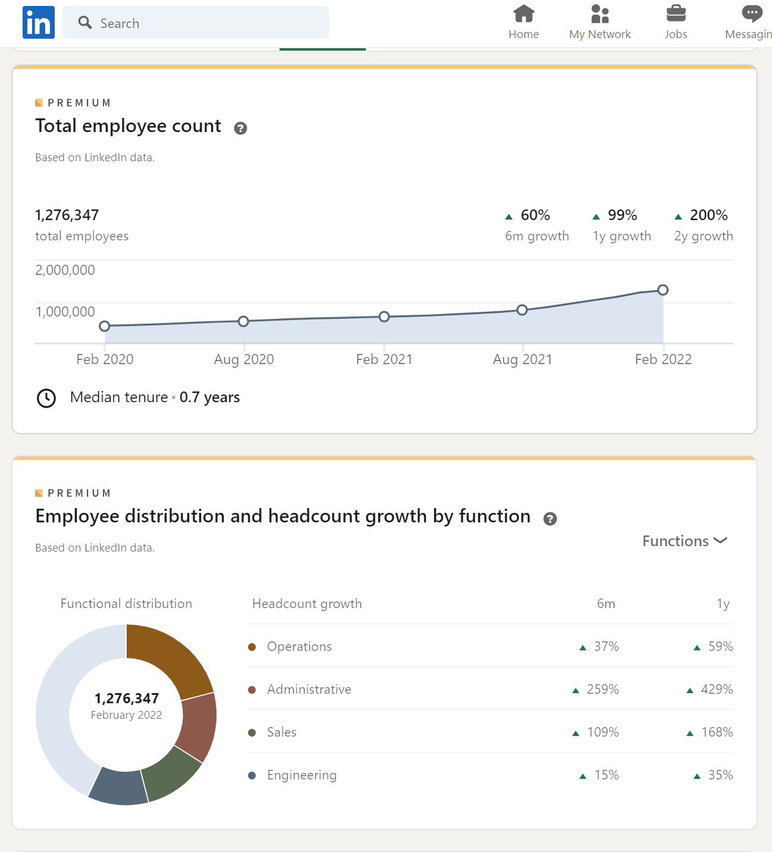

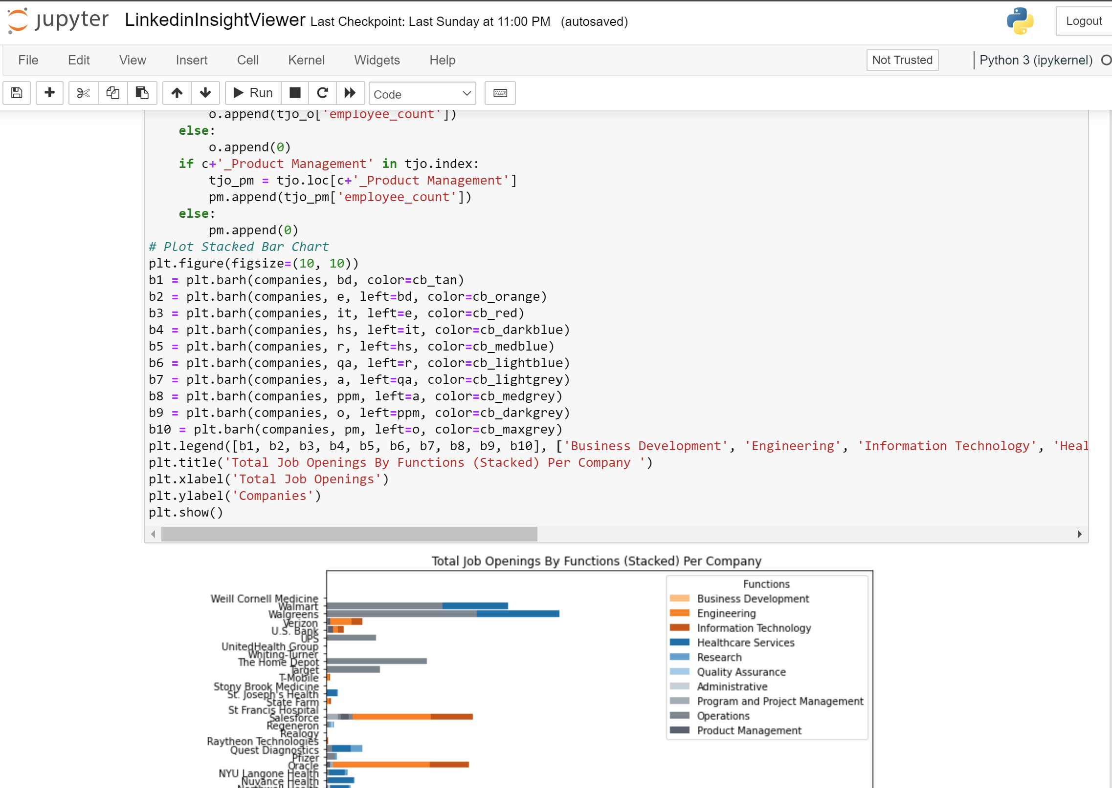


2a.
1.
2b.
Local Computer
Process:
1. main.py uses Selenium & the chrome driver to open chrome, log into Linkedin, loop through links, and pull premium insights in hidden tables, storing the resulting pandas dataframes in pickle files.
2a. The Jupyter Notebook file opens the pickle data, and uses the data to make graphs and charts.
2b. Created a visual in Tableau for ease of use by the end-users.

