Slide 1
Household Financial Analysis
Spending, Debt, Liquidity, and Financial Health Assessment
Tools: PostgreSQL • SQL • Python • pandas • Matplotlib • Excel Prepared by: Jared Tyler Fontecha

Slide 2
Project Objective
Evaluate household spending, debt, liquidity, and overall financial health using a full analytics workflow.
Clean and classify raw financial data in PostgreSQL, analyze it with Python/pandas, and present findings through charts and an Excel dashboard.
Identify the biggest financial risks, spending drivers, and realistic paths toward improved cash flow.
Goal: Turn raw household financial data into clear, decision-ready insights.

Slide 3
Data Pipeline
Raw CSV Files
PostgreSQL
Raw household data
Store structured data
SQL Cleaning & Classification
Python/Pandas Analysis
Clean, classify, standardize
Analyze financial metrics
Excel Dashboard
Purpose: Build a reusable workflow that separates data cleaning, analysis, visualization, and reporting.
Matplotlib Visualizations
Present findings
Create charts

Slide 4
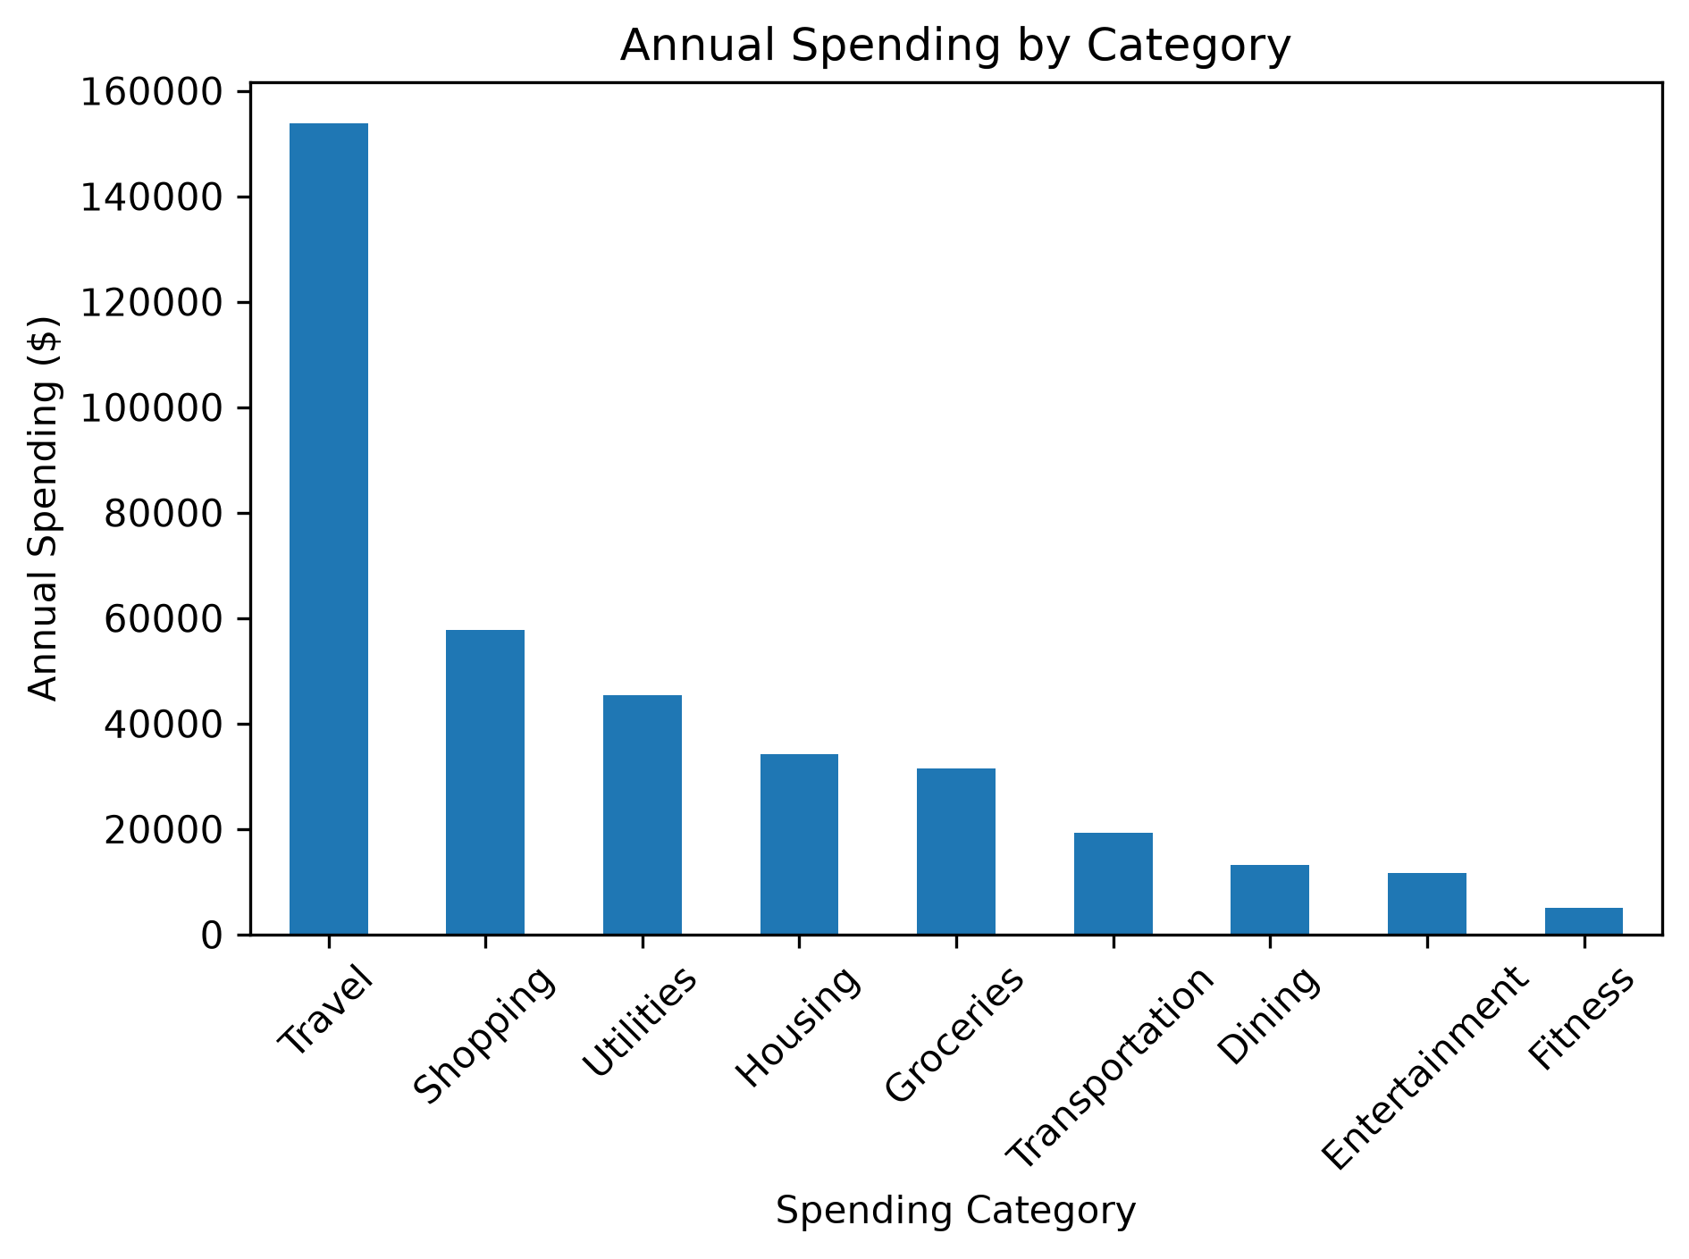
Spending Overview
Annual spending: $372,066.27
Travel is the largest category at $153,896.94
Travel represents 41.36% of total spending

Slide 5
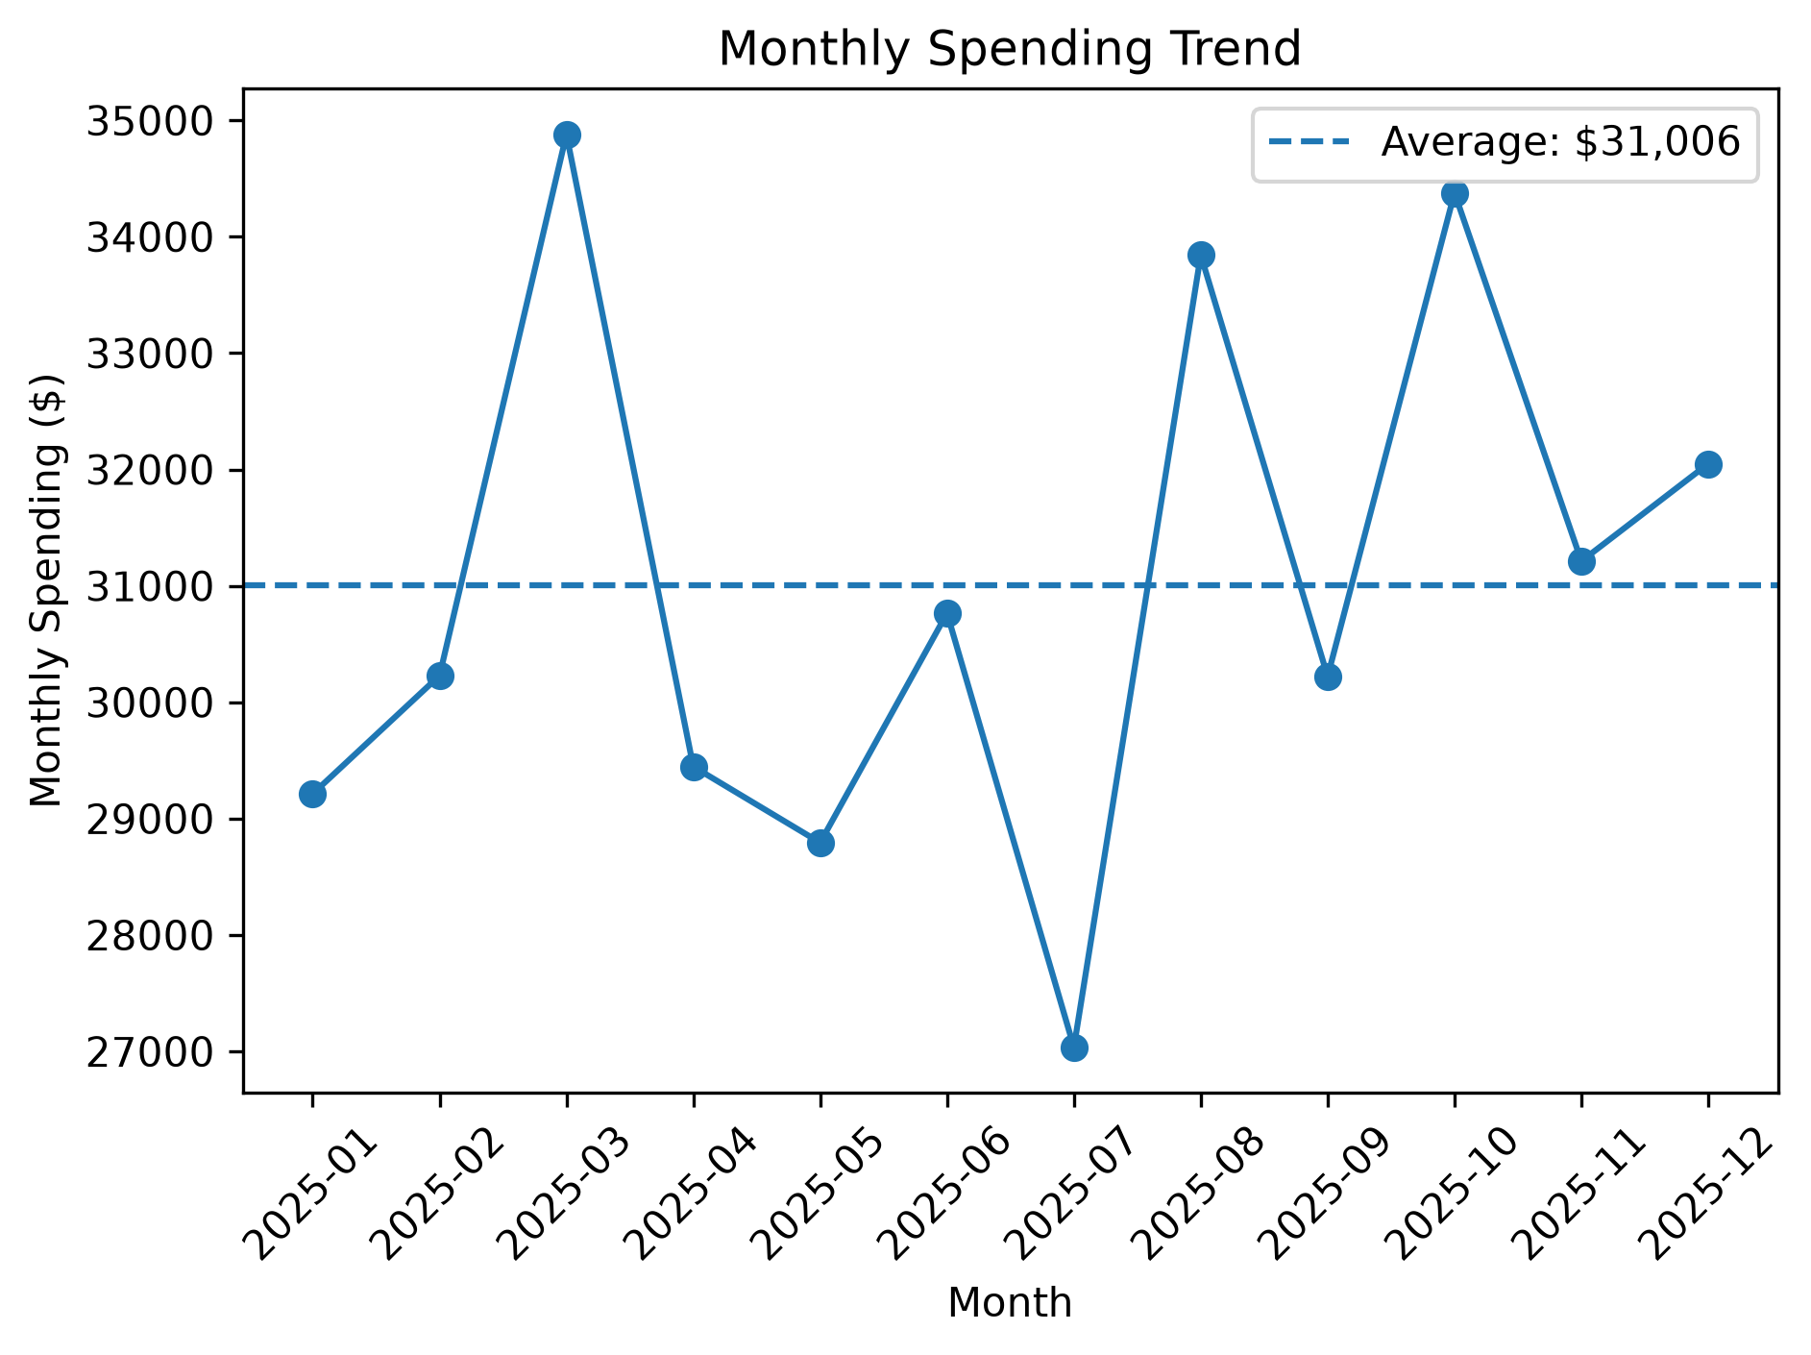
Monthly Spending Trends
Average monthly spending: $31,005.52
March (+12.49%) and October (+10.87%) were the only months at least 10% above average.
Travel was the top category in both high-spending months.

Slide 6
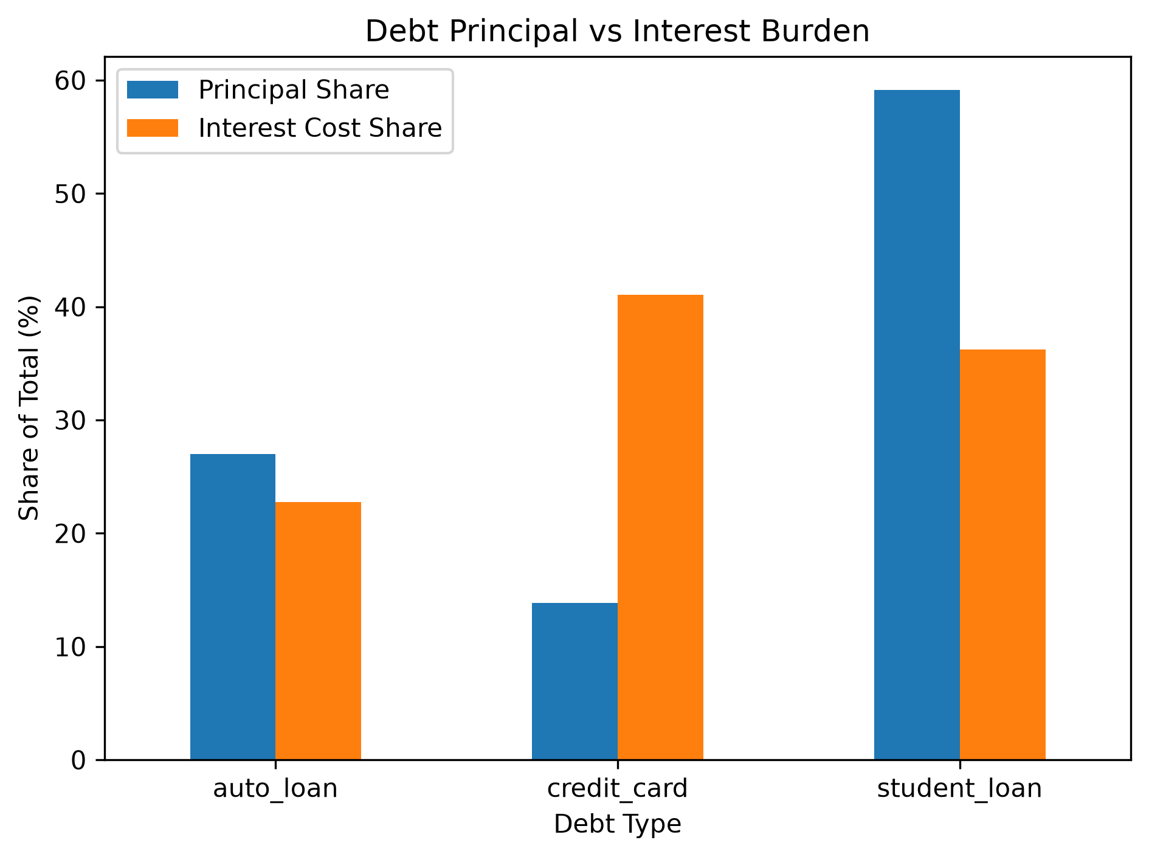
Debt & Liquidity
Adjusted total known debt: $85,550
Checking cash: $19,000
Cash-to-debt ratio: 22.21%
Credit cards are only 13.86% of listed debt principal but account for 41.05% of estimated annual interest cost
Note: Amex $1,850 balance was identified in accounts but missing from the debt schedule

Slide 7
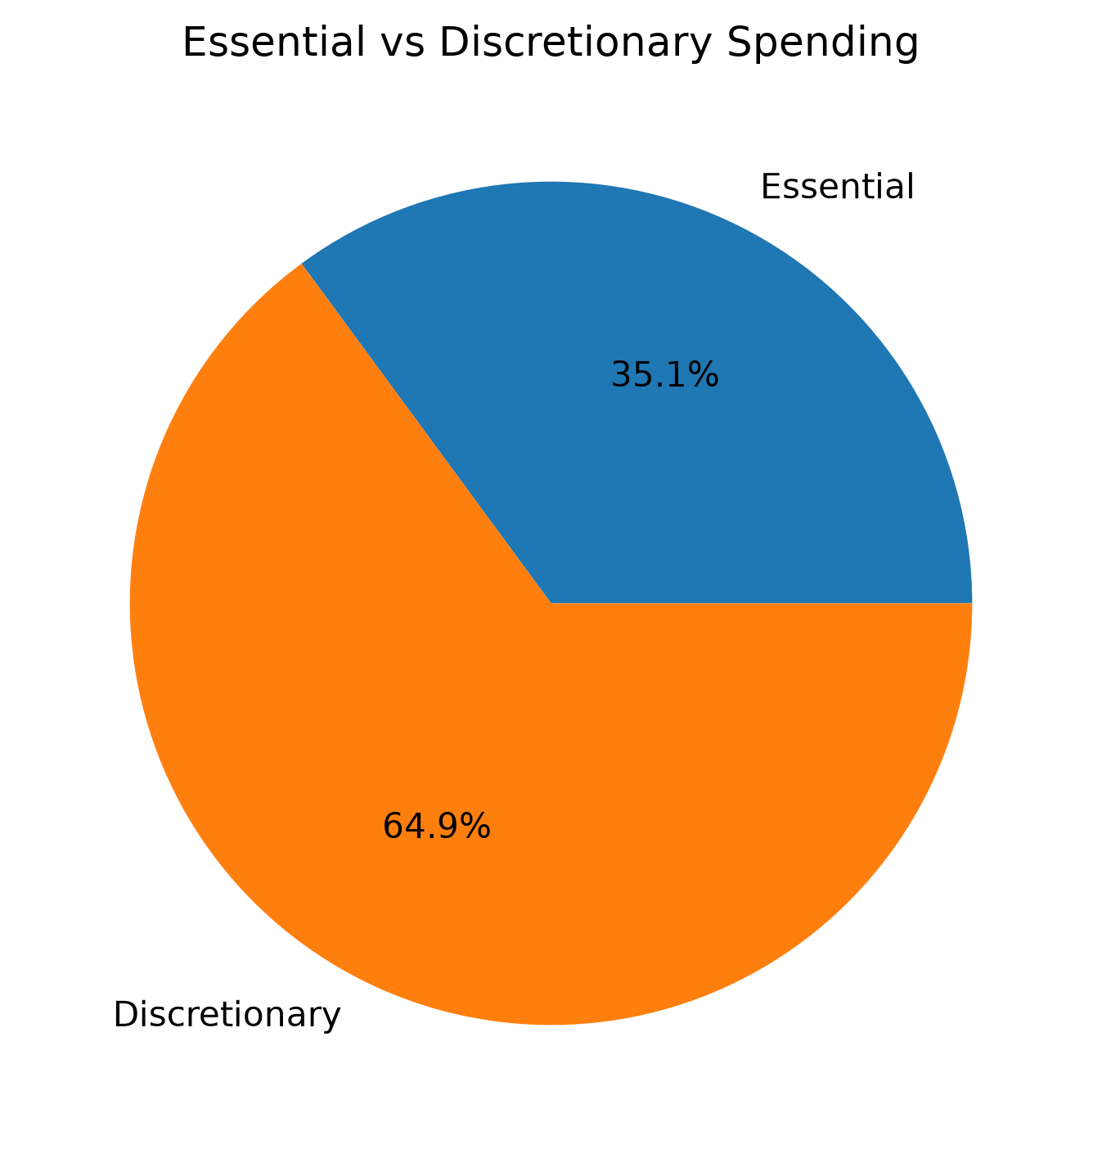
Financial Health
Annual income: $174,923.04
Annual spending: $372,066.27
Annual net cash flow: -$197,143.23
Cash flow margin: -112.70%
Custom Financial Health Score: 40/100 — High Risk
Note: Custom project metric; not an industry-standard financial score.

Slide 8
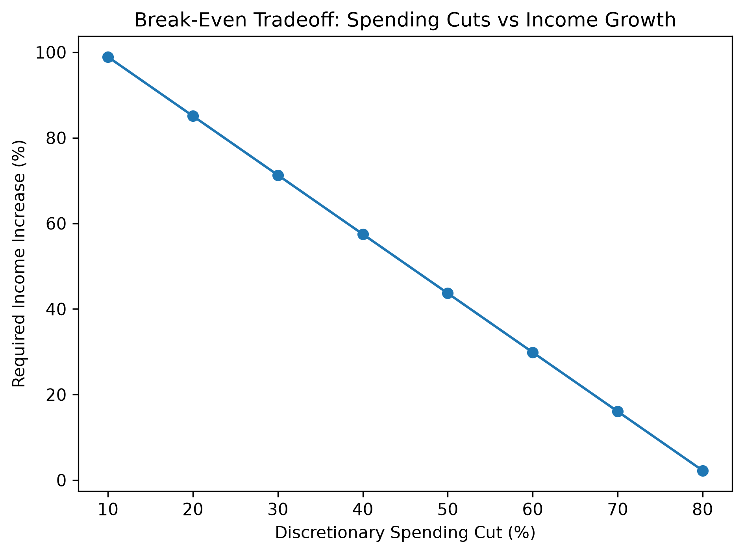
Break-Even Scenario Analysis
10% spending cut → still requires about 98.90% income growth
50% spending cut → requires about 43.67% income growth
80% spending cut → requires only about 2.25% income growth
Takeaway: Break-even requires major discretionary cuts, income growth, or a combination of both.

Slide 9
Key Recommendations
Reduce discretionary spending, especially Travel, the largest spending category.
Prioritize high-APR credit card debt, which creates a disproportionate share of interest cost.
Build a larger cash reserve to improve liquidity and reduce reliance on credit.
Use a combined approach of spending cuts and income growth to restore positive cash flow.
Priority: Stabilize cash flow first, then accelerate debt reduction.

Slide 10
Conclusion
The household’s biggest issue is a structural cash-flow deficit, with annual spending materially exceeding annual income.
Discretionary spending—especially Travel—drives most of the gap, while high-APR credit cards create an outsized interest burden.
A realistic improvement plan requires significant spending reductions, stronger liquidity, and targeted debt repayment.
Overall: The analysis converts raw transaction data into a clear, decision-ready financial assessment using SQL, Python, visualization, and Excel.

