Slide 1
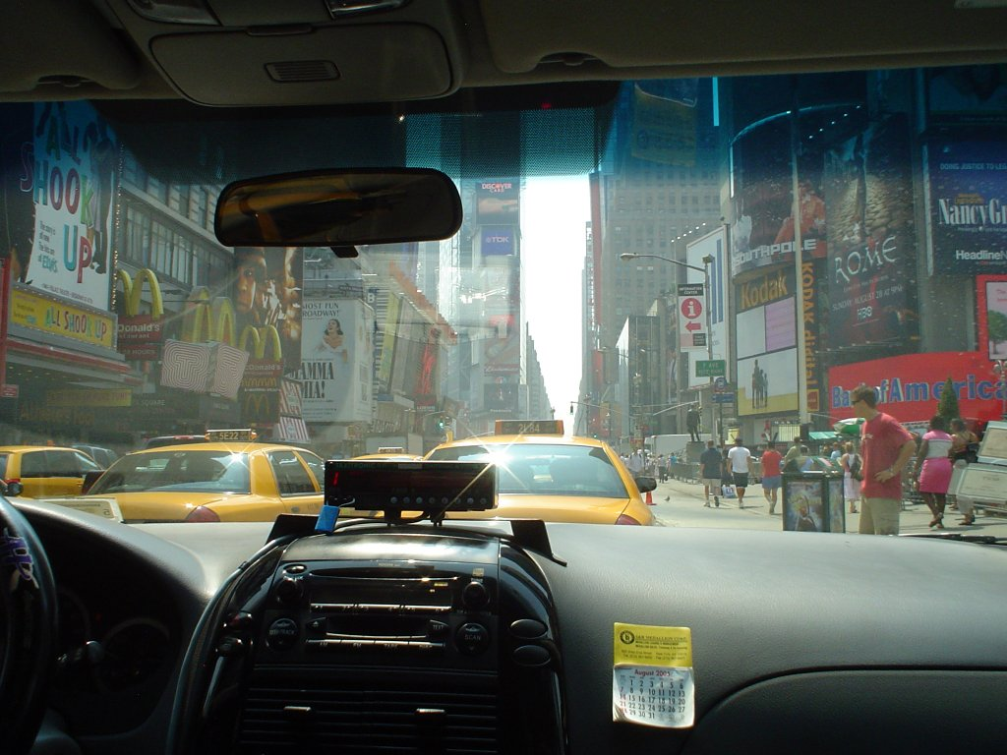
What is a?
Passearch
Jared Gabor

Slide 2
Passearch
Find Passengers!
Jared Gabor

Slide 3
> 1 Billion Taxi Rides
Pick-up & drop-off times
Locations
Fare information
Jared Gabor

Slide 4
Algorithms
Spatial clustering, density estimation
- to combine data from similar locations
Regression (w/ stochastic gradient descent)
- predict demand index at each location
- features:
- time of day, day of week, etc.
- weather
- special events (concerts, sports)
Jared Gabor

