Slide 1
Lecture 7: Parallel Patterns II

Slide 2

Overview
Segmented Scan
Sort
Mapreduce
Kernel Fusion

Slide 3
SEGMENTED SCAN

Slide 4
Segmented Scan
What it is:
  Scan + Barriers/Flags associated with certain positions in the input arrays
  Operations don’t propagate beyond barriers
Do many scans at once, no matter their size

Slide 5
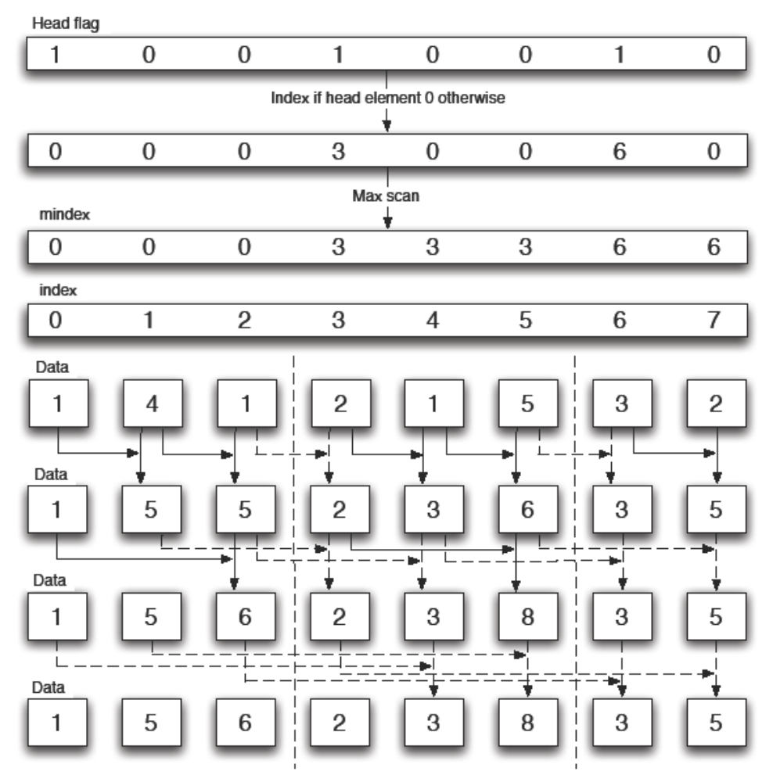
Image taken from “Efficient parallel scan algorithms for GPUs” by S. Sengupta, M. Harris, and M. Garland

Slide 6
Segmented Scan
__global__ void segscan(int * data, int * flags)
{
__shared__ int s_data[BL_SIZE];
__shared__ int s_flags[BL_SIZE];
int idx = threadIdx.x + blockDim.x * blockIdx.x;
// copy block of data into shared
// memory
s_data[idx] = …; s_flags[idx] = …;
__syncthreads();

Slide 7
Segmented Scan
…
// choose whether to propagate
s_data[idx] = s_flags[idx] ? s_data[idx] : s_data[idx - 1] + s_data[idx];
// create merged flag
s_flags[idx] =
s_flags[idx - 1] | s_flags[idx];
// repeat for different strides
}

Slide 8
Segmented Scan
Doing lots of reductions of unpredictable size at the same time is the most common use
Think of doing sums/max/count/any over arbitrary sub-domains of your data

Slide 9
Segmented Scan
Common Usage Scenarios:
  Determine which region/tree/group/object class an element belongs to and assign that as its new ID
  Sort based on that ID
  Operate on all of the regions/trees/groups/objects in parallel, no matter what their size or number

Slide 10
Segmented Scan
Also useful for implementing divide-and-conquer type algorithms
  Quicksort and similar algorithms

Slide 11
SORT

Slide 12
Sort
Useful for almost everything
Optimized versions for the GPU already exist
Sorted lists can be processed by segmented scan
Sort data to restore memory and execution coherence

Slide 13
Sort
binning and sorting can often be used interchangeably
Sort is standard, but can be suboptimal
Binning is usually custom, has to be optimized, can be faster

Slide 14
Sort
Radixsort is faster than comparison-based sorts
If you can generate a fixed-size key for the attribute you want to sort on, you get better performance

Slide 15
MAPREDUCE

Slide 16
Mapreduce
Old concept from functional progamming
Repopularized by Google as parallel computing pattern
Combination of sort and reduction (scan)

Slide 17
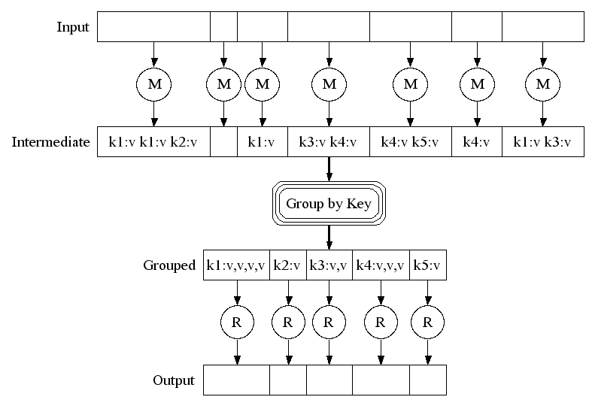
Mapreduce
Image taken from Jeff Dean’s presentation at http://labs.google.com/papers/mapreduce-osdi04-slides/index-auto-0007.html

Slide 18
Mapreduce: Map Phase
Map a function over a domain
Function is provided by the user
Function can be anything which produces a (key, value) pair
  Value can just be a pointer to arbitrary datastructure

Slide 19
Mapreduce: Sort Phase
All the (key,value) pairs are sorted based on their keys
Happens implicitly
Creates runs of (k,v) pairs with same key
User usually has no control over sort function

Slide 20
Mapreduce: Reduce Phase
Reduce function is provided by the user
  Can be simple plus, max,…
Library makes sure that values from one key don’t propagate to another (segscan)
Final result is a list of keys and final values (or arbitrary datastructures)

Slide 21
KERNEL FUSION

Slide 22
Kernel Fusion
Combine kernels with simple producer->consumer dataflow
Combine generic data movement kernel with specific operator function
Save memory bandwidth by not writing out intermediate results to global memory

Slide 23
Separate Kernels
__global__ void is_even(int * in, int * out)
{
int i = …
out[i] = ((in[i] % 2) == 0) ? 1: 0;
}
__global__ void scan(…)
{
…
}

Slide 24
Fused Kernel
__global__ void fused_even_scan(int * in, int * out, …)
{
int i = …
int flag = ((in[i] % 2) == 0) ? 1: 0;
// your scan code here, using the flag directly
}

Slide 25
Kernel Fusion
Best when the pattern looks like
Any simple one-to-one mapping will work
output[i] = g(f(input[i]));

Slide 26
Fused Kernel
template <class F>
__global__ void opt_stencil(float * in, float * out, F f)
{ // your 2D stencil code here
for(i,j)
{
partial = f(partial,in[…],i,j);
}
float result = partial;
}

Slide 27
Fused Kernel
class boxfilter
{ private:
table[3][3];
boxfilter(float input[3][3])
public:
float operator()(float a, float b, int i, int j)
{
return a + b*table[i][j];
}
}

Slide 28
Fused Kernel
class maxfilter
{ public:
float operator()(float a, float b, int i, int j)
{
return max(a,b);
}
}

Slide 29
Questions?

Slide 30
Backup Slides

Slide 31
Example Segmented Scan
int data[10] = {1, 1, 1, 1, 1, 1, 1, 1, 1, 1};
int flags[10] = {0, 0, 0, 1, 0, 1, 1, 0, 0, 0};
int step1[10] = {1, 2, 1, 1, 1, 1, 1, 2, 1, 2};
int flg1[10] = {0, 0, 0, 1, 0, 1, 1, 1, 0, 0};
int step2[10] = {1, 2, 1, 1, 1, 1, 1, 2, 1, 2};
int flg2[10] = {0, 0, 0, 1, 0, 1, 1, 1, 0, 0};
…

Slide 32
Example Segmented Scan
int step2[10] = {1, 2, 1, 1, 1, 1, 1, 2, 1, 2};
int flg2[10] = {0, 0, 0, 1, 0, 1, 1, 1, 0, 0};
…
int result[10] = {1, 2, 3, 1, 2, 1, 1, 2, 3, 4};

