Slide 1
Lecture 5: Performance Considerations

Slide 2

But First!
Always measure where your time is going!
  Even if you think you know where it is going
  Start coarse, go fine-grained as need be
Keep in mind Amdahl’s Law when optimizing any part of your code
  Don’t continue to optimize once a part is only a small fraction of overall execution time

Slide 3
Performance Considerations
Memory Coalescing
Shared Memory Bank Conflicts
Control-Flow Divergence
Occupancy
Kernel Launch Overheads

Slide 4
MEMORY COALESCING

Slide 5
Memory Coalescing
Off-chip memory is accessed in chunks
  Even if you read only a single word
  If you don’t use whole chunk, bandwidth is wasted
Chunks are aligned to multiples of 32/64/128 bytes
  Unaligned accesses will cost more

Slide 6
Threads 0-15 access 4-byte words at addresses 116-176
Thread 0 is lowest active, accesses address 116
128-byte segment: 0-127
t0
t1
t2
t3
t15
...
0
32
64
96
128
160
192
224
256
288
128B segment

Slide 7
Threads 0-15 access 4-byte words at addresses 116-176
Thread 0 is lowest active, accesses address 116
128-byte segment: 0-127 (reduce to 64B)
t0
t1
t2
t3
t15
...
0
32
64
96
128
160
192
224
256
288
64B segment

Slide 8
Threads 0-15 access 4-byte words at addresses 116-176
Thread 0 is lowest active, accesses address 116
128-byte segment: 0-127 (reduce to 32B)
t0
t1
t2
t3
t15
...
0
32
64
96
128
160
192
224
256
288
32B transaction

Slide 9
Threads 0-15 access 4-byte words at addresses 116-176
Thread 3 is lowest active, accesses address 128
128-byte segment: 128-255
t0
t1
t2
t3
t15
...
0
32
64
96
128
160
192
224
256
288
128B segment

Slide 10
Threads 0-15 access 4-byte words at addresses 116-176
Thread 3 is lowest active, accesses address 128
128-byte segment: 128-255 (reduce to 64B)
t0
t1
t2
t3
t15
...
0
32
64
96
128
160
192
224
256
288
64B transaction

Slide 11
Memory Coalescing
Think about the stride of your accesses
__global__ void foo(int* input, float3* input2)
{
int i = threadIdx.x + blockDim.x * blockIdx.x;
// Stride 1
int a = input[i];
// Stride 2, half the bandwidth is wasted
int b = input[2*i];
// Stride 3, 2/3 of the bandwidth wasted
float c = input2[i].x;
}

Slide 12
Example: Array of Structures (AoS)
struct hash_entry {
uint key;
uint value;
uint flag;
};
// cudaMalloc’ed an array of these
hash_entry * d_AoS_hash;

Slide 13
Example: Structure of Arrays (SoA)
struct SoA {
uint * keys;
uint * values;
uint * flags;
};
// cudaMalloc the individual arrays
SoA d_SoA_hash;

Slide 14
Example: SoA vs. AoS
__global__ void bar(hash_entry * AoS_hash, SoA SoA_hash)
{
int i = threadIdx.x + blockDim.x * blockIdx.x;
// array of structures, wastes bandwidth
uint key = AoS_hash[i].key;
// structure of arrays, efficient use of bandwidth
uint key_better = SoA_hash.keys[i];
}

Slide 15
Memory Coalescing
AoS is often better than SoA
  Very clear win on stride 1 access patterns
  Unpredictable access patterns are case-by-case

Slide 16
SHARED MEMORY BANK CONFLICTS

Slide 17
Shared Memory
Shared memory is banked
  Only matters for threads within a warp
  Full performance with some restrictions
  Threads can each access different banks
  Or can all access the same value
Consecutive words are in different banks
If two or more threads access the same bank but different value, get bank conflicts

Slide 18
Bank Addressing Examples
No Bank Conflicts
No Bank Conflicts
Thread 0
Bank 0
Thread 0
Bank 0
Thread 1
Bank 1
Thread 1
Bank 1
Thread 2
Bank 2
Thread 2
Bank 2
Thread 3
Bank 3
Thread 3
Bank 3
Thread 4
Bank 4
Thread 4
Bank 4
Thread 5
Bank 5
Thread 5
Bank 5
Thread 6
Bank 6
Thread 6
Bank 6
Thread 7
Bank 7
Thread 7
Bank 7
Thread 15
Bank 15
Thread 15
Bank 15

Slide 19
Bank Addressing Examples
2-way Bank Conflicts
8-way Bank Conflicts
Thread 0
Bank 0
Thread 0
x8
Bank 0
Thread 1
Bank 1
Thread 1
Bank 1
Thread 2
Bank 2
Thread 2
Bank 2
Thread 3
Bank 3
Thread 3
Thread 4
Bank 4
Thread 4
Bank 5
Thread 5
Bank 7
Bank 6
Thread 6
Bank 8
Bank 7
Thread 7
Bank 9
Thread 8
x8
Thread 9
Thread 10
Thread 11
Bank 15
Thread 15
Bank 15

Slide 20
Trick to Assess Impact On Performance
Change all SMEM reads to the same value
  All broadcasts = no conflicts
  Will show how much performance could be improved by eliminating bank conflicts
The same doesn’t work for SMEM writes
  So, replace SMEM array indices with threadIdx.x
  Can also be done to the reads

Slide 21
Additional “memories”
Texture and constant
Read-only
Data resides in global memory
Different read path:
  includes specialized caches

Slide 22
Constant Memory
Data stored in global memory, read through a constant-cache path
  __constant__ qualifier in declarations
  Can only be read by GPU kernels
  Limited to 64KB
To be used when all threads in a warp read the same address
  Serializes otherwise
Throughput:
  32 bits per warp per clock per multiprocessor

Slide 23
CONTROL FLOW DIVERGENCE

Slide 24
Control Flow
Instructions are issued per 32 threads (warp)
Divergent branches:
  Threads within a single warp take different paths
    if-else, ...
  Different execution paths within a warp are serialized
Different warps can execute different code with no impact on performance

Slide 25
Control Flow
Avoid diverging within a warp
  Example with divergence:
    if (threadIdx.x > 2) {...} else {...}
    Branch granularity < warp size
  Example without divergence:
    if (threadIdx.x / WARP_SIZE > 2) {...} else {...}
    Branch granularity is a whole multiple of warp size

Slide 26
Example: Diverging Loop Iteration Counts
__global__ void per_thread_sum(int * indices, int * edges, float * nodes, float * sums)
{
…
// number of loop iterations is data
// dependent
for(int j=indices[i];j<indices[i+1]; j++)
{
sum += nodes[edges[j]];
}
sums[i] = sum;
}

Slide 27
Loop Count Divergence
A single thread can drag a whole warp with it for a long time
Know your data patterns
If data is unpredictable, try to flatten peaks by letting threads work on multiple data items

Slide 28
OCCUPANCY

Slide 29
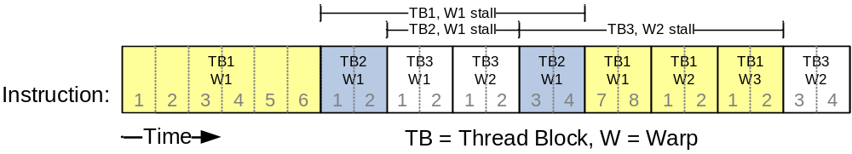
Reminder: Thread Scheduling
SM implements zero-overhead warp scheduling
  At any time, only one of the warps is executed by SM *
  Warps whose next instruction has its inputs ready for consumption are eligible for execution
  Eligible Warps are selected for execution on a prioritized scheduling policy
  All threads in a warp execute the same instruction when selected

Slide 30
Thread Scheduling
What happens if all warps are stalled?
  No instruction issued -> performance lost
Most common reason for stalling?
  Waiting on global memory
If your code reads global memory every couple of instructions
  You should try to maximize occupancy

Slide 31

What determines occupancy?
Register usage per thread & shared memory per threadblock

Slide 32
Resource Limits (1)
Registers
Shared Memory
Registers
Shared Memory
TB 2
TB 1
TB 1
TB 1
TB 0
TB 0
TB 2
TB 1
TB 0
TB 0
Pool of registers and shared memory per SM
  Each threadblock grabs registers & shared memory
  If one or the other is fully utilized -> no more threadblocks

Slide 33
Resource Limits (2)
Can only have 8 threadblocks per SM
  If they’re too small, can’t fill up the SM
  Need 128 threads / TB (gt200), 192 thread/ TB (gf100)
Higher occupancy has diminishing returns for hiding latency

Slide 34
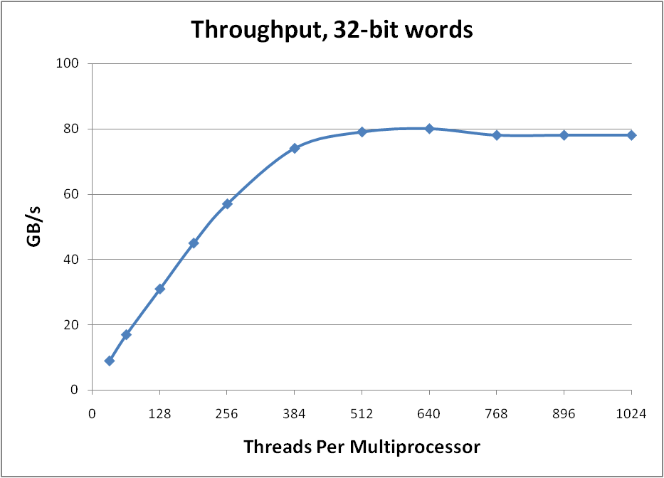

Hiding Latency with more threads

Slide 35
How do you know what you’re using?
Use nvcc -Xptxas –v to get register and shared memory numbers
Plug those numbers into Cuda Occupancy Calculator

Slide 36
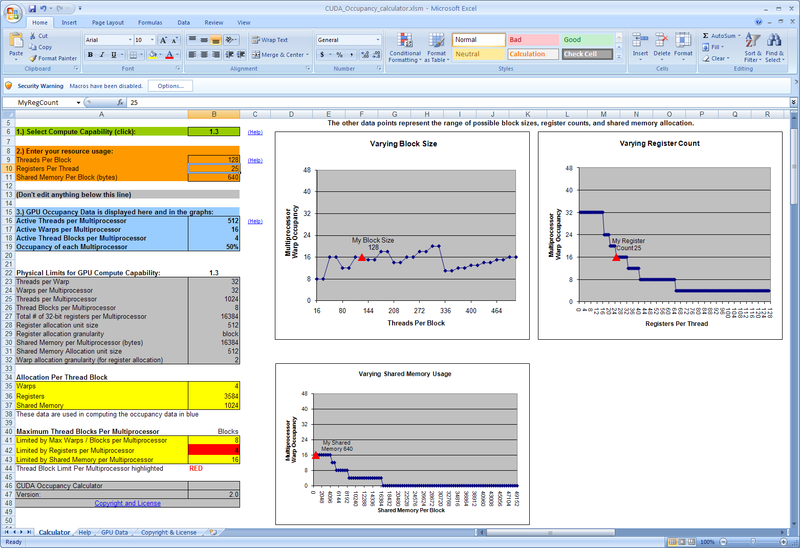

Slide 37
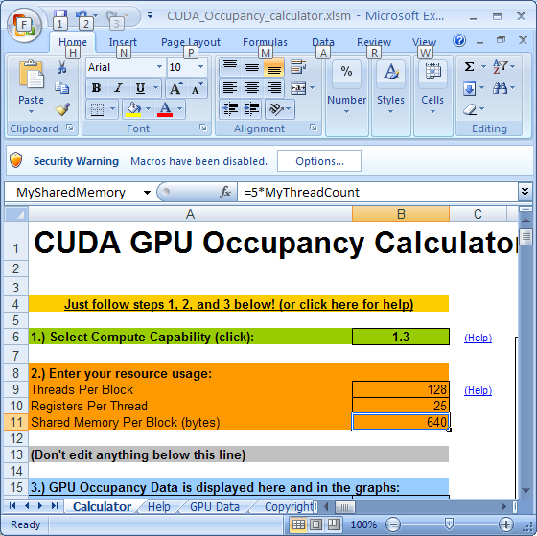

Slide 38
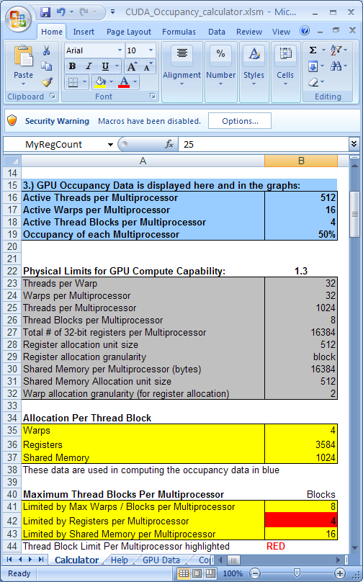

Slide 39
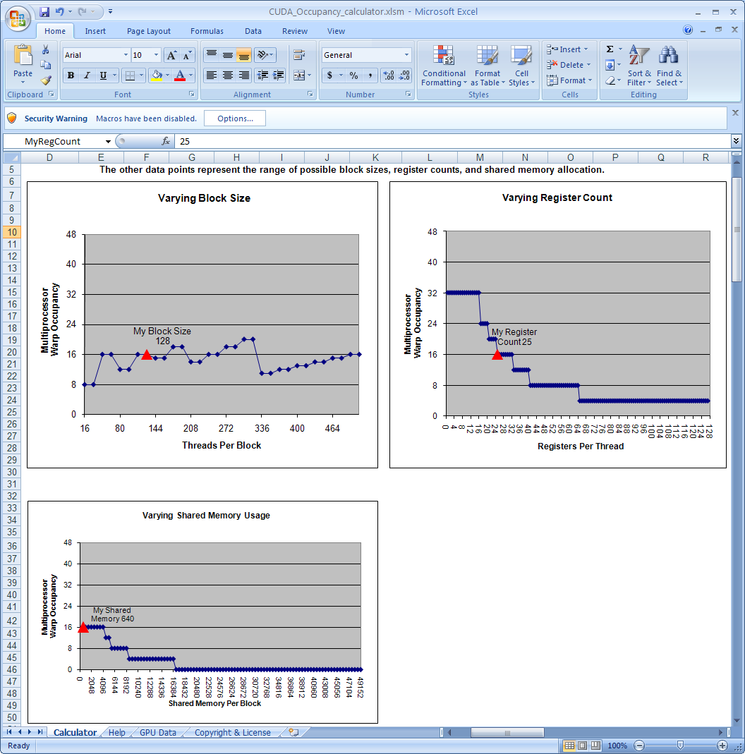

Slide 40
How to influence how many registers you use
Pass option –maxrregcount=X to nvcc
This isn’t magic, won’t get occupancy for free
Use this very carefully when you are right on the edge

Slide 41
KERNEL LAUNCH OVERHEADS

Slide 42
Kernel Launch Overheads
Kernel launches aren’t free
  A null kernel launch will take non-trivial time
  Actual number changes with HW generations and driver software, so I can’t give you one number
Independent kernel launches are cheaper than dependent kernel launches
  Dependent launch: Some readback to the cpu
If you are launching lots of small grids you will loose substantial performance to this effect

Slide 43
Kernel Launch Overheads
If you are reading back data to the cpu for control decisions, consider doing it on the GPU
Even though the GPU is slow at serial tasks, can do surprising amounts of work before you used up kernel launch overhead

Slide 44
Performance Considerations
Measure, measure, then measure some more!
Once you identified the bottlenecks, apply judicious tuning
  What is most important depends on your program
  You’ll often have a series of bottlenecks, where each optimization gives a smaller boost than expected

Slide 45
Questions?

Slide 46
Backup

Slide 47
Shared Memory
Uses:
  Inter-thread communication within a block
  Cache data to reduce global memory accesses
  Use it to avoid non-coalesced access
Organization:
  16 banks, 32-bit wide banks (Tesla)
  32 banks, 32-bit wide banks (Fermi)
  Successive 32-bit words belong to different banks
Performance:
  32 bits per bank per 2 clocks per multiprocessor
  smem accesses are per 16-threads (half-warp)
  serialization: if n threads (out of 16) access the same bank, n accesses are executed serially
  broadcast: n threads access the same word in one fetch

Slide 48
Example: Averaging Peaks
__global__ void per_thread_sum(…)
{
while(!done)
{
for(int j=indices[i];
j<min(indices[i+1],indices[i]+MAX_ITER); j++)
{…}
}
}

