Slide 1

CS 193G
Lecture 5: Parallel Patterns I

Slide 2

Getting out of the trenches
So far, we’ve concerned ourselves with low-level details of kernel programming
  Allocation of threads to data
  Launch grid configuration
  __shared__ memory management
Lots of moving parts

Slide 3
CUDA Madlibs
__global__ void foo(void)
{
extern __shared__ smem[];
int i = ???
// now what???
}
...
int B = ???
int N = ???
int S = ???
foo<<<B,N,S>>>();

Slide 4
Primordial CUDA Pattern: Blocking
Partition data to operate in well-sized blocks
  Small enough to be staged in shared memory
  Assign each data partition to a thread block
  No different from cache blocking!
Provides several performance benefits
  Have enough blocks to keep processors busy
  Working in shared memory cuts memory latency dramatically
  Likely to have coherent access patterns on load/store to shared memory

Slide 5
Primordial CUDA Pattern: Blocking
All CUDA kernels are built this way
  Blocking may not matter for a particular problem, but you’re still forced to think about it
  Not all kernels require __shared__ memory
  All kernels do require registers
All of the parallel patterns we’ll discuss have CUDA implementations that exploit blocking in some fashion

Slide 6
Common Parallel Computing Scenarios
Many parallel threads need to generate a single result
→ Reduce
Many parallel threads need to partition data
→ Split
Many parallel threads produce variable output / thread
→ Compact / Expand

Slide 7
Reduction
Reduce vector to a single value
  Via an associative operator (+, *, min/max, AND/OR, …)
  CPU: sequential implementation
    for(int i = 0, i < n, ++i) ...
  GPU: tree-based implementation
3
1
7
0
4
1
6
3
4
7
5
9
11
14
25
Notes:
Common in traditional GPGPU
Ping-pong between render targets, reduce by 1/2 at a time
Completely bandwidth bound using graphics API
All memory writes/reads off-chip, no reuse of intermediate sums
CUDA solves this by exposing on-chip shared memory
Reduce blocks of data in shared memory to save bandwidth

Slide 8
Serial Reduction
// reduction via serial iteration
float sum(float *data, int n)
{
float result = 0;
for(int i = 0; i < n; ++i)
{
result += data[i];
}
return result;
}

Slide 9
Parallel Reduction – Interleaved
Values (in shared memory)
10
1
8
-1
0
-2
3
5
-2
-3
2
7
0
11
0
2
Step 1 Stride 1
Thread IDs
0
1
2
3
4
5
6
7
Values
11
1
7
-1
-2
-2
8
5
-5
-3
9
7
11
11
2
2
Step 2 Stride 2
Thread IDs
0
1
2
3
Values
18
1
7
-1
6
-2
8
5
4
-3
9
7
13
11
2
2
Step 3 Stride 4
Thread IDs
0
1
Values
24
1
7
-1
6
-2
8
5
17
-3
9
7
13
11
2
2
Step 4 Stride 8
Thread IDs
0
Values
41
1
7
-1
6
-2
8
5
17
-3
9
7
13
11
2
2

Slide 10
Parallel Reduction – Sequential
Values (in shared memory)
10
1
8
-1
0
-2
3
5
-2
-3
2
7
0
11
0
2
Step 1 Stride 8
Thread IDs
0
1
2
3
4
5
6
7
Values
8
-2
10
6
0
9
3
7
-2
-3
2
7
0
11
0
2
Step 2 Stride 4
Thread IDs
0
1
2
3
Values
8
7
13
13
0
9
3
7
-2
-3
2
7
0
11
0
2
Step 3 Stride 2
Thread IDs
0
1
Values
21
20
13
13
0
9
3
7
-2
-3
2
7
0
11
0
2
Step 4 Stride 1
Thread IDs
0
Values
41
20
13
13
0
9
3
7
-2
-3
2
7
0
11
0
2

Slide 11
Parallel Reduction Complexity
Log(N) parallel steps, each step S does N/2^{S} independent ops
  Step Complexity is O(log N)
For N=2^{D}, performs ∑_{S∈[1..D]}2^{D-S} = N-1 operations
  Work Complexity is O(N) – It is work-efficient
  i.e. does not perform more operations than a sequential algorithm
With P threads physically in parallel (P processors),
time complexity is O(N/P + log N)
  Compare to O(N) for sequential reduction

Slide 12
Split Operation
Given:array of true and false elements (and payloads)
Return an array with all true elements at the beginning
Examples: sorting, building trees
Flag
T
F
F
T
F
F
T
F
Payload
3
1
7
0
4
1
6
3
T
T
T
F
F
F
F
F
3
0
6
1
7
4
1
3

Slide 13
Variable Output Per Thread: Compact
Remove null elements
Example: collision detection
3
0
7
0
4
1
0
3
3
7
4
1
3

Slide 14
Variable Output Per Thread:
General Case
Reserve Variable Storage Per Thread
Example: binning
2
1
0
3
2
A
C
D
G
B
E
H
F

Slide 15
Split, Compact, Expand
Each thread must answer a simple question:
“Where do I write my output?”
The answer depends on what other threads write!
Scan provides an efficient parallel answer

Slide 16
Scan (a.k.a. Parallel Prefix Sum)
Given an array A = [a₀, a₁, …, a_{n-1}]
and a binary associative operator ⊕ with identity I,
scan(A) = [I, a₀, (a₀ ⊕ a₁), …, (a₀ ⊕ a₁ ⊕ … ⊕ a_{n-2})]
Prefix sum: if ⊕ is addition, then scan on the set
returns the set
3 | 1 | 7 | 0 | 4 | 1 | 6 | 3
0 | 3 | 4 | 11 | 11 | 15 | 16 | 22

Slide 17
Applications of Scan
Scan is a simple and useful parallel building block for many parallel algorithms:
Fascinating, since scan is unnecessary in sequential computing!
Radix sort
Quicksort (seg. scan)
String comparison
Lexical analysis
Stream compaction
Run-length encoding
Polynomial evaluation
Solving recurrences
Tree operations
Histograms
Allocation
Etc.

Slide 18
A Scan Algorithm – Preview
3 | 1 | 7 | 0 | 4 | 1 | 6 | 3
Assume array is already in shared memory
See Harris, M., S. Sengupta, and J.D. Owens. “Parallel Prefix Sum (Scan) in CUDA”, GPU Gems 3

Slide 19
A Scan Algorithm – Preview
3 | 1 | 7 | 0 | 4 | 1 | 6 | 3
Iteration 1, n/2 threads
3 | 4 | 7 | 7 | 4 | 5 | 6 | 9
Each corresponds to a single thread.
Iterate log(n) times. Each thread adds value stride elements away to its own value

Slide 20
A Scan Algorithm – Preview
3 | 1 | 7 | 0 | 4 | 1 | 6 | 3
3 | 4 | 7 | 7 | 4 | 5 | 6 | 9
Iteration 2, n/4 threads
3 | 4 | 7 | 11 | 4 | 5 | 6 | 14
Each corresponds to a single thread.
Iterate log(n) times. Each thread adds value stride elements away to its own value

Slide 21
A Scan Algorithm – Preview
3 | 1 | 7 | 0 | 4 | 1 | 6 | 3
3 | 4 | 7 | 7 | 4 | 5 | 6 | 9
3 | 4 | 7 | 11 | 4 | 5 | 6 | 14
Iteration log(n), 1 thread
3 | 4 | 7 | 11 | 4 | 5 | 6 | 25
Each corresponds to a single thread.
Iterate log(n) times. Each thread adds value stride elements away to its own value.
Note that this algorithm operates in-place: no need for double buffering

Slide 22
A Scan Algorithm – Preview
3 | 4 | 7 | 11 | 4 | 5 | 6 | 0
We now have an array of partial sums. Since this is an exclusive scan,
set the last element to zero. It will propagate back to the first element.

Slide 23
A Scan Algorithm – Preview
3 | 4 | 7 | 11 | 4 | 5 | 6 | 0
Iteration 1
1 thread
3 | 4 | 7 | 0 | 4 | 5 | 6 | 11
Each corresponds to a single thread.
Iterate log(n) times. Each thread adds value stride elements away to its own value,
and sets the value stride elements away to its own previous value.

Slide 24
A Scan Algorithm – Preview
3 | 4 | 7 | 11 | 4 | 5 | 6 | 0
3 | 4 | 7 | 0 | 4 | 5 | 6 | 11
Iteration 2
2 threads
3 | 0 | 7 | 4 | 4 | 11 | 6 | 16
Each corresponds to a single thread.
Iterate log(n) times. Each thread adds value stride elements away to its own value,
and sets the value stride elements away to its own previous value.

Slide 25
A Scan Algorithm – Preview
3 | 4 | 7 | 11 | 4 | 5 | 6 | 0
3 | 4 | 7 | 0 | 4 | 5 | 6 | 11
3 | 0 | 7 | 4 | 4 | 11 | 6 | 16
Iteration log(n)
n/2 threads
0 | 3 | 4 | 11 | 11 | 15 | 16 | 22
Done! We now have a completed scan that we can write out to device memory.
Total steps: 2 * log(n).
Total work: 2 * (n-1) adds = O(n) Work Efficient!

Slide 26
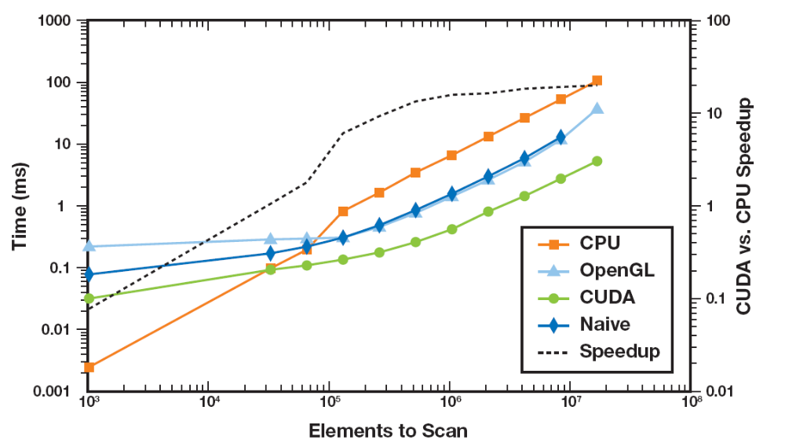
CUDA Scan Performance
GeForce 8800 GTX, Intel Core2 Duo Extreme 2.93 GHz
GPU vs. CPU 20x CUDA vs. OpenGL 7x

