Slide 1
Lecture 3: CUDA Threads & Atomics

Slide 2
ATOMICS

Slide 3

The Problem
How do you do global communication?
Finish a grid and start a new one

Slide 4
Global Communication
Finish a kernel and start a new one
All writes from all threads complete before a kernel finishes
step1<<<grid1,blk1>>>(...);
// The system ensures that all // writes from step1 complete.
step2<<<grid2,blk2>>>(...);

Slide 5

Global Communication
Would need to decompose kernels into before and after parts

Slide 6
Race Conditions
Or, write to a predefined memory location
  Race condition! Updates can be lost

Slide 7
Race Conditions
threadId:0 threadId:1917
// vector[0] was equal to 0
vector[0] += 5; vector[0] += 1;
... ...
a = vector[0]; a = vector[0];
What is the value of a in thread 0?
What is the value of a in thread 1917?

Slide 8
Race Conditions
Thread 0 could have finished execution before 1917 started
Or the other way around
Or both are executing at the same time

Slide 9
Race Conditions
Answer: not defined by the programming model, can be arbitrary

Slide 10
Atomics
CUDA provides atomic operations to deal with this problem

Slide 11
Atomics
An atomic operation guarantees that only a single thread has access to a piece of memory while an operation completes
The name atomic comes from the fact that it is uninterruptable
No dropped data, but ordering is still arbitrary
Different types of atomic instructions
atomic{Add, Sub, Exch, Min, Max, Inc, Dec, CAS, And, Or, Xor}
More types in fermi

Slide 12
Example: Histogram
// Determine frequency of colors in a picture
// colors have already been converted into ints
// Each thread looks at one pixel and increments
// a counter atomically
__global__ void histogram(int* color,
int* buckets)
{
int i = threadIdx.x
+ blockDim.x * blockIdx.x;
int c = colors[i];
atomicAdd(&buckets[c], 1);
}

Slide 13
Example: Workqueue
// For algorithms where the amount of work per item
// is highly non-uniform, it often makes sense for
// to continuously grab work from a queue
__global__
void workq(int* work_q, int* q_counter,
int* output, int queue_max)
{
int i = threadIdx.x
+ blockDim.x * blockIdx.x;
int q_index =
atomicInc(q_counter, queue_max);
int result = do_work(work_q[q_index]);
output[i] = result;
}

Slide 14
Atomics
Atomics are slower than normal load/store
You can have the whole machine queuing on a single location in memory
Atomics unavailable on G80!

Slide 15
Example: Global Min/Max (Naive)
// If you require the maximum across all threads
// in a grid, you could do it with a single global
// maximum value, but it will be VERY slow
__global__
void global_max(int* values, int* gl_max)
{
int i = threadIdx.x
+ blockDim.x * blockIdx.x;
int val = values[i];
atomicMax(gl_max,val);
}

Slide 16
Example: Global Min/Max (Better)
// introduce intermediate maximum results, so that
// most threads do not try to update the global max
__global__
void global_max(int* values, int* max,
int *regional_maxes,
int num_regions)
{
// i and val as before …
int region = i % num_regions;
if(atomicMax(&reg_max[region],val) < val)
{
atomicMax(max,val);
}
}

Slide 17
Global Min/Max
Single value causes serial bottleneck
Create hierarchy of values for more parallelism
Performance will still be slow, so use judiciously
See next lecture for even better version!

Slide 18
Summary
Can’t use normal load/store for inter-thread communication because of race conditions
Use atomic instructions for sparse and/or unpredictable global communication
  See next lectures for shared memory and scan for other communication patterns
Decompose data (very limited use of single global sum/max/min/etc.) for more parallelism

Slide 19

Questions?

Slide 20
SM EXECUTION & DIVERGENCE

Slide 21
How an SM executes threads
Overview of how a Stream Multiprocessor works
SIMT Execution
Divergence

Slide 22
Scheduling Blocks onto SMs
Streaming Multiprocessor
Thread Block 5
Thread Block 27
Thread Block 61
Thread Block 2001
HW Schedules thread blocks onto available SMs
  No guarantee of ordering among thread blocks
  HW will schedule thread blocks as soon as a previous thread block finishes

Slide 23
Warps
Control
Control
Control
Control
Control
Control
ALU
ALU
ALU
ALU
ALU
ALU
Control
ALU
ALU
ALU
ALU
ALU
ALU
A warp = 32 threads launched together
  Usually, execute together as well

Slide 24
Mapping of Thread Blocks
Each thread block is mapped to one or more warps
The hardware schedules each warp independently
Thread Block N (128 threads)
TB N W1
TB N W2
TB N W3
TB N W4

Slide 25
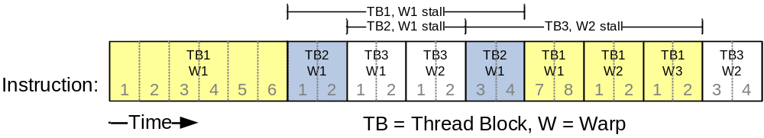
Thread Scheduling Example
SM implements zero-overhead warp scheduling
  At any time, only one of the warps is executed by SM *
  Warps whose next instruction has its inputs ready for consumption are eligible for execution
  Eligible Warps are selected for execution on a prioritized scheduling policy
  All threads in a warp execute the same instruction when selected

Slide 26
Control Flow Divergence
What happens if you have the following code?
if(foo(threadIdx.x))
{
do_A();
}
else
{
do_B();
}

Slide 27
Control Flow Divergence
Branch
Branch
Path A
Path A
Path B
Path B
From Fung et al. MICRO ‘07

Slide 28
Control Flow Divergence
Nested branches are handled as well
if(foo(threadIdx.x))
{
if(bar(threadIdx.x))
do_A();
else
do_B();
}
else
do_C();

Slide 29
Control Flow Divergence
Branch
Branch
Branch
Path A
Path B
Path C

Slide 30
Control Flow Divergence
You don’t have to worry about divergence for correctness (*)
You might have to think about it for performance
  Depends on your branch conditions
Notes:
* Mostly true, except corner cases (for example intra-warp locks)

Slide 31
Control Flow Divergence
Performance drops off with the degree of divergence
switch(threadIdx.x % N)
{
case 0:
...
case 1:
...
}

Slide 32
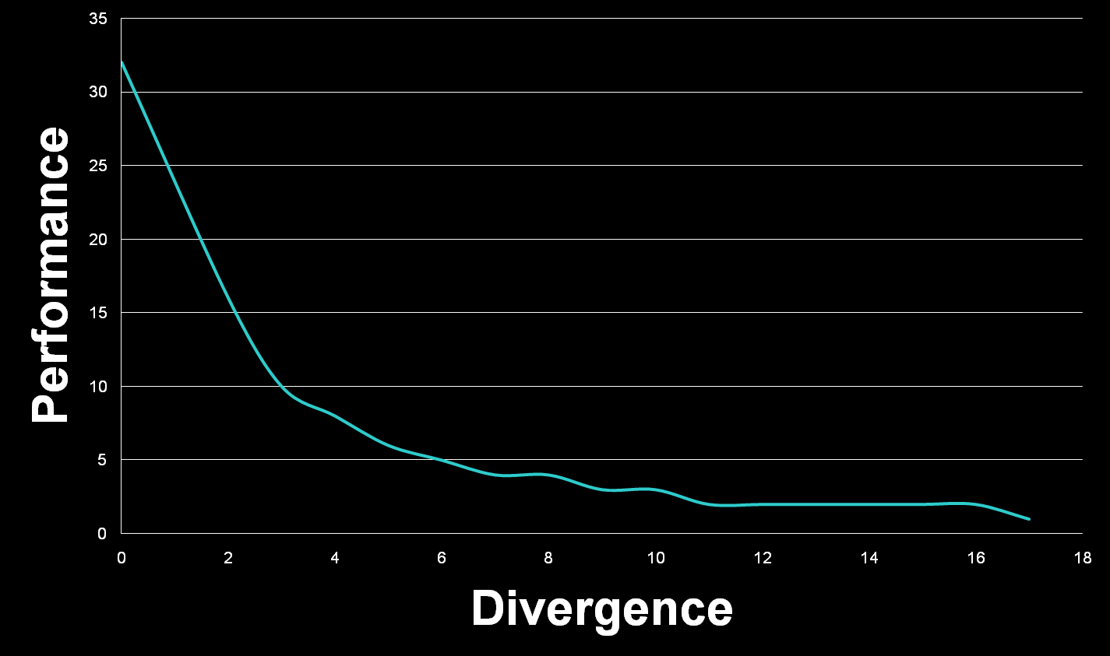
Divergence

Slide 33
Atomics
atomicAdd returns the previous value at a certain address
Useful for grabbing variable amounts of data from a list

Slide 34
Questions?

Slide 35
Backup

Slide 36
Compare and Swap
int compare_and_swap(int* register,
int oldval, int newval)
{
int old_reg_val = *register;
if(old_reg_val == oldval)
*register = newval;
return old_reg_val;
}

Slide 37
Compare and Swap
Most general type of atomic
Can emulate all others with CAS

Slide 38
Locks
Use very judiciously
Always include a max_iter in your spinloop!
Decompose your data and your locks

