Slide 1
Sparse Matrix-Vector Multiplication on Throughput-Oriented Processors
Nathan Bell and Michael Garland

Slide 2

Overview
GPUs deliver high SpMV performance
  10+ GFLOP/s on unstructured matrices
  140+ GByte/s memory bandwidth
No one-size-fits-all approach
  Match method to matrix structure
Exploit structure when possible
  Fast methods for regular portion
  Robust methods for irregular portion

Slide 3
Characteristics of SpMV
Memory bound
  FLOP : Byte ratio is very low
Generally irregular & unstructured
  Unlike dense matrix operations (BLAS)
Notes:
Computational intensity is low because we read in a lot of data per FLOP (2 FLOPs per NZ)

Slide 4
Solving Sparse Linear Systems
Iterative methods
  CG, GMRES, BiCGstab, etc.
  Require 100s or 1000s of SpMV operations
Notes:
Represents dominant cost in iterative solvers

Slide 5
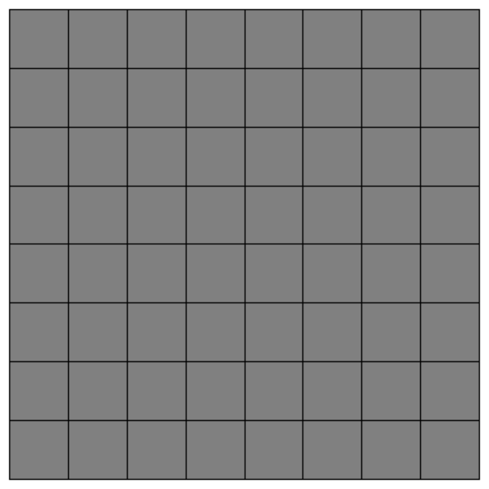
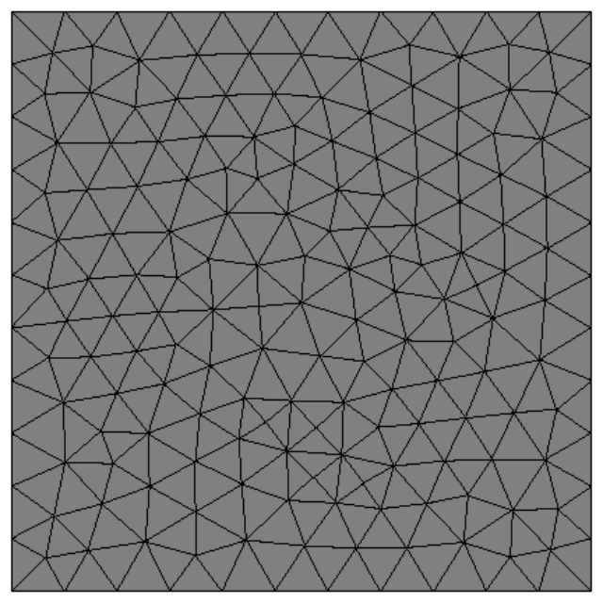
Finite-Element Methods
Discretized on structured or unstructured meshes
  Determines matrix sparsity structure

Slide 6
Objectives
Expose sufficient parallelism
  Develop 1000s of independent threads
Minimize execution path divergence
  SIMD utilization
Minimize memory access divergence
  Memory coalescing

Slide 7
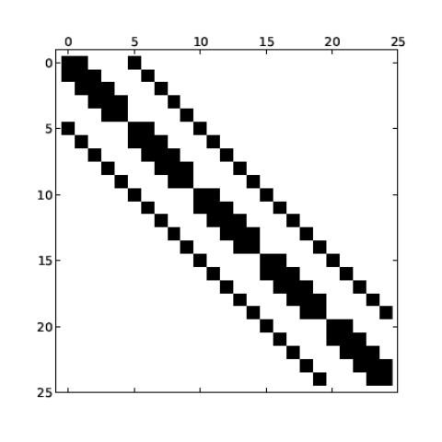
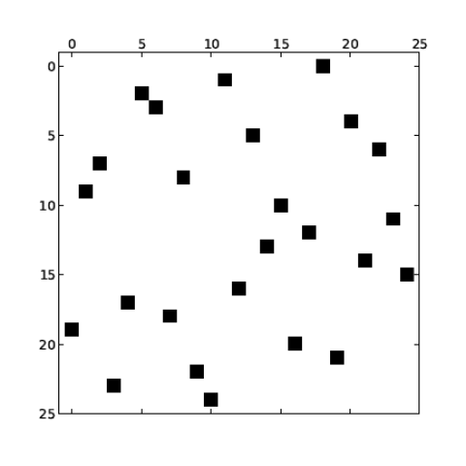
Sparse Matrix Formats
(CSR) Compressed Row
(ELL) ELLPACK
(COO) Coordinate
(DIA) Diagonal
(HYB) Hybrid
Structured Unstructured
Notes:
No one-size-fits-all solution
Different formats tailored to different sparsity structures
DIA and ELL are ideal vector formats, but impose rigid containts on structure
In contrast CSR and COO accomodate unstructured matrices, but at the cost of irregularity in matrix format
HYB is a hybrid of the ELL and COO that splits the matrix into structured and unstructured portions

Slide 8
Compressed Sparse Row (CSR)
Rows laid out in sequence
Inconvenient for fine-grained parallelism
Notes:
Even CPU SIMD doesn’t map well to CSR unless you have blocks
Introduce CSR (scalar) and CSR (vector), CSR (block) doesn’t work because 32-thread blocks don’t fill the machine

Slide 9
CSR (scalar) kernel
One thread per row
  Poor memory coalescing
  Unaligned memory access
Thread 1
Thread 2
Thread 0
Thread 3
Thread 4
…
…
…
…

Slide 10
CSR (vector) kernel
One SIMD vector or warp per row
  Partial memory coalescing
  Unaligned memory access
Warp 0
Warp 1
Warp 2
Warp 3
Warp 4

Slide 11
ELLPACK (ELL)
Storage for K nonzeros per row
  Pad rows with fewer than K nonzeros
  Inefficient when row length varies

Slide 12
Hybrid Format
ELL handles typical entries
COO handles exceptional entries
  Implemented with segmented reduction
Notes:
The threshold K represents the typical number of nonzeros per row
In many cases, such as FEM matrices, ELL stores 90% or more of the matrix entries
COO uses segmented reduction

Slide 13
Exposing Parallelism
DIA, ELL & CSR (scalar)
  One thread per row
CSR (vector)
  One warp per row
COO
  One thread per nonzero
Finer Granularity

Slide 14
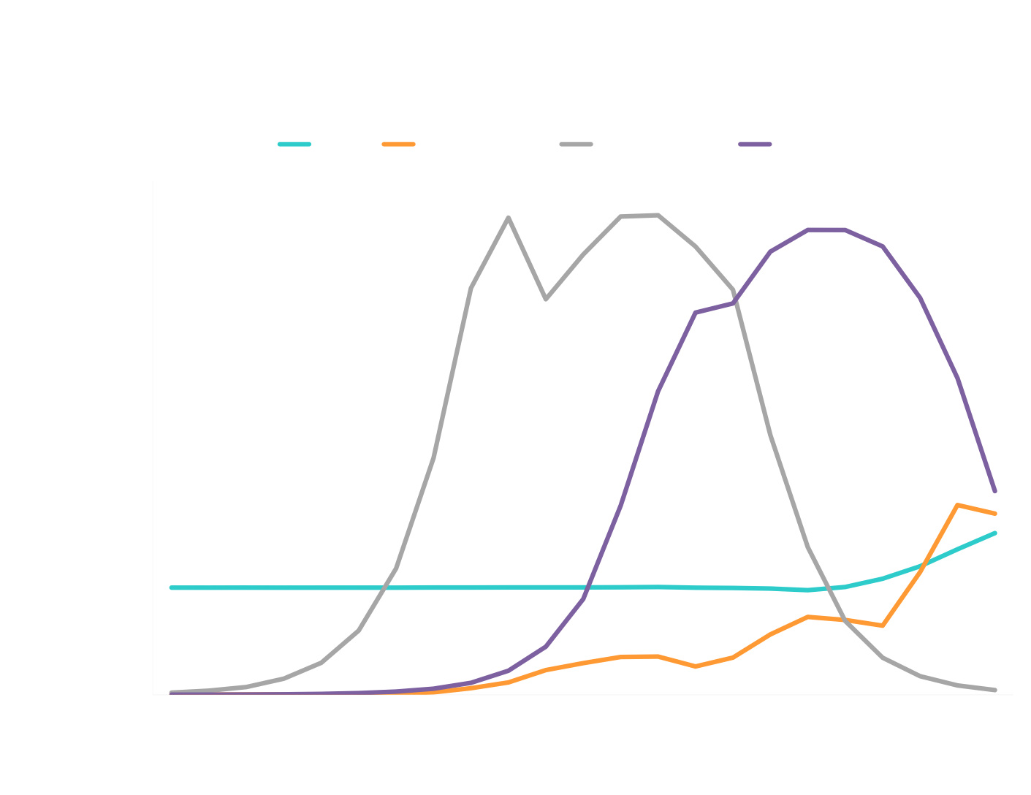
Exposing Parallelism
Notes:
SpMV performance for matrices with 4M nonzeros and various shapes (rows * columns = 4M)
We chose HYB splitting strategy to ensure that HYB = max(ELL, COO) on this chart
Even if your matrix is stored perfectly in ELL, if rows not > 20K then insufficient parallelism

Slide 15
Execution Divergence
Variable row lengths can be problematic
  Idle threads in CSR (scalar)
  Idle processors in CSR (vector)
Robust strategies exist
  COO is insensitive to row length
Notes:
We

Slide 16
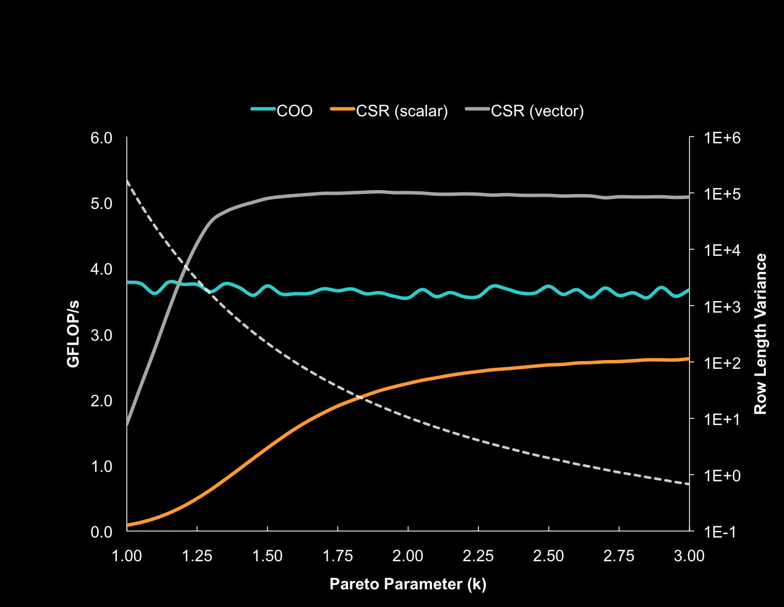
Execution Divergence

Slide 17
Memory Access Divergence
Uncoalesced memory access is very costly
  Sometimes mitigated by cache
Misaligned access is suboptimal
  Align matrix format to coalescing boundary
Access to matrix representation
  DIA, ELL and COO are fully coalesced
  CSR (vector) is partially coalesced
  CSR (scalar) is seldom coalesced

Slide 18
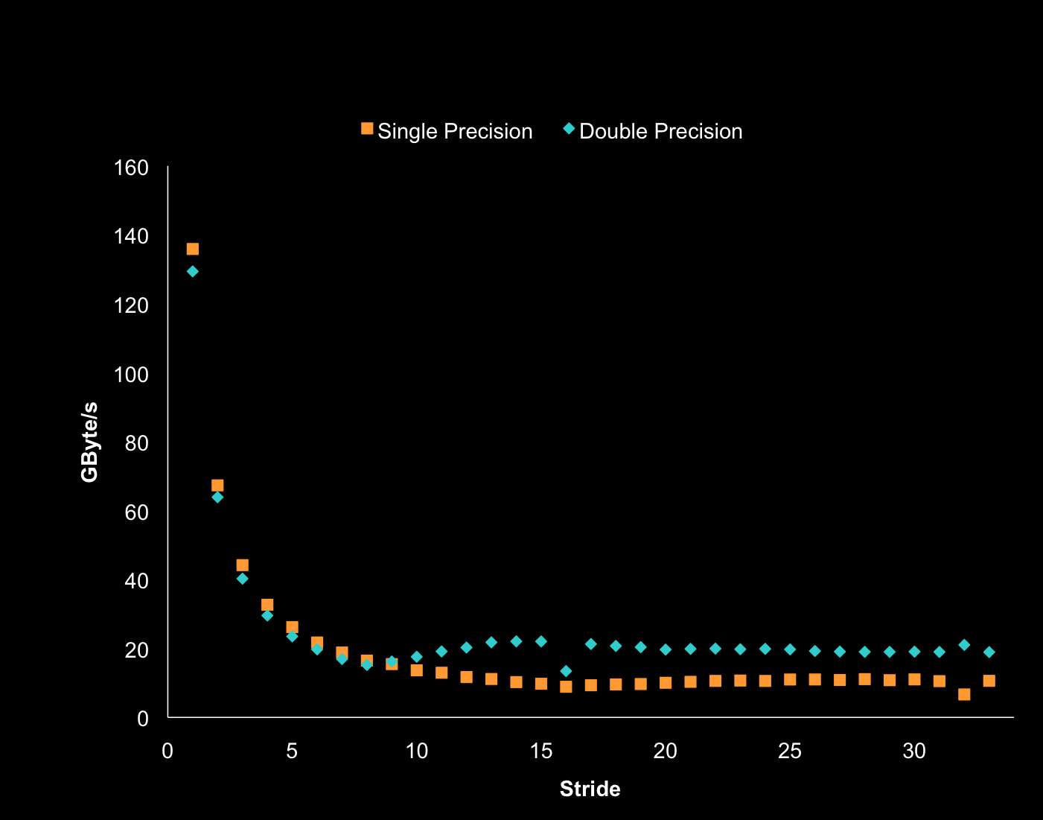
Memory Bandwidth (AXPY)
Notes:
As long as we obey the memory coalescing rules we observe high bandwidth utilization/near-peak performance

Slide 19
Performance Results
GeForce GTX 285
  Peak Memory Bandwidth: 159 GByte/s
  All results in double precision
  Source vector accessed through texture cache
Structured Matrices
  Common stencils on regular grids
Unstructured Matrices
  Wide variety of applications and sparsity patterns

Slide 20
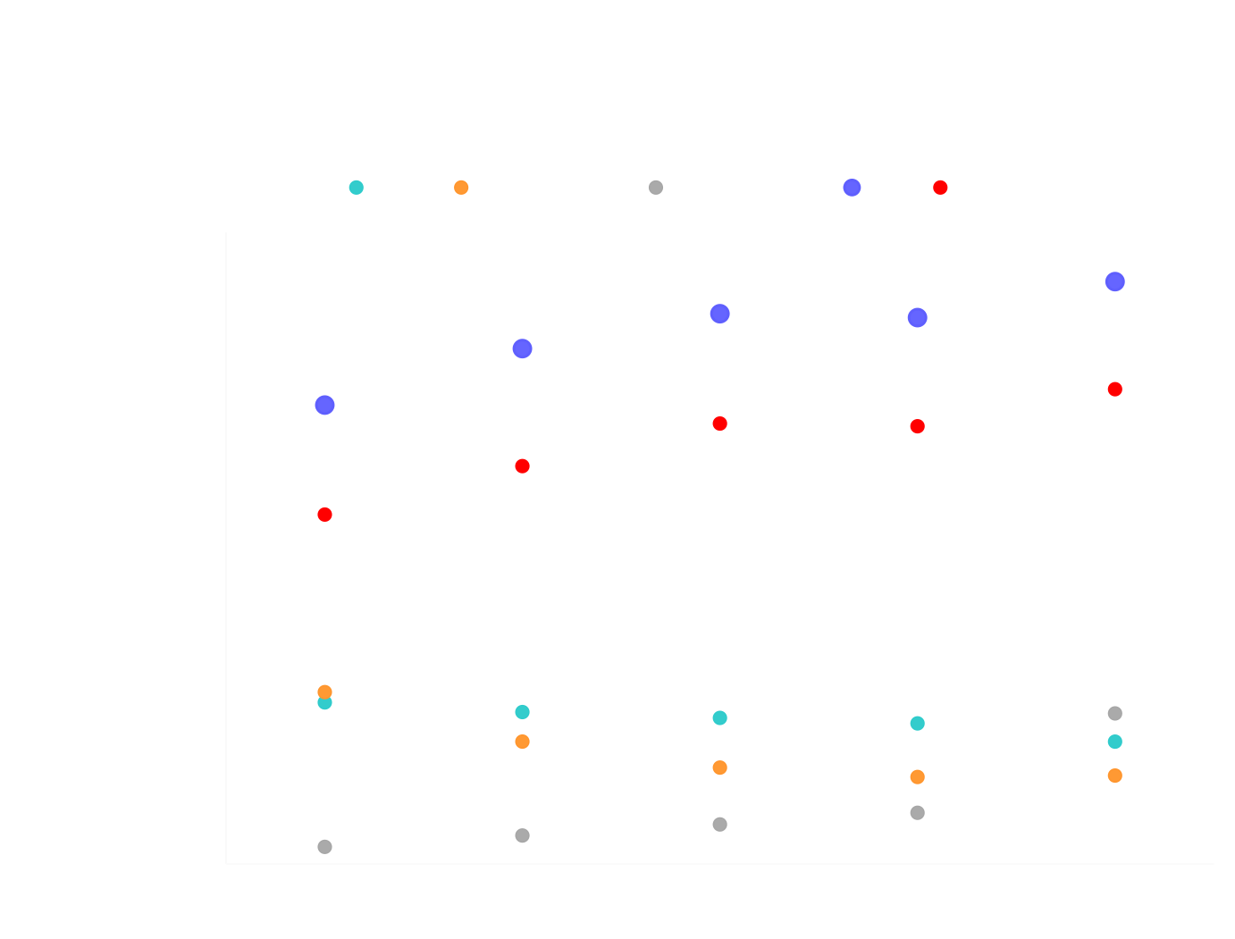
Structured Matrices

Slide 21
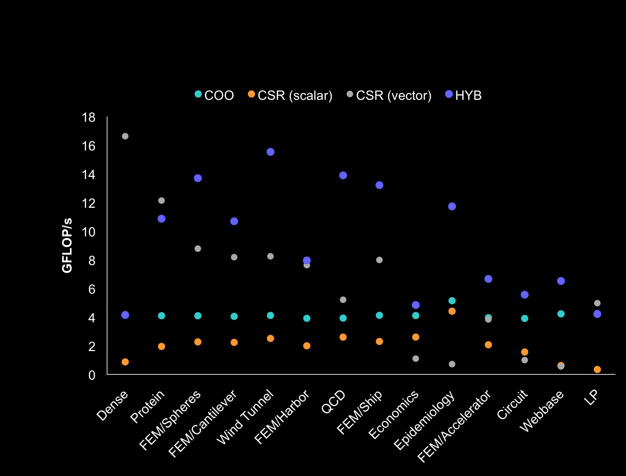
Unstructured Matrices

Slide 22
Performance Comparison
System | Cores | Clock (GHz) | Notes
GTX 285 | 240 | 1.5 | NVIDIA GeForce GTX 285
Cell | 8 (SPEs) | 3.2 | IBM QS20 Blade (half)
Core i7 | 4 | 3.0 | Intel Core i7 (Nehalem)
Sources:
  Implementing Sparse Matrix-Vector Multiplication on Throughput-Oriented Processors
  N. Bell and M. Garland, Proc. Supercomputing '09, November 2009
Optimization of Sparse Matrix-Vector Multiplication on Emerging Multicore Platforms
Samuel Williams et al., Supercomputing 2007.

Slide 23
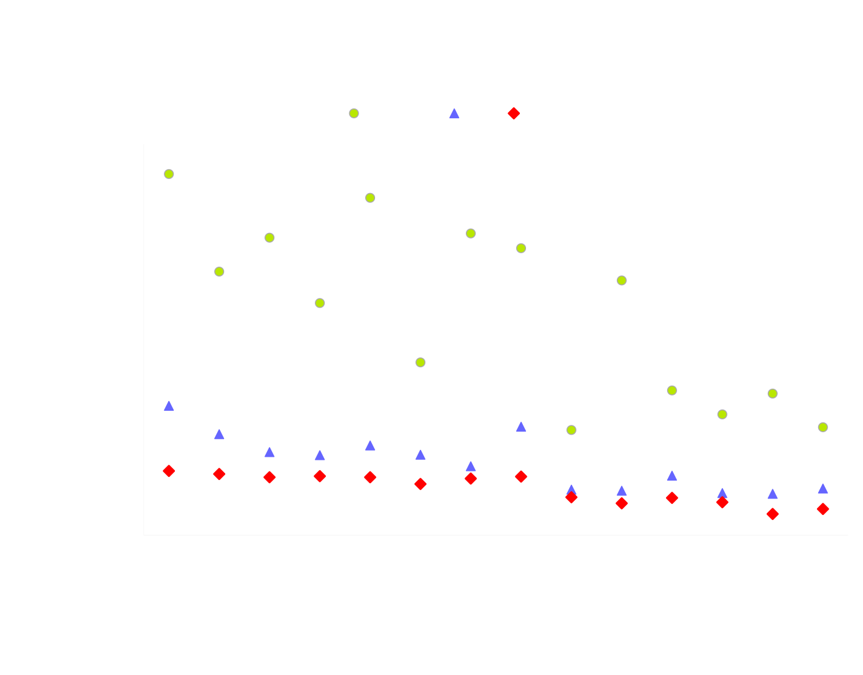
Performance Comparison
Notes:
The GTX 280 is faster in all 14 cases
GPUs have much higher peak BW than multicore platforms, and of that bandwidth we deliver a high fraction

Slide 24
ELL kernel
__global__ void ell_spmv(const int num_rows, const int num_cols,
const int num_cols_per_row, const int stride,
const double * Aj, const double * Ax,
const double * x, double * y)
{
const int thread_id = blockDim.x * blockIdx.x + threadIdx.x;
const int grid_size = gridDim.x * blockDim.x;
for (int row = thread_id; row < num_rows; row += grid_size) {
double sum = y[row];
int offset = row;
for (int n = 0; n < num_cols_per_row; n++) {
const int col = Aj[offset];
if (col != -1)
sum += Ax[offset] * x[col];
offset += stride;
}
y[row] = sum;
}
}
Notes:
25-line kernel, DIA is similarly short, CSR (vector) & COO somewhat more complex
Version with texture caching would use texfetch1d(x_texture, col);

Slide 25

#include <cusp/hyb_matrix.h>
#include <cusp/io/matrix_market.h>
#include <cusp/krylov/cg.h>
int main(void)
{
// create an empty sparse matrix structure (HYB format)
cusp::hyb_matrix<int, double, cusp::device_memory> A;
// load a matrix stored in MatrixMarket format
cusp::io::read_matrix_market_file(A, "5pt_10x10.mtx");
// allocate storage for solution (x) and right hand side (b)
cusp::array1d<double, cusp::device_memory> x(A.num_rows, 0);
cusp::array1d<double, cusp::device_memory> b(A.num_rows, 1);
// solve linear system with the Conjugate Gradient method
cusp::krylov::cg(A, x, b);
return 0;
}
http://cusp-library.googlecode.com

Slide 26
Extensions & Optimizations
Block formats (register blocking)
  Block CSR
  Block ELL
Block vectors
  Solve multiple RHS
  Block Krylov methods
Other optimizations
  Better CSR (vector)

Slide 27
Further Reading
  Implementing Sparse Matrix-Vector Multiplication
  on Throughput-Oriented Processors
  N. Bell and M. Garland
  Proc. Supercomputing '09, November 2009
  Efficient Sparse Matrix-Vector Multiplication on CUDA
  N. Bell and M. Garland
  NVIDIA Tech Report NVR-2008-004, December 2008
  Optimizing Sparse Matrix-Vector Multiplication on GPUs
M. M. Baskaran and R. Bordawekar.
IBM Research Report RC24704, IBM, April 2009
Model-driven Autotuning of Sparse Matrix-Vector Multiply on GPUs
J. W. Choi, A. Singh, and R. Vuduc
Proc. ACM SIGPLAN (PPoPP), January 2010
Notes:
CUSP is and open source library (Apache license) of sparse matrix operations and solvers
We are open to collaboration

Slide 28
Questions?
nbell@nvidia.com

