Slide 1
Solving PDEs with CUDA
Jonathan Cohen
jocohen@nvidia.com
NVIDIA Research

Slide 2

PDEs (Partial Differential Equations)
Big topic
Some common strategies
Focus on one type of PDE in this talk
Poisson Equation
  Linear equation => Linear solvers
  Parallel approaches for solving resulting linear systems

Slide 3
Poisson Equation
Classic Poisson Equation:
▼²p = rhs (p, rhs scalar fields)
(Laplacian of p = sum of second derivatives)
∂²p/∂x² + ∂²p/∂y² + ∂²p/∂z² = rhs
∂²p/∂x² ≈ ∂(p+∆x)/∂x - ∂p/∂x
∆x

Slide 4
To compute Laplacian at P[4]:
P[0] | P[1] | P[2] | P[3] | P[4] | P[5] | P[6] | P[7]
1/∆x²
1
-2
1
1st Derivatives on both sides:
∂p/∂x = P[4] - P[3]
∆x
∂(p+∆)/∂x = P[5] - P[4]
∆x
Derivative of 1st Derivatives:
P[5] - P[4] - P[4] - P[3]
∆x ∆x
1/∆x² ( P[3] – 2P[4] + P[5] )
∆x

Slide 5
Poisson Matrix
Poisson Equation is a sparse linear system
-2 | 1 |  |  |  |  |  | 1
1 | -2 | 1
 | 1 | -2 | 1
 |  | 1 | -2 | 1
 |  |  | 1 | -2 | 1
 |  |  |  | 1 | -2 | 1
 |  |  |  |  | 1 | -2 | 1
1 |  |  |  |  |  | 1 | -2
P[0]
P[1]
P[2]
P[3]
P[4]
P[5]
P[6]
P[7]
= ∆x² RHS

Slide 6
Approach 1: Iterative Solver
Solve M p = r, where M and r are known
Error is easy to estimate: E = M p’ - r
Basic iterative scheme:
Start with a guess for p, call it p’
Until | M p’ - r | < tolerance
p’ <= Update(p’, M, r)
Return p’

Slide 7
Serial Gauss-Seidel Relaxation
Loop until convergence:
For each equation j = 1 to n
  Solve for P[j]
E.g. equation for P[1]:
  P[0] - 2P[1] + P[2] = h*h*RHS[1]
  Rearrange terms:
  P[1] = P[0] + P[2] - h*h*RHS[1]
  2

Slide 8
One Pass of Serial Algorithm
  P[0] = P[7] + P[1] -h*h*RHS[0]
  2
  P[1] = P[2] + P[0] -h*h*RHS[1]
  2
  P[2] = P[1] + P[3] -h*h*RHS[2]
  2
  P[7] = P[6] + P[0] -h*h*RHS[7]
  2
P[0]
P[1]
P[2]
P[3]
P[4]
P[5]
P[6]
P[7]
P[0]
P[1]
P[2]
P[3]
P[4]
P[5]
P[6]
P[7]
P[0]
P[1]
P[2]
P[3]
P[4]
P[5]
P[6]
P[7]
P[0]
P[1]
P[2]
P[3]
P[4]
P[5]
P[6]
P[7]

Slide 9
Red-Black Gauss-Seidel Relaxation
Can choose any order in which to update equations
  Convergence rate may change, but convergence still guaranteed
“Red-black” ordering:
Red (odd) equations independent of each other
Black (even) equations independent of each other
P[0] | P[1] | P[2] | P[3] | P[4] | P[5] | P[6] | P[7]

Slide 10
Parallel Gauss-Seidel Relaxation
Loop n times (until convergence)
For each even equation j = 0 to n-1
  Solve for P[j]
  For each odd equation j = 1 to n
  Solve for P[j]
  For loops are parallel – perfect for CUDA kernel

Slide 11
One Pass of Parallel Algorithm
  P[0] = P[7] + P[1] -h*h*RHS[0]
  2
  P[2] = P[1] + P[3] -h*h*RHS[2]
  2
  P[4] = P[3] + P[5] -h*h*RHS[4]
  2
  P[6] = P[5] + P[7] -h*h*RHS[6]
  2
  P[1] = P[0] + P[2] -h*h*RHS[1]
  2
  P[3] = P[2] + P[4] -h*h*RHS[3]
  2
  P[5] = P[4] + P[6] -h*h*RHS[5]
  2
  P[7] = P[6] + P[0] -h*h*RHS[7]
  2
P[0]
P[1]
P[2]
P[3]
P[4]
P[5]
P[6]
P[7]
P[0]
P[1]
P[2]
P[3]
P[4]
P[5]
P[6]
P[7]

Slide 12
CUDA Pseudo-code
__global__ void RedBlackGaussSeidel(
Grid P, Grid RHS, float h, int red_black)
{
int i = blockIdx.x*blockDim.x + threadIdx.x;
int j = blockIdx.y*blockDim.y + threadIdx.y;
i*=2;
if (j%2 != red_black) i++;
int idx = j*RHS.jstride + i*RHS.istride;
P.buf[idx] = 1.0/6.0*(-h*h*R.buf[idx] +
P.buf[idx + P.istride] + P.buf[idx – P.istride] +
P.buf[idx + P.jstride] + P.buf[idx – P.jstride]);
}
// on host:
for (int i=0; i < 100; i++) {
RedBlackGaussSeidel<<<Dg, Db>>>(P, RHS, h, 0);
RedBlackGaussSeidel<<<Dg, Db>>>(P, RHS, h, 1);
}

Slide 13
Optimizing the Poisson Solver
Red-Black scheme is bad for coalescing
  Read every other grid cell => half memory bandwidth
  Lots of reuse between adjacent threads (blue and green)
Texture cache (Fermi L1 cache) improves performance by 2x
  Lots of immediate reuse, very small working set
  In my tests, (barely) beats software-managed shared memory
P[0] | P[1] | P[2] | P[3] | P[4] | P[5] | P[6] | P[7]

Slide 14
Generalizing to non-grids
What about discretization over non-Cartesian grids?
  Finite element, finite volume, etc.
Need discrete version of differential operator (Laplacian) to this geometry
Works out to same thing:
L p = r
where L is matrix of Laplacian discretizations
1.2
1.2
- 4
1.6

Slide 15
Graph Coloring
Need partition into non-adjacent sets
  Classic ‘graph coloring’ problem
  Red-black is special case, where 2 colors suffice
  Too many colors => not enough parallelism within each color
  Not enough colors => hard coloring problem
  Until convergence:
  Update green terms in parallel
  Update orange terms in parallel
  Update blue terms in parallel

Slide 16
Back to the Poisson Matrix…
1D Poisson Matrix has particular sparse structure:
3 non-zeros per row, around the diagonal
-2 | 1 |  |  |  |  |  | 1
1 | -2 | 1
 | 1 | -2 | 1
 |  | 1 | -2 | 1
 |  |  | 1 | -2 | 1
 |  |  |  | 1 | -2 | 1
 |  |  |  |  | 1 | -2 | 1
1 |  |  |  |  |  | 1 | -2
P[0]
P[1]
P[2]
P[3]
P[4]
P[5]
P[6]
P[7]
= ∆x² RHS

Slide 17
Approach 2: Direct Solver
Solve the matrix equation directly
Exploit sparsity pattern – all zeroes except diagonal, 1 above, 1 below = “tridiagonal” matrix
Many applications for tridiagonal matrices
  Vertical diffusion (adjacent columns do not interact)
  ADI methods (e.g. separate 2D blur x blur, y blur)
  Linear solvers (multigrid, preconditioners, etc.)
Typically many small tridiagonal systems =>
per-CTA algorithm

Slide 18
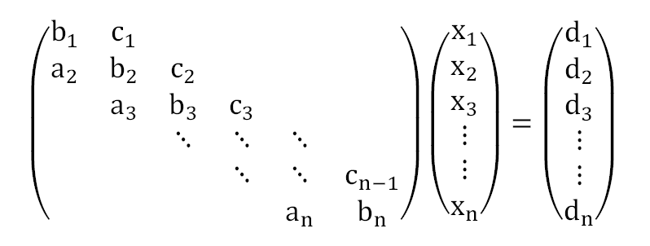
What is a tridiagonal system?

Slide 19

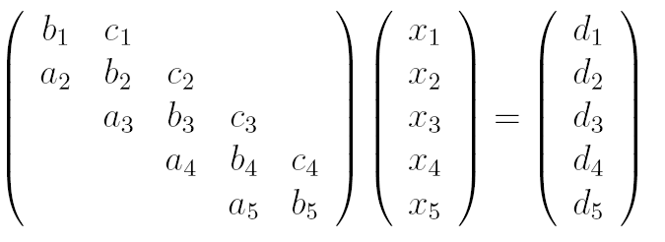



















A Classic Sequential Algorithm
Gaussian elimination in tridiagonal case (Thomas algorithm)
Phase 2: Backward Substitution
Phase 1: Forward Elimination
Notes:
One by one

Slide 20
Cyclic Reduction: Parallel algorithm
Basic linear algebra:
Take any row, multiply by scalar, add to another row => Solution unchanged
B1 | C1 |  |  |  |  |  | A1
A2 | B2 | C2
 | A3 | B3 | C3
 |  | A4 | B4 | C4
 |  |  | A5 | B5 | C5
 |  |  |  | A6 | B6 | C6
 |  |  |  |  | A7 | B7 | C7
C8 |  |  |  |  |  | A8 | B8
X1
X2
X3
X4
X5
X6
X7
X8
R1
R2
R3
R4
R5
R6
R7
R8
=

Slide 21
Scale Equations 3 and 5
B1 | C1 |  |  |  |  |  | A1
A2 | B2 | C2
 | A3 | B3 | C3
 |  | A4 | B4 | C4
 |  |  | A5 | B5 | C5
 |  |  |  | A6 | B6 | C6
 |  |  |  |  | A7 | B7 | C7
C8 |  |  |  |  |  | A8 | B8
X1
X2
X3
X4
X5
X6
X7
X8
R1
R2
R3
R4
R5
R6
R7
R8
-A4/B3 *
=
-C4/B5 *

Slide 22
Add scaled Equations 3 & 5 to 4
B1 | C1 |  |  |  |  |  | A1
A2 | B2 | C2
 | A3’ | -A4 | C3’
 |  | A4 | B4 | C4
 |  |  | A5’ | -C4 | C5’
 |  |  |  | A6 | B6 | C6
 |  |  |  |  | A7 | B7 | C7
C8 |  |  |  |  |  | A8 | B8
X1
X2
X3
X4
X5
X6
X7
X8
R1
R2
R3
R4
R5
R6
R7
R8
+
+
=

Slide 23
Zeroes entries 4,3 and 4,5
B1 | C1 |  |  |  |  |  | A1
A2 | B2 | C2
 | A3’ | -A4 | C3’
 | A3’ |  | B4’ |  | C5’
 |  |  | A5’ | -C4 | C5’
 |  |  |  | A6 | B6 | C6
 |  |  |  |  | A7 | B7 | C7
C8 |  |  |  |  |  | A8 | B8
X1
X2
X3
X4
X5
X6
X7
X8
R1
R2
R3
R4’
R5
R6
R7
R8
=

Slide 24
Repeat operation for all equations
B1’ |  | C2’ |  |  |  | A8’
 | B2’ |  | C3’ |  |  |  | A1’
A2’ |  | B3’ |  | C4’
 | A3’ |  | B4’ |  | C5’
 |  | A4’ |  | B5’ |  | C6’
 |  |  | A5’ |  | B6’ |  | C7’
C8’ |  |  |  | A6’ |  | B7’
 | C1’ |  |  |  | A7’ |  | B8’
X1
X2
X3
X4
X5
X6
X7
X8
R1’
R2’
R3’
R4’
R5’
R6’
R7’
R8’
=

Slide 25
Permute – 2 independent blocks
B1’ | C2’ |  | A8’
A2’ | B3’ | C4’
 | A4’ | B5’ | C6’
C8’ |  | A6’ | B7’
 |  |  |  | B2’ | C3’ |  | A1’
 |  |  |  | A3’ | B4’ | C5’
 |  |  |  |  | A5’ | B6’ | C7’
 |  |  |  | C1’ |  | A7’ | B8’
X1
X3
X5
X7
X2
X4
X6
X8
R1’
R3’
R5’
R7’
R3’
R4’
R6’
R8’
Odd
=
Even

Slide 26
Cyclic Reduction Ingredients
Apply this transformation (pivot + permute)
Split (n x n) into 2 independent (n/2 x n/2)
Proceed recursively
Two approaches:
  Recursively reduce both submatrices until n 1x1 matrices obtained. Solve resulting diagonal matrix.
  Recursively reduce odd submatrix until single 1x1 system. Solve system. Reverse process via back-substitution.

Slide 27





Cyclic Reduction (CR)
2 threads working
4 threads working
1 thread working
8-unknown system
Forward
Reduction
4-unknown system
2-unknown system
Solve 2 unknowns
Backward
Substitution
Solve the rest 2 unknowns
Solve the rest 4 unknowns
2*log2 (8)-1 = 2*3 -1 = 5 steps

Slide 28
Parallel Cyclic Reduction (PCR)
4 threads working
One 8-unknown system
Forward
Reduction
Two 4-unknown systems
Four 2-unknown systems
Solve all unknowns
log2 (8) = 3 steps

Slide 29
Work vs. Step Efficiency
CR does O(n) work, requires 2 log(n) steps
PCR does O(n log n) work, requires log(n) steps
Smallest granularity of work is 32 threads: performing fewer than 32 math ops = same cost as 32 math ops
Here’s an idea:
  Save work when > 32 threads active (CR)
  Save steps when < 32 threads active (PCR)

Slide 30
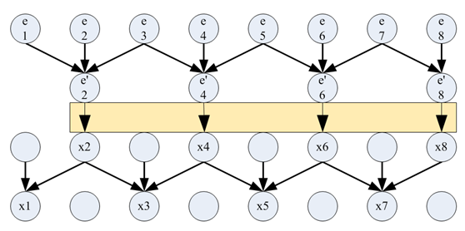
Hybrid Algorithm
Switch to PCR
Switch back to CR
System size reduced at the beginning
No idle processors
Fewer algorithmic steps
Even more beneficial because of:
bank conflicts
control overhead

Slide 31
PCR vs Hybrid
Make tradeoffs between the computation, memory access, and control
  The earlier you switch from CR to PCR
    The fewer bank conflicts, the fewer algorithmic steps
    But more work
Notes:
So We have show that the performance is determined by the different components including control overhead, memory access and computation
Furthermore, We can actually make tradeoffs between these components, the hybrid solver is such an example

Slide 32
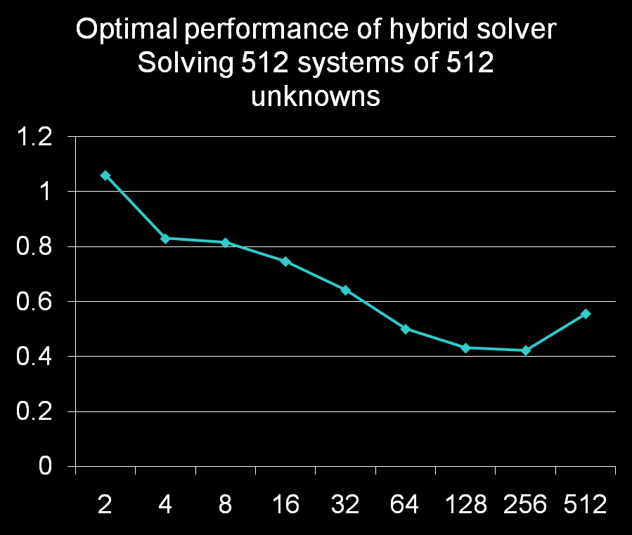
Hybrid Solver – Optimal cross-over
Time (milliseconds)
CR
Hybrid
PCR
Optimal intermediate system size
Notes:
Left side
Right side

Slide 33

Results: Tridiagonal Linear Solver
12x
12x
2.5x
1.3x
Time (milliseconds)
2.5x
1.3x
PCI-E: CPU-GPU data transfer
MT GE: multi-threaded CPU Gaussian Elimination
GEP: CPU Gaussian Elimination with pivoting (from LAPACK)
From Zhang et al., “Fast Tridiagonal Solvers on GPU.” PPoPP 2010.

Slide 34
Summary
Linear PDE => Linear solver (e.g. Poisson Equation)
2 basic approaches: Iterative vs. Direct
Parallel iterative solver (Red Black Gauss Seidel)
  Design update procedure so multiple terms can be updated in parallel
Parallel direct solver (Cyclic Reduction)
  Exploit structure of matrix to solve using parallel operations
‘General purpose’ solvers largely mythical. Most people use special purpose solvers => Lots of good research potential mining this field

