Slide 1

Electronic Resource Management Systems: Learning from Experience
Jared Howland
Brigham Young University

Slide 2
Background
Notes:
*My introduction - ERL since 2005
*ARL Member Library
*29,000 FTE
*Sister campuses in SLC, Idaho, and Hawaii
**We do a lot of licensing for these campuses as well
*415 licensed electronic databases
*71,245 licensed electronic journals (15,000 outside of aggregators)
*296,089 licensed electronic books
*Multiple consortia (UALC, GWLA, CCLA)
*Sirsi Unicorn is our ILS provider
*How many of you already have an ERM in place?

Slide 3
Library Organization
Notes:
*Databases are purchased out of a central pot of money - other electronic resources come out of the serials or monographs budget
*Subject librarians make purchasing decision unless they are requesting new money
*Requests that require new money are discussed 2 times a year by a collection development committee

Slide 4
ERM Selection
2001: Realized need
2002: Built home-grown solution
2004: Investigated commercial options
Notes:
*2001: Realized the need for a system to track the purchasing and management of electronic collections
*2002: Built SORT (System for Online Resource Tracking)
**Could not handle consortial purchases or historical prices very well
*2004: Assistant University Librarian attended the Charleston Conference and attended a session that detailed the elements of a working ERM system and the ERMI report - also heard reports about systems coming online including Gold Rush

Slide 5
Gold Rush http://grweb.coalliance.org/
Notes:
*2005 - Invited the Colorado Alliance to campus to demonstrate the Gold Rush features
*Ultimately we selected our ERM by matching our required criteria for an ERM with the available functionality of the only system on the market at the time
*Although there were tradeoffs, we felt that the functionality would meet our needs at a price we could afford at the time

Slide 6
Reflection on ERM Selection
Knowledgebase
Price
Flexibility
Integration
Type of System
Notes:
*Before purchasing, determine the following based on your own library's situation:
#Accuracy of the knowledgebase
#Price
#Flexibility of the ERM (integration with public interface or not)
#Importance of integration into the library’s ILS
#Type of system
##Stand alone vs Integrated
##Proprietary vs Open source
##Locally hosted vs Vendor hosted
##Consortium/branches vs Single location
##As a package vs ERM only
*The more integrated the ERM is into existing workflows, the more successful you will be with using it

Slide 7
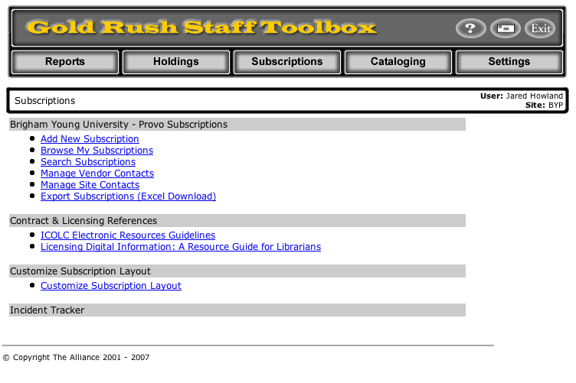
Gold Rush Screenshots

Slide 8
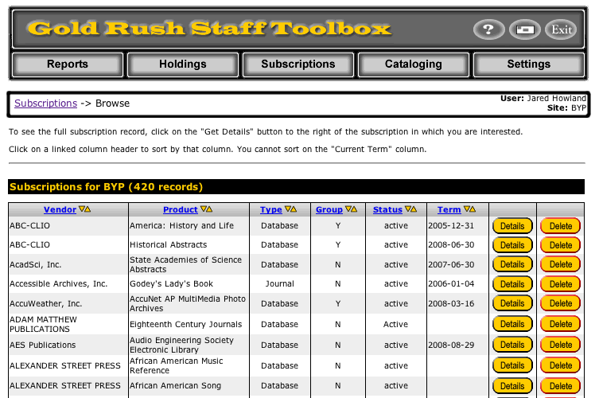
Gold Rush Screenshots

Slide 9
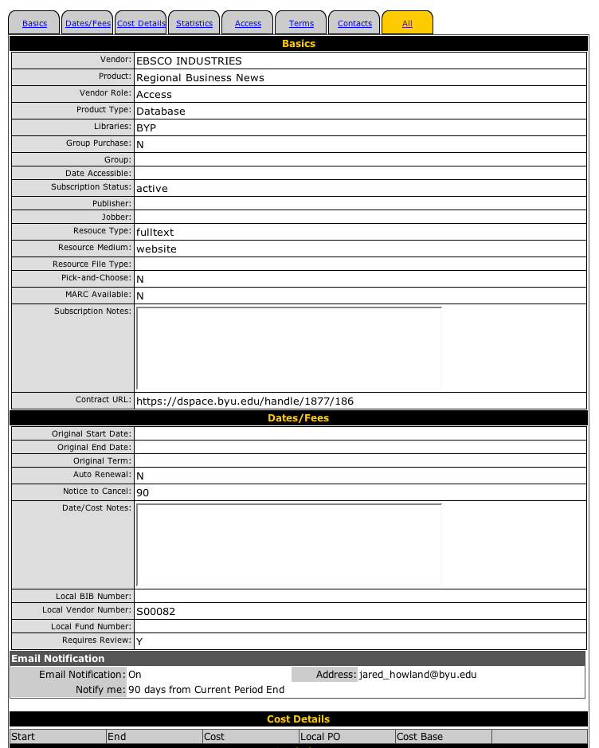
Gold Rush Screenshots

Slide 10
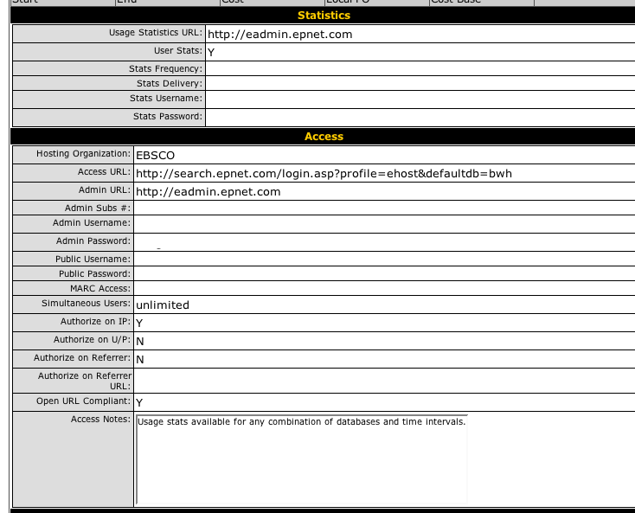
Gold Rush Screenshots

Slide 11
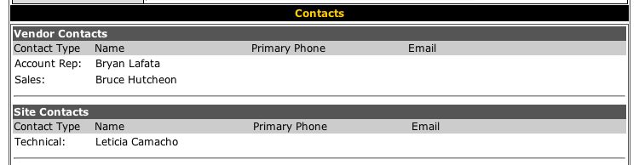
Gold Rush Screenshots

Slide 12
ERM Implementation
Created Committee
Gathered Information
Defined Skeleton Record
Established Standards
Entered Information
Notes:
#Committee that had representation from Serials, Cataloging and Electronic Resources
#Gathered information from all available resources
**SORT
**Emails
**Mail
**Files
**Spreadsheets
**Memory
**ILS
#Defined skeleton or minimal record and a base record
#Established standards for the way some information would be entered into the system
#Entered all known information into the system
#*We used an invoice as a time to gather more information about the resource by calling the vendor (upgraded from base to skeleton or skeleton to a more complete record)

Slide 13
Reflection on ERM Implementation
Expand Committee
Streamline Workflows
Create Dictionary
Notes:
*Involve more people in the committee - ERMs potentially help a lot of people - both within and outside the library
**ILL, Copyright Clearance, Bookstore
*Use implementation as a time to evaluate workflows and streamline when and where possible
*Create dictionary to define each element in your ERM - How you will enter the information (format, standardized notes, etc), who will enter the information, when the information will be entered, examples of the information to be entered

Slide 14
License Expression Working Group http://www.niso.org/committees/License_Expression/LicenseEx_comm.html

Slide 15
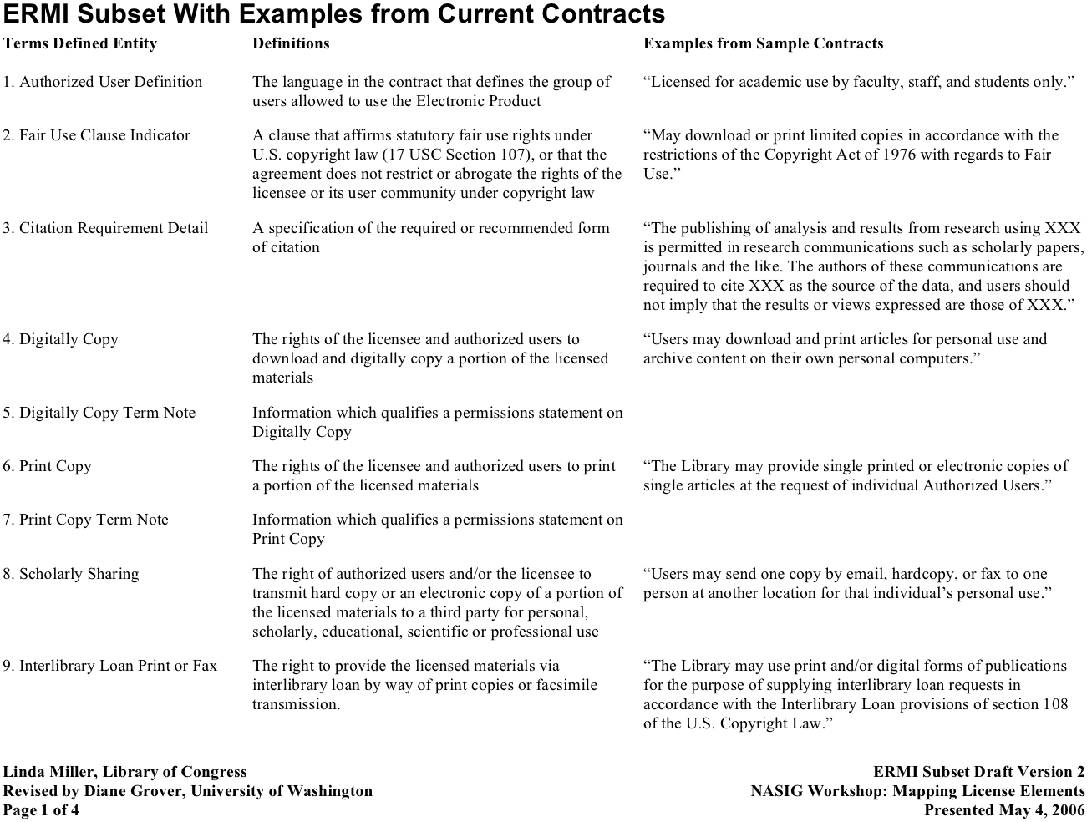
License Expression

Slide 16
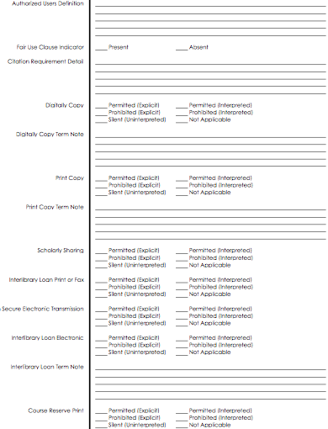
License Expression

Slide 17
D-Space https://dspace.byu.edu

Slide 18
Home-grown ERM
PROS | CONS
Fully customizable | Must create/license your own knowledgebase
 | Must maintain yourself
 | Need your own servers/IT staff

Slide 19
Vendor-hosted ERM
PROS | CONS
Vendor does all maintenance | Not fully customizable
 | More difficult to integrate with local systems

Slide 20
Library-hosted ERM
PROS | CONS
Mostly customizable | Must do some maintenance
Easier to integrate with local systems | Need your own servers/IT staff

Slide 21
Questions jared_howland@byu.edu

