Slide 1
Federated Searching
Do Undergraduates Prefer it and
Does it Add Value?
C. Jeffrey Belliston
Jared L. Howland
Brigham Young University
ACRL 13th National Conference
March 31, 2007

Slide 2
Poll: Institution Type – Highest Degree Offered
Associate
Bachelor’s
Master’s
Doctorate
C. Jeffrey Belliston
Jared L. Howland
Brigham Young University
ACRL 13th National Conference
March 31, 2007

Slide 3
Poll: Institution Size – Enrollment
Under 1,000
1,000 – 4,999
5,000 – 14,999
15,000 – 24,999
25,000 or more
C. Jeffrey Belliston
Jared L. Howland
Brigham Young University
ACRL 13th National Conference
March 31, 2007

Slide 4
Poll: Federated Searching Experience
Considering implementing
Actively planning for implementation
Implementing or pilot project
Fully implemented – less than happy with
Fully implemented – happy with
C. Jeffrey Belliston
Jared L. Howland
Brigham Young University
ACRL 13th National Conference
March 31, 2007

Slide 5
Study Background 1
Consortium of Church Libraries and Archives (CCLA)
  Five academic and several special libraries
All academic institutions interested
  Competition with Google
  Desire to promote scholarly subscription resources in an effective way
  Expose less-used content to greater use
C. Jeffrey Belliston
Jared L. Howland
Brigham Young University
ACRL 13th National Conference
March 31, 2007

Slide 6
Study Background 2
Before implementation
  Demos from leading vendors for CCLA libraries
  Discussion and input from library staffs
    “Let technology mature”
    “Opt for leading edge not bleeding edge”
CCLA Directors decided to license
  Initial 3 year agreement (expires 2007)
  Actual implementation left under local control
C. Jeffrey Belliston
Jared L. Howland
Brigham Young University
ACRL 13th National Conference
March 31, 2007

Slide 7
Study Background 3
Impetus for study came from impending renewal
  Is federated searching doing what we hoped it would?
Four questions
  Does federated searching save time?
  Does federated search satisfy students' information needs?
  Do students prefer federated search to the alternative of searching databases individually?
  Does federated searching yield quality results?
C. Jeffrey Belliston
Jared L. Howland
Brigham Young University
ACRL 13th National Conference
March 31, 2007

Slide 8
Study Methodology – Preparation 1
Hoped to do at all four institutions
  Received IRB approval at all four
  Dropped LDS Business College due to poor response
E-mailed potential undergraduate participants
Decided upon hypothetical research questions (both biology)
With faculty and librarian help, created subjective grading rubric
C. Jeffrey Belliston
Jared L. Howland
Brigham Young University
ACRL 13th National Conference
March 31, 2007

Slide 9
Study Methodology – Preparation 2
With vendor help, designed implementation-neutral web interface
  Did not want study interface to look like any of the institutional interfaces
Wrote and tested instructions for data collection
Printed instructions and questionnaires
Scheduled rooms and respondent appointments
  Suggested 30-60 minutes as typical timeframe
  Provided, on our end, a minimum of two hours to complete
C. Jeffrey Belliston
Jared L. Howland
Brigham Young University
ACRL 13th National Conference
March 31, 2007

Slide 10
Study Methodology – Data Collection 1
Seated student at computer already on main Web page for study
Provided consent form and asked for signature
Provided written general instruction sheet
C. Jeffrey Belliston
Jared L. Howland
Brigham Young University
ACRL 13th National Conference
March 31, 2007

Slide 11
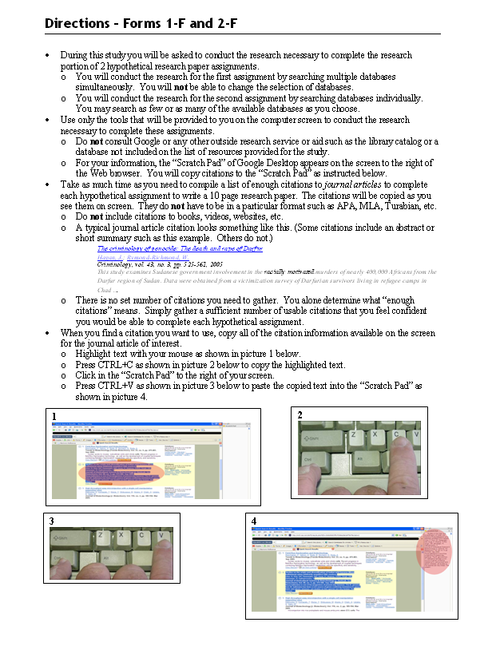
Brief explanation of what participant would be doing
Caution against use of other resources
Emphasis on journal articles and what meant by “citation”
How to copy from search results to Google Scratch pad
C. Jeffrey Belliston
Jared L. Howland
Brigham Young University
ACRL 13th National Conference
March 31, 2007

Slide 12
Study Methodology – Data Collection 2
Provided specific instruction sheet/ questionnaire combo for 1st question/1st method combination
Noted participant student login ID
When ready to start, noted start time for 1st q/1st m
When finished, noted end time for 1st q/1st m
Copied citations from Google Scratch Pad to MS Word and saved with standard naming convention (loginid.1q1m.q#)
C. Jeffrey Belliston
Jared L. Howland
Brigham Young University
ACRL 13th National Conference
March 31, 2007

Slide 13
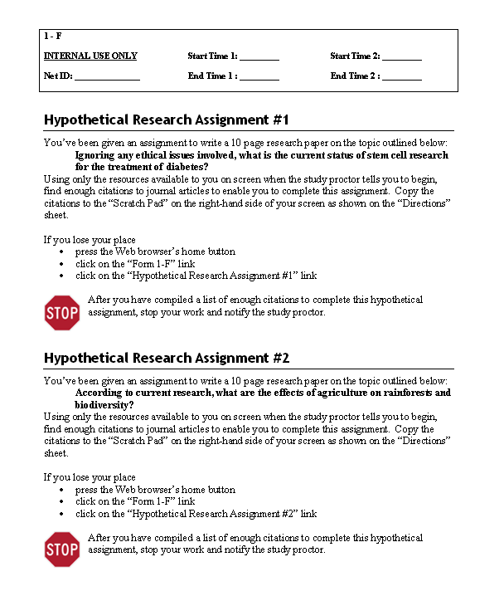
C. Jeffrey Belliston
Jared L. Howland
Brigham Young University
ACRL 13th National Conference
March 31, 2007

Slide 14
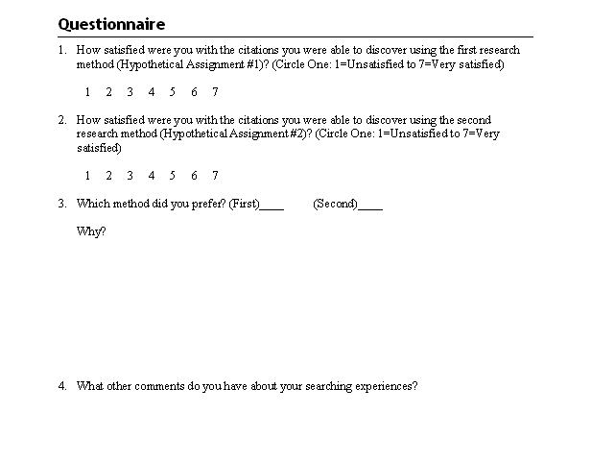
C. Jeffrey Belliston
Jared L. Howland
Brigham Young University
ACRL 13th National Conference
March 31, 2007

Slide 15
Study Methodology – Data Collection 3
Cleared Google Scratch Pad
Repeated for 2nd q/2nd m
Asked participant to complete questionnaire
Thanked participant and gave incentive
Copied MS Word documents from hard drive to flash drive
C. Jeffrey Belliston
Jared L. Howland
Brigham Young University
ACRL 13th National Conference
March 31, 2007

Slide 16
Study Methodology – Data Analysis 1
Entered start/stop times and questionnaire data into MS Excel spreadsheet
To get into standard format, entered data from each citation set into RefWorks
  Created new folder for each citation set
  Removed all non-journal article citations
  Removed all duplicate citations
Created master journal list
C. Jeffrey Belliston
Jared L. Howland
Brigham Young University
ACRL 13th National Conference
March 31, 2007

Slide 17
Study Methodology – Data Analysis 2
For journals on master journal list
  Gathered impact factors from ISI Journal Citation Reports
  Gathered peer-reviewed data from Ulrichsweb.com
  Recorded data in MS Excel worksheet
Output each citation set into MS Word using RefWorks custom format
Printed citation sets and gave to student grader
Wrote macro for MS Word to parse data in RefWorks custom format into a csv format capable of import to MS Excel
C. Jeffrey Belliston
Jared L. Howland
Brigham Young University
ACRL 13th National Conference
March 31, 2007

Slide 18
Study Methodology – Data Analysis 3
Imported csv file into MS Excel
Wrote macros for Excel to
  Assign impact factor and peer-review data to each citation
  Calculate timeliness of each citation
  Calculate for each citation set
    Ratio of peer-reviewed to total citations
    Average timeliness
    Average impact factor
  Insert data from objective analysis into master spreadsheet
Entered grades from subjective grading rubric into master spreadsheet
C. Jeffrey Belliston
Jared L. Howland
Brigham Young University
ACRL 13th National Conference
March 31, 2007

Slide 19
Study Methodology – Data Analysis 4
Used SAS to perform statistical analysis
C. Jeffrey Belliston
Jared L. Howland
Brigham Young University
ACRL 13th National Conference
March 31, 2007

Slide 20
Purpose Revisited
1:
Does federated searching save time?
C. Jeffrey Belliston
Jared L. Howland
Brigham Young University
ACRL 13th National Conference
March 31, 2007

Slide 21
Poll: Time Savings
Does federated searching save time?
Yes
No
C. Jeffrey Belliston
Jared L. Howland
Brigham Young University
ACRL 13th National Conference
March 31, 2007

Slide 22
Time Saved Using Federated Search
2 minutes
23 seconds
C. Jeffrey Belliston
Jared L. Howland
Brigham Young University
ACRL 13th National Conference
March 31, 2007

Slide 23
Time Saved Using Federated Search
10.5%
less time searching using federated search
C. Jeffrey Belliston
Jared L. Howland
Brigham Young University
ACRL 13th National Conference
March 31, 2007

Slide 24
Time Saved Using Federated Search
 | Time Saved | %
BYU | 4 minutes 11 seconds | 20.7%*
BYU Idaho | 11 seconds | 1.9%
BYU Hawaii | 26 seconds | 4.4%
* Statistically Significant
C. Jeffrey Belliston
Jared L. Howland
Brigham Young University
ACRL 13th National Conference
March 31, 2007

Slide 25
Time Saved Using Federated Search
“[Federated search] definitely saved time and was more convenient to use than the [non-federated search].”
--BYU Undergraduate (emphasis added)
C. Jeffrey Belliston
Jared L. Howland
Brigham Young University
ACRL 13th National Conference
March 31, 2007

Slide 26
Purpose Revisited
2:
Does federated search satisfy students' information needs?
C. Jeffrey Belliston
Jared L. Howland
Brigham Young University
ACRL 13th National Conference
March 31, 2007

Slide 27
Poll: Satisfaction
How satisfied do you think the undergraduates were with the results found using federated search?
1=Unsatisfied to 7=Very satisfied
    <3
    Between 3 and 4
    Between 4 and 5
    Between 5 and 6
    Between 6 and 7
C. Jeffrey Belliston
Jared L. Howland
Brigham Young University
ACRL 13th National Conference
March 31, 2007

Slide 28
Poll: Satisfaction
How satisfied do you think the undergraduates were with the results found using non-federated searching?
1=Unsatisfied to 7=Very satisfied
    <3
    Between 3 and 4
    Between 4 and 5
    Between 5 and 6
    Between 6 and 7
C. Jeffrey Belliston
Jared L. Howland
Brigham Young University
ACRL 13th National Conference
March 31, 2007

Slide 29
Federated Search Satisfaction Rating
5.59
C. Jeffrey Belliston
Jared L. Howland
Brigham Young University
ACRL 13th National Conference
March 31, 2007

Slide 30
Non-federated Search Satisfaction Rating
4.8
C. Jeffrey Belliston
Jared L. Howland
Brigham Young University
ACRL 13th National Conference
March 31, 2007

Slide 31
Satisfaction
16.5%
more satisfied with federated search
C. Jeffrey Belliston
Jared L. Howland
Brigham Young University
ACRL 13th National Conference
March 31, 2007

Slide 32
Satisfaction Using Federated Search
 | More satisfaction | %
BYU | 0.99 | 20.7%*
BYU Idaho | -0.07 | -1.3%
BYU Hawaii | 1.44 | 34.9%*
* Statistically Significant
C. Jeffrey Belliston
Jared L. Howland
Brigham Young University
ACRL 13th National Conference
March 31, 2007

Slide 33
Satisfaction Using Federated Search
“I found that both were not very user friendly…I was frustrated and very tempted to just go back to good old ‘Google’!!”
--BYU Hawaii Undergraduate (emphasis added)
C. Jeffrey Belliston
Jared L. Howland
Brigham Young University
ACRL 13th National Conference
March 31, 2007

Slide 34
Purpose Revisited
3:
Do students prefer federated search to the alternative of searching databases individually?
C. Jeffrey Belliston
Jared L. Howland
Brigham Young University
ACRL 13th National Conference
March 31, 2007

Slide 35
Poll: Preference
Do students prefer federated search to the alternative of searching databases individually?
    Yes
    No
C. Jeffrey Belliston
Jared L. Howland
Brigham Young University
ACRL 13th National Conference
March 31, 2007

Slide 36
Federated Search Preference
70%
of the students preferred federated search over non-federated search
C. Jeffrey Belliston
Jared L. Howland
Brigham Young University
ACRL 13th National Conference
March 31, 2007

Slide 37
Federated Search Preference
 | % Preferred Federated Search
BYU | 72%
BYU Idaho | 52%
BYU Hawaii | 81%
C. Jeffrey Belliston
Jared L. Howland
Brigham Young University
ACRL 13th National Conference
March 31, 2007

Slide 38
Federated Search Preference
“…[Federated search] got right to the point. I found more useful information. [With the non-federated search] I had to do a longer search.”
--BYU Idaho Undergraduate (emphasis added)
C. Jeffrey Belliston
Jared L. Howland
Brigham Young University
ACRL 13th National Conference
March 31, 2007

Slide 39
Purpose Revisited
4:
Does federated searching yield quality results?
C. Jeffrey Belliston
Jared L. Howland
Brigham Young University
ACRL 13th National Conference
March 31, 2007

Slide 40
Poll: Quality of Results
Does federated searching yield higher quality results than non-federated searching?
    Yes
    No
    Same quality regardless of search technique
C. Jeffrey Belliston
Jared L. Howland
Brigham Young University
ACRL 13th National Conference
March 31, 2007

Slide 41
Federated Search Preference
Ambiguous
results for quality of citations found using federated searching versus non-federated searching
C. Jeffrey Belliston
Jared L. Howland
Brigham Young University
ACRL 13th National Conference
March 31, 2007

Slide 42
Quality of Results
 | % change in quality between federated and non-federated results
 | Librarian-created rubric | Faculty-created rubric
Overall | -5.6%* | 8.1%
* Statistically Significant
C. Jeffrey Belliston
Jared L. Howland
Brigham Young University
ACRL 13th National Conference
March 31, 2007

Slide 43
Quality of Results
 | % change in quality between federated and non-federated results
 | Librarian-created rubric | Faculty-created rubric
BYU | -5.7% | -2.5%
BYU Idaho | -2.3% | 10.2%
BYU Hawaii | -8.5% | -2.6%
C. Jeffrey Belliston
Jared L. Howland
Brigham Young University
ACRL 13th National Conference
March 31, 2007

Slide 44
Quality of Results
“I love Google, but this certainly helps to narrow your information down to ‘good’ resources.”
--BYU Hawaii Undergraduate (emphasis added)
C. Jeffrey Belliston
Jared L. Howland
Brigham Young University
ACRL 13th National Conference
March 31, 2007

Slide 45
Conclusions
1:
Federated searching saves time
C. Jeffrey Belliston
Jared L. Howland
Brigham Young University
ACRL 13th National Conference
March 31, 2007

Slide 46
Conclusions
2:
Federated searching satisfies undergraduate’s information needs
C. Jeffrey Belliston
Jared L. Howland
Brigham Young University
ACRL 13th National Conference
March 31, 2007

Slide 47
Conclusions
3:
Undergraduates prefer federated search to searching databases individually
C. Jeffrey Belliston
Jared L. Howland
Brigham Young University
ACRL 13th National Conference
March 31, 2007

Slide 48
Conclusions
4:
There is no clear difference between the quality of results found using federated search and searching databases individually
C. Jeffrey Belliston
Jared L. Howland
Brigham Young University
ACRL 13th National Conference
March 31, 2007

Slide 49
Future Research
Extrapolate results beyond BYU, BYU Hawaii and BYU Idaho
C. Jeffrey Belliston
Jared L. Howland
Brigham Young University
ACRL 13th National Conference
March 31, 2007

Slide 50
Future Research
Extrapolate results beyond undergraduate population
C. Jeffrey Belliston
Jared L. Howland
Brigham Young University
ACRL 13th National Conference
March 31, 2007

Slide 51
Future Research
Study the effects of specific federated search implementations
C. Jeffrey Belliston
Jared L. Howland
Brigham Young University
ACRL 13th National Conference
March 31, 2007

Slide 52
Questions
C. Jeffrey Belliston
Jared L. Howland
Brigham Young University
ACRL 13th National Conference
March 31, 2007

Slide 53
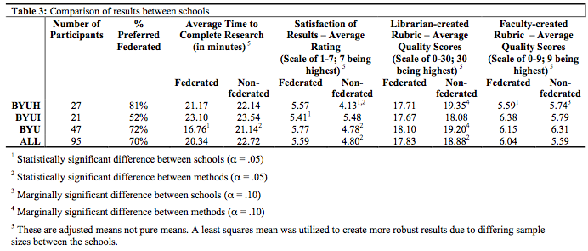
Actual Numbers
C. Jeffrey Belliston
Jared L. Howland
Brigham Young University
ACRL 13th National Conference
March 31, 2007

Slide 54
Least Squares Mean
Least Squares Mean: The effect of any covariates is statistically removed from the scores prior to computing the means
C. Jeffrey Belliston
Jared L. Howland
Brigham Young University
ACRL 13th National Conference
March 31, 2007

