Slide 1


How Scholarly is ?
A Comparison of Google Scholar to Library Databases
Jared L. Howland | Thomas C. Wright | Rebecca A. Boughan | Brian C. Roberts
Brigham Young Univeristy

Slide 2
Introduction
Literature Review

Slide 3
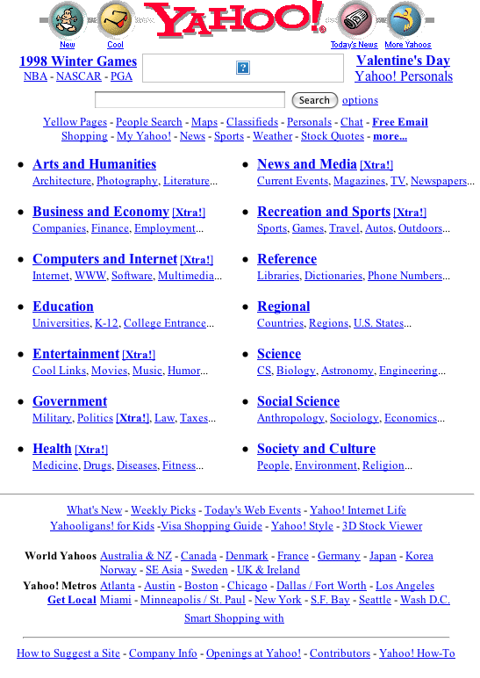
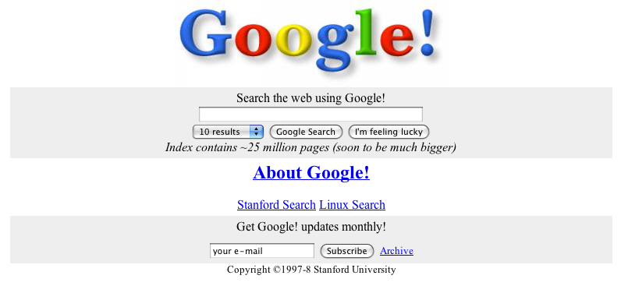
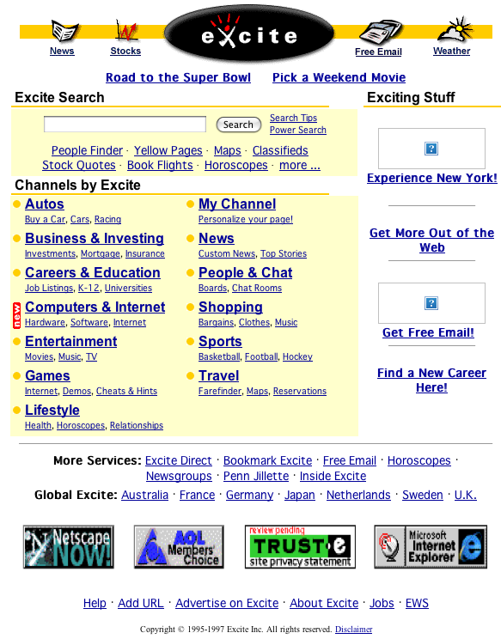
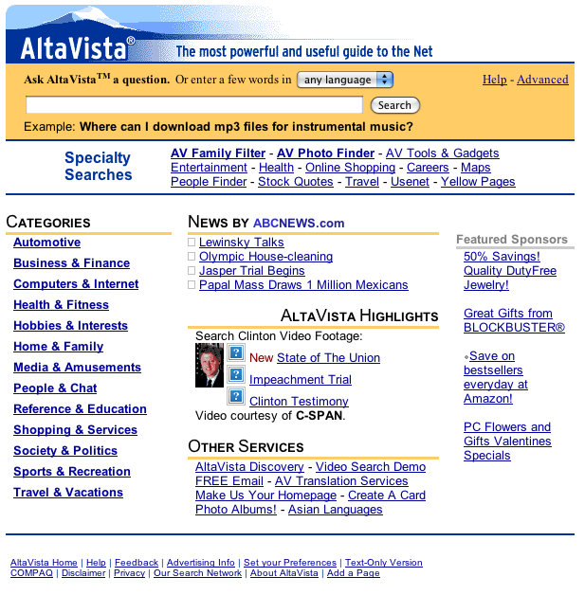
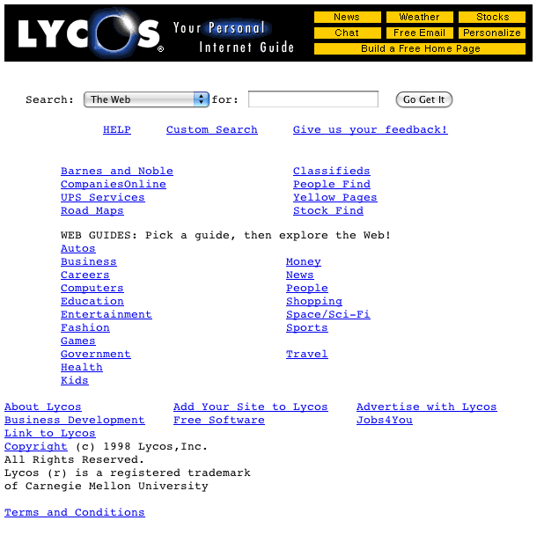
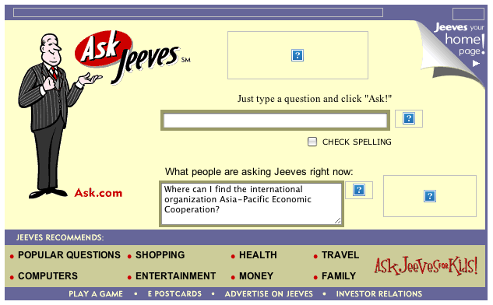
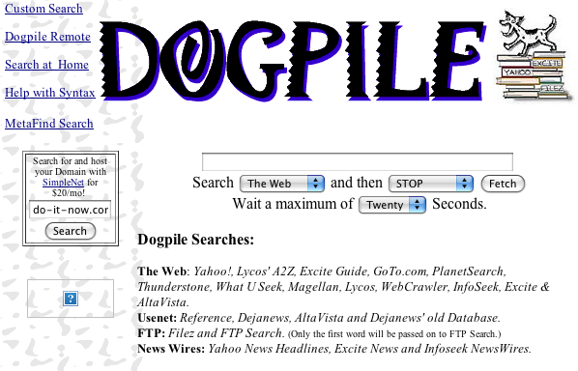
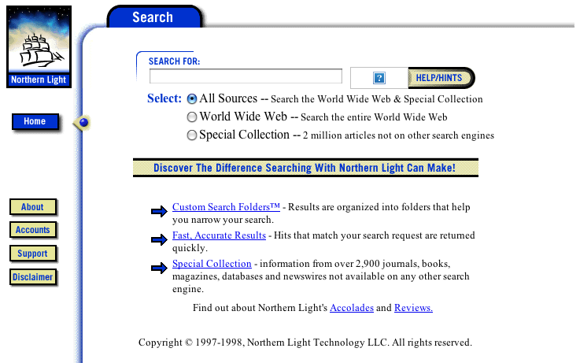

Slide 4
Methodology
Subject specialists
Notes:
7 Subject specialists from 3 disciplines:
3 from sciences
2 from humanities
2 from social sciences
Blind to purpose of study
Asked them to give us 3 things...

Slide 5
How does the acquisition and use of a second language in children affect their general cognitive development?
Notes:
A question they would typically receive from a student
(humanities)

Slide 6
(bilingual* OR L2) AND
(child* OR toddler) AND “cognitive development”
Notes:
A structured query they would use to search a database

Slide 7
Linguistic and Language Behavior Abstracts
Notes:
The database they would use to search for that question

Slide 8
Academic Discipline | Database Query | Library Database
Science | (ACL or “anterior cruciate ligament*”) and injur* and (athlet* or sport or sports) and (therap* or treat* or rehab*) | SportDiscus
Science | lung cancer and (etiol* or caus*) and (cigarette* or smok* or nicotine*) | Medline
Science | “dark matter” and evidence | Applied Science and Technology Abstracts
Social Science | (“fast food” or mcdonald’s or wendy’s or “burger king” or restaurant) and franchis* and (knowledge n3 transfer or “knowledge management” or train*) | Business Source Premier
Social Science | (“standardized test*” or “high stakes test*”) and (“learning disabilit*” or Dyslexia or “learning problem”) and accommodat* | PsycINFO
Humanities | (bilingual* or L2) and (child* or toddler) and “cognitive development” | Linguistics and Language Behavior Abstracts
Humanities | (memor* or remembrance or memoir*) and (holocaust) and (Spiegelman or Maus) | JSTOR
Notes:
This is what things looked like after we got all the information back from the librarians

Slide 9
Methodology
Search using query
Notes:
Then we took that information and used it in 2 ways.

Slide 10

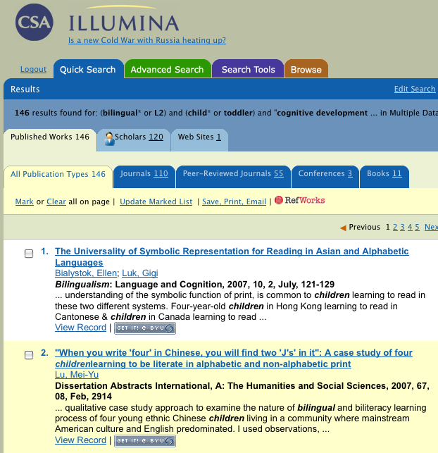
Native database results
Notes:
The first was to actually run the search query in the suggested database.
We put the first 30 citations into a bibliographic citation manager and saved all of the actual full text
We chose 30 because usability studies (Jakob Neilsen) tell us that less than 1% of all users ever go beyond the 3rd page of results and very few people ever change the defaults (ie, once they run a search they stick with it, success or failure).
Most of our DBs present 10 results per page so 30 results should represent a large enough sample to represent the actual set of results the majority of our users is ever going to see after performing a search.

Slide 11
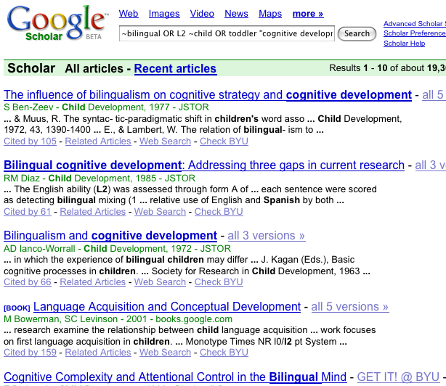
Google Scholar results
Notes:
We ran the same query in Google Scholar and saved the results again in a bibliographic Manager.
We used Zotero to quickly export all of the results.
We also saved the full text of each citation for later use in our study.

Slide 12
Methodology
Search using citations
Notes:
So, the first searches we ran using the native DBs and GS was for the query given to us by the librarian
The second set of searches we ran was to see if the citations we found in the DB were available in GS and vice versa

Slide 13
Is this citation available in Google Scholar?
Notes:
Here is the same screenshot we saw just a minute ago.
We took the bibliographic information for each citation and searched for the citation within Google Scholar.

Slide 14
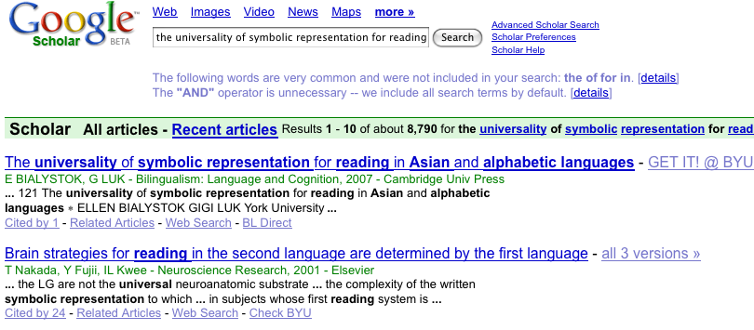
Yes, it is available
Notes:
We then did the same thing in reverse.
We took the 30 results from GS and searched for each citation within the database

Slide 15
in
DB
in GS
in both
Exclusivity
Notes:
This allowed us to later calculate something we called “exclusivity”
We put the citations into 1 of 3 possible “exclusivity” categories
Shows proportion of citations within our study that overlap. As you can see, within our study we found that, on average, GS had a larger result set overall as well as more exclusively than the databases.

Slide 16
Methodology
Citation grading
Notes:
So now that we have the citations from the database and the citations from Google Scholar. We used the bibliographic manager to generate a list of references that we input into an Excel spreadsheet. Then, using a random number table, we completely randomized the order of the citations for each subject specialist.

Slide 17
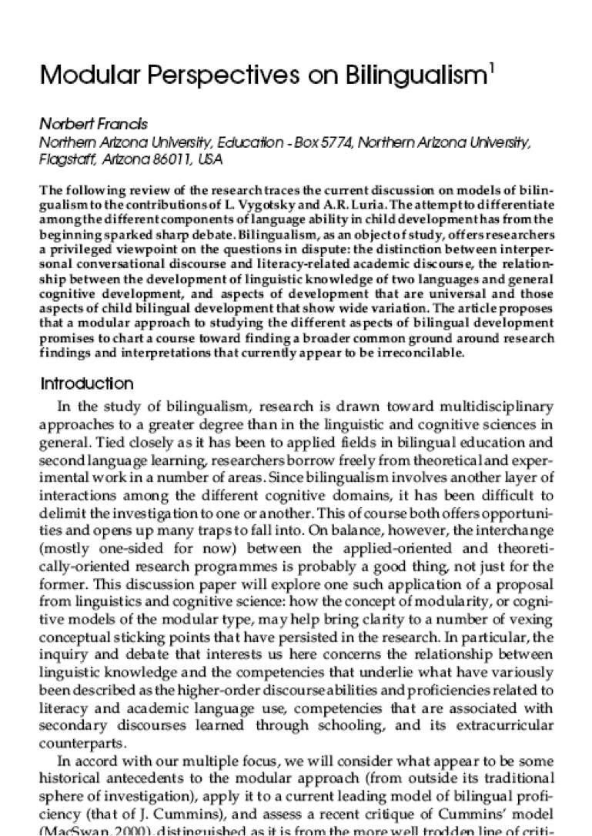
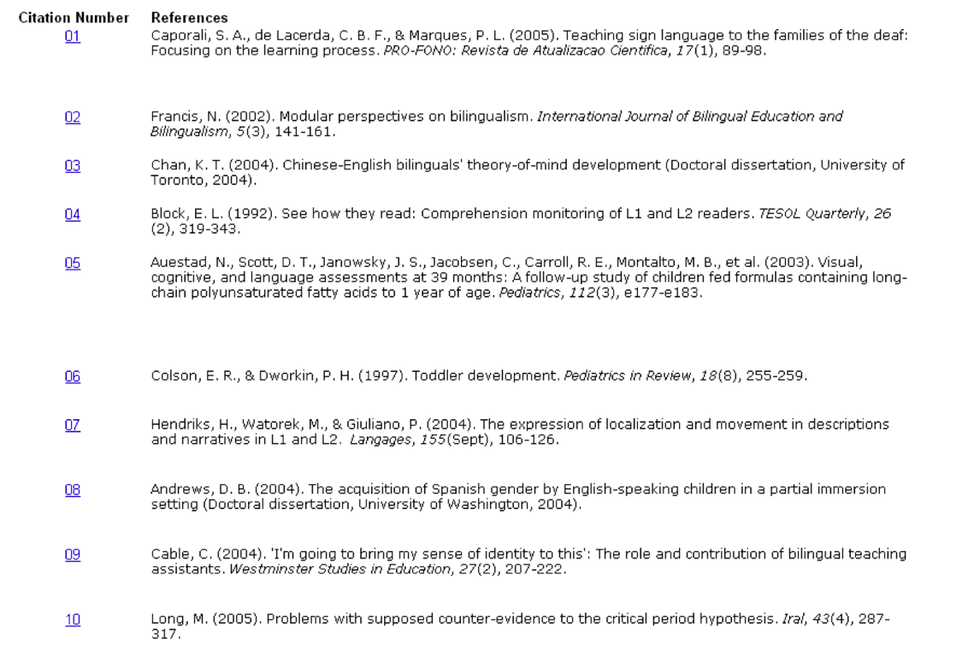
Notes:
Finally, to deliver the content to the librarians in a way in which it would be easiest for them to evaluate, we saved the full-text of each citation according to its randomly assigned citation number. Then we used Excel to create hyperlinks to the full-text of each citation and delivered this list along with the full-text on a CD to the subject librarians. We asked them to evaluate each citation using a rubric which we provided in hard copy form. As you can see, the subject librarians were only able to see the citation number and the bibliographic information. By clicking on the hyperlinked citation number, the full-text of that citation would appear and the subject librarians could easily rate the citation on the rubric.
Have full text appear on this page after click to simulate linking from provided document.

Slide 18
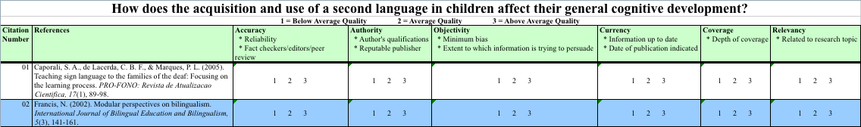
Accuracy:
Authority:
Objectivity:
Currency:
Coverage:
Relevancy:
reliability, fact checkers/editors, peer review
author’s qualifications, reputable publisher
minimum bias, extent to which persuasion is the goal
information up to date, date of publication indicated
depth of coverage
related to research topic
Rubric and Full Text
Notes:
This screen shows the rubric that we used. It is based on a rubric that has popularly been used to evaluate print resources (Alexander, 1999)
Alexander, J. E. (1999). Web wisdom: How to evaluate and create information quality on the Web.
We asked each subject librarian to assign a score of between 1 and 3 within 6 different categories to each of the citations (1 was below average, 2 was average and 3 was above average).
These six categories were:
Accuracy – which looks at
Authority – specifically the
Objectivity – looking for
Currency – is the information up to date?
How deep is the Coverage
And finally Relevancy – how well does the citation relate to the research question
This resulted in a total possible score of 18 for each citation - we called this a scholarliness score

Slide 19
Methodology
total scholarliness score = μ + Ei + Lj + ELij + εijkl
  where
    μ = Average total score
E = Effect due to exclusivity (i = 1, 2, 3)
L = Effect due to librarian (j = 1, 2, ... 7)
EL = Interaction between exclusivity and librarian
ε = Error term
Notes:
We used this statistical model to evaluate the data. Essentially this formula says 2 important things about the way we used the data:
1. We controlled for the differences between the way librarians grade
2. We controlled for the differences in how exclusively the citation was available
This allowed us to pinpoint and measure any differences there may have been between disciplines in our data as well as any differences that can be attributed to the source of the citations

Slide 20
Results
Google Scholar was 17.6% more scholarly
Notes:
Citations found only in GS had, on average, a 17.6% higher scholarliness score than citations found only in the DB

Slide 21
Results
Highest scholarliness score when found in both
Notes:
Citations found in both GS and the DB were even higher than citations found only in GS

Slide 22
Results
No difference between disciplines
Notes:
We found no statistically significant difference in the scholarliness scores between disciplines (ie, humanities citations in GS are just as scholarly as science citations found in GS)

Slide 23
Participant | Found Only in Database Average Score | Found Only in GS Average Score | Percent Change in Scholarliness Score Between the Database and GS | Found in Both Average Score
1 | 11.7 | 16.1 | 36.8% | 13.5
2 | 13.2 | 13.8 | 4.5% | 14.6
3 | N/A | 12.0 | N/A | 15.6
4 | 10.0 | 13.5 | 35.0% | 14.3
5 | 10.0 | 11.6 | 16.0% | 11.5
6 | 11.7 | 12.8 | 8.5% | 14.3
7 | 16.5 | 14.4 | -12.7% | 13.9
Least Squares Mean | 11.9 | 14.0 | 17.6% | 14.2

Slide 24
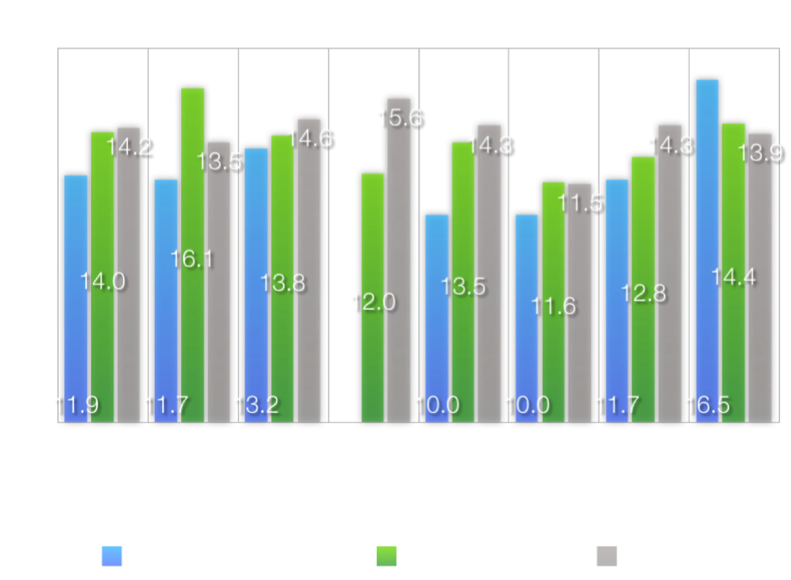

Slide 25
Participant | Percent of database citations in GS | Percent of GS citations in database
1 | 76.7% | 0.0%
2 | 83.3% | 43.3%
3 | 100.0% | 96.7%
4 | 96.7% | 80.0%
5 | 93.3% | 28.0%
6 | 0.0% | 46.7%
7 | 81.8% | 34.5%
AVERAGE | 76.0% | 47.0%

Slide 26
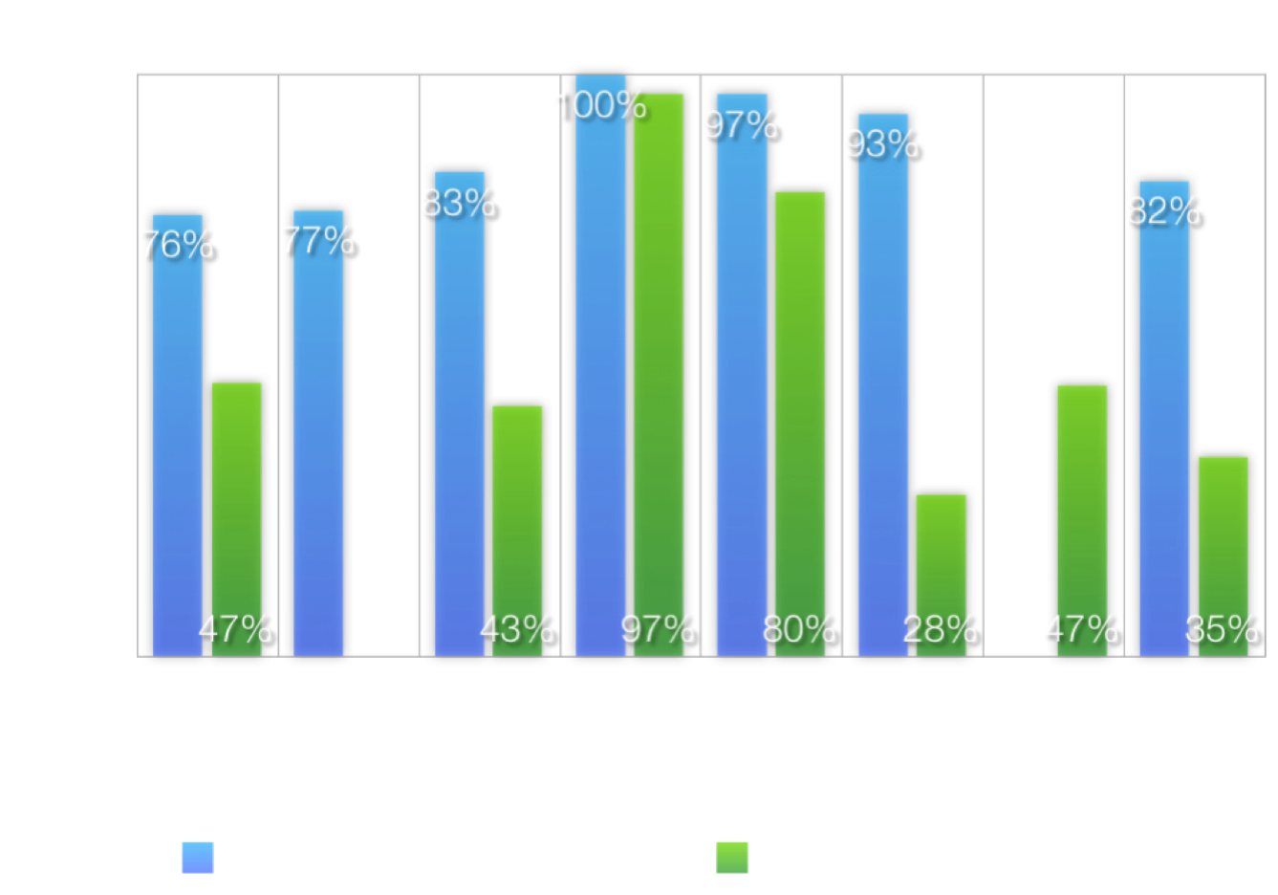

Slide 27
Future Studies
Generally applicable results
Notes:
This study can only be extrapolated statistically to the specific topics and subject specialists used in this study
A more robust statistical methodology would need to be employed to make these results generally applicable
We are encouraged by the results we received and feel that they would probably hold up but cannot say so until another study is done

Slide 28
Future Studies
Improved rubric
Notes:
If we had to do it over again, we would have increased the Likert scale on our rubric from 1-3 to 1-7 or 1-10
This would have allowed for a more nuanced statistical analysis and made it easier to spot significant differences, if any, between GS and databases

Slide 29
Future Studies
Scholarliness calculation
Notes:
Our scholarliness calculation, ultimately, was based on the subjective opinions of librarians with subject expertise.
There are lots of ways to create a scholarliness score (citation counts, impact factors, etc). Which is best is still debatable

Slide 30
Future Studies
Comparison to federated searching
Notes:
Our study compared GS to individual library databases. A more appropriate comparison may be GS to federated search tools.

Slide 31
Questions?
jared_howland@byu.edu
tom_wright@byu.edu
rebecca_boughan@byu.edu
http://dspace.byu.edu/handle/1877/634

