Slide 1

Licensed Databases vs. Google Scholar:
Which is more Scholarly?
Jared Howland
Tom Wright

Slide 2
Background

Slide 3
Methodology in 10 semi-easy-to-follow steps

Slide 4
step 1
Multiple disciplines

Slide 5
step 2
Question

Slide 6
How does the acquisition and use of a second language in children affect their general cognitive development?

Slide 7
step 3
Database query

Slide 8
bilingual* and child* and "cognitive development"

Slide 9
step 4
Database

Slide 10
Linguistics and Language Behavior Abstracts

Slide 11
step 5
Translate query

Slide 12
~bilingual ~child "cognitive development"

Slide 13
step 6
Perform searches

Slide 14
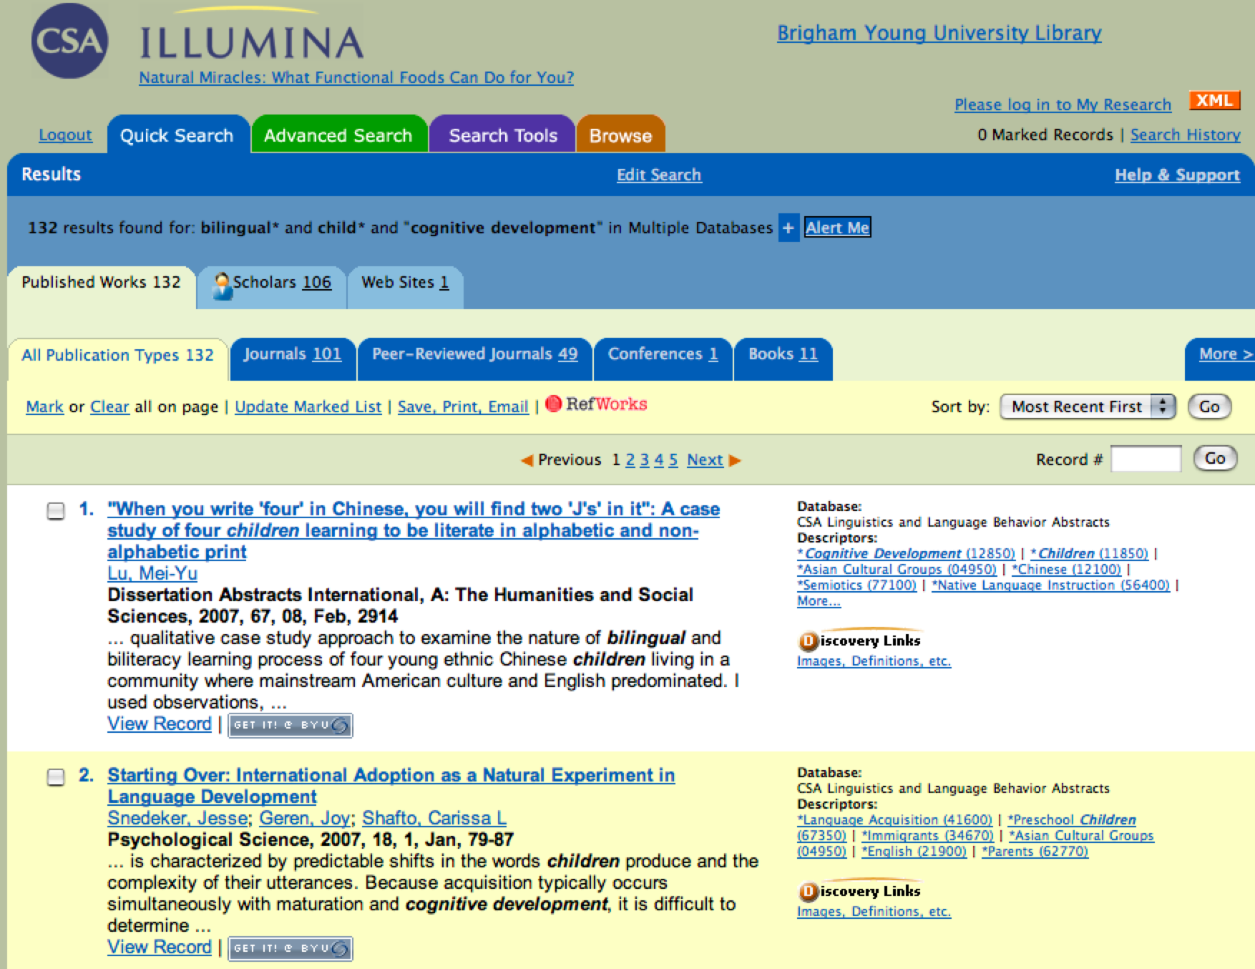
Search database

Slide 15
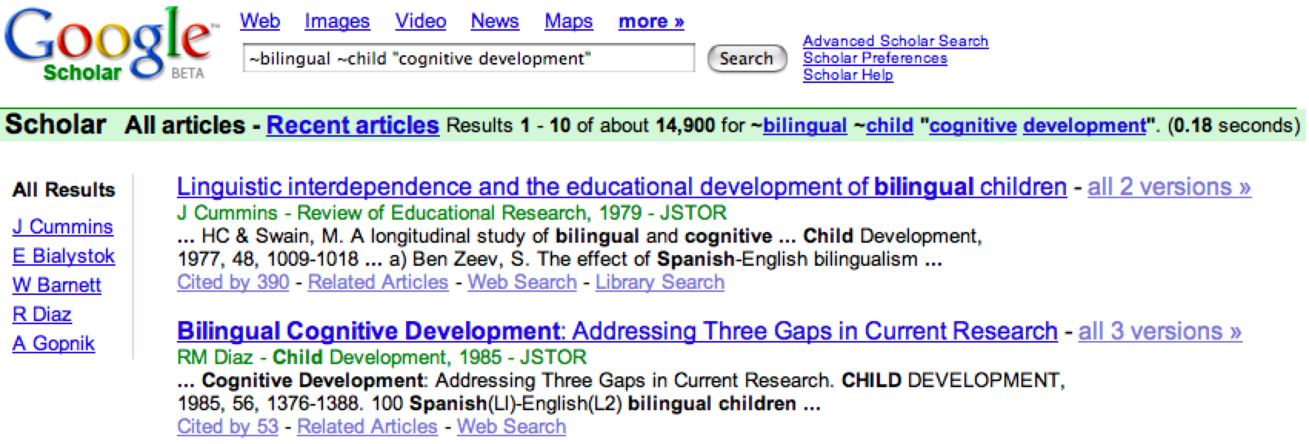
Search Google Scholar

Slide 16
step 7
Determine if citations found in one resource are available in the other (exclusivity)

Slide 17
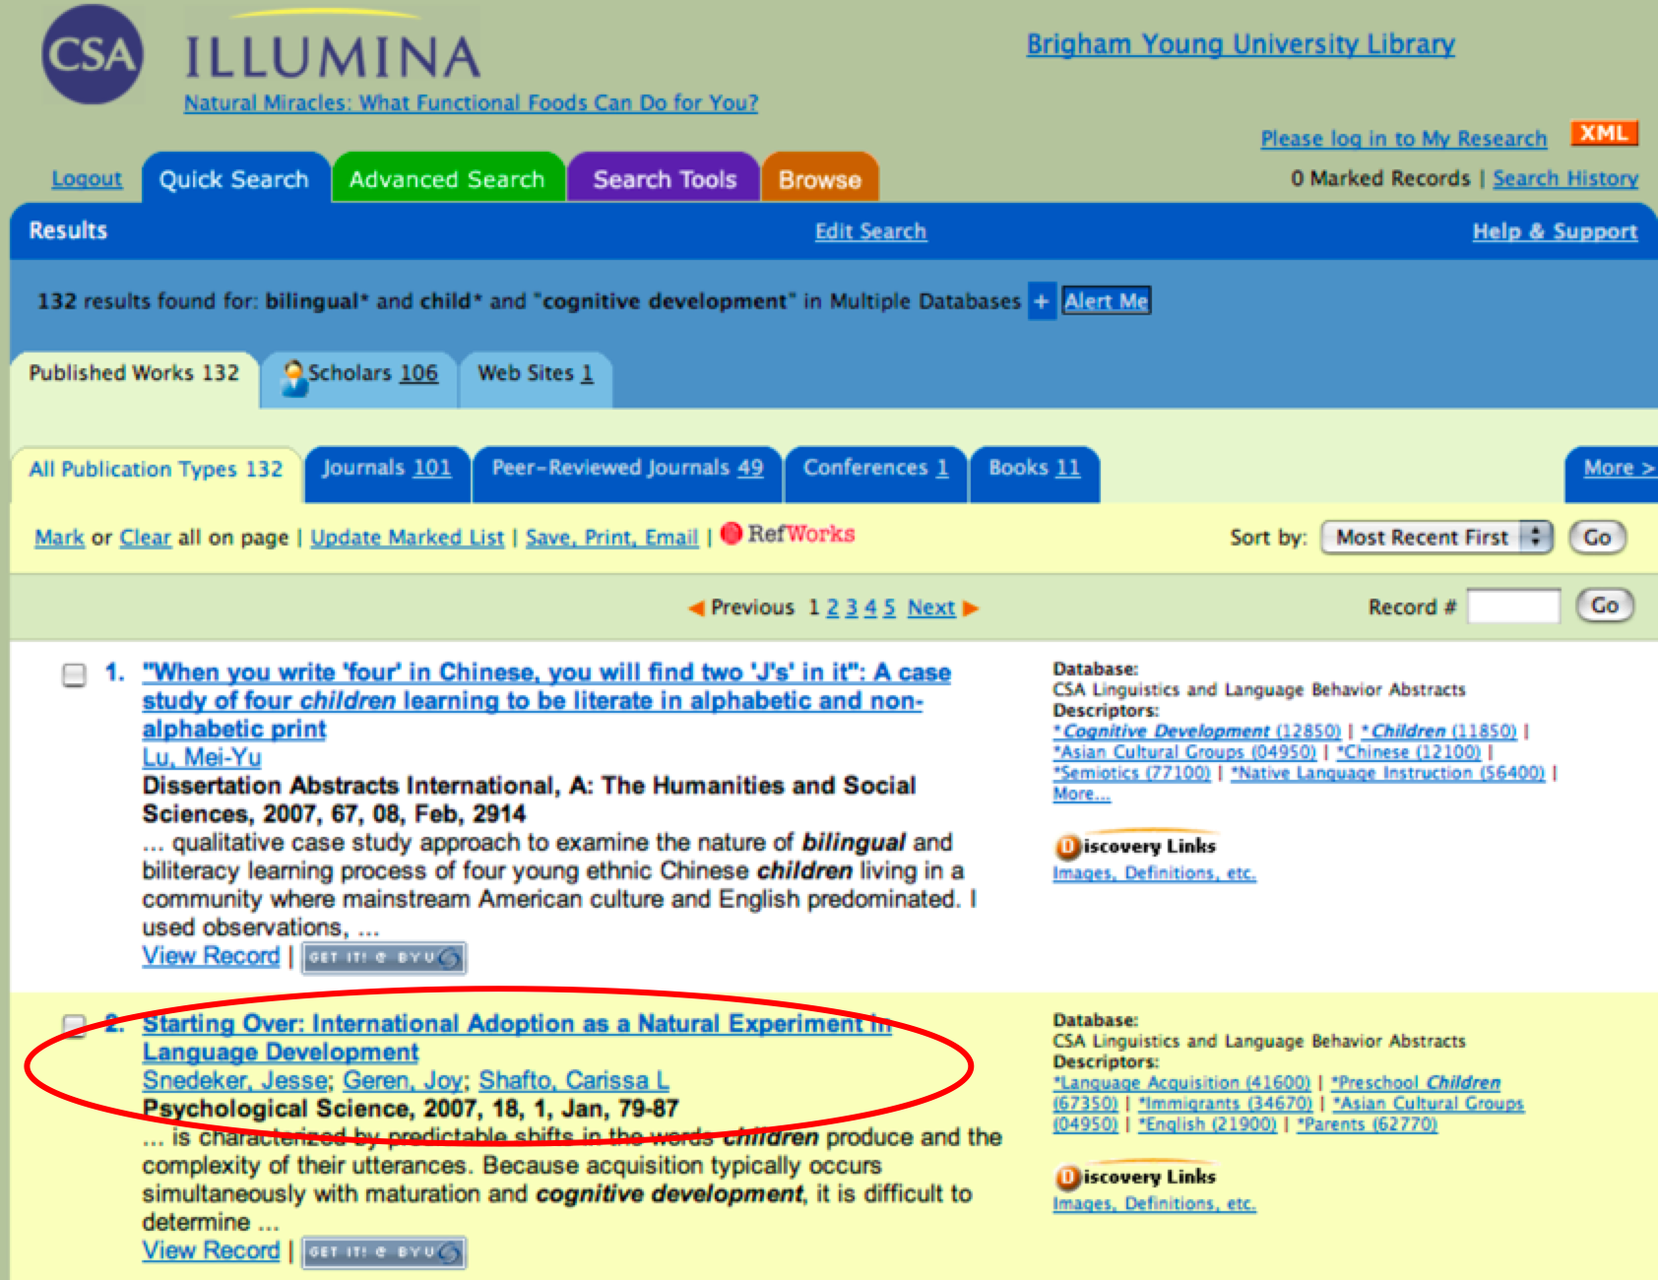
Database citation

Slide 18
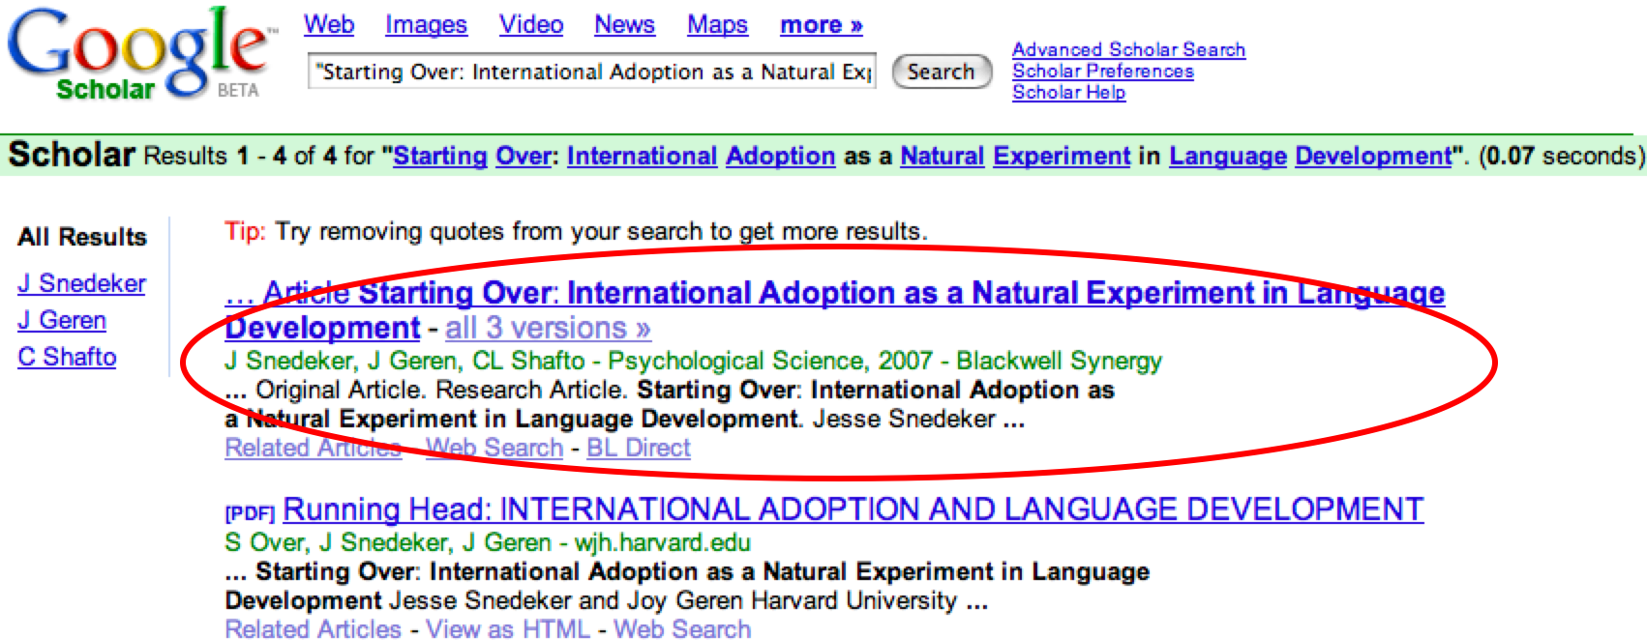
Found in Google Scholar

Slide 19
step 8
Standardize citations

Slide 20
step 9
Randomize citations

Slide 21
step 10
Grade citations

Slide 22
Rubric

Slide 23
Results

Slide 24
Google Scholar is on average more scholarly
14.2 vs 13.6
Notes:
(14.2-13.6)/13.6

Slide 25
total score = μ + E_{i} + R_{j} + ER_{ij} + ε_{ijkl}
Where: μ = Average total score
E = effect due to exclusivity
R = effect due to reseacher ε = error term

Slide 26
No statistically significant difference between disciplines

Slide 27
Statistically significant difference for exclusivity

Slide 28
Exclusivity Comparisons
Participant | DB Average Score | GS Average Score | Both Average Score
1 | 11.7 | 16.1 | 13.5
2 | 13.2 | 13.8 | 14.6
3 | N/A | 12.0 | 15.9
4 | 10.0 | 13.5 | 14.3
5 | 10.0 | 11.6 | 11.9
6 | 11.8 | 12.8 | 14.3
7 | N/A | 14.4 | 14.4
Notes:
.3675
.0454
.35
.16
.0847

Slide 29
Questions

