Slide 1
Of Lending and Licensing
Gerrit van Dyk (Interlibrary Loan)
Jared L. Howland (Licensing)

Slide 2
From “Chapter 8: Electronic Resources & Interlibrary Loan” in
Survey of Database Licensing Practices. New York, N.Y: Primary Research Group, 2011.
Notes:
Primary Research Group just published a study on library database licensing trends. In it, it had some interesting figures related to ILL and licensing of eContent. 3 out of 4 libraries surveyed have not tried to renegotiate their database licenses to allow for ILL lending.

Slide 3
From “Chapter 8: Electronic Resources & Interlibrary Loan” in
Survey of Database Licensing Practices. New York, N.Y: Primary Research Group, 2011.
Notes:
Only 42% said they even keep records for their licensing.

Slide 4
Notes:
If you library is like ours, we have seen a steep drop in print acquisition and just as steep climb in electronic acquisitions of serials. Print: blue; Serials Purple.
As more an more titles are going digital, we will all have a harder time filling journal and ebook requests if 3 out of 4 libraries do not try to get rights to lend electronically. In essence, interlibray loan as a service would not only suffer but would be in danger of irrelevance.
Jared’s going to talk about what we can be doing at our institutions to be more proactive about licensing eContent for ILL.

Slide 5

Notes:
Step 1: Find out who licenses resources for your library. Their office will look like this.

Slide 6

Notes:
Step 2: Find out if your licensing guru is asking for lending rights. IF not, request that lending rights be requested every time a license is negotiated.

Slide 7
http://link.jaredhowland.com/licensing_language
Notes:
Step 3: Offer example language for lending rights. Example language can be found in what is called the “Standard License Agreement”. Specifically, the URL here has an example license agreement that includes favorable lending language on pages 2–3.

Slide 8


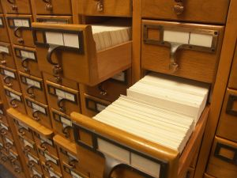
Notes:
Step 4: Start tracking your license agreements. Preferably using an Electronic Resource Management System (ERM), but anything is preferable to nothing. If your licensing guru is already tracking this, find out how you can access and use this data.
Step 5: Do not, as a policy, prohibit electronic lending. Instead, find ways to lend – restructure, redesign do whatever you need to. Work with your licensing person to find out the best way to find out what lending rights are available.
Step 6: Work with cataloging to make sure records of electronic content that can be lent are loaded into OCLC.

Slide 9

“Riddle me this…”
Notes:
So the question is, once you find the few titles you can’t lend…how do you just deflect them and not everything? Wouldn’t it be great if there was a way to only deflect those individual titles but not everything else?

Slide 10
008 8312254p####6###3###baeng0831017
a Will Lend
b Will Not Lend
c Will Lend Hard Copy Only
l Limited Lending Policy
u Unknown
http://www.loc.gov/marc/umh/UMHpt7-9.html
Notes:
There is a way! Our friends in the MARC world thought of it a long time ago. Character 20 on a 0-20 scale in the 008 field of the MARC Holdings record will designate an item Will Lend, Will Not Lend, Will Lend Hard Copy Only, Limited Lending Policy, or Unknown.
For those non catalogers in the room, what does this mean?

Slide 11
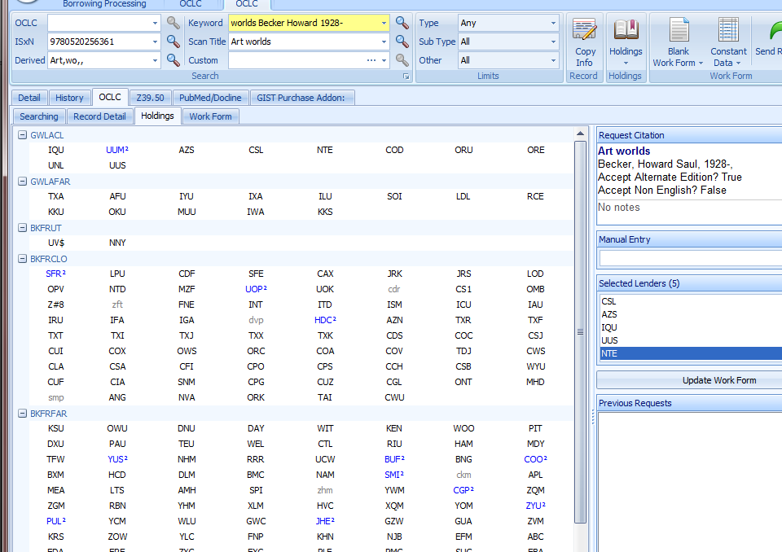
Notes:
This is how it SHOULD work in ILLiad:
It should make your library a non-supplier for just that item…not everything.
What actually happens is it allows you to select the library but the borrower gets an autodeflect notice: Autodeflection: request type

Slide 12
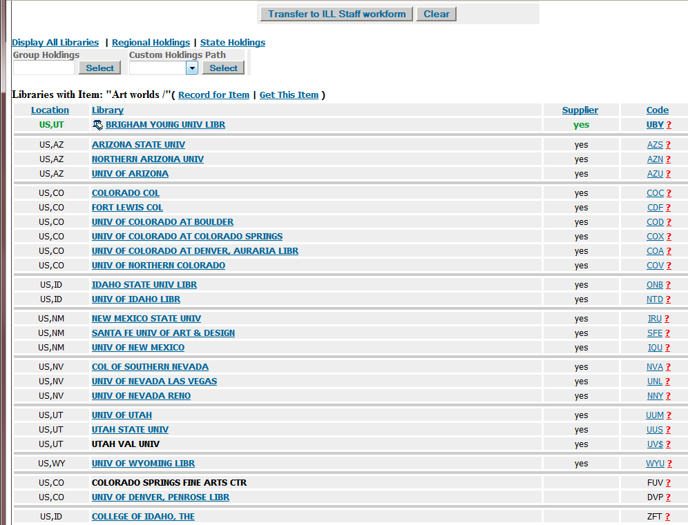
Notes:
Or if you use OCLC resource Sharing:
It makes you a non-supplier of that item, at the bottom of everyone’s custom holdings.

Slide 13
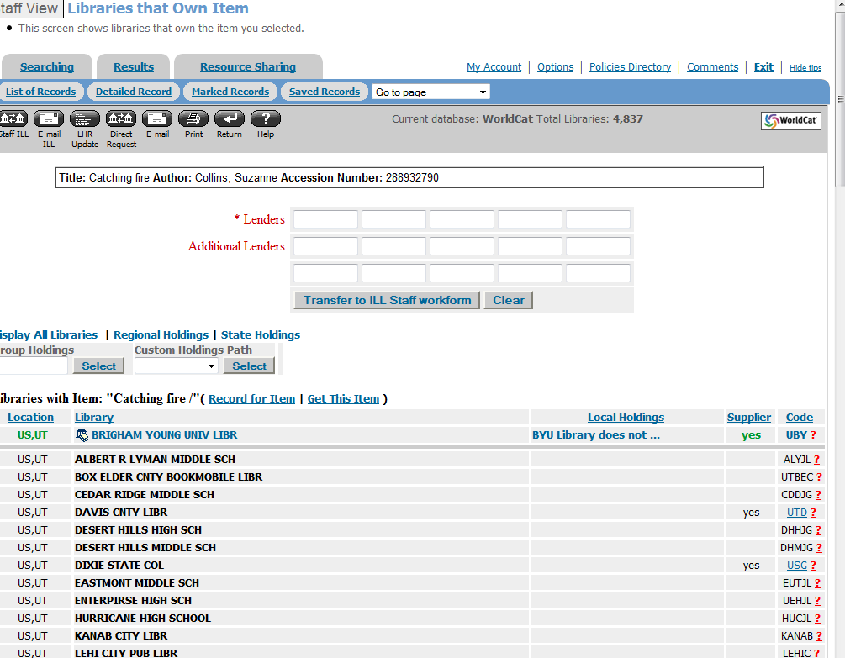
Notes:
In reality, however, this is how it really works:
You are still totally visible and show up as a supplier but then the requesting library gets a deflection notice: Auto-Deflection: request type

Slide 14


Notes:
Other option: don’t send up holdings for those journals. That’s what we do… our journals do not even show up—those that we can’t lend

Slide 15

Notes:
Conclusion:
We need to ask our vendors for ILL privileges
We need to keep track of the license agreements
We need to either deflect only those titles we can’t lend, or possible just not send up our holdings for those items until we intend to lend

Slide 16

gerrit_vandyk@byu.edu
jared_howland@byu.edu
Notes:
Q/A

