Slide 1
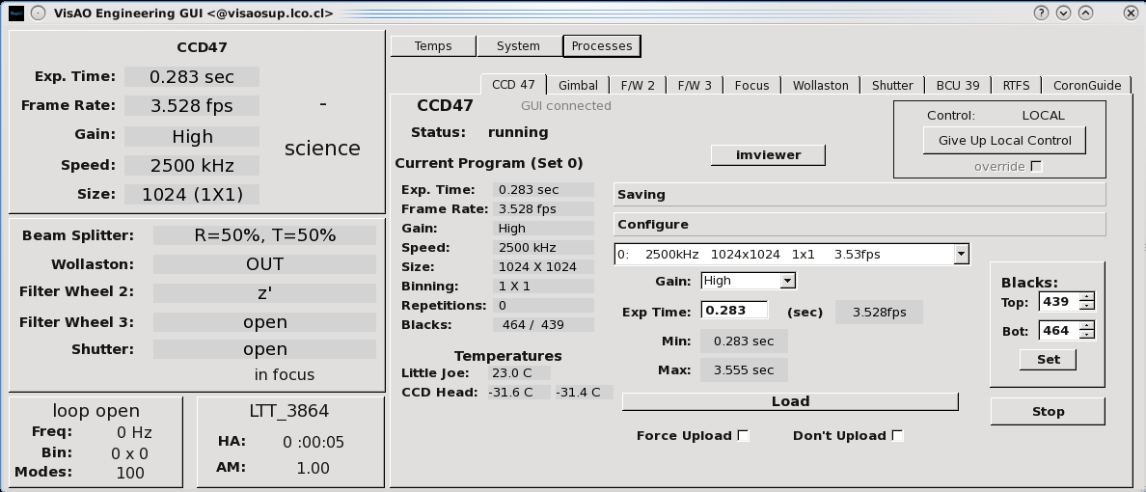
System Information
Buttons
Component Tabs
Process Status Area
CCD47 Status
Camera Configuration
Gimbal and Focus status
AO Loop Status
Pointing Information
Component Control Panels

