Slide 1
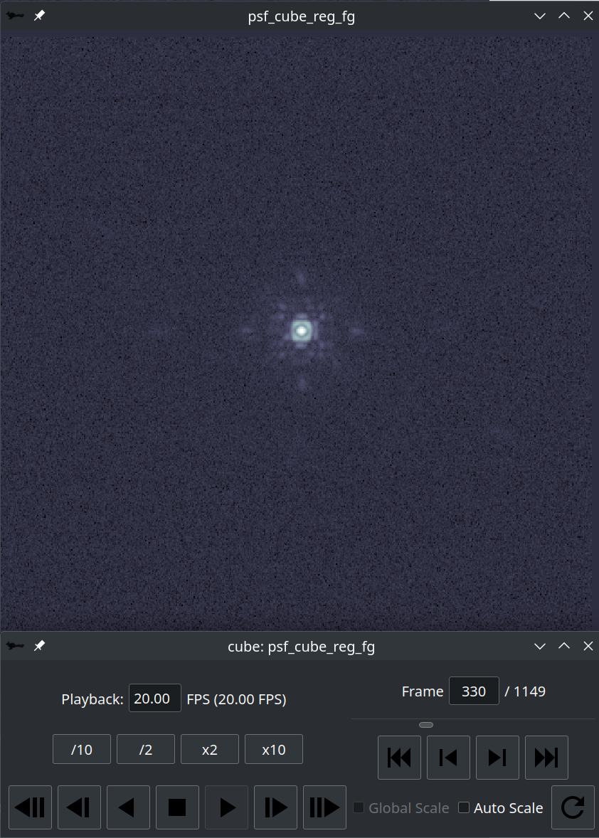
Frames Per Second (FPS) for playback. Enter the desired FPS. The number in parens will update with the current effective FPS.
Change to a
frame number.
frame slider
Change desired FPS by factors of 2 or 10.
Playback controls. Fast-forward/backward do not change desired FPS
-10 -1 +1 +10
re-stretch
bwd bwd bwd stop fwd fwd fwd
x10 x2 x1 x1 x2 x10

