Slide 1
机器人,传感器, 电机
机器人软件包
传感器软件包
相机
深度相机
激光测距传感器
电机软件包
Dynamixel
如何使用开源软件包

Slide 2
传感器软件包

Slide 3
传感器软件包的类型
一维测距仪
可以用于制造低成本机器人的红外线性距离传感器
二维测距仪
可以测量2D平面上的距离的传感器，主要用于导航
3D 传感器
3D距离测量中使用的传感器，例如英特尔的RealSense，微软的Kinect，华硕的Xtion
音频/语音识别
当前，与语音识别相关的部分很少，但在不断增加
相机
用于对象识别，面部识别，字符识别等的相机驱动程序以及各种应用程序包
传感器接口
很少有传感器支持Web协议
仍然有许多传感器可以从微处理器获取数据
这些传感器可与MCU中的UART或小型PC中的ROS一起使用.

Slide 4
练习
‘LRF, IMU, USB 相机,
深度相机, 机器人模型
让我们通过Rviz来检验’
使用PC的Rviz观察来自
已接收传感器的数据
4

Slide 5
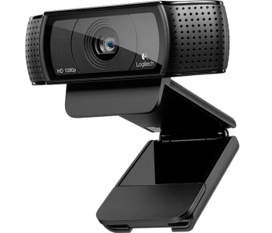
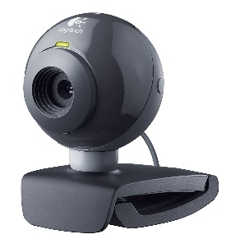
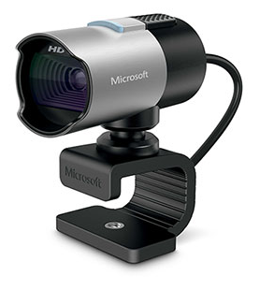
传感器包练习 #1 (USB 相机)
$ sudo apt-get install ros-kinetic-uvc-camera
$ rosrun uvc_camera uvc_camera_node
$ rosrun uvc_camera uvc_camera_node _device:=/dev/video?
$ rosrun image_view image_view image:=/image_raw
$ rqt_image_view image:=/image_raw
$ rviz
If there are more than two cameras,
Enter the device number you want to use instead of the question mark
(Especially, for notebooks)
Three ways to view image messages
* 选择Rviz展示选项
1) 改变固定坐标系
Global Options > Fixed Frame = camera
2) 添加图像展示
Click ‘Add’ in the bottom left corner of Rviz, then select Image
(Add > by display > Rviz > Image)
3) 改变话题
Change the value of ‘Image > Image Topic’ to "/image_raw"
5

Slide 6

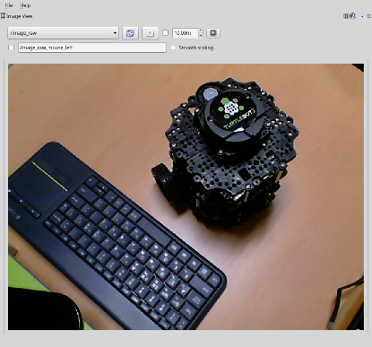


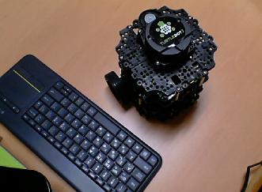
传感器包练习 #2 (远程传输图像)
Sensor PC
Remote PC
ROS_MASTER_URI = http://IP_OF_REMOTE_PC:11311
ROS_HOSTNAME = IP_OF_SENSOR_PC
ROS_MASTER_URI = http://IP_OF_REMOTE_PC:11311
ROS_HOSTNAME = IP_OF_REMOTE_PC
* Example of running ROS Master on a remote PC
修改 两个PC的‘~/.bashrc’ (ROS_MASTER_URI and ROS_HOSTNAME)
在远程PC执行 ’roscore’ & ’rqt_image_view image:=/image_raw
在传感器PC执行 ’rosrun uvc_camera’, ‘uvc_camera_node’

Slide 7
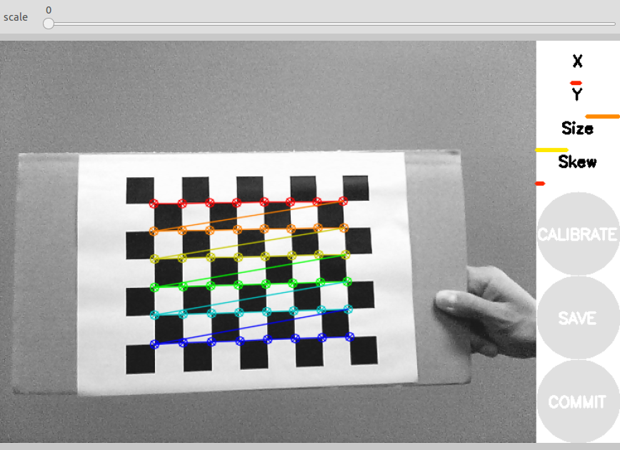
传感器包练习 #3 (相机标定)
$ sudo apt-get install ros-kinetic-camera-calibration
$ rosrun uvc_camera uvc_camera_node
$ rosrun camera_calibration cameracalibrator.py --size 8x6 --square 0.024 image:=/image_raw camera:=/camera

Slide 8
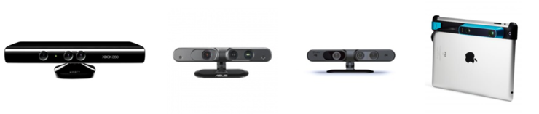
传感器包练习 #4 (深度相机)
$ sudo apt-get install ros-kinetic-openni2-camera ros-kinetic-openni2-launch $ tar -xvf Sensor-Bin-Linux-x64-v5.1.0.41.tar.bz2
$ cd Sensor-Bin-Linux-x64-v5.1.0.41/
$ sudo sh install.sh
$ roslaunch openni2_launch openni2.launch
(In case of ASUS’s Xtion)
$ sudo apt-get install ros-kinetic-astra-camera ros-kinetic-astra-launch
$ wget https://raw.githubusercontent.com/tfoote/ros_astra_camera/master/orbbec-usb.rules
$ wget https://raw.githubusercontent.com/tfoote/ros_astra_camera/master/install.sh
$ sudo ./install.sh
$ roslaunch astra_launch astra.launch
(In case of ASTRA)
* Change the display options of RViz
1) Change fixed frame
Change ‘Global Options > Fixed Frame’ to "camera_depth_frame"
2) Add & configure PointCloud2
Click ‘Add’ at the bottom left of rviz, then select PointCloud2
3) Change topic name & detail settings
8

Slide 9
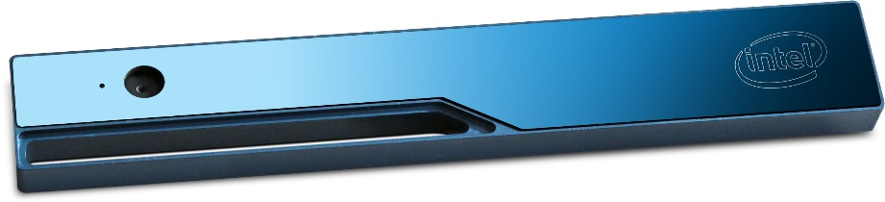
传感器包练习 #4 (深度相机)
(In case of RealSense)
$ sudo apt-get install ros-kinetic-librealsense ros-kinetic-realsense-camera $ roslaunch realsense_camera r200_nodelet_default.launch
$ rosrun rviz rviz -d rviz/realsenseRvizConfiguration1.rviz
* Change the display options of RViz
1) Change fixed frame
Change ‘Global Options > Fixed Frame’ to "camera_depth_frame"
2) Add & configure PointCloud2
Click ‘Add’ at the bottom left of rviz, then select PointCloud2
3) Change topic name & detail settings
9

Slide 10
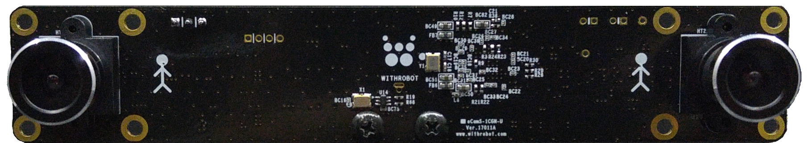
传感器包练习 #5 (立体相机)
$ sudo apt-get install libv4l-dev libudev-dev ros-kinetic-rtabmap*
$ cd ~/catkin_ws/src/ $ svn export https://github.com/withrobot/oCam/trunk/Software/oCamS_ROS_Package/ocams
$ cd ~/catkin_ws/ && catkin_make
$ sudo gedit /etc/udev/rules.d/99-ttyacms.rules
ATTRS{idVendor}=="04b4" ATTRS{idProduct}=="00f9", MODE="0666", ENV{ID_MM_DEVICE_IGNORE}="1"
ATTRS{idVendor}=="04b4" ATTRS{idProduct}=="00f8", MODE="0666", ENV{ID_MM_DEVICE_IGNORE}="1"
$ sudo udevadm control --reload-rules
$ roslaunch ocams pointcloud.launch
(In case of oCam-Stereo)
https://github.com/withrobot/oCam/tree/master/Products/oCamS-1CGN-U
10

Slide 11
传感器包练习 #6 (LDS)
(In case of LDS)
$ cs
$ git clone https://github.com/ROBOTIS-GIT/hls_lfcd_lds_driver.git
$ cm
$ sudo chmod a+rw /dev/ttyUSB0
$ roslaunch hls_lfcd_lds_driver view_hlds_laser.launch
(In case of RPLiDAR)
$ cs
$ git clone https://github.com/robopeak/rplidar_ros.git
$ cm
$ sudo chmod a+rw /dev/ttyUSB0
$ roslaunch rplidar_ros rplidar.launch
(In case of HOKUYO)
$ sudo apt-get install ros-kinetic-urg-node
$ sudo chmod a+rw /dev/ttyACM0 $ rosrun urg_node urg_node
* 改变Rviz显示选项卡
1) 选择固定坐标系: Global Options > Fixed Frame = laser
2)添加和配置轴: Click ‘Add’ at the bottom left of rviz, then add Axes (Change ‘Length’ & ‘Radius’ is option)
3)添加和配置LaserScan: Click ‘Add’ at the bottom left of rviz, then add LaserScan
(Topic designation is required, ‘Color Transformer’, ‘Color’, etc. are options)
11

Slide 12
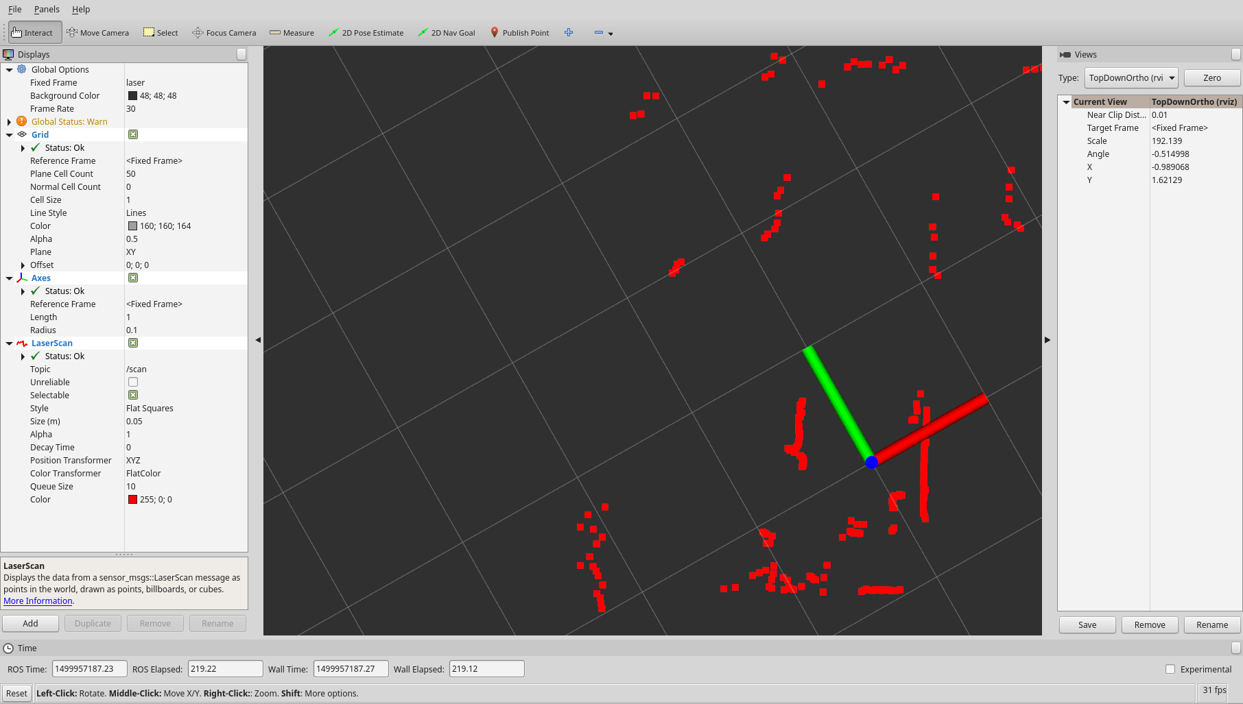
传感器包练习 #6 (LDS)
Views:TopDownOrtho
Fixed Frame：laser
Axis Length：1
Axis Radius：0.1
Topic name：/scan
Color Conversion Criteria：FlatColor
Color：255;0;0 (Red)
12

Slide 13
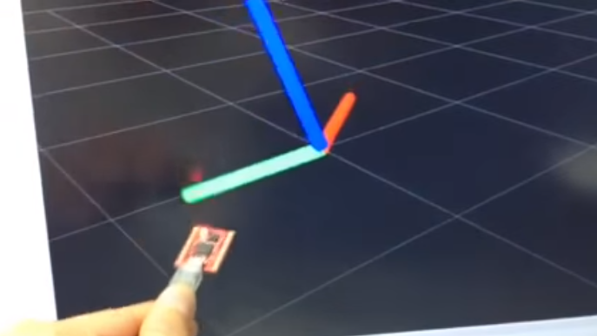
传感器包练习 #7 (IMU)
$ cs
$ git clone https://github.com/robotpilot/myahrs_driver.git
$ cm
$ sudo chmod a+rw /dev/ttyACM0
$ roslaunch myahrs_driver myahrs_driver.launch
(In case of withrobot’s myAHRS+)
13

Slide 14
电机驱动包

Slide 15
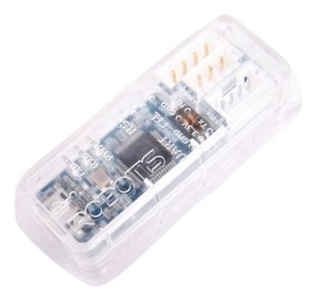

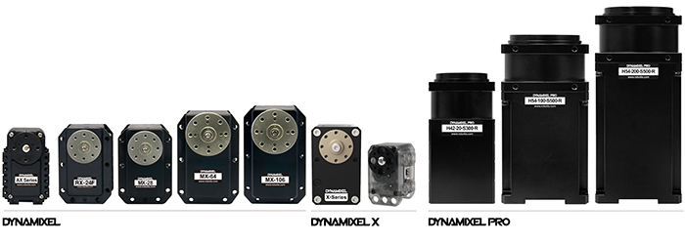
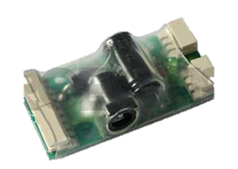
通过ROS 控制Dynamixel
DynamixelSDK (http://wiki.ros.org/dynamixel_sdk)
支持三大代表操作系统 (Linux, Windows, MacOS)
支持的编程语言有C, C++, C#, Python, Java, MATLAB, LabVIEW, etc.
支持 ROS
dynamixel_workbench (http://wiki.ros.org/dynamixel_workbench)
提供各种示例以方便在ROS中使用
在ROS下提供GUI工具
U2D2
SMPS2DYNAMIXEL
Dynamixel

