Slide 1

Genomic analysis of SARS-CoV-2 differences in Asymptomatic and Symptomatic Subjects
Jiayu Huang, Matthew Hibbs, and Jared Neikirk
11/28/2022

Slide 2
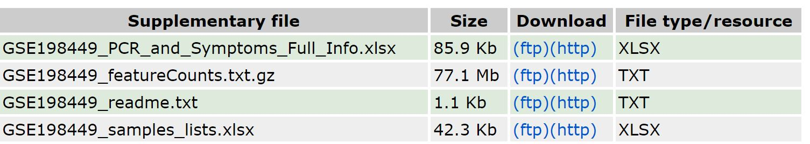
Introduction
Dataset
RNA Sequencing data performed on 475 subjects at different time points as part of a SARS-Cov-2 initial outbreak amongst Marine recruits tracking both symptomatic and asymptomatic individuals
~1858 RNA-seq data sets in total
Using RNA-seq data from blood from participants of the COVID-19 Health Action Response for Marines (CHARM) study, what features can we identify from asymptomatic participants that are different from participants with symptoms and how strong of a predictor is the feature?
https://www.ncbi.nlm.nih.gov/geo/query/acc.cgi?acc=GSE198449

Slide 3
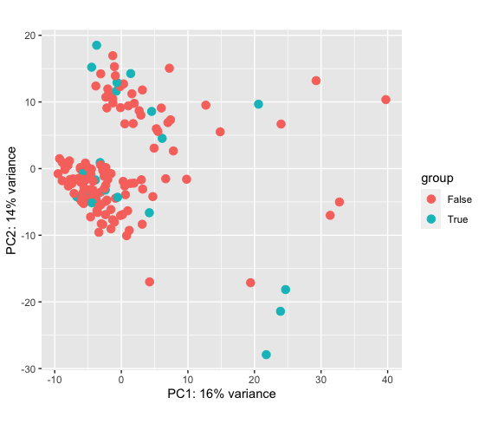
Introduction
PCA Plot
We can observe from the PCAPlot() that when constructing components that describe the features of our dataset – groups of people who are Symptomatic (TRUE) and those who are not (FALSE) – there is greater PC2 variance amongst the Symptomatic group and greater PC1 variance amongst the Asymptomatic group. However, overall the variance of the groups are quite similar.

Slide 4
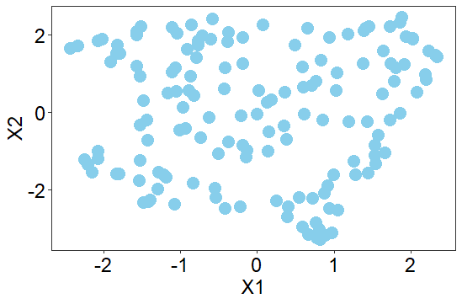
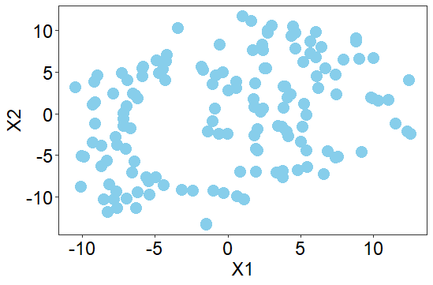
Introduction
UMAP
t-SNE
After performing Uniform Manifold Approximation and Projection (UMAP) on our dataset and reducing the dimensionality of the data, UMAP separates the clusters of our groups quite a bit amongst both axis, giving the plot great variance in the data/grouping of clusters. There is also a certain degree of structure to the plot in the sense that there doesn’t appear to be significant outliers on either axis, and data aggregates relatively close to each other overall.
The quality of data reconstruction for the t-SNE plot did not improve at large perplexity values.

Slide 5
Hypothesis
What features can we identify from asymptomatic participants that are different from participants with symptoms and how strong of a predictor is the feature?
If we can show that there is a sufficient amount of data supporting the relationship between a specific gene (or set of genes) and whether a positive COVID patient is asymptomatic or not, we could more accurately predict which patients would be asymptomatic before they have contracted the virus.

Slide 6
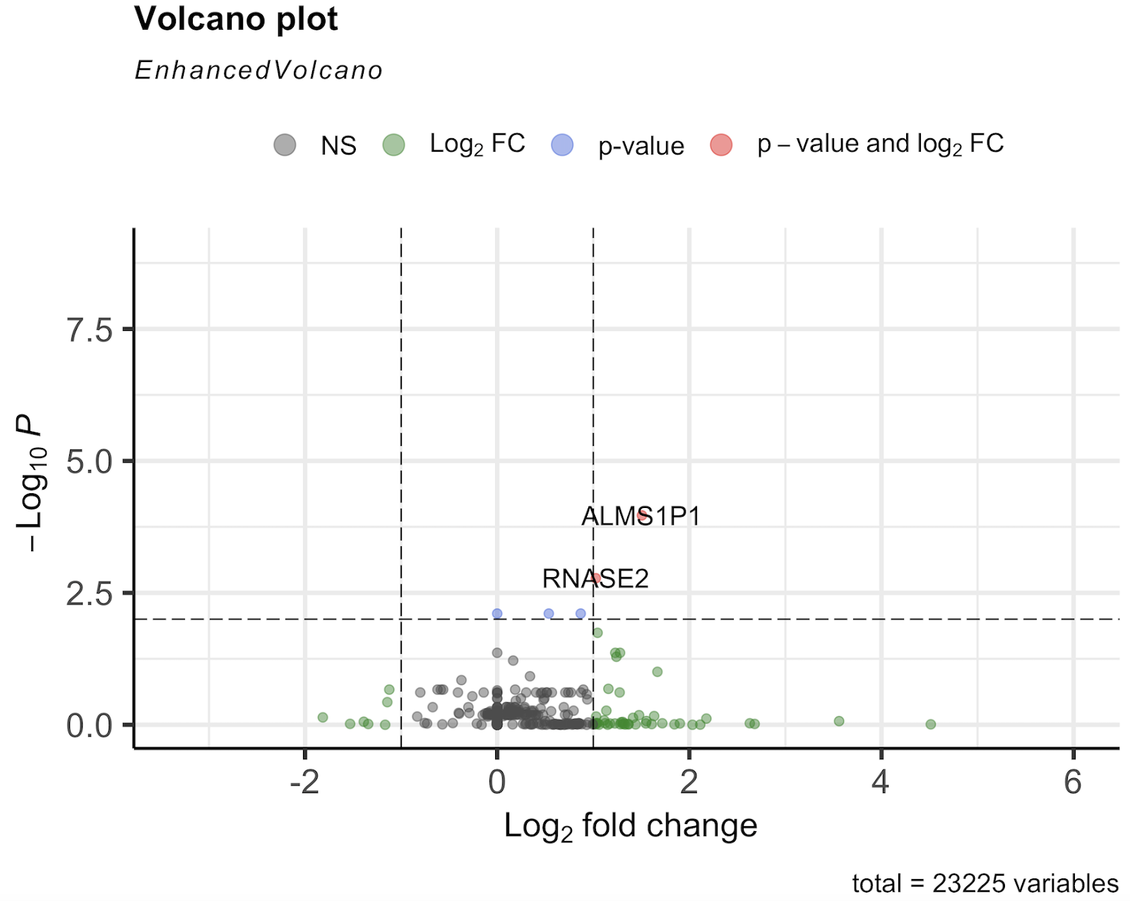
Differential Expression and Enrichment Analysis
Based on the volcano plot above, we observe that the ALMS1P1 and the RNASE2 gene are statistically significant and an outlier when attributing p-value and log2Fc. The log2 fold change of a couple outlier genes are also observed 2-4 times greater than around the median log2 fold change. The gene data itself is also quite spread out amongst the x (log2 fold change) axis.

Slide 7
Differential Expression and Enrichment Analysis
Gene set enrichment analysis
Source | Term ID | Term Name | P(adj)
GO:BP | GO:0036293 | Response to decreased oxygen levels | 3.053x10-2
GO:BP | GO:0098542 | Defense reponse to other organism | 4.288x10-2
HP | HP:0000007 | Autosomal recessive inheritance | 1.071x10-2
HPA | HPA:0210000 | Fallopian tube | 1.228x10-3
HPA | HPA:0060000 | bronchus | 1.150x10-2

Slide 8
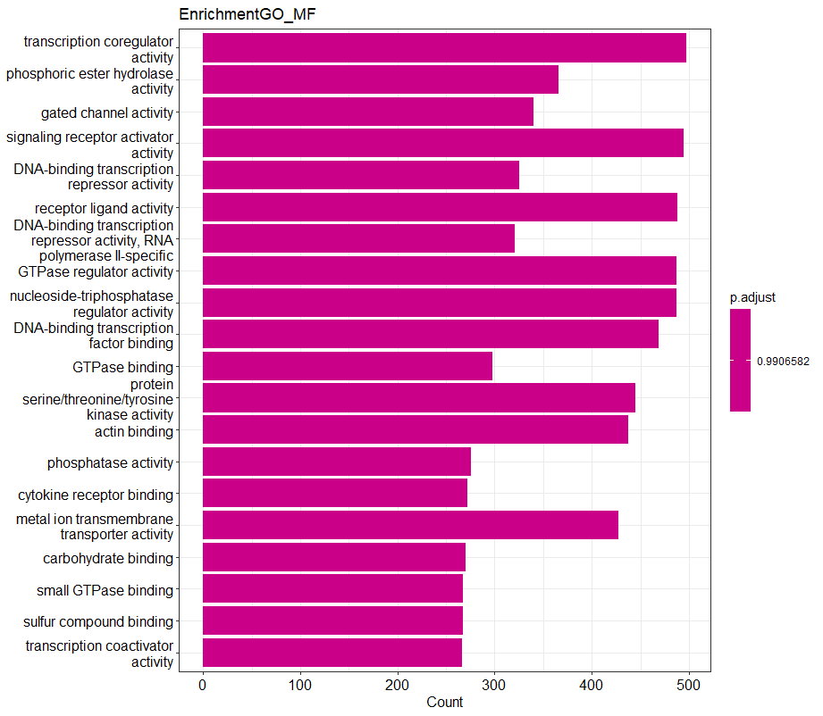
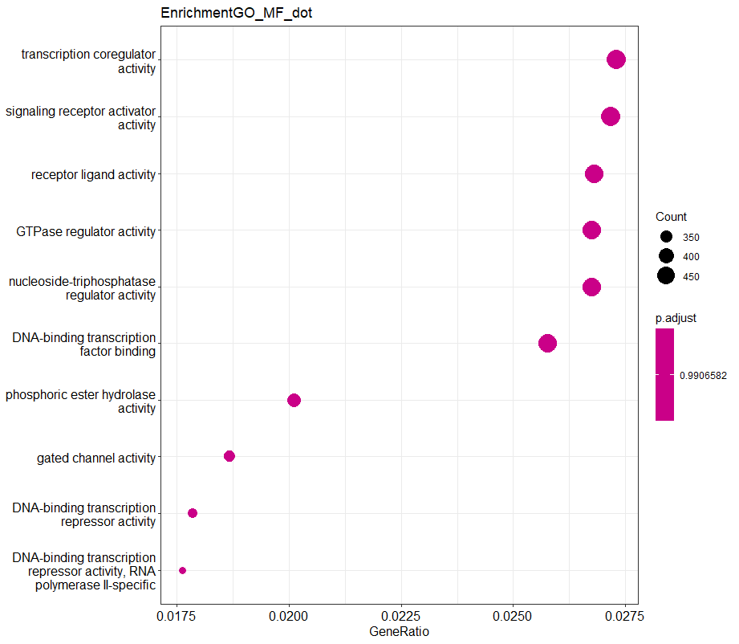
Differential Expression and Enrichment Analysis
ClusterProfiler

Slide 9
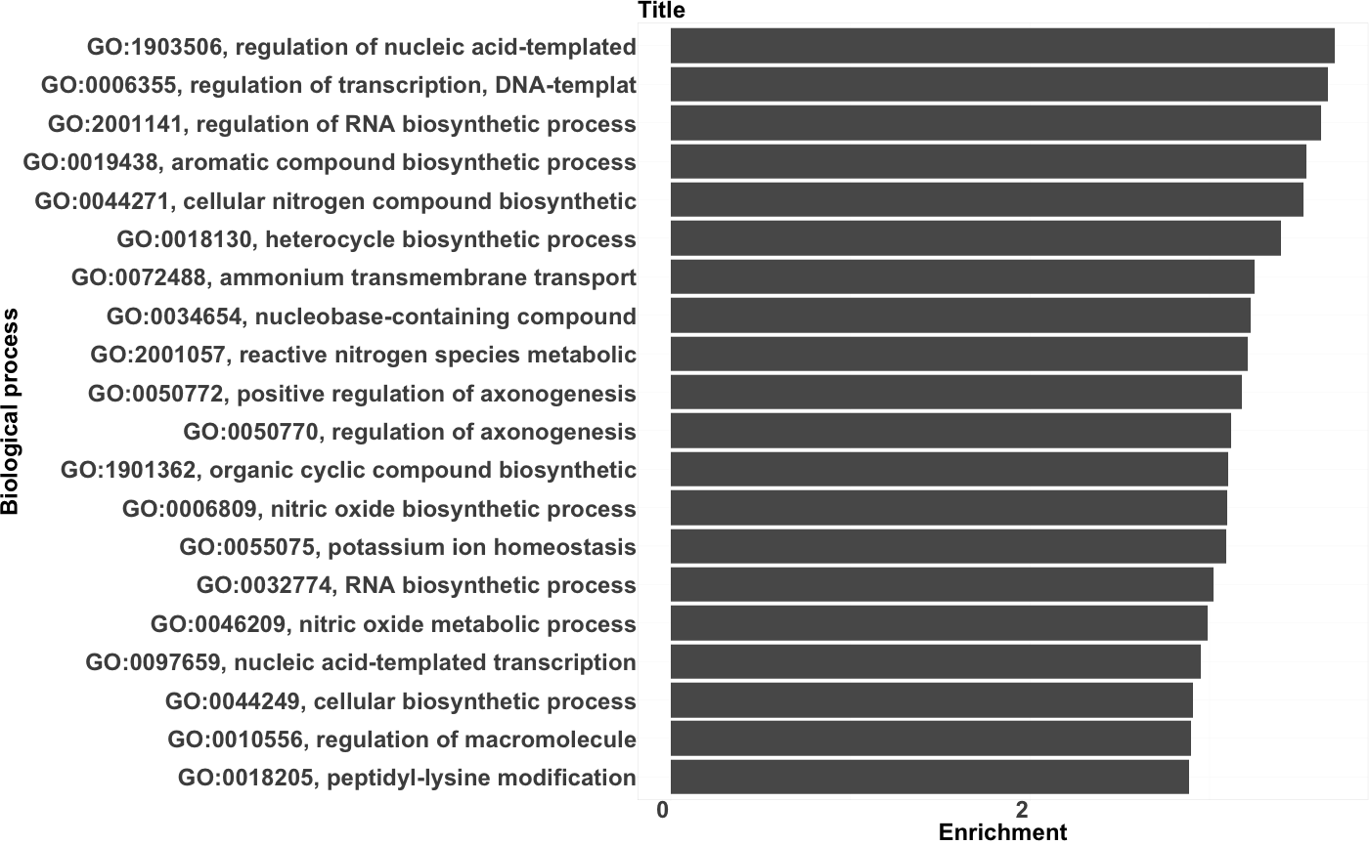
Differential Expression and Enrichment Analysis
topGO
topGO data object (with gene ontology) using significant genes from the dataset (<0.05) plotted using Kolmogorov-Smirnov (K-S) test to make use of the rank information provided from the data object
(as suggested here: https://www.biostars.org/p/350710/).

Slide 10
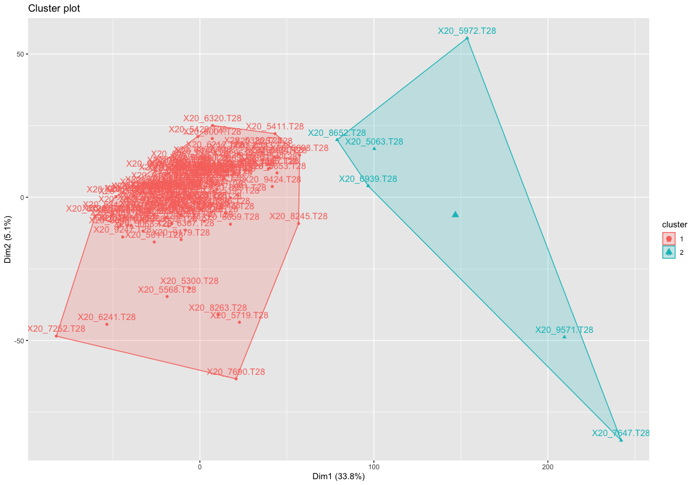
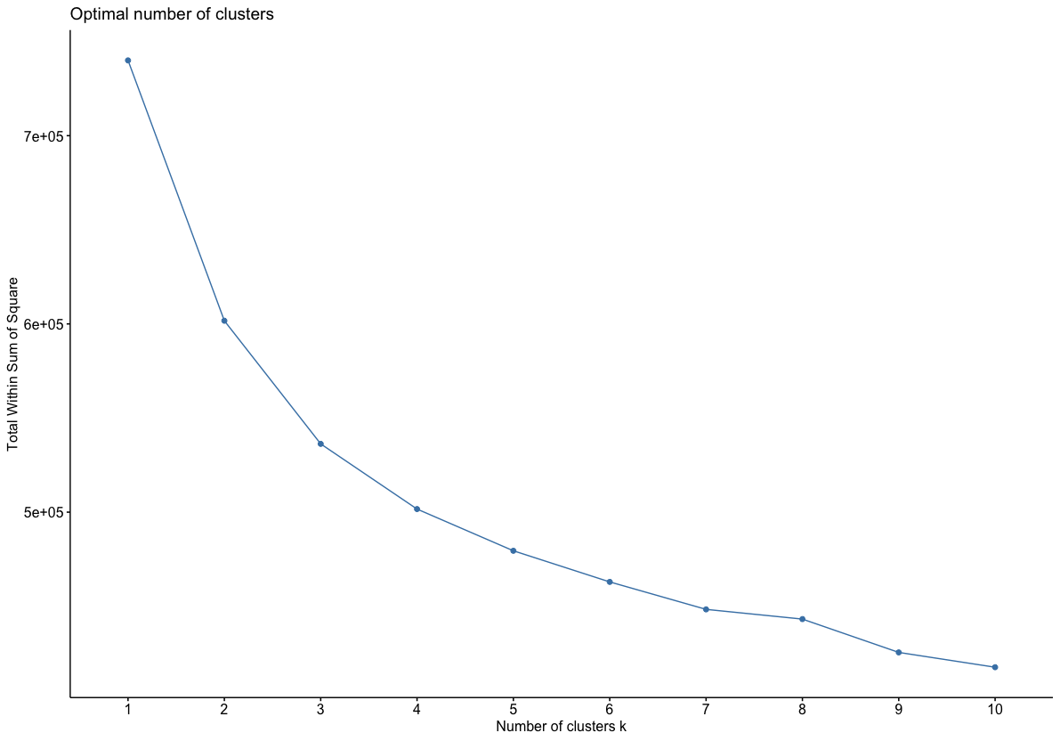
Clustering & Enrichment Analysis
K-means Clustering

Slide 11
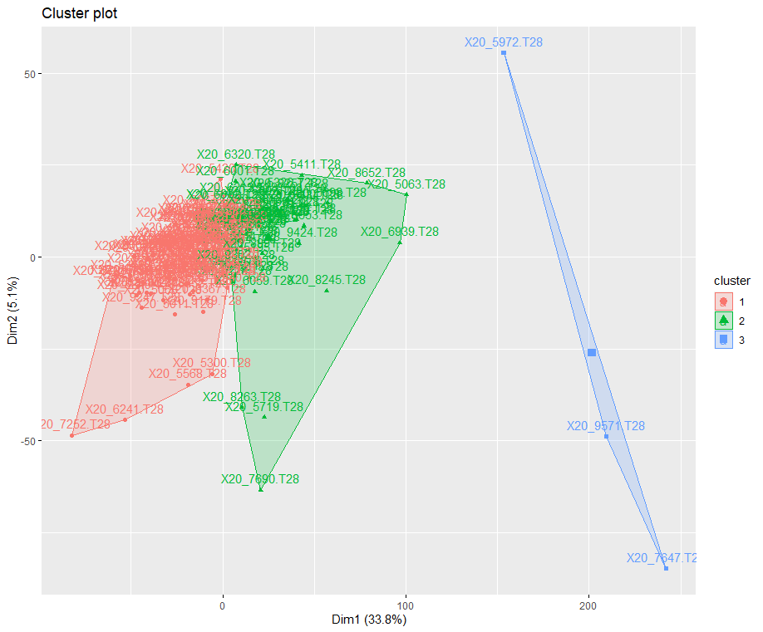
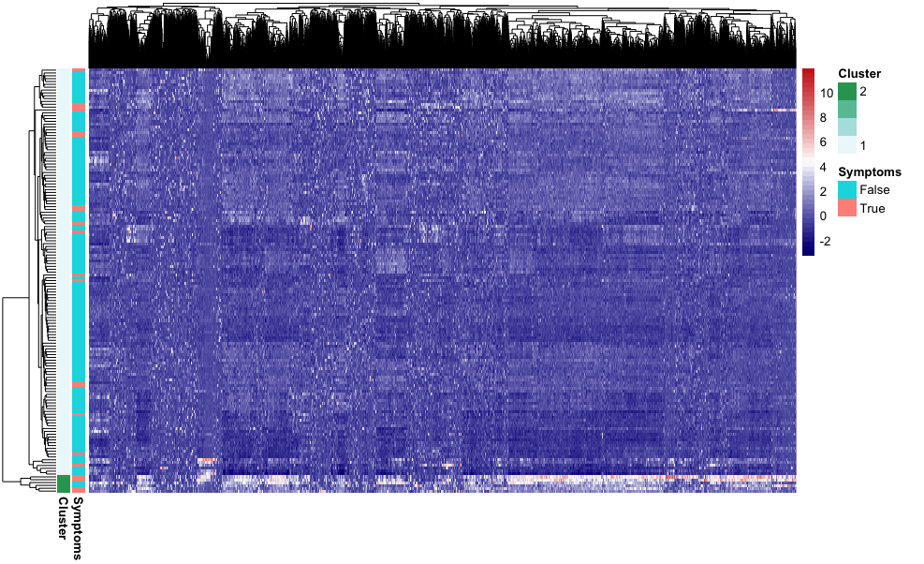
Clustering & Enrichment Analysis
K-means clustering heatmap
k=3

Slide 12
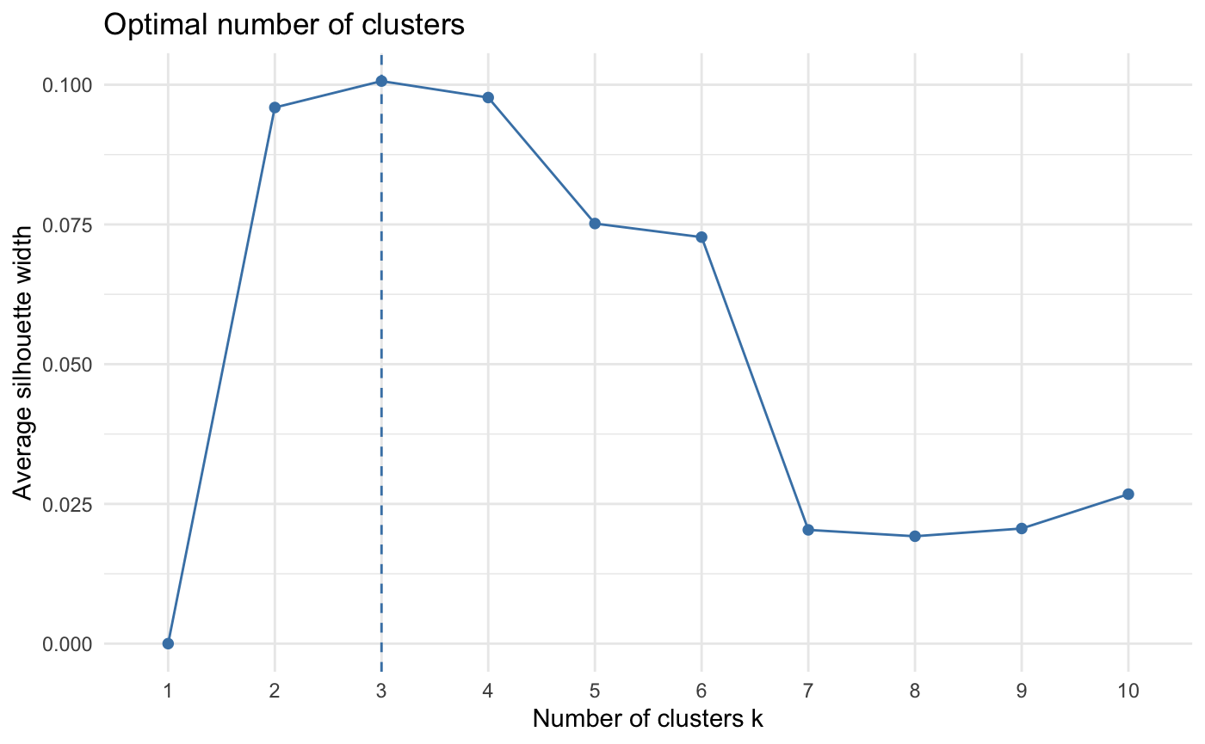
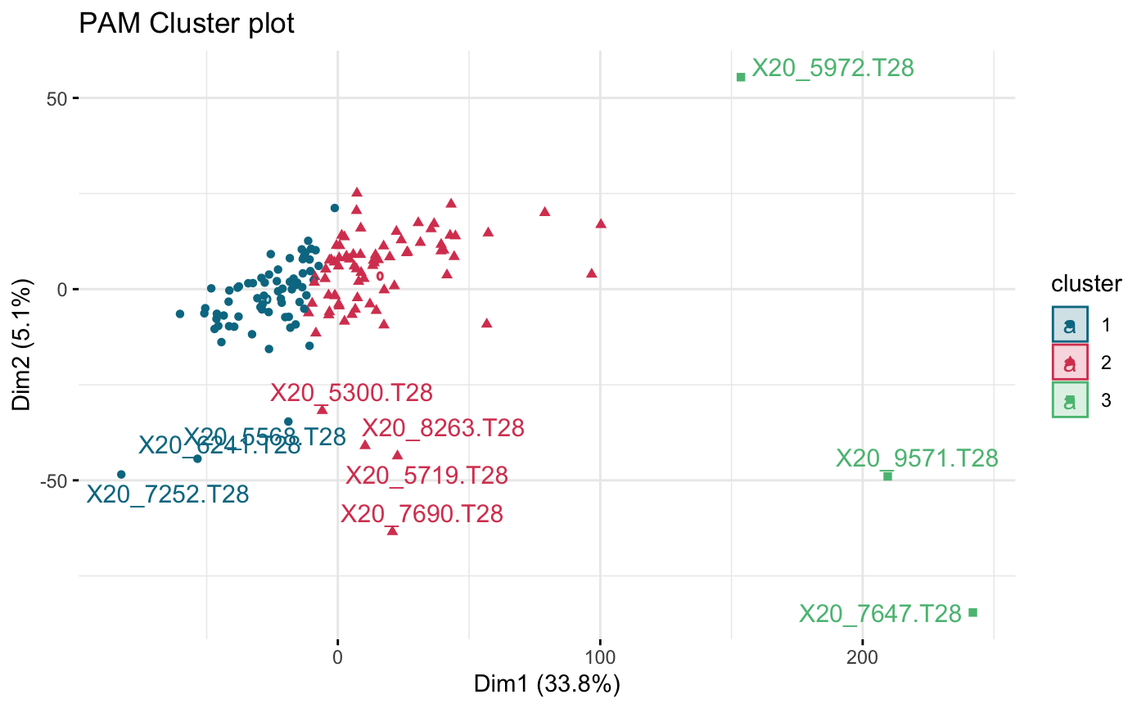
Clustering & Enrichment Analysis
PAM Clustering
Silhouette Analysis for Optimal K Value
PAM Cluster Plot

Slide 13
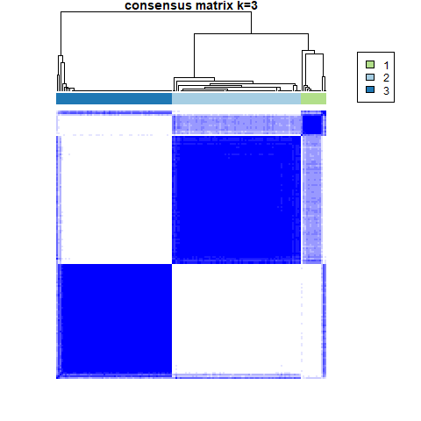
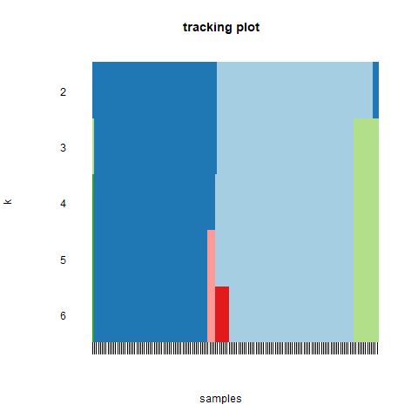
Clustering & Enrichment Analysis
ConsensusClusterPlus

Slide 14
Clustering & Enrichment Analysis
Stats
 | P-value (adjusted) | P-value
K-means vs. Group |  | 1.58x10^-4
PAM vs. Group |  | 7.14x10^-1
Consensus vs. Group |  | 8.83x10^-1
K-means vs. PAM | 8.83x10^-1 | 2.94x10^-1
K-means vs. Consensus | 1,00 | 7.16x10^-1
PAM vs. Consensus | 4.43x10^-17 | 1.48x10^-17

Slide 15
Conclusions & Future Work
What features can we identify from asymptomatic participants that are different from participants with symptoms and how strong of a predictor is the feature?
Based on these findings, we accept our null hypothesis that no statistical evidence exists within the study that shows a significant relationship between certain distinct features and symptomatic patients.
This does not prove that no features exist that have an impact on a positive COVID-19 patient being asymptomatic.
Our dataset was not large enough to prove that a significant relationship exists. Patterns underlying the data were discovered but disproven by inconsistent results between methods.
Further studies will be relevant to explore if certain patterns found in this study persist consistently across a wider dataset.
What would we do differently?
If we had to redo this project again, we would probably do more in depth research on a better dataset that would be more applicable to research on our hypothesis.
Our dataset had to be standardized and duplicate sets had to be removed, substantially decreasing the total sample count, leaving our results less accurate overall.

