Slide 1
Facial Recognition Rack Mount System
Jared Nixon
Garrett Eledui
Jason Parker
Daniel Hasty
CPE495 Computer Engineering Design I
Electrical and Computer Engineering The University of Alabama in Huntsville

Slide 2
Team Face Off
Jared Nixon – Team Lead
Garrett Eledui – Software Integration
Jason Parker – Hardware Integration
Daniel Hasty – Software Support

Slide 3
The Need
With the rising data hijacking occurrnces, physical security is of need in modern datacenters.
Most of the focus is on cybersecurity.
Result: Physical security takes the backburner.
The goal is to find a happy medium between ease of use for the everyday user, yet secure to keep the information thief out.

Slide 4
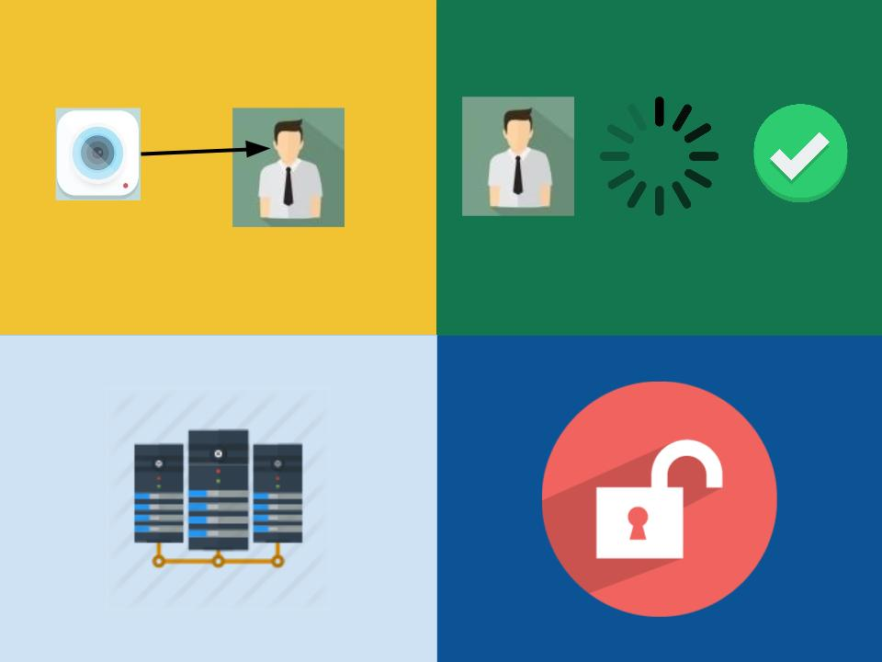
The Concept
Four Steps
Take Photo, Process image, Unlock door, Access server

Slide 5
Marketing Requirements
Sponsor Requires:
The system should have a camera, processing unit, and means of opening a lock on a server rack.
The system should be easy to use with minimal experience.
The system should have the ability for the user to request entry and for the user to know whether they were authenticated or not.

Slide 6
Engineering Requirements
The marketing requirements shown previously allow us to define our engineering requirements as follows:
Performance – The system should unlock the rack door in no more than 10 seconds from the point when access is requested.
Functionality – The system will process the photo and relay an access granted or access denied signal to the actuator.
Usability – Users of the system should be able to unlock with the push of a button and have user feedback.

Slide 7
Main Approach
Using a Raspberry Pi camera module, take a sample when a push button is pressed.
Send the sample to the CPU so that it can be processed.
Decide to authenticate or not.
If access is granted, turn the actuator, and turn the RGB led to green.
If access is not granted, deny access, and turn the RGB led to red.

Slide 8
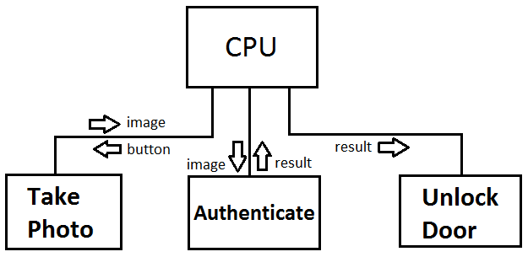
Functional Decomposition of the System

Slide 9
The Project Timeline
Projected Schedule:
Research – 11/4
Submit Components – 11/11
Basic Prototype – 2/10
Optimization – 4/1
Testing – 4/4
Actual Schedule:
Research – 11/4
Submit Components – 11/21
Basic Prototype – 2/24
Optimization – 4/7
Testing - Ongoing

Slide 10
Testing Plan in Action
Unit Testing
Can the button be pushed and acknowledged?
Can a picture be taken and sent to the proper facial function?
Can the software verify that a picture was taken?
Can the facial function verify a face is present?
Can the software apply voltage to control LED indicator?
Can the software apply voltage to control actuators?
Integration Testing
Can the button be pushed and trigger a picture to be taken?
Can the software receive the photo and verify a face is present / not present, and send command out to appropriate peripherals?
Can the actuator / LED receive command and take action?
All of these unit and integration tests have been verified as working.

Slide 11
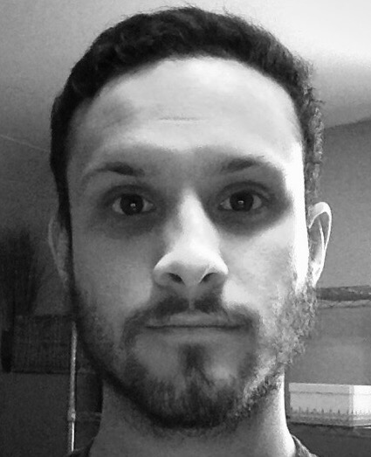
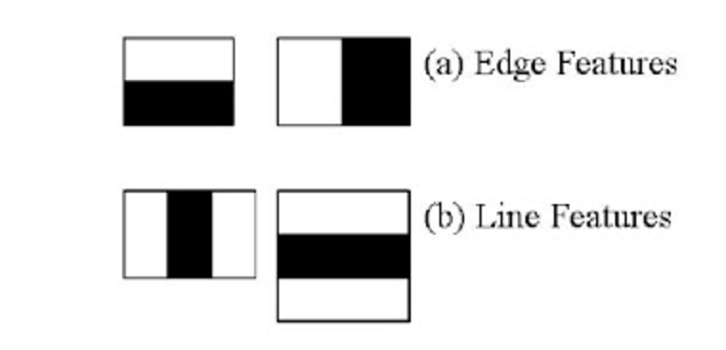
Facial Recognition: The Concept
Features – Combinations of Pixels
White Pixels
Black Pixels
Gray Pixels (varying)

Slide 12
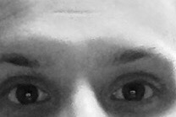
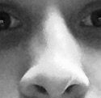
Finding Features
Edge Features
Line Features

Slide 13
OpenCV: Facial Recognition
Haar Cascade Library
Can be trained using a machine learning algorithm.
We chose not to further train our system due to its current sufficiency and accuracy in finding a face.

Slide 14
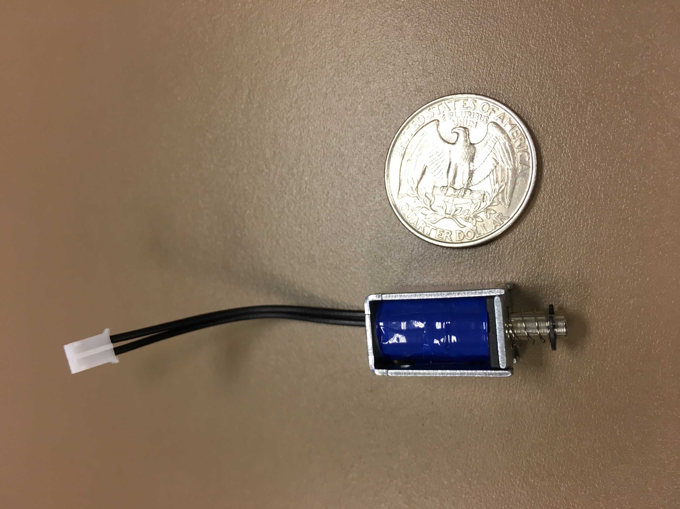
Risks Associated (Update)
Main Risk: Actuator Size
These solenoids were surprisingly strong and no other solenoid was needed due to size issues.
A new problem was introduced with these solenoids, despite accounting for it in previous designs.

Slide 15
Power Problems
Current Issue:
Selected solenoid is “in” when not powered.
Solenoid should be “out” when not powered.
This is needed so power does not constantly have to be applied to keep the server rack locked, as these solenoids can get very hot very fast.
This would also leave server racks locked in the case of a power failure, instead of being wide open.

Slide 16
Project Deliverables
Preliminary Design Review – February 23, 2017
Bulletin Board Update – Twice Through Semester
Project Briefings – March 30, 2017 & April 13, 2017
Project Video – April 17, 2017
Project Poster – April 20, 2017
Project Demonstration – April 20, 2017
Final Design Presentation – April 20, 2017
Project Notebook – April 27, 2017

Slide 17
Individual Responsibility
Jared Nixon – Ensure deadlines are made, keep team headed in the right direction, and support software development.
Garrett Eledui – Develop / Integrate facial recognition software
Jason Parker – Develop communication between system components.
Daniel Hasty – Develop software where help is needed to help maintain deadlines.

Slide 18
Cost Estimation
Item | Quantity | Projected | Actual
Raspberry Pi | 1 | $39.95 | $39.95
Camera Module | 1 | $18.50 | $29.95
Case | 1 | $5.00 | $8.00
Solenoids | 2 | $18.00 | $9.90
RGB LED (25 pack) | 1 | $10.00 | $12.50
Push Button | 2 | $4.00 | $3.00
SD Card (w/ OS) | 1 | $11.95 | $11.95
Transistors (3 pack) | 1 | N/A | $2.50
Wires | 1 | N/A | $10.00
Mock Door | 1 | N/A | $40.00
Pi Power | 1 | N/A | $9.00
Shipping Total: | $18.08
Totals: |  | $107.40 | $176.75

Slide 19
Project Achievements
Successful prototype of a single rack mount facial recognition system.
Successful understanding of the emphasis of the project, which is actuator control.
Successful integration of facial recognition software that can be improved in future projects.
The team met all marketing and engineering requirements given by Emerson Network Power.

Slide 20
Lessons Learned
Recall the basics on complex problems.
Basics are a subset of complex engineering problems, such as V=IR.
How to stay on top of deadlines?
Communication is key.
Don’t let deadlines sneak up.
What makes a system open for expansion?
Starting simple and add features later.
Don’t start too large.

Slide 21
Future Possibilities
This successful R&D project at its core is a unit test of a much larger picture.
Our completed project sets up possible future senior design projects for this system, including:
Detecting specific faces as authorized or not authorized.
Multiple Rack Mounts communicating with each other through one database.

Slide 22
Acknowledgements
Emerson Network Power:
Contact: Thom Rigsby
AT&T Laboratories, Cambridge
Database of Faces used for testing.

Slide 23
QUESTIONS?

