Slide 1
Facial Recognition Rack Mount System
Jared Nixon
Garrett Eledui
Jason Parker
Daniel Hasty
CPE495 Computer Engineering Design I
Electrical and Computer Engineering The University of Alabama in Huntsville

Slide 2
Team Face Off
Jared Nixon – Team Lead
Garrett Eledui – Software Integration
Jason Parker – Hardware Integration
Daniel Hasty – Software Support

Slide 3
The Need
With the rising data hijacking occurrnces, physical security is of need in modern datacenters.
Most of the focus is on cybersecurity.
Result: Physical security takes the backburner.
The goal is to find a happy medium between ease of use for the everyday user, yet secure to keep the information thief out.

Slide 4
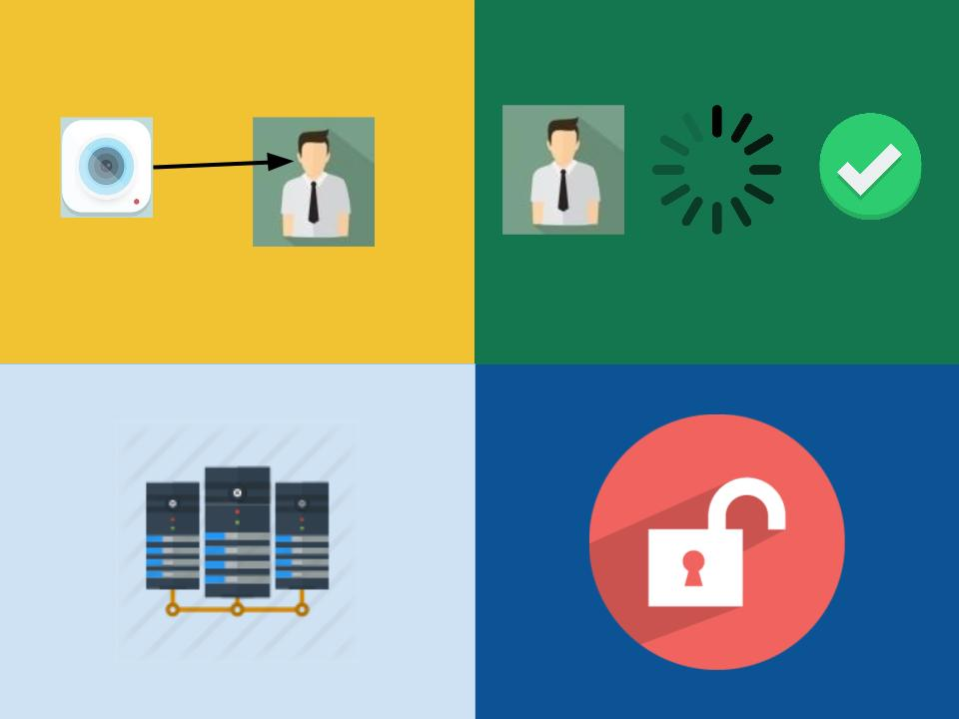
The Concept
Four Steps
Take Photo, Process image, Unlock door, Access server

Slide 5
Marketing Requirements
Sponsor Requires:
The system should have a camera, processing unit, and means of turning a lock on a server rack.
The system should be easy to use with minimal experience.
The system should have the ability for the user to request entry and for the user to know whether they were authenticated or not.

Slide 6
Engineering Requirements
The marketing requirements shown previously allow us to define our engineering requirements as follows:
Performance – The system should unlock the rack door in no more than 10 seconds from the point when access is requested.
Functionality – The system will process the photo and relay an access granted or access denied signal to the actuator.
Usability – Users of the system should be able to unlock with the push of a button and have user feedback.

Slide 7
Survey: Market & Competition
There is facial recognition software & hardware in existence today
Existing System used for door access – AMG product contains facial recognition, fingerprint recognition, and user database
Pros: product is pre built, impressive features
Cons: High price of $499

Slide 8
Survey: Existing Projects
Windows Team IoT: Facial Recognition Door
Team develop project that unlocks door using facial recognition
Facial Recognition is done using Microsoft API: Project Oxford
Could implement this API to perform our facial recognition
Could implement a similar pattern of use with the micro controller

Slide 9
Main Approach
Using a Raspberry Pi camera module, take a sample when a push button is pressed.
Send the sample to the CPU so that it can be processed.
Decide to authenticate or not.
If access is granted, turn the actuator, and turn the RGB led to green.
If access is not granted, deny access, and turn the RGB led to red.

Slide 10
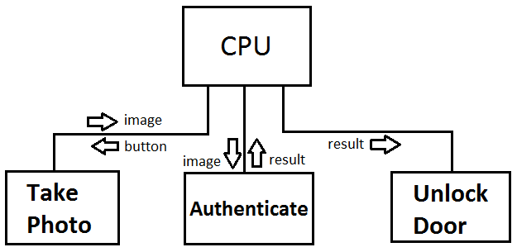
Functional Decomposition of the System

Slide 11
Project Summary
The Facial Recognition Rack Mount project is a system-level hardware/software design with a primary intention of keeping server rooms safe and secure. With physical security of modern datacenters being often overlooked, the goal of this project is to provide the means of increasing that security.

Slide 12
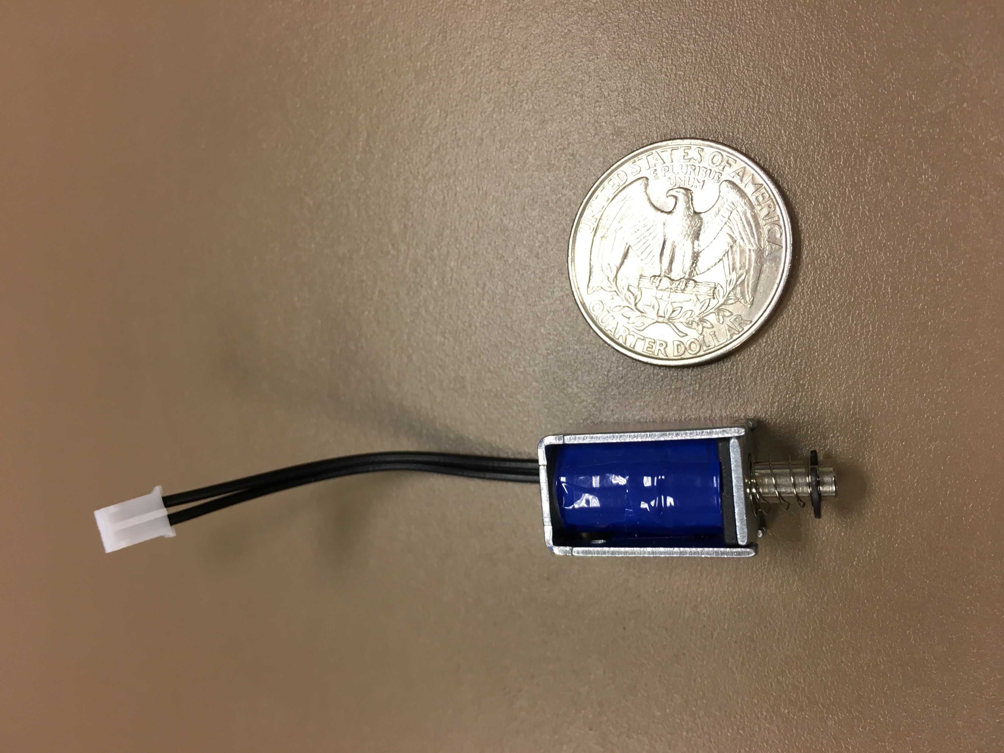
Risks Associated
Main Risk: Actuator Size
There is no guarantee this actuator will stop even a toddler from getting into the rack mount.
Confident the Raspberry Pi can power this thing, but will likely have to look into other actuators.

Slide 13
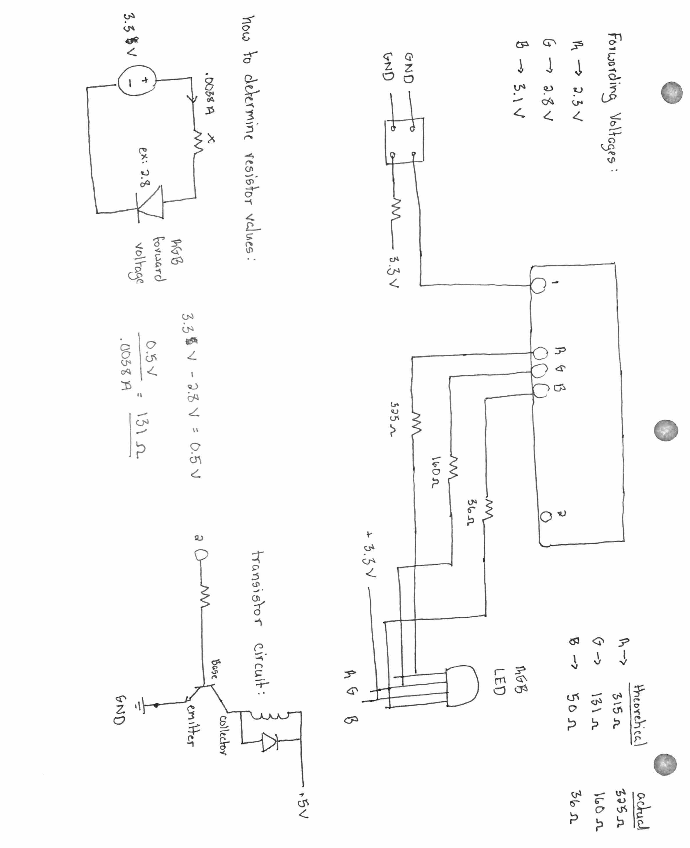
Lets Talk Circuits

Slide 14
What’s working?
4 of the 5 units are currently working.
They consist of the following:
Push Button Unit
Camera Unit
RGB LED Unit
Facial Recognition Unit
These units still require a lot of testing.

Slide 15
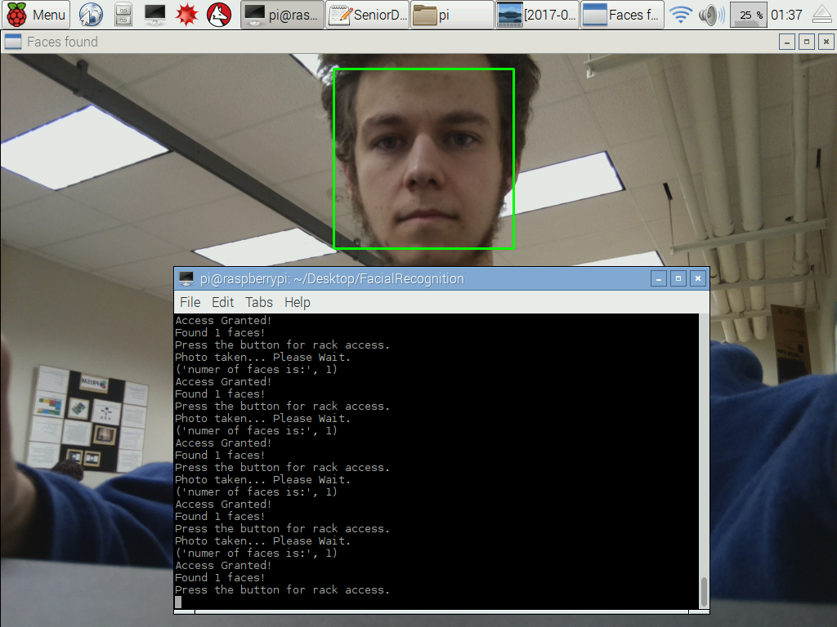

Slide 16
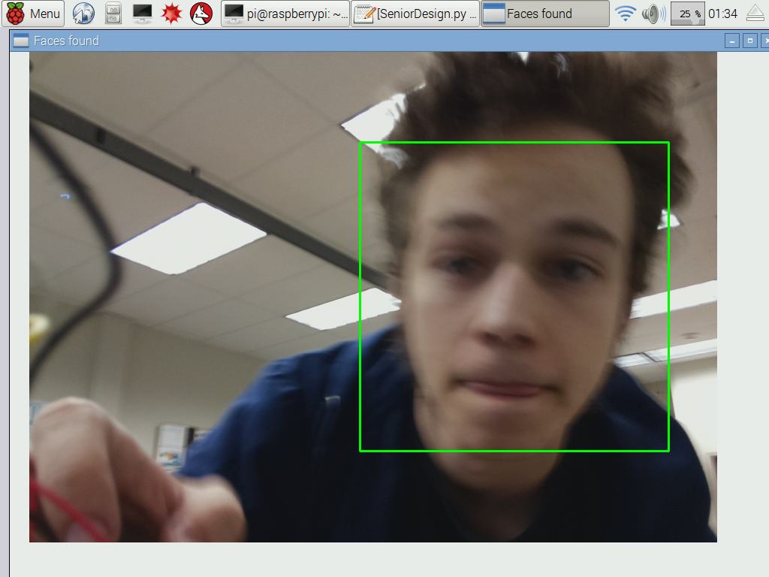

Slide 17
What’s Not? (But needs to be)
1 of the 5 units are not currently working.
The unit that is not working is the actuator unit.
The plan to get it working:
Get the circuitry working with the current actuators.
Test to see if it can be brute forced through.
If yes, order new actuators and decide if external power is going to be needed.

Slide 18
Speed Bumps
Needed power supply for the Raspberry Pi
Common Anode vs. Common Cathode
Male to Female jumper wires
Stable connections to the button
Decided to go ahead and solder to the button

Slide 19
New Discoveries (Haar Frontal Face)
Machine Learning
Features:
Edge
Line
Center-Surround
DetectMultiScale() – Function
Parameters include: scaleFactor, minNeighbors, minSize, maxSize

Slide 20
Response to Feedback
Feedback:
How is recognizing a generic face useful?
Software too large for Raspberry Pi?
Confusion was expressed about the Windows API vs OpenCV?
Response:
Scope of the project is defined by sponsor, could be useful for logging.
Largest portion of install is libraries, which fit on the 8 GB SD card.
Using the Raspberry Pi with OpenCV

Slide 21
Testing Plan
Unit Testing
Can the button be pushed and acknowledged?
Can a picture be taken and sent to the proper facial function?
Can the software verify that a picture was taken?
Can the facial function verify a face is present?
Can the software apply voltage to control LED indicator?
Can the software apply voltage to control actuators?
Integration Testing
Can the button be pushed and trigger a picture to be taken?
Can the software receive the photo and verify a face is present / not present, and send command out to appropriate peripherals?
Can the actuator / LED receive command and take action?
Regression Testing
Ensure bugs introduced during development are fixed.

Slide 22
The Project Timeline
Milestone 1 – Deadline of November 4th
Research HW/SW, algorithms, actuators.
Milestone 2 – Deadline of November 11th
Submit hardware components required.
Decide on appropriate coding language.
Milestone 3 – Deadline of February 10th
Facial recognition lock in the most basic form.
Ensure the lock will NOT open for objects.
Validate the camera takes successful samples.

Slide 23
The Project Timeline
Milestone 4 – Deadline of March 3^{rd -} Optional
Distinguish between authorized and non-authorized faces.
Milestone 5 – Deadline of March 31st - Optional
Implement the three tier authentication system.
Perhaps manual override for hardware / power failures.
Milestone 6 – Deadline of April 14th
Test the final prototype of the project.

Slide 24
Project Deliverables
Preliminary Design Review – February 2017
Final Design Presentation – April 2017
Bulletin Board Update – Twice through semester
Project Briefings – March 2017 and April 2017
Project Demonstration – April 2017
Project Video – April 2017
Project Notebook – April 2017

Slide 25
Individual Responsibility
Jared Nixon – Ensure deadlines are made, keep team headed in the right direction, and support software develoment.
Garrett Eledui – Develop / Integrate facial recognition software
Jason Parker – Develop communication between system components.
Daniel Hasty – Develop software where help is needed to help maintain deadlines.

Slide 26
Cost Estimation
Item Needed | Quantity | Cost | Total
Raspberry Pi 3 | 1 | $39.95 | $39.95
Case | 1 | $5.00 | $5.00
Case Lid | 1 | $3.00 | $3.00
Camera Module | 1 | $29.95 | $29.95
SD Card (comes w/ Raspbian Jessie OS) | 1 | $11.95 | $11.95
Solenoid | 2 | $4.95 | $9.90
RGB LED (25 pack) | 1 | $12.50 | $12.50
Push Button | 2 | $1.50 | $3.00
TOTAL: | 10 items | $108.80 | $115.25

Slide 27
Added Non-Foreseeable Costs
Power Supply Pi – $9.00
Female to Male jumper wires – $12.00
Extra Actuators (Likely will need) – N/A
Framework of a door – N/A

