Slide 1
Servo / Actuator Control in Embedded Systems
Jared Nixon
Daniel Hasty
Jason Parker
Garrett Eledui

Slide 2
What is an Actuator?
Actuator – A kind of motor that controls or moves mechanisms or systems.
Four main types
Electric
Hydraulic
Mechanical
Pneumatic
Embedded system environments are typically going to use electric actuators, as they convert electrical energy into mechanical torque, and they can draw power from the embedded system.

Slide 3
Linear vs. Rotary Actuators
Linear Actuators:
These actuators produce forward and backward finite linear motion.
The distance for linear actuators is typically measured in inches or millimeters.
Linear actuators are used in things such as DVD players, video game consoles, and locking mechanisms.
Rotary Actuators:
There actuators produce rotary motion, but unlike linear actuators, these can be infinite motion. They can spin in the same direction for as long as needed.
The distance for rotary actuators is typically measured in degrees.
Rotary actuators can be used in robotics and things such as windows.

Slide 4
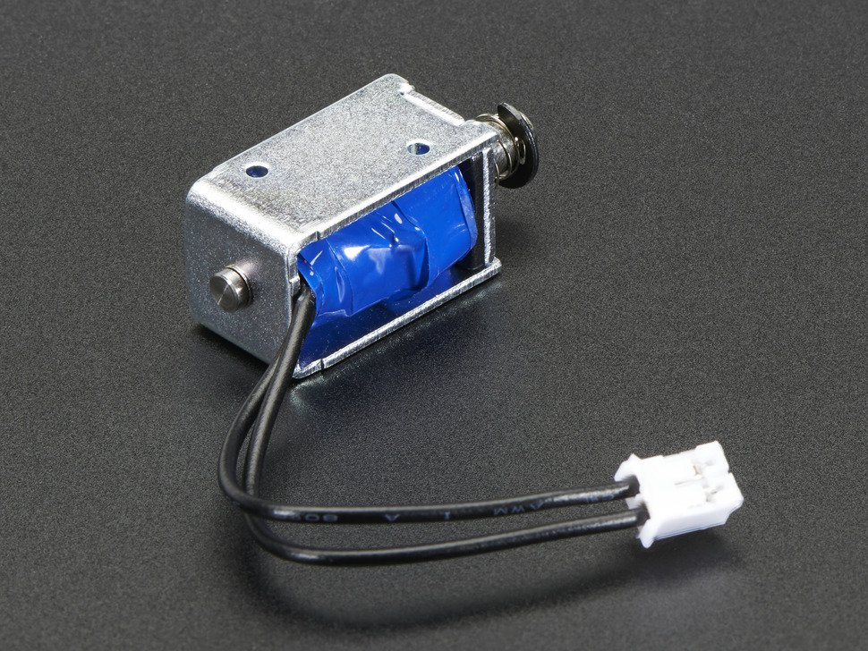
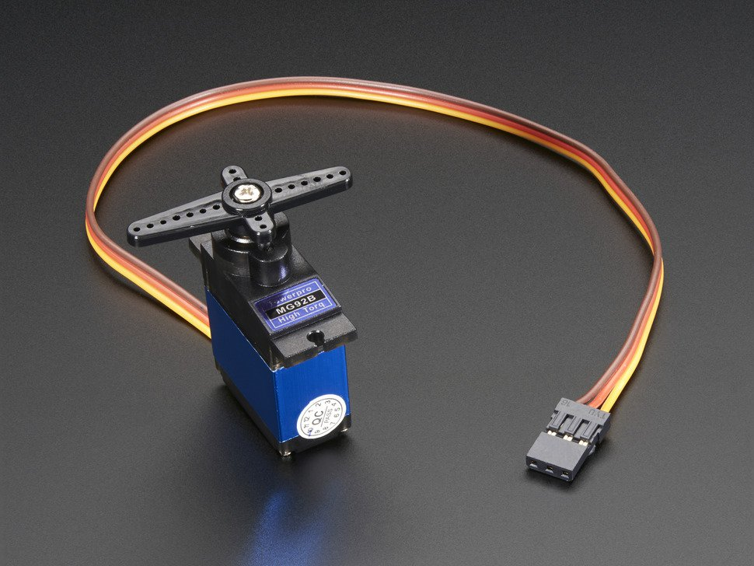
Linear vs. Rotary Actuators
Linear Actuators:
Rotary Actuators:

Slide 5
Actuators and Our Project
How do actuators tie into our project?
Two linear actuators are needed for locking and unlocking our server rack door. The two pin holes on the server door (one top and one bottom) will have linear actuators pulled in and out in order to lock and unlock.
Most actuators will require stepping up voltage in order to perform in an embedded system.
The linear actautor we purchased is rated at 5 V, so no voltage gain circuit will be necessary.

Slide 6
Power Problems
Current Problems
An embedded system can control actuators with no problems, but it cannot power many actuators with no problems.
Typically one can be supported with no power issues, but what happens if a project requires five to ten actuators?
An external power supply will be required for an embedded system if there are many actuators in the system.
What happens if current flows unexpectedly back into your embedded system? You’ve likely lost your embedded system.
Good Practice: Add a diode in with your actuator, so when current flows from the embedded system to the actuator, there is no chance of current coming back, due to the one way flow.
Eleminates risk of losing the entire system when powering an actuator.

Slide 7
Common Issues with Servo
Even well-maintained servo motor systems can experience issues during normal operation.
These issues can arise while using and fine tuning a servo motor with an embedded environment, and they include:
Connection mishaps.
Power Supply not sufficient.
Motor failures.
Motor unresponsive to software commands.
Even mechanical issues can arise such as:
Overheating.
Erratic operation.
Abnormal noise.

Slide 8
Common Motor Issues with Possible Solutions
Issue: No Rotation
Loose or open connections, excessive load, worn bearings.
Issue: Overheating
Voltage exceeding max value, excessive duty cycle, excessive motor current.
Issue: Erratic Operation
Rotor leads are reversed.
Issue: Abnormal Noise
Loose parts, worn bearings, too high of a GAIN.

Slide 9
Common Motor Issues with Possible Solutions
Issue: Unstable axis or system.
Improper setting of acceleration/deceleration rates, improper grounding, or GAIN potentiometer incorrectly set.
Issue: Motor does not respond to velocity commands.
System malfunction, motor wiring is open, motor malfunction.

Slide 10
Common Electrical Issues with Actuators
Incorrect power voltage
Incorrect control voltage
Thermal overload is engaged
Power board failure
Loose wire harness
Corrosion on wires

Slide 11
Software/Hardware Integration
Embedded systems require software to drive the hardware
For us, this means software that can control when the actuator is active or not
The overall system can be considered as a Finite State Machine (FSM)
A system such as ours will have a more or less constant control loop
Software needs to have accurate information on the state of the hardware in able to drive it properly
Examples of possible errors:
Actuators, due to wear and tear, are not able to respond to software generated signals
Software believes the actuator to be in a state other than it’s actual state
Software incapable of interpreting input commands
Software not interfacing properly with hardware

Slide 12
Economic and Efficiency of Solenoids
Solenoids are extremel diverse, different ones for different uses.
There are a majority of ones to choose from.
Solenoids can be the most influential factor in system. Therefore, it is important to find the one that works best for your project.
Solenoids have two main types:
Push Solenoid
Pull Solenoid
Choice for our project: Push-Pull (it can do both)
Draws up to 1 amp.
Circuit will likely need:
Transistor
Diode

Slide 13
Resources for Actuators
If you need more information on the four main types of actuators to see which will best suit your project:
http://www.thegreenbook.com/four-types-of-actuators.htm
Main article that describes the unique differences in linear and rotary actuators:
http://www.indramat-us.com/linear-actuator-vs-rotary-actuator/
More information on anything related to Servos:
http://www.tigertek.com/servo-motor-resources.html
Embedded Systems Actuator Integration Information:
P. H. G. Mani, D. I. Khan and D. K. Raju, "Sensors and Actuators Integration in Embedded Systems," ACEEE International Journal on Network Security, Vol. 2, No. 2, pp. 4-9, April 2011.
https://www.scribd.com/document/102814755/Sensors-and-Actuators-Integration-in-Embedded-Systems

