Slide 1
Facial Recognition Rack Mount System
Jared Nixon
Garrett Eledui
Jason Parker
Daniel Hasty
CPE495 Computer Engineering Design I
Electrical and Computer Engineering The University of Alabama in Huntsville

Slide 2
Team Face Off
Jared Nixon – Team Lead – GUI Design and Design Patterns
Garrett Eledui – Software Integration – Software Design, Graphics Development and Image Processing
Jason Parker – Hardware Integration – Software Design, Cybersecurity, System Administration, and Machine Learning
Daniel Hasty – Software Support – Software Design and Cybersecurity

Slide 3
The Need
With the rising data hijacking occurrnces, physical security is of need in modern datacenters.
Most of the focus is on cybersecurity.
Result: Physical security takes the backburner.
The goal is to find a happy medium between ease of use for the everyday user, yet secure to keep the information thief out.

Slide 4
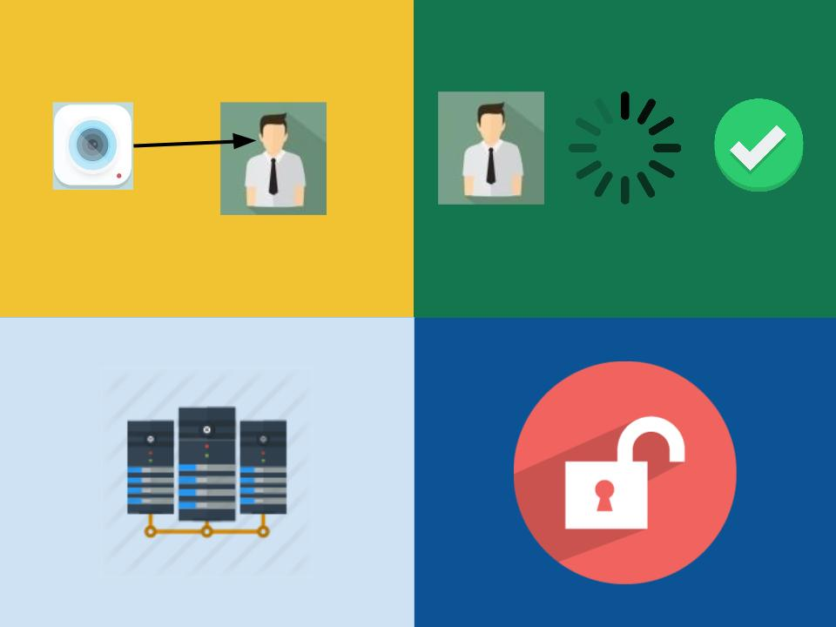
The Concept
Four Steps
Take Photo, Process image, Unlock door, Access server

Slide 5
Marketing Requirements
Sponsor Requires:
The system should have a camera, processing unit, and means of turning a lock on a server rack.
The system should be easy to use with minimal experience.
The system should have the ability for the user to request entry and for the user to know whether they were authenticated or not.

Slide 6
Engineering Requirements
The marketing requirements shown previously allow us to define our engineering requirements as follows:
Performance – The system should unlock the rack door in no more than 10 seconds from the point when access is requested.
Functionality – The system will process the photo and relay an access granted or access denied signal to the actuator.
Usability – Users of the system should be able to unlock with the push of a button and have user feedback.

Slide 7
Survey: Market & Competition
There is facial recognition software & hardware in existence today
Existing System used for door access – AMG product contains facial recognition, fingerprint recognition, and user database
Pros: product is pre built, impressive features
Cons: High price of $499

Slide 8
Survey: Existing Projects
Windows Team IoT: Facial Recognition Door
Team develop project that unlocks door using facial recognition
Facial Recognition is done using Microsoft API: Project Oxford
Could implement this API to perform our facial recognition
Could implement a similar pattern of use with the micro controller

Slide 9
Possible Approaches
Using a Raspberry Pi camera module, take a sample when a push button is pressed.
Send the sample to the CPU, and encode it so that it can be sent for processing.
Decide to authenticate or not.
If access is granted, turn the actuator, and turn the RGB led to green.
If access is not granted, deny access, and turn the RGB led to red.

Slide 10
Possible Approaches
Using facial recognition as the biometric for this system seems to be very innovative because facial recognition is still a new technology that has not been integrated into a lot of products.
Obstacles:
Finding an appropriate actuator that will successfully turn the rack lock.
Integrating the actuator into the system.

Slide 11
Project Summary
The Facial Recognition Rack mount project is HW/SW integration designed to keep the integrity of modern server rooms safe and secure. As datacenters grow in size, many people get focused on just the cyber side of these areas, so the physical side takes the backburner. With this system design, only authorized personel will be allowed to access the server racks, ensuring chaos is less likely to happen on the physical sites of datacenters. This authentication system will occur in front of a rack mount where entry is being requested by process a captured photo, and determining whether that person is authorized or not based upon their facial features.

Slide 12
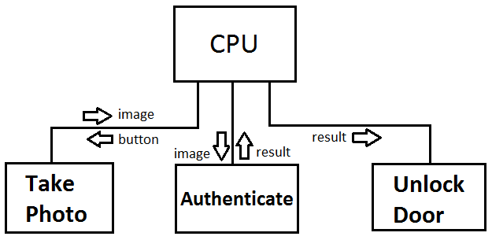
Functional Decomposition of the System

Slide 13
Testing Plan
Unit Testing
Does each individual component work as intended?
Integration Testing
Do multiple components work together? (two or more)
Acceptance Testing
Is it acceptable for customer delivery?
Verification / Validation
Does it meet engineering requirements and work as intended?
Does it meet the customer needs and work correctly?
Regression Testing
Ensure bugs introduced during development are fixed.

Slide 14
The Project Timeline
Milestone 1 – Deadline of November 4th
Research HW/SW, algorithms, actuators.
Deliverable: Project Proposal Presentation (11/2)
Milestone 2 – Deadline of November 11th
Submit hardware components required.
Decide on appropriate coding language.
Milestone 3 – Deadline of February 10th
Facial recognition lock in the most basic form.
Ensure the lock will NOT open for objects.
Validate the camera takes successful samples.
Deliverable: Preliminary Design Review (Jan 2017)

Slide 15
The Project Timeline
Milestone 4 – Deadline of March 3^{rd -} Optional
Distinguish between authorized and non-authorized faces.
Milestone 5 – Deadline of March 31st - Optional
Implement the three tier authentication system.
Perhaps manual override for hardware / power failures.
Milestone 6 – Deadline of April 14th
Test the final prototype of the project.
Deliverable: Final Design Review (April 2017)

Slide 16
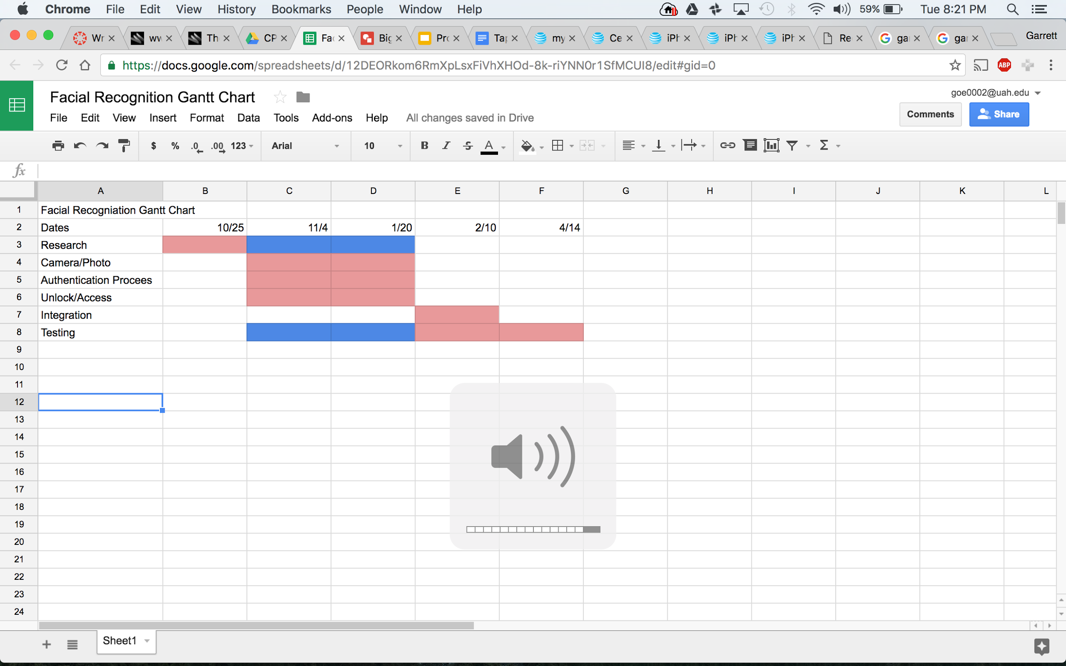
The Project Timeline

Slide 17
Individual Responsibility
Jared Nixon – Ensure deadlines are made, keep team headed in the right direction, and support software develoment.
Garrett Eledui – Develop / Integrate facial recognition software
Jason Parker – Develop communication between system components.
Daniel Hasty – Develop software where help is needed to help maintain deadlines.

Slide 18
Cost Estimation
Materials Required:
Raspberry Pi 3 – $39.95
Raspberry Pi 3 Camera Module – $18.50
Raspberry Pi 3 Case – $5.00
Actuator Kit – $19.95
RGB LED light – $1.00
Push Button – $1.50
TOTAL COST: $85.90

