Slide 1
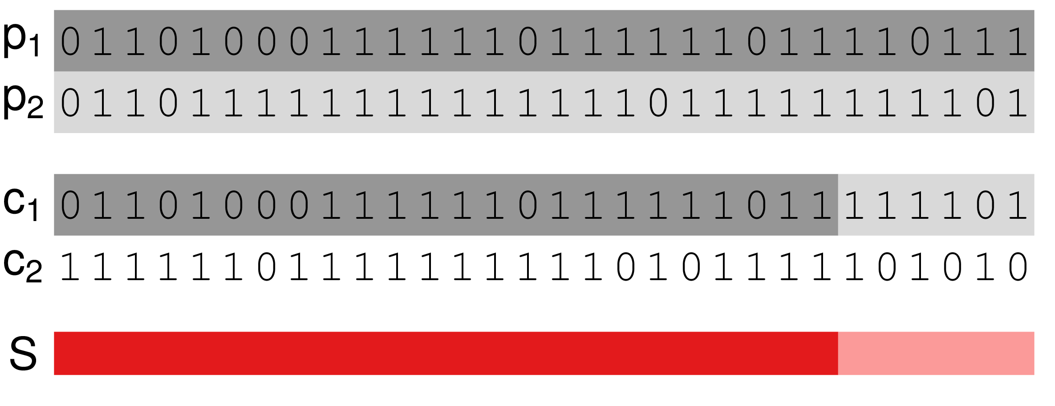
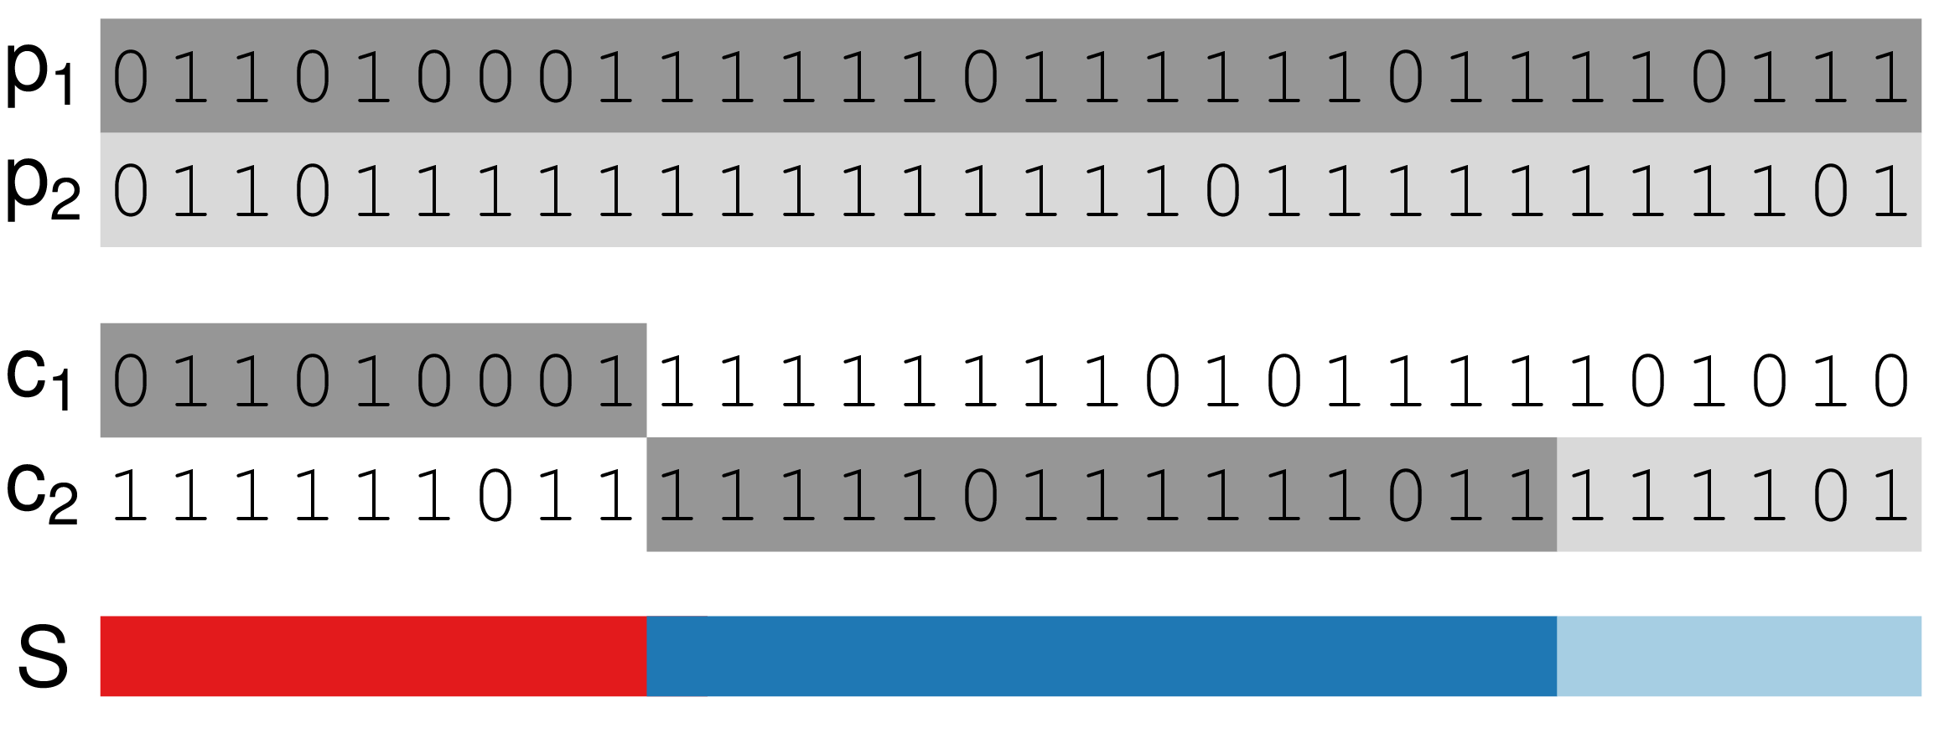
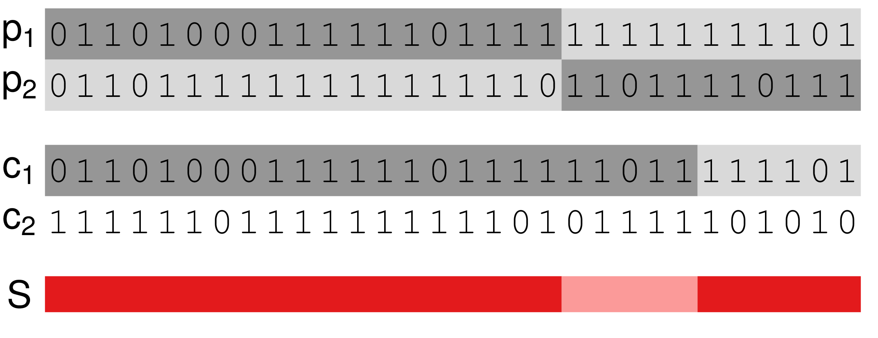
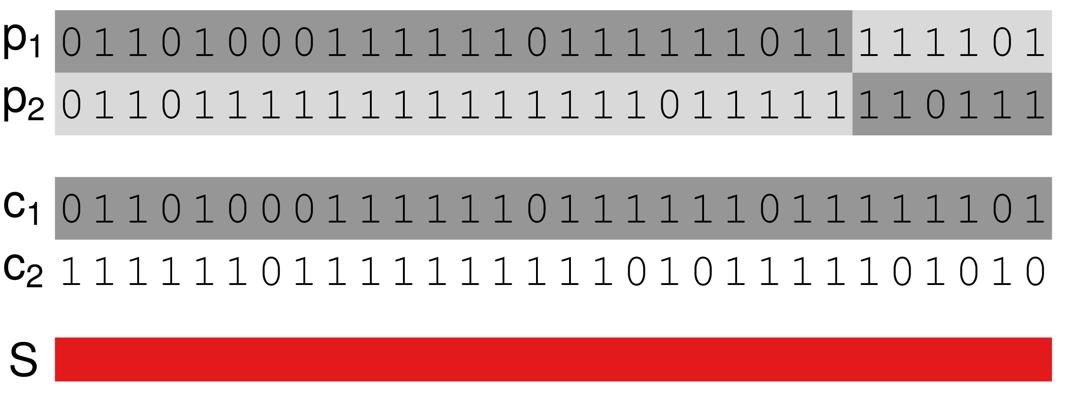
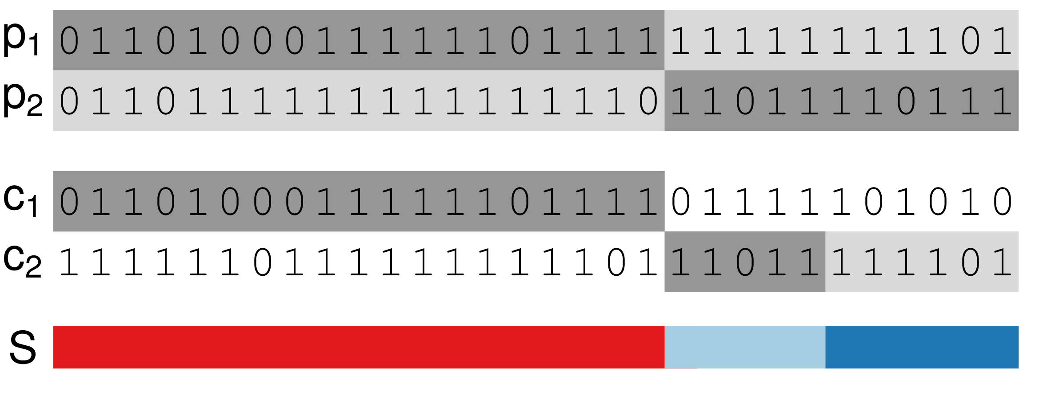
True haplotypes inferred correctly and true recombination event inferred as T₂ transition
T₂
Switch error in the child’s haplotypes that causes a T₃ transition
Switch error in the parent’s haplotypes that causes a T₂ transition
T₃
T₂
T₂
T₂
Switch error in the parent’s haplotypes at true recombination event.
Switch error in the parent’s and child’s haplotypes that causes a T₄ transition
T₄
T₂

