Slide 1
StudyBuddy
Team 5:
Jared Pek (U2220146G)
Barry Ng (U2222267H)
Gary Leo (U2222411L)
Abhinav (U2223031L)
Shrutikhaa (U2223972L)

Slide 2
About StudyBuddy
Conducive Study Areas
Effective Study Materials
AI Study Helper

Slide 3
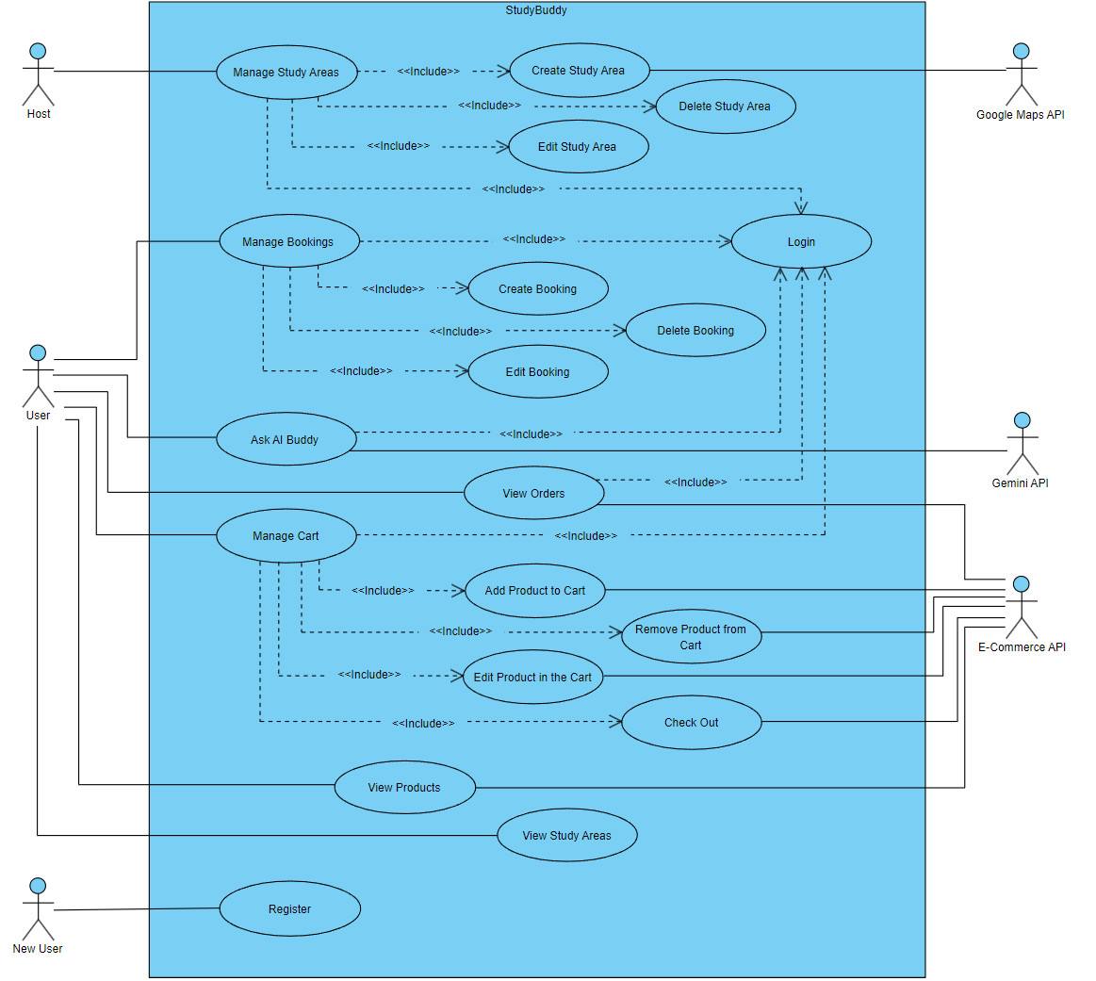
Use Case Diagram

Slide 4
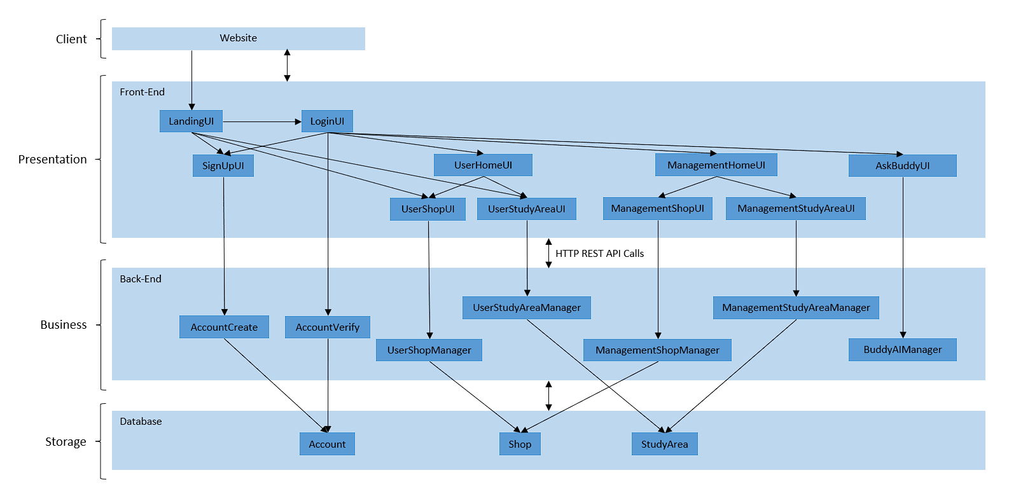
System Architecture → Layered
Decouple front-end and back-end → Secure
Independent development of both layers → Faster
Implementation of multiple front-ends with the same back-end → Scalable

Slide 5
LIVE DEMO

Slide 6
Design Principles and Patterns → Architecture
Front-End
Principle of Least Knowledge
Layers not concerned with exact implementation of others
Only needs to know what the other layer provides
HTTP REST API Calls
Back-End

Slide 7
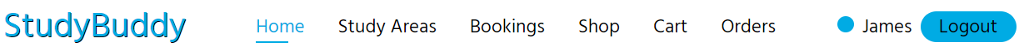

Design Principles and Patterns → UI / Front-End
Facade Pattern
Simple interface to access features within a more complex system
DRY Principle
Reusable components that can simply be called whenever needed
No need to rewrite the same code

Slide 8

Design Principles and Patterns → Back-End
MVC Pattern
Model → Data Structure
View → Request Response
Controller → Control Logic
Minimize coupling between features
Single Responsibility Principle
Each API endpoint only has 1 reason to change
Easy to debug and test all API endpoints

Slide 9
Software Engineering Principles
Frequent Refactoring
Consistently optimize and clean our code
Maintain efficiency, readability, maintainability
Version Tracking
Track development iterations
Easily revert to previous version
Pair Programming
At least 2 developers working on the same feature
Enhance debugging
Agile Methodologies
Biweekly sprints
Product backlog

Slide 10

THANK
YOU!

