Slide 1

XCOM — Next Generation of Inter- and Intra- Planetary Communication Technology
Group 5: Jared Branscum, Haoran Wang, Ding Zhang, Francine Luo
https://drive.google.com/open?id=1Dp8Z_P2gHvt6VLNhe46WbGqAoUKyqBQu
Notes:
Francine

Slide 2
Overview
Our Goal
Data communication in general
Telecommunications on Earth vs Space
Past Work
Current Progress on Implementation
Challenges of Actual Implementation
Steps to Move Towards Achieving Success
Notes:
Francine

Slide 3
Our Goal
Develop protocol for X-ray message transmission
Use X-ray messages for data communication with minimal latency and maximal throughput
Demonstrate the accuracy of the developed protocol

Slide 4
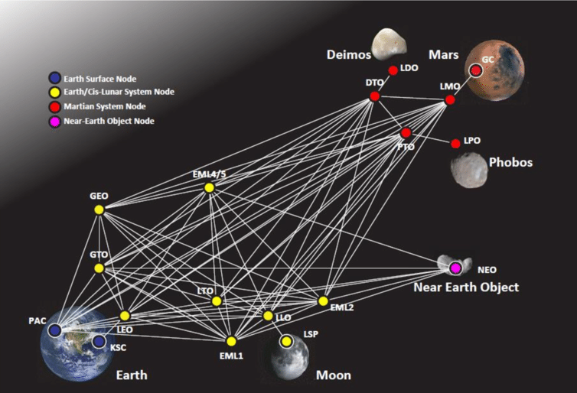
Structure of the Interplanetary Communication Technology
Notes:
Francine
In the future, human beings will colonize different planetaries in the solar system or other galaxies. However, the current technology to transmit data uses radio wave, for example, we use radio wave to communicate between the hubble telescope and the Earth. which is fast enough for now, but it is not able to achieve instant transmission in the future. We use peer-to-peer technology to support the interplanetary communication. At that time the X-ray transmitters can be built on different planets and even telescopes. And each of these planets and telescopes can be seen as different nodes of the peer to peer network. And since X-ray can carry more information while traveling longer distances. We believe it will become a next generation technology.

Slide 5
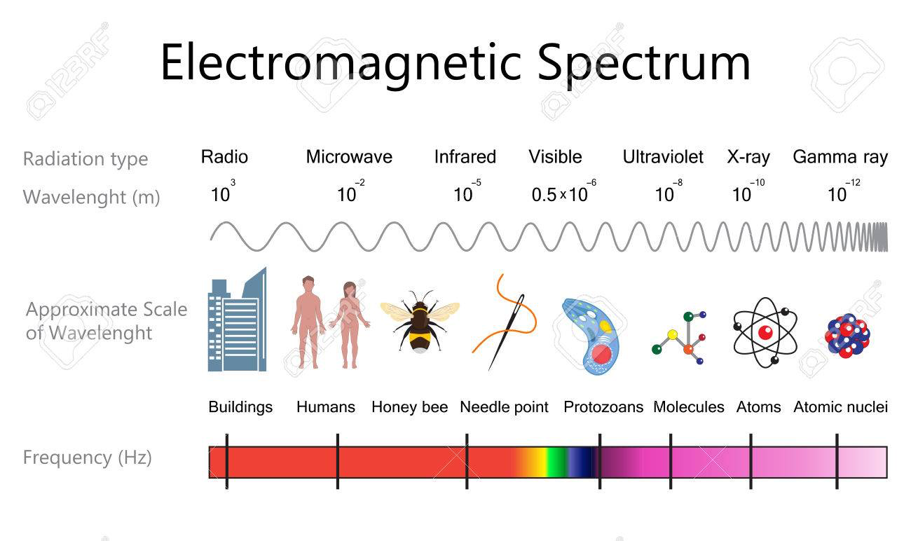
Background
Digital Signal Processing
Modulation Schemes - focus on digital modulation: phase shift keying
Electromagnetic Spectrum in terms of Network Bandwidth, Throughput, Latency, and Energy Usage
Theoretical Limits and Potential
Source: An Introduction to Digital Signal Processing.
Notes:
Digital signal processing is the use of digital processing, such as by computers or more specialized digital signal processors, to perform a wide variety of signal processing operations.
modulation is the process of varying one or more properties of a periodic waveform, called the carrier signal, with a modulating signal that typically contains information to be transmitted.
Different waves have different electromagnetic spectrum, with radio wave having the longest wavelength carrying the least energy and gamma having the shortest wavelength carrying the highest energy.

Slide 6
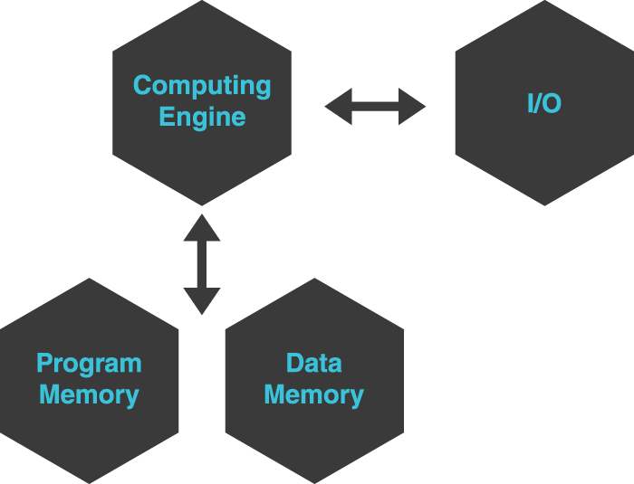
Digital Signal Processing
Filters, Measures, Compress, and Produce Analog Signals
Takes digitized signals that were originally analog and manipulates them to represent digital information
Analog-to-Digital Converter
Digital-to-Analogue Converter
Source: An Introduction to Digital Signal Processing.
Notes:
five different aspects that varies from each DSP: clock frequency, RAM size, data bus width, ROM size, and I/O voltage. All of these components really are just going to affect the arithmetic format, speed, memory organization, and data width of a processor.
The goal of a DSP is usually to measure, filter or compress continuous real-world analog signals.
A typical digital processing system
Analog signal->adc->digital signal processing->dac->digital signal
Hundreds or even thousands of analog filters, switches, frequency converters can be combined together to work for a digital signal processor

Slide 7
Digital Modulation for Analog Signals
WiFi converts Digital Information into continuous analog signals that are contained within the WiFi’s protocol.
Modulation Schemes give waveforms meaning and allow us to transfer information along these signals
Key Components of an Analog Signal: Amplitude, Frequency, and Phase Shift
Source: An Introduction to Digital Signal Processing.
Notes:
Baseband signal represents the information to be encoded through the modulation technique.

Slide 8
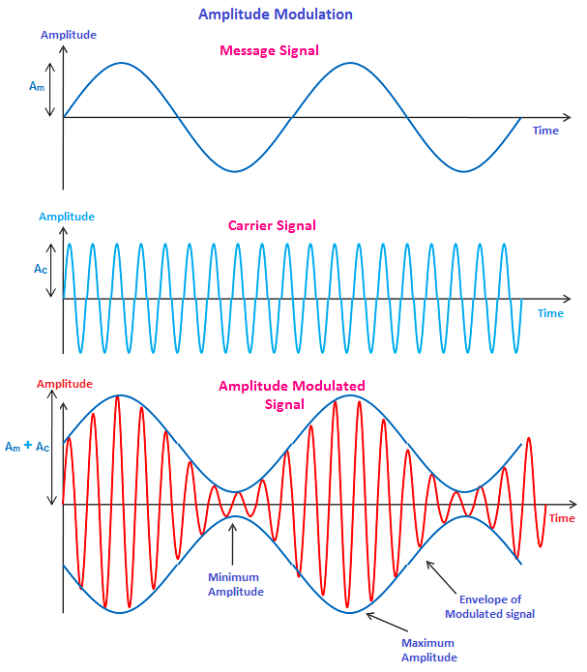
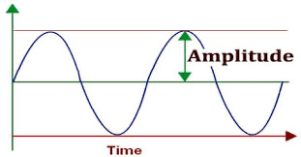
Amplitude Modulation Source: Practical Guide to Radio-Frequency Analysis & Design.
Amplitude Modulation - multiply continuously varying sinusoidal carrier by an offset of a continuous varying information signal, which is called a baseband whose amplitude is greater than or equal to 0.
Notes:
Amplitude is the height of signal. Amplitude modulation is a type of modulation where the amplitude of the carrier signal is changed in accordance with the amplitude of the message signal. Comparing to frequency modulation, in amplitude modulation, only the amplitude of the carrier wave is changed while the frequency and phase of the carrier wave remain constant.

Slide 9

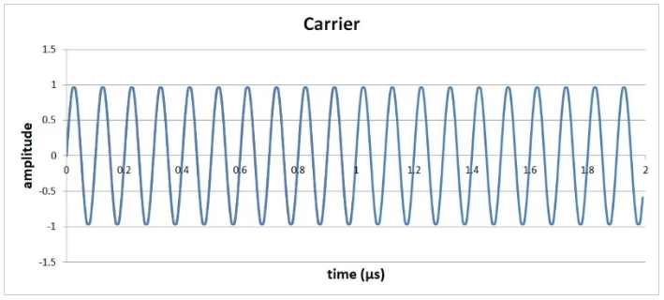
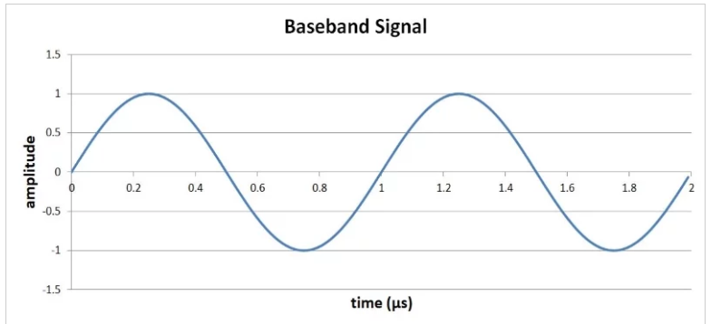
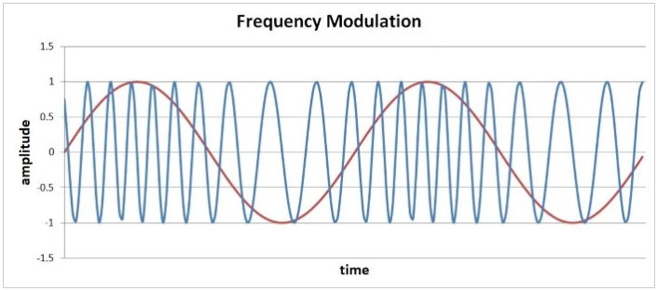
Frequency Modulation
Frequency Modulation - Instantaneous angular frequency is the derivative of phase in respect to time
The modulation index can be used to make the frequency deviation more sensitive or less sensitive to variations in the baseband value.
Source: Practical Guide to Radio-Frequency Analysis & Design.
Notes:
Haoran
An FM spectrum is influenced by the modulation index as well as by the ratio of the amplitude of the modulating signal to the frequency of the modulating signal.
Comparing to Amplitude modulation, in frequency modulation, only the frequency of the carrier wave is changed while the frequency and phase of the carrier wave remain constant.
Simply add the integral of the baseband signal (message signal) to your carrier signal to receive the modulated signal.

Slide 10
Phase Shift Modulation (critical to WiFi)
BPSK, QPSK, DQPSK
Adds the baseband signal to the carrier signal
Very similar to Frequency Shift Modulation
More Challenging because phase has no universal reference like FSK
BPSK: 2 bits per symbol; QPSK 4 bits per symbol; DQPSK 4 bits per symbol
Source: Practical Guide to Radio-Frequency Analysis & Design.
Notes:
Jared
Very similar to Frequency Modulation which is achieve by adding the integral of the baseband signal to the carrier signal
Phase Modulation - simply adding the baseband signal
The first thing that comes to mind here is that from a visual standpoint, FM is more intuitive than PM—there is a clear visual connection between the higher- and lower-frequency sections of the modulated waveform and the higher and lower baseband values. With PM, the relationship between the baseband waveform and the behavior of the carrier is perhaps not immediately apparent. However, after a bit of inspection we can see that the PM carrier frequency corresponds to the slope of the baseband waveform; the highest-frequency sections occur during the steepest positive slope of xBB, and the lowest-frequency sections occur during the steepest negative slope.
Many types of Phase Modulation: Binary Shift BPSK 2 bits per symbol, Quadrature Shift QPSK 4 bits per symbol
More Challenging
DQPSK - differential qpsk, based on previous symbol, relative shift
-resolves phase synchronization

Slide 11
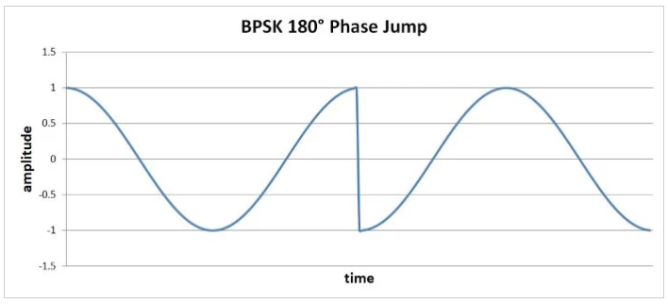
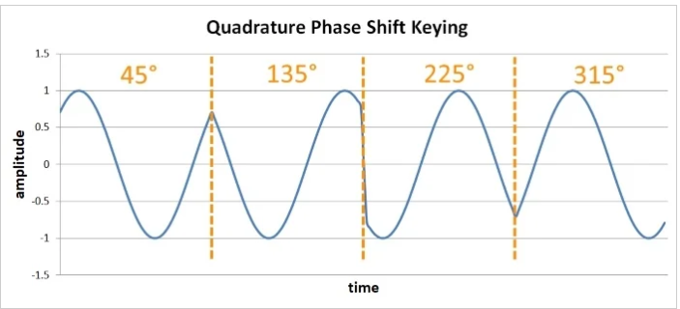
BPSK: inverting the carrier signal in response to one logic state and leaving it alone for the other logic state.
QPSK: 90° phase jumps instead of 180°
The more data we can encode in a symbol, the higher the data rate.
Source: Practical Guide to Radio-Frequency Analysis & Design.
Notes:
Jared
I can do 10 and 11 if you dont want to
Ill just read your speaker’s note lol……

Slide 12
Compare & Contrast
Amplitude modulation is simple, but it is susceptible to noise and requires a high-linearity power amplifier.
Frequency modulation is less susceptible to amplitude noise and can be used with higher-efficiency, lower-linearity amplifiers.
Digital phase modulation offers better theoretical performance in terms of bit error rate than digital frequency modulation, but digital FM is advantageous in low-power systems because it does not require a high-linearity amplifier.
Notes:
Jared

Slide 13
EM Parameters in terms of Computer Networks
Data Rate of WiFi standards (Mbit/s) = Data Subcarriers * Modulation * Coding *Spatial Streams / (Data Interval+Guard Interval)
Power Requirement of Data Transmission: Pr = Pt/(4πd^2), where Pr is received power, Pt is transmitted power and d is distance in meters
Source: 802.11 OFDM Rates

Slide 14
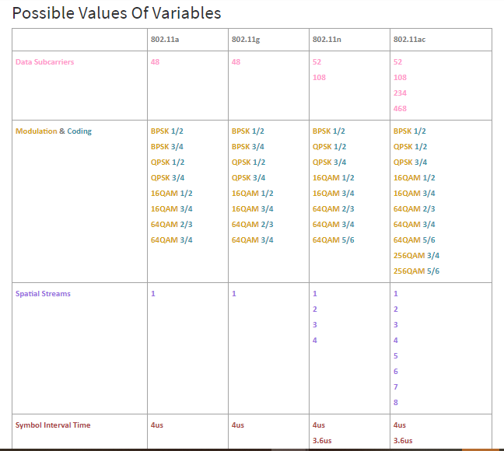
Notes:
802.11n has a theoretical maximum data rate of 300Mbps and reach 450Mbps with 3 antennae
802.11ac has a theoretical maximum speed of 866.7 Mbps on eight 160MHz 256-QAM channels, for a total of 6,933 Mbps
Source: 802.11 OFDM Rates

Slide 15
Potential of the X-Ray Band as a medium for data communication in space
Using a higher frequency spectrum can achieve theoretically higher data rates
The power requirement to transmit the same data will be smaller
Organic matter does not lie in space and there’s significantly less material that could create noise to the signal, very important for higher frequency EM waves
The vast increase in data rate allows us to take better more sophisticated measurements of celestial objects
Notes:
With the huge increase in frequency, there’s only a space of 1000HZ before the EM signal becomes a Gamma Ray
3x10^16Hz to 3x10^19Hz, Hertz cycles per second
Energy range 100eV to 200 keV
So less spectral bandwidth
Lack of signal attenuating objects if positioned correctly

Slide 16
Laser-based Communication
Data Rate (bps) = 1/n P_r[photons/sec] where P_r is received power, and n is power sensitivity of the receiver [photons/bit]
Atmospheric Attenuation t = exp(-BL), where B is the total attenuation coefficient, L is distance between transmitter and receiver (km); B = B_abs * B_scat, where B_abs = molecular and aerosol absorption and B_scat = molecular and aerosol scattering
Source: Free Space Optical Communication - Theory and Practice.

Slide 17
The Theory for Modulating on the X-Ray Spectrum
Dilemma with X-ray Spectrum: the bandwidth of using the X-ray spectrum is only 1kHz. Range of frequencies is 3*10^16Hz to 3*10^19Hz.
Using Nyquist Rate Formula which assumes error-free channel and no noise, and if we assume we use 256-QAM which modulates 8 bits per symbol, our theoretical maximum data rate comes out to being: 2*1000*log_2(8) = 6000 bits/second = 6kbps
The reason this is so small is because the EM spectrum range at higher frequencies is smaller
This implies that the data rate performed by the XCOM project would be very small using a traditional continuous wave modulation. However, pulse modulation would be a lot more effective.

Slide 18
Past Work
Laser-based communication experiments (2013) - overall goals and results
622 Mbps over 239,000 miles between the Earth and the Moon
XCOM Project by NASA in 2018 - discuss overall goals and results
Designed an X-ray modulator that modulates at 1ns
Data rate is not mentioned
Sources:
NASA Laser Communication System Sets Record with Data Transmissions to and from Moon.
XCOM Project
Notes:
FSO - Free Space Optics

Slide 19
Challenges
Hardware Challenges - the feasibility of this is dependent on the signal-to-noise ratio, the range of communication, and amount of channel bandwidth
Software Challenges - clock speed of the DSP to compute the modulated signal
Financial Challenges - cost of infrastructure, power requirement, and cost to deploy into space
Mathematical Feasibility - Is This Even Possible? How many devices can even use the channel?

Slide 20
Implementation
Explore the efficiency of existing modulation schemes
Results of Experiments
Implementation of Network Protocol
Results from Implementation of Protocol
Notes:
Ding from here

Slide 21
Security Concerns
As X-ray Communication Technology could be significantly efficient and powerful in data transfer, it’s CIA(Confidentiality, Integrity, and Authenticity) issue may sooner or later become the biggest concern in adopting this large scale technology. Hence, we are proposing the combination of packet encoding with p2p message update.
Notes:
Ding to here

Slide 22
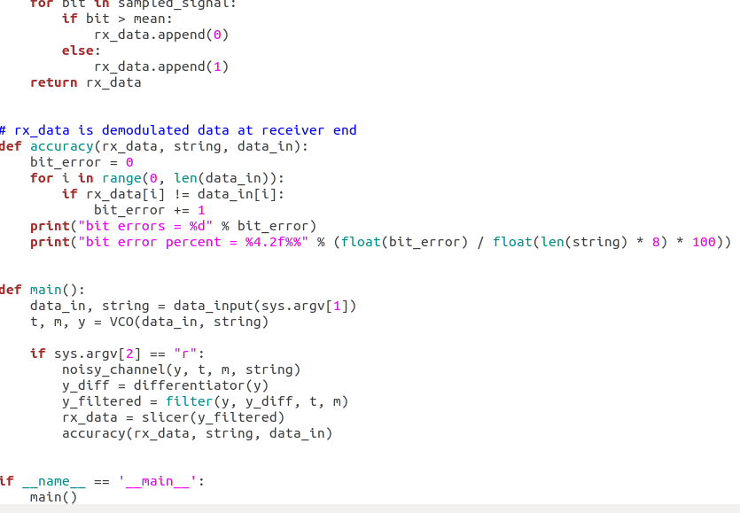
Snippet of FSK(Frequency-shift keying) Code
Notes:
Frequency-shift keying (FSK) is a frequency modulation scheme in which digital information is transmitted through discrete frequency changes of a carrier signal

Slide 23
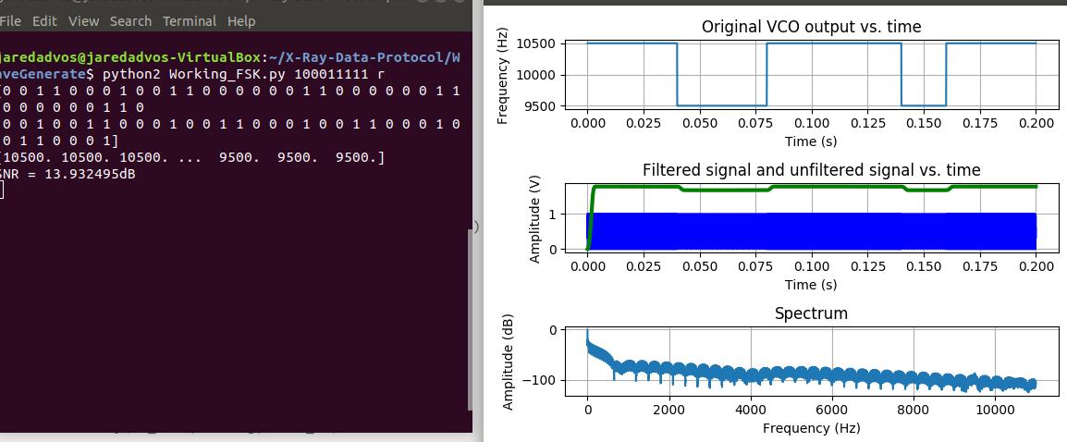


Slide 24
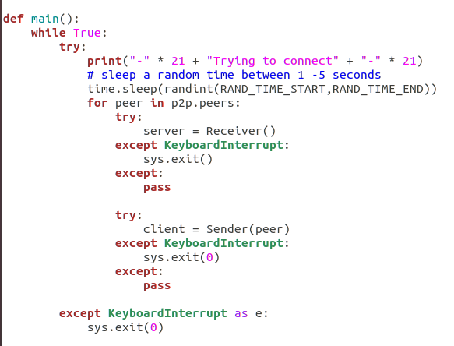
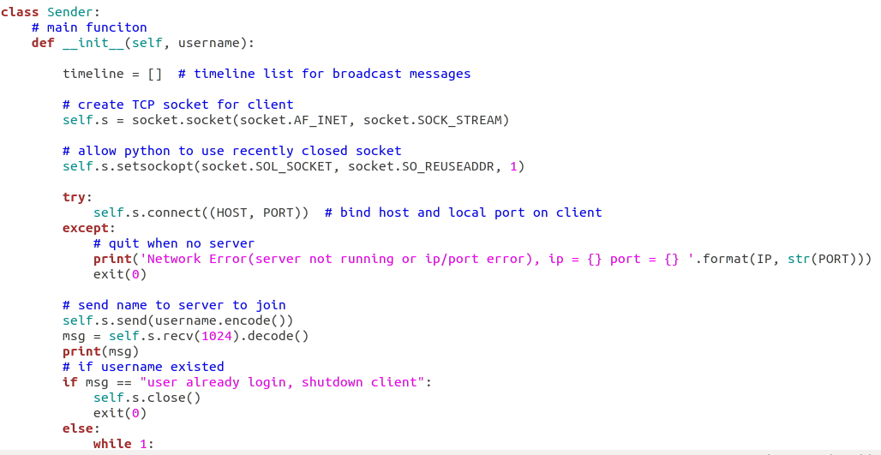
Snippet of P2P Code

Slide 25
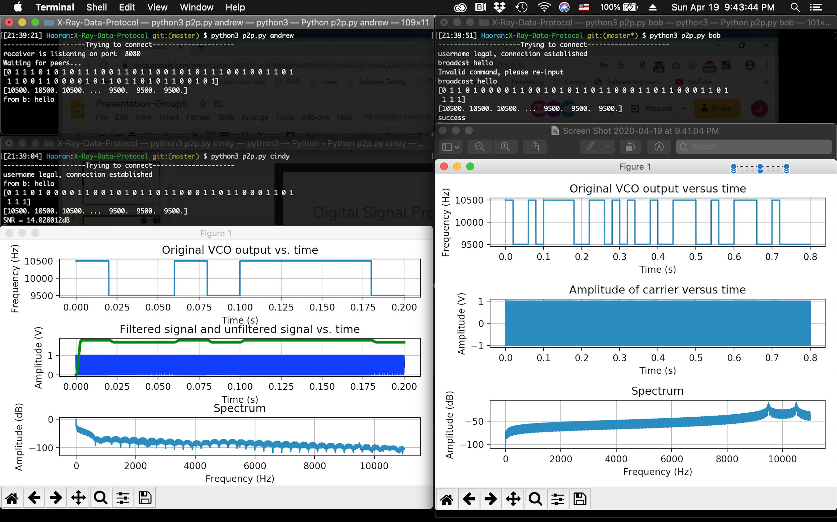

Slide 26
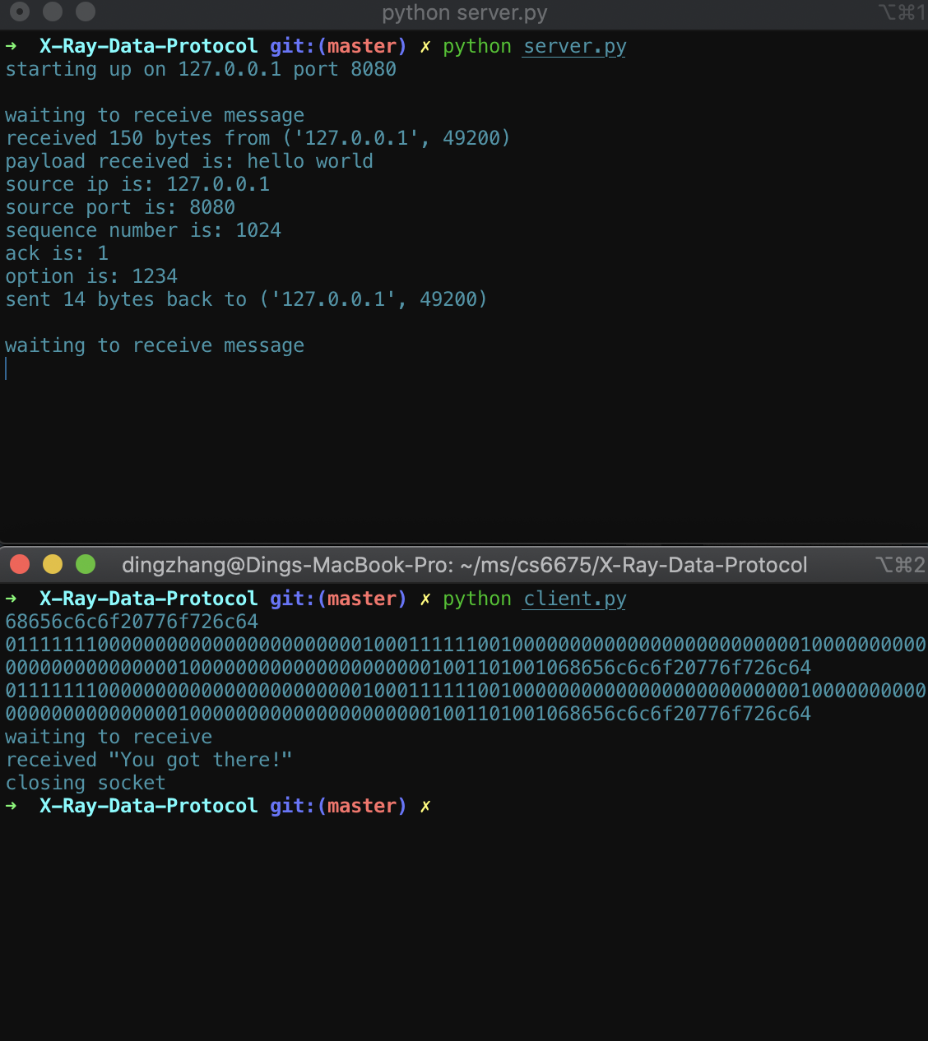
Results for packet encoding

Slide 27
Conclusions
From our theoretical analysis, we found that pulse-based communication can achieve a significantly higher data rate than continuous wave modulation if we transmit data at a higher frequency spectrum. However, there are still many challenges in implementation.
The sound-to-noise ratio is very important in data communication implementations.
There is a lack of security for data communication in space, so this is an interesting field for research.
Notes:
Francine

Slide 28
Future Work
Since our project is designed for the X-Ray spectrum, we would like to test it on a real hardware device if we have the chance.
If we had more time, we would make a comparison of the different modulation schemes and explore pulse modulation as well.
Notes:
Francine

Slide 29
Problems Encountered
Management Challenges: Time constraints and the remote-distance led to a lack of productivity which resulted in an incomplete analysis and unfinished experiments of the different modulation schemes.
Software Challenges: We also found that simulating the X-Ray spectrum was not possible in Python 2 because the frequency value was too large to graph. We were unable to find an alternative. Thus, we tested accuracy at smaller frequency ranges instead.
Communication was difficult and dividing the workload was challenging as many of us were not experienced in the field of digital signal processing.

Slide 30
Bibliography
An Introduction to Digital Signal Processing. https://www.allaboutcircuits.com/technical-articles/an-introduction-to-digital-signal-processing/
Free Space Optical Communication - Theory and Practice. https://www.intechopen.com/books/contemporary-issues-in-wireless-communications/free-space-optical-communications-theory-and-practices
FSK Explained with Python. https://www.allaboutcircuits.com/technical-articles/fsk-explained-with-python/
Practical Guide to Radio-Frequency Analysis & Design. https://www.allaboutcircuits.com/textbook/radio-frequency-analysis-design/#radio-frequency-modulation
NASA Laser Communication System Sets Record with Data Transmissions to and from Moon. https://www.nasa.gov/press/2013/october/nasa-laser-communication-system-sets-record-with-data-transmissions-to-and-from/
XCOM Project. https://techport.nasa.gov/view/94821
802.11 OFDM Rates. https://dot11.exposed/2018/11/29/802-11-ofdm-data-rates-the-math-behind-the-numbers/

