Slide 2
Does the need for good sleep increase with age?
Why can’t I pull those college all nighters anymore?
As we age do we need more sleep?
Do we get more stressed out when we age due to sleep?

Slide 3
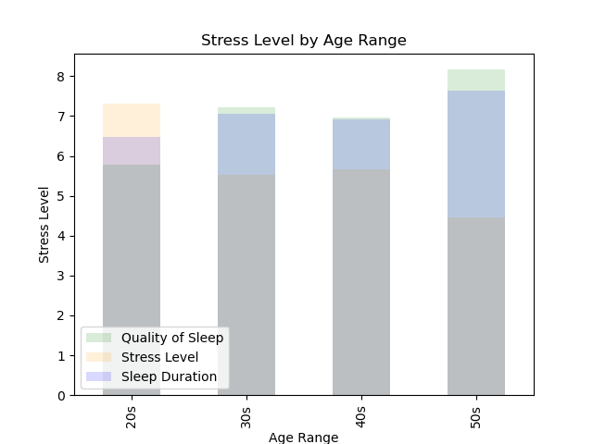
On average, people who slept more were less stressed

Slide 4
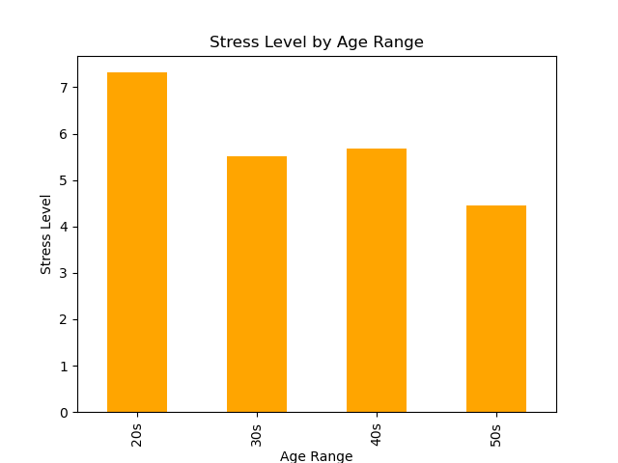
Who is the most stressed out age group?
Created bins and calculated the average per bin
20s 7.315789
30s 5.521127
40s 5.675214
50s 4.447917

Slide 5
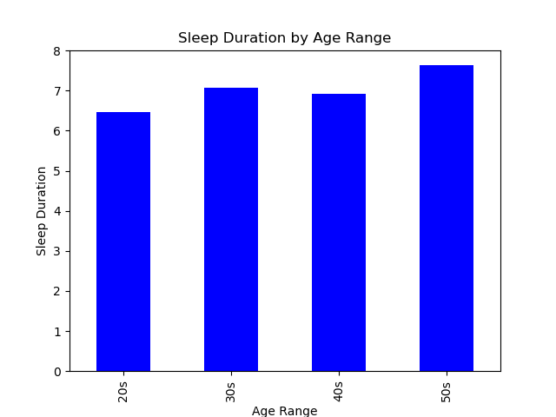
Who sleeps the most?
20s 6.468421
30s 7.066901
40s 6.909402
50s 7.631250

Slide 6
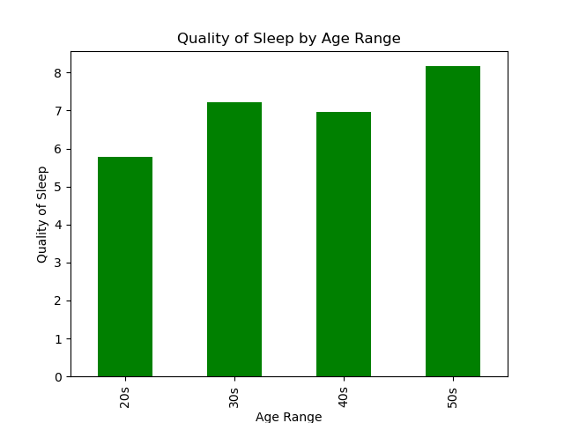
Who has the best sleep?
20s 5.789474
30s 7.225352
40s 6.965812
50s 8.166667

Slide 7
On average, people who slept more were less stressed

Slide 8
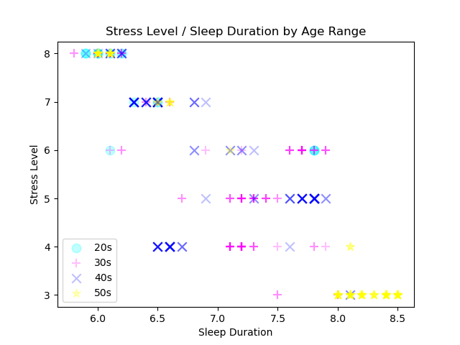
Sleep Duration - All Participants
Outliers?
Trends?

Slide 9
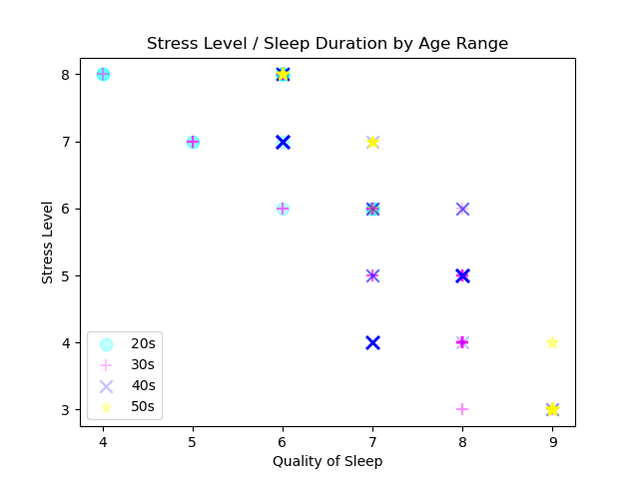
Sleep Quality – All participants
Outliers?
Trends?

Slide 10
Conclusion
No matter how old you were, if you slept more, you were less stressed
Chicken or the egg… do you sleep less because you are stressed or are you more stressed because you don’t sleep

