Slide 1

CSCI 3753: Operating Systems
Headline
Week 10
October 31st, 2025

Slide 2

Happy Halloween!
https://tinyurl.com/CSCI3753

Slide 3
Announcements
PS3 due Sunday at midnight!
Quiz 10 due at midnight tonight!
PA7 is due NEXT Sunday!
As always recitation materials are stored here
https://tinyurl.com/CSCI3753

Slide 4
Memory Management
Operating systems must manage memory
memory pages or segments
Not all memory is utilized at once
OS will operate on a subset of memory
Optimized memory usage
Reduced memory access time -> better performance
https://tinyurl.com/CSCI3753

Slide 5
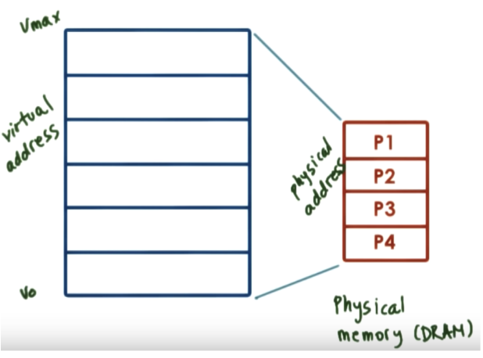
Page Based Memory Management
Virtual vs Physical Memory
Keep few pages in memory, rest on disk
Allocate
allocation, replacement
pages -> page frames
Arbitration
Address translation
Address validation
Page tables
https://tinyurl.com/CSCI3753

Slide 6
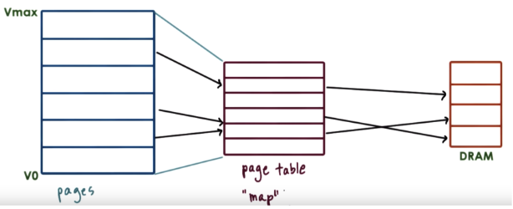
Page Tables
Virtual memory pages and physical memory page frames are of the same size
Page table is like a map that tells the OS where to find the virtual memory reference
Virtual address has an offset
https://tinyurl.com/CSCI3753

Slide 7
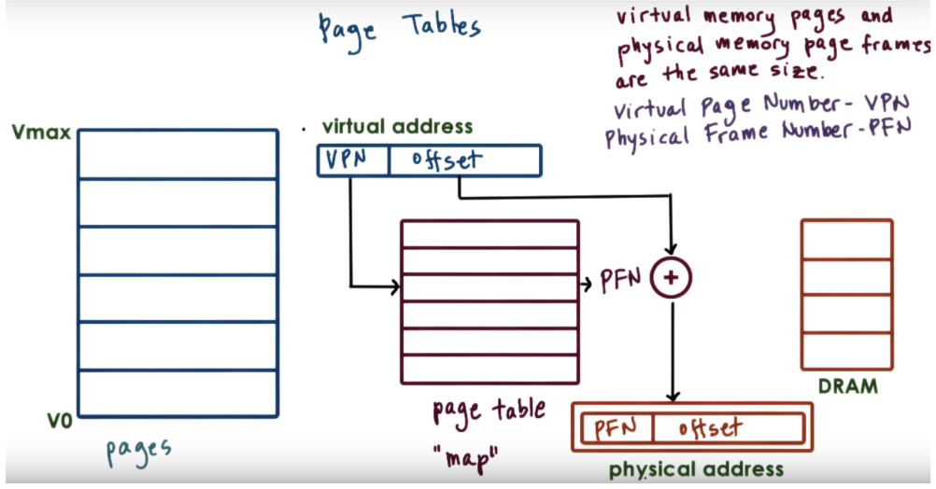
Page Tables
https://tinyurl.com/CSCI3753

Slide 8
Page Fault
A referenced page is NOT loaded in memory
OS blocks the process and retrieves the referenced page
Significant performance overhead
Need to keep page fault frequency low
(e.g. less than 1 in 107 for overhead less than 10%)
https://tinyurl.com/CSCI3753

Slide 9
Demand Paging
Virtual Memory >> Physical Memory
Virtual memory page not always in physical memory
Physical page frame can be saved and restored to/from secondary storage
Demand Paging
Pages swapped in and out of memory and swap partition (disk)
https://tinyurl.com/CSCI3753

Slide 10
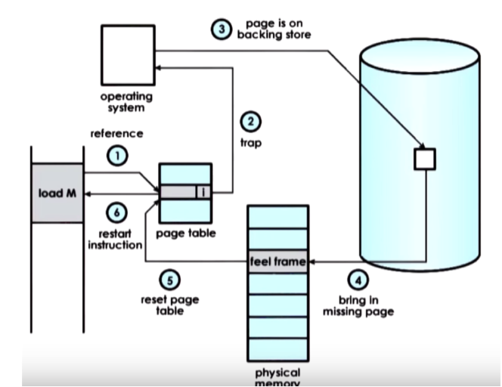
Demand Paging
https://tinyurl.com/CSCI3753

Slide 11
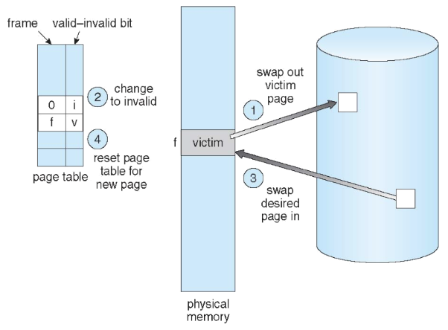
Basic Page Replacement Process
Locate the desired page on disk
Find a free frame
If there is a free frame, use it
If not, use a page replacement policy to
Select a victim frame
Write victim frame to disk if dirty
3. Brind the desired page into the newly free frame and update the page and frame tables
4. Continue the process by restarting the instruction that caused the trap
https://tinyurl.com/CSCI3753

Slide 12
Page Replacement
Virtual Memory address space >> Physical Memory
With demand paging, physical memory fills up quickly
When a process faults and memory is full, some page must be swapped out
Handling a page fault now requires two disk accesses, not one
Which page should we replace?
Local replacement - replace a page of the faulting process
Global replacement - possibly replace the page of another process
https://tinyurl.com/CSCI3753

Slide 13
Page Replacement Evaluation
Record a trace of the pages accessed by a process
Generate a page trace:
e.g. 1, 7, 7, 4, 6, 5, 8, 1, 1, 1, 7, 7, 7, 6, 5, 6
Simulate the behavior of a page replacement algorithm on the trace and record the number of page faults generated
Parameters: algorithm, page reference string, # of memory frames
Fewer faults -> better performance
https://tinyurl.com/CSCI3753

Slide 14
Page Replacement Algorithms
A page replacement algorithm picks a page to be paged out and frees up a frame
Optimal - the one that leads to the least faults
FIFO - First In, First Out
LRU - Least Recently Used
https://tinyurl.com/CSCI3753

Slide 15
First In First Out (FIFO)
Idea: The oldest page in physical memory is the one selected for replacement
Extremely simple to implement
Keep a list
Victims are chosen from the tail
New pages are placed on the head
Performance can be poor
FIFO does not consider page usage
In the worst case, each page that is paged out could be the one that is referenced next
https://tinyurl.com/CSCI3753

Slide 16
Least Recently Used (LRU)
Idea: Replace the page in memory that has not been accessed for the longest time
If a page wasn’t used recently, then it is unlikely to be used again in the near future
If a page was used recently, then it is likely to be used again in the near future
Select victim that was used least recently
https://tinyurl.com/CSCI3753

Slide 17

LRU Example
Access: 1, 2, 3, 2, 1, 5, 2, 1, 6, 2, 5, 6, 3, 1, 3, 6, 1, 2
3 frames
1
2
3
2
1
5
2
1
6
2
5
6
3
1
3
6
1
2
1
1
2
1
2
3
1
2
3
1
2
3
1
2
5
1
2
5
1
2
5
1
2
6
1
2
6
5
2
6
5
2
6
5
3
6
1
3
6
1
3
6
1
3
6
1
3
6
1
2
6
Nine page faults!
https://tinyurl.com/CSCI3753

Slide 18
Upcoming PAs
Goal: Implement a paging strategy which a paging simulator can use to maximize the performance of the memory accesses in a set of predefined programs
PA7: LRU
PA8: Predictive algorithms
https://tinyurl.com/CSCI3753

Slide 19
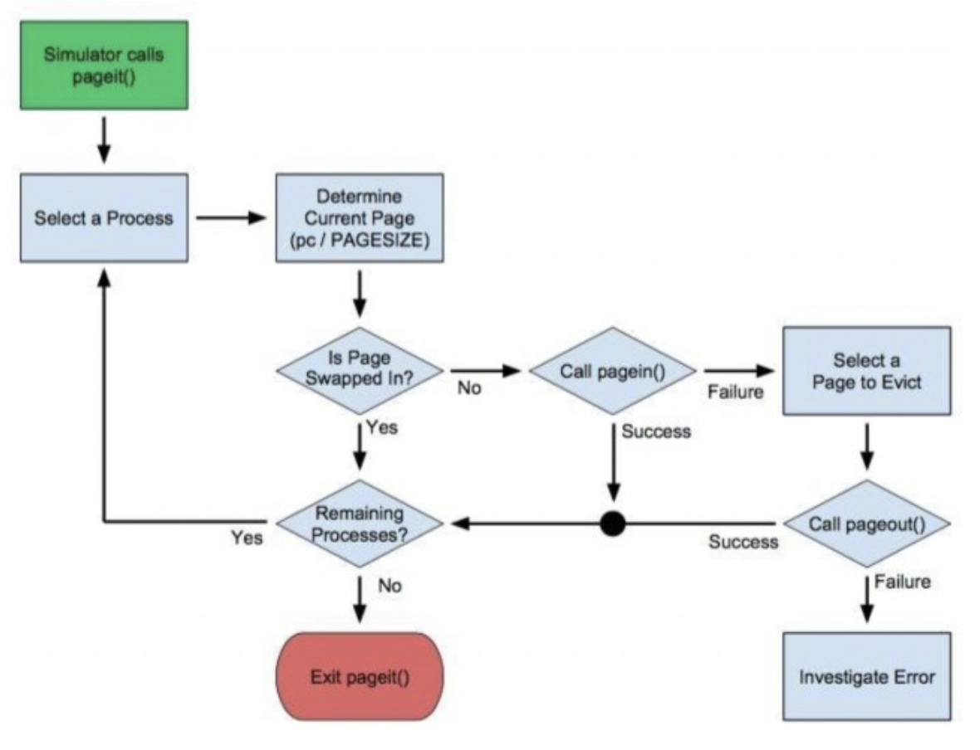
PA7 Diagram
Most of y’alls work is here!
Basic swapping algorithm for single process already provided in pager-basic.c!!
https://tinyurl.com/CSCI3753

Slide 20
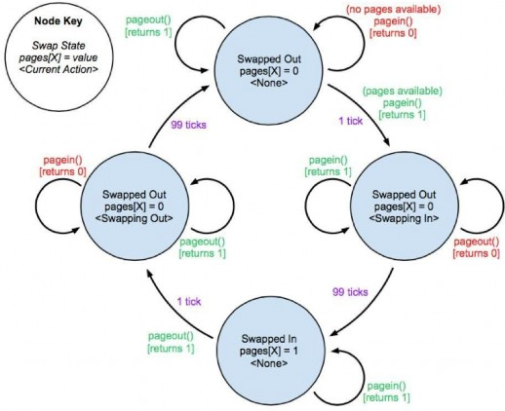
PA7 Diagram
https://tinyurl.com/CSCI3753

Slide 21
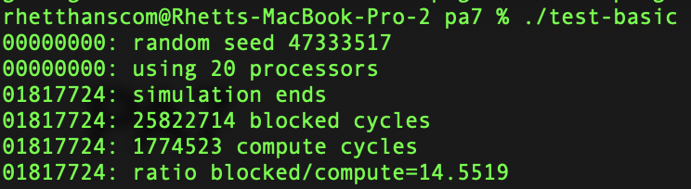
PA7
Goal: Implement a LRU paging strategy which a paging simulator can use to improve the performance of the memory accesses in a set of predefined programs
pager-basic.c offers a simple, already completed pageit() function which only allows for a single process and page to be in memory at a time
Great for seeing/understanding how to work with the data
pager-lru.c is where you will do your work
To make and run: make all
./test-basic OR ./test-lru
https://tinyurl.com/CSCI3753

