Slide 1
Operating System Concepts Process synchronization
Hossein based on Prof. Saeid Abrishami Slides

Slide 2
Background
Shared memory is a method
Concurrent access to shared data may result in data inconsistency
Maintaining data consistency requires mechanisms to ensure the orderly execution of cooperating processes
Example: Producer-Consumer Problem
producer process produces information that is consumed by a consumer process
unbounded-buffer places no practical limit on the size of the buffer
bounded-buffer assumes that there is a fixed buffer size

Slide 3
Bounded Buffer Producer-Consumer
0
1
2
n-1
…
in
out
producer → in
consumer → out
Buffer is circular

Slide 4
Producer Code
while (true) {
//produce an item and put in nextProduced
while (counter == BUFFER_SIZE); //do nothing
buffer [in] = nextProduced;
in = (in + 1) % BUFFER_SIZE;
counter++;
}

Slide 5
Consumer Code
while (true) {
while (counter == 0); // do nothing
nextConsumed = buffer[out];
out = (out + 1) % BUFFER_SIZE;
counter--;
//consume the item in nextConsumed
}

Slide 6
Race Condition
counter++ could be implemented as
register1 = counter
register1 = register1 + 1
counter = register1
counter-- could be implemented as
register2 = counter
register2 = register2 – 1
count = register2
Consider this execution interleaving with “count = 5” initially:
S0: producer execute register1 = counter {register1 = 5}
S1: producer execute register1 = register1 + 1 {register1 = 6}
S2: consumer execute register2 = counter {register2 = 5}
S3: consumer execute register2 = register2 - 1 {register2 = 4}
S4: consumer execute counter = register2 {count = 4}
S5: producer execute counter = register1 {count = 6 }

Slide 7
Race Condition
We would arrive at this incorrect state because we allowed both processes to manipulate the variable counter concurrently
Race Condition
When several processes access and manipulate the same data concurrently and the outcome of the execution depends on the particular order in which the access takes place
Synchronization
To ensure that only one process at a time can be manipulating the same data

Slide 8
The Critical-Section Problem
Consider system of n processes {p₀, p₁, … p_{n-1}}
Each process has critical section segment of code
Process may be changing common variables, updating table, writing file, etc
When one process in critical section, no other may be in its critical section
The critical section problem is to design protocol to solve this
Each process must ask permission to enter critical section in entry section, may follow critical section with exit section, then remainder section

Slide 9
The Critical-Section Problem
do {
entry section
critical section
exit section
remainder section
} while (TRUE);

Slide 10
Solutions to Critical-Section Problem
Software-based solutions
Hardware-based solutions
Operating system solution
Programming languages solution

Slide 11
Semaphore
A synchronization tool which is provided by OS
A semaphore S is an integer variable that, apart from initialization, is accessed only through two standard atomic operations
wait() or P()
signal() or V()
wait(S) { signal(S) {
while (S<=0) ; S++;
S--; }
}

Slide 12
Semaphore
Types of semaphores
Counting (general) semaphore – integer value can range over an unrestricted domain
Binary semaphore – integer value can range only between 0 and 1; can be simpler to implement
Also known as mutex locks (silberschatz definition)
Binary semaphores can be used to deal with the critical-section problem (See next slide)
Counting semaphores can be used to control access to a given resource consisting of a finite number of instances (See producer-consumer solution using semaphores)

Slide 13
Mutual Exclusion using Semaphores
Semaphore mutex; // initialized to 1
do {
wait (mutex);
Critical Section
signal (mutex);
Remainder section
} while (TRUE);

Slide 14
Semaphore Implementation
Main disadvantage: busy waiting
While a process is in its critical section, any other process that tries to enter its critical section must loop continuously in the entry code
This type of semaphore is also called a spinlock because the process "spins" while waiting for the lock
Spinlocks do have an advantage in that no context switch is required when a process must wait on a lock
Thus, when locks are expected to be held for short times, spinlocks are useful

Slide 15
Semaphore Implementation
To overcome the need for busy waiting, we can modify the definition of the wait() and signal()
With each semaphore there is an associated waiting queue
Two operations are provided by the operating system as basic system calls
block place the process invoking the operation on the appropriate waiting queue and switch it to blocked state
wakeup remove one of processes in the waiting queue and place it in the ready queue

Slide 16
Semaphore Implementation
struct semaphore {
int value;
queueType queue; //a queue of blocked processes
}
wait(semaphore S) { Signal(semaphore S) {
S.value --; S.value ++;
if (S.value < 0) { if (S.value <= 0) {
add this process to S.queue; remove a process P from S.queue;
block(); wakeup(P);
} }
}

Slide 17
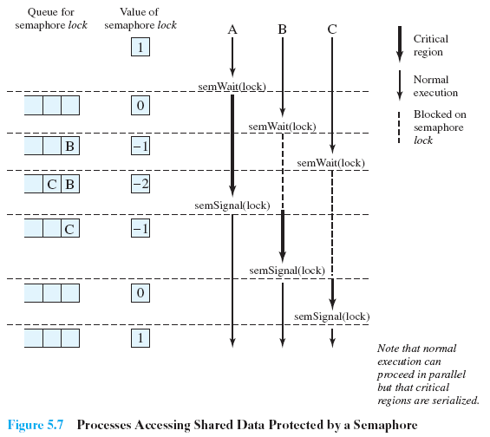
Semaphore Implementation

Slide 18
Semaphore Implementation
Must guarantee that no two processes can execute wait() and signal() on the same semaphore at the same time
Thus, implementation becomes the critical section problem where the wait and signal code are placed in the critical section
Could now have busy waiting in critical section implementation
But implementation code is short
Thus, the critical section is almost never occupied, and busy waiting occurs rarely, and then for only a short time.

Slide 19
Deadlock and Starvation
Deadlock: two or more processes are waiting indefinitely for an event that can be caused by only one of the waiting processes
Let S and Q be two semaphores initialized to 1
P₀ P₁
wait (S); wait (Q);
wait (Q); wait (S);
… …
signal (S); signal (Q);
signal (Q); signal (S);
Starvation or indefinite blocking: a situation in which processes wait indefinitely within the semaphore.

Slide 20
Classic Problems of Synchronization
We present a number of synchronization problems as examples of a large class of concurrency-control problems
Classical problems used to test newly-proposed synchronization schemes
Examples
Producer-Consumer (Bounded-Buffer) Problem
Readers and Writers Problem
Dining-Philosophers Problem

Slide 21
Producer-Consumer Problem
N buffers, each can hold one item
Semaphore mutex provides mutual exclusion for accesses to the buffer pool, initialized to the value 1
Semaphore full counts the number of full buffers, initialized to the value 0
Semaphore empty counts the number of empty buffers, initialized to the value N

Slide 22
Producer-Consumer Problem
Producer:
do {
//produce an item in nextp
wait (empty);
wait (mutex);
//add the item to the buffer
signal (mutex);
signal (full);
} while (TRUE);
Consumer:
do {
wait (full);
wait (mutex);
//remove an item from buffer to nextc
signal (mutex);
signal (empty);
//consume the item in nextc
} while (TRUE);

