Slide 1
Automated Security Test Case Generation
Author: Jeremy Arellano

Slide 2
Why This Work Matters
Growing prevalence of software security breaches globally
Impact of security breaches on data integrity and service availability
Increasing complexity of software systems and their vulnerabilities
Need for efficient, automates solutions for a rapidly changing landscape

Slide 3
Background: The Problem
Rising Threats
Increase in frequency of software security breaches. Overtime they have been getting more severe.
Consequences of Breaches
Data Loss, Compromised Services, Denial of Services
Current Preventative Measures
Static: Code analysis without execution (parsing and searching through repositories for common security vulnerabilities)
Dynamic: Analyzing the output of a program as its running
Shortfalls
Vulnerabilities are consistently being found, causing static techniques to quickly become out of date.

Slide 4
Background: The Need for Automation
Manual Testing Limitations: Often take long periods of time to develop, especially for more complex repositories
Automated Solutions: Test case generation exists for some applications such as IoT applications
Larger architectural projects have built in scans that analyze the structure and potential weaknesses these structures have on its security

Slide 5
Project Goals And Research Questions
Bridge the gap with an automated test generation framework that expands away from a category of applications to a wider range
1
Utilize risk and architectural views to enhance the generation of these security test cases
2
Compare how this program behaves with existing programs that specialize in one area of security.
3

Slide 6

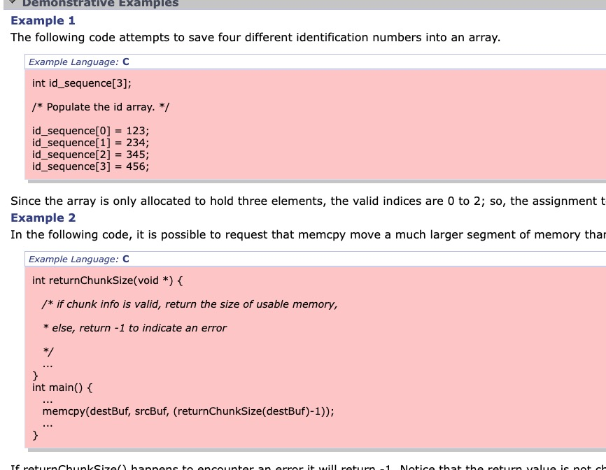
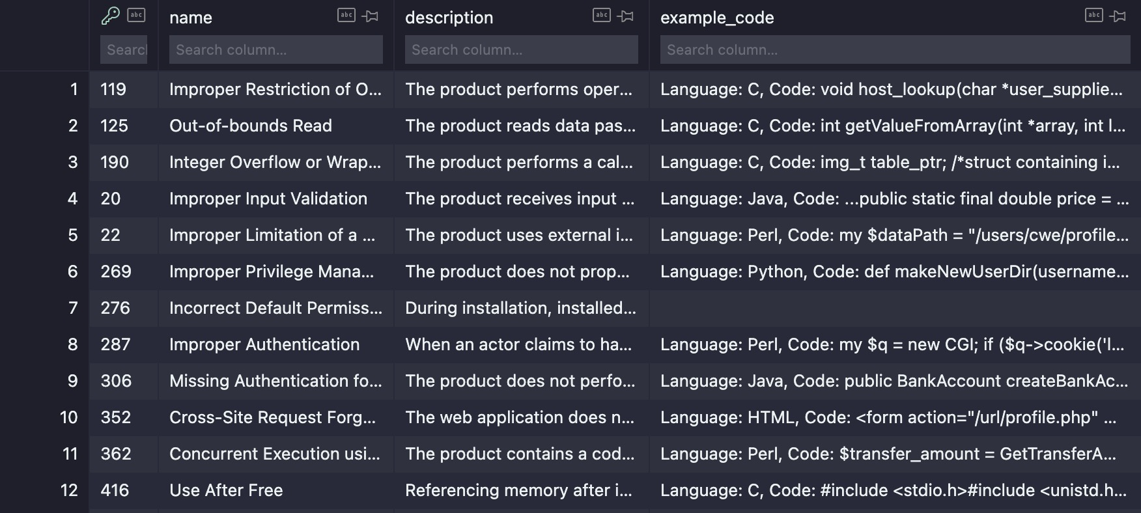
Early Results: Data Collected
CWE Database: Created and parse the most common through the given XML files
25 Most Dangerous Software Weaknesses
OWASP Top Ten
Repositories to Analyze
Utilizing an open-source project “Home Assistant from GitHub to run static and architectural overview of the contents

Slide 7
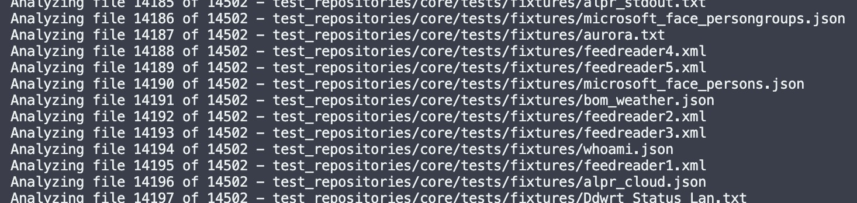
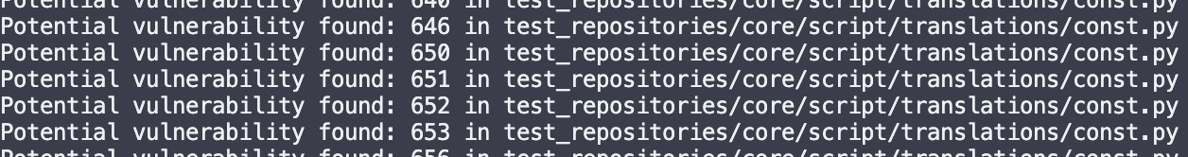
Early Results: Initial Framework Development
Static Analyzer built to parse through the entire repository and match its contents with the common security vulnerability database
Matches a percentage to how close a vulnerability is to matching with the database
Compiles a list of vulnerabilities and appends the ID, and Name of the CWE associated with the file.
So far, this process returns a lot of false positives

Slide 8
Real-World Impact
Security Enhancement Tool: Being able to use this tool with software development to enhance the security of applications
Development Efficiency: Eliminate the need to manual security testing and reduce the time needed to scan large repositories
Adaptability: Being able to use this framework with a large diversity of projects.

Slide 9
Inherent Challenges
Current static approach is limited, robustness in the diversity of different vulnerabilities
Evolving threats as mentioned before can become a problem in the future for this algorithm
Efficiency and coverage is a major challenge, incorporating an algorithm that will cover 100% of a repository and all of its corresponding vulnerabilities.
Being able to scan general architecture and pinpointing vulnerabilities from this

Slide 10
Road Ahead: Future Plans
Figuring out how to extract more information from the CWE database and categorize them into severity
Possibly add an efficient measure so that the algorithm can run efficiently (i.e., scan multiple files at once rather than one at a time).
Incorporate Architectural Design Analysis within the algorithm to find vulnerabilities in structure

