Slide 1
GD-Workshop and
GD-Mastering
Dylan Bromley
Sega of America
Confidential
Notes:
Your notes here.

Slide 2
GD-Workshop
Using GD-Workshop: A Walkthrough
Notes:
Your notes here.

Slide 3
GD-Workshop
Emulation Drive
4 gig SCSI hard drive
1 possibly 2: 2 gig FAT16 partitions
Can be reformatted to one 4 gig FAT32 or NTFS drive

Slide 4
GD-Workshop
Physical GDROM
120 minutes
1 Gig of data

Slide 5
GD-Workshop
Definition of Data Areas
Low Density Area: 4 minuets long and holds ~35MB of data
High Density Area: 112 minuets long and holds ~1GB of data

Slide 6
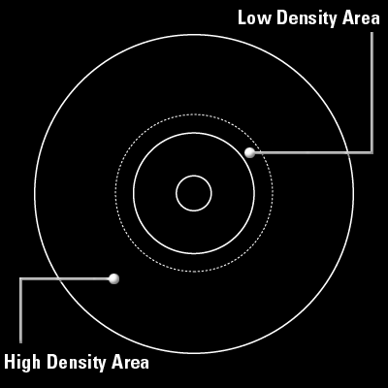
GD-Workshop

Slide 7
GD-Workshop
Track Types
CDDA: Contains raw audio files. Each audio file must be on its own track
Mode1: These tracks contain game data information and the game executable

Slide 8
GD-Workshop
Definition of Sessions
Session 1: Low Density Area of GD
Both tracks must contain 4 sec of data
- Track 1 - Mode1: GD buffer
- Track 2 - CDDA: Stores audio file to be played when inserted into a CD Player

Slide 9
GD-Workshop
Session 2: High Density Area
Need for two Mode-1 tracks
- Track 3: Mode-1 Buffer area
- Needs 4 sec of data
- Track Tab: Pad Track Check Box

Slide 10
GD-Workshop
Track 4: Mode-1 Game Data
- Outer most track on physical GD
- Contains 1ST_READ.BIN File
- Files can be reordered for file read speed optimization via the list view option

Slide 11
GD-Workshop
Adding of Digital Audio Tracks
Insertion of CDDA tracks
Reorder of last Mode-1 track

Slide 12
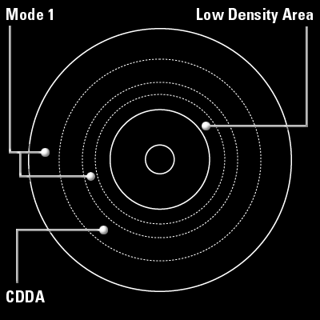
GD-Workshop

Slide 13
GD-Mastering

Slide 14
GD-Mastering
Compilation of a Bootable File
All example make files contain a BIN option
In the EXE directory the BIN file is created
BIN file must be placed on last Mode-1 track

Slide 15
GD-Mastering
IP.BIN: The First File Loaded
IP.BIN and IP0000.BIN are required to be present in the project.
IP0000.BIN = IP.BIN x8

Slide 16
GD-Mastering
Creation of IP.BIN and IP0000.BIN is included in the release in the shinobi samples directory
This file contains several different fields which need to be customized for each title

Slide 17
GD-Mastering
Hardware ID
Maker ID
Device Information
Area Symbols
Peripherals
Product Number
Version
Release Date
1st Read File Name
Software Maker Info
90 - d0: Title String Info
Game Title

Slide 18
GD-Mastering
Placement of IP.BIN files within the project
Disc tab in GD-Workshop
System Area File (single): IP0000.BIN
System Area File (high): IP.BIN

Slide 19
GD-Mastering
Testing Your Bootable Project
Close the drawer
Reset the Dev Station

Slide 20
GD-Mastering
Burning The Image
Add the GD-Writer
  - Configuration\SCSI Bus
  - Select GD-Writer and Add as GD-Writer

Slide 21
GD-Mastering
Testing Burning
- Emulator \ Test Write
- Goes through the process of burning without turning on laser

Slide 22
GD-Mastering
Final Burning
- Emulator \ Write
- ~1 hour to burn

Slide 23
GD-Mastering
Testing the Burn
- Switch GD Emulator to GD-ROM mode
- This mode allows booting from the GD drive
- Insert GD and reset Dev Station

