Slide 1
Robust Joint Motion Forecasting Under Missing and Noisy Observations
Compact MotionLM-style joint forecaster on the Waymo Open Motion Dataset — corruption-aware training and bounded RL post-training
Status: PRELIMINARY (development set, seed 0). Development numbers use manifests/dev.json; held-out numbers use the locked manifests/final.json (final evaluation pending).
Notes:
Deck generated from saved results only: slides/content.json, built by scripts/build_slide_content.py and slides/build_deck.js. Regenerate: python scripts/build_slide_content.py --dev-eval /media/jarettpoliner/extradrive1/recovered_seagate_files/Waymo_AV_data/runs/eval_dev_prelim --seeds 0 --label PRELIMINARY (development set, seed 0) --figures reports/figures/dev_prelim --demos reports/demos/prelim_M0_vs_M1_missing_0.3 reports/demos/prelim_M0_vs_M1_noise_0.5 reports/demos/prelim_independent_vs_joint_clean && node slides/build_deck.js

Slide 2
Research question and motivation
Question
Why it matters
Approach
Does a joint two-agent autoregressive forecaster keep its accuracy and physical consistency when the observed history is incomplete or noisy — and can training on corrupted observations, plus bounded reward post-training, make it more robust without hurting clean accuracy?
Deployed trackers drop frames and jitter. Forecasters trained only on clean logs can degrade sharply; robustness must be measured with the same evaluator on the same scenes, with uncertainty, before claiming an improvement.
Reproduce a compact MotionLM-style joint model (M0), train a matched corruption-aware variant (M1) and an independent-agent ablation, then post-train M1 with REINFORCE + KL + replay against simpler controls. Preregistered thresholds; paired group bootstrap.
Preregistered success rule (PLAN.md): ≥ 5 % relative reduction of core-suite joint minADE@6, ≤ 3 % clean worsening, ≤ 0.5 pp overlap increase
Scope kept to forecasting, robustness and bounded RL — no observation selection, no architecture expansion
PRELIMINARY

Slide 3
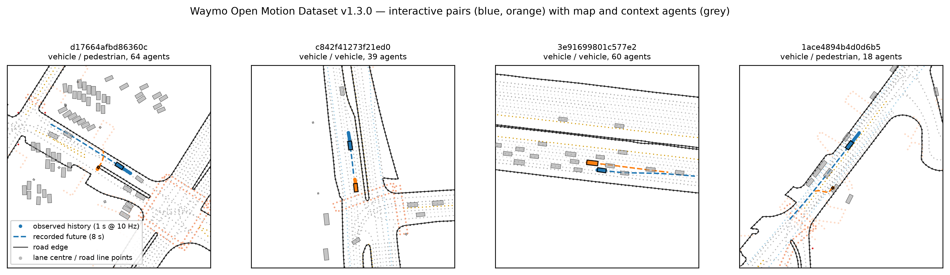
Task and dataset
9,144
500
1,000
1 s → 8 s
2
training windows (9,144 after removing scenes that share a source segment with dev)
development scenes (selection, tuning, sampling freeze)
final held-out scenes, LOCKED (official validation shards)
history @ 10 Hz → 16 joint steps @ 2 Hz
interacting targets per scene (objects_of_interest)
WOMD v1.3.0 scenario format, 48 training + 12 validation shards; 1.7 % of pair scenarios excluded by the 10 Hz timing rule (dropped frames, not interpolated)
Calibration on dev: tokenizer saturation 0.08 %, reconstruction 0.092 m; offroad convention validated by log playback (0.98 % offroad); logged-future overlap reference 1 % on jointly valid intervals (audit v2)
PRELIMINARY

Slide 4
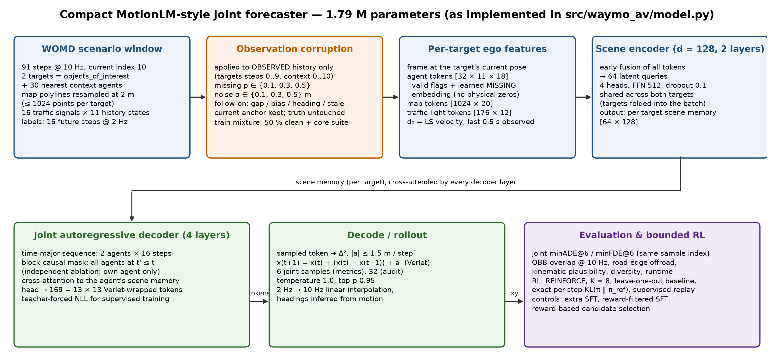
Implemented architecture
PRELIMINARY

Slide 5
Experimental design and baselines
Method | Training observations | Role
Constant position / constant velocity | — (deterministic, 1 sample) | non-learned floor; CV uses the model's own d₀ estimator
Independent decoder (Mind) | clean | ablation: same model, no cross-agent attention
Joint M0 | clean | clean-trained baseline (reference for all paired deltas)
Joint M1 | 50 % clean + core corruption suite | corruption-aware model
M1 + extra SFT | as M1, matched extra steps | control: more supervised training
M1 + reward-filtered SFT | own samples, reward-filtered | control: reward signal without policy gradient
M1 + bounded RL | REINFORCE, K = 8, LOO baseline, KL, replay | post-training (reward: overlap, offroad, kinematics)
Corruption suite (observations only)
Core: missing 10/30/50 % of history frames; Gaussian position noise σ = 0.1/0.3/0.5 m.
Held-out severities: missing 70 %, σ = 1.0 m, compound.
The current anchor frame is kept; ground truth is never corrupted.
Measurement
Joint minADE@6 / minFDE@6 over the same sample index (6 samples; 32-sample audit for overlap/diversity).
OBB overlap at 10 Hz, road-edge offroad (vehicles), kinematic plausibility, diversity.
Paired bootstrap over heuristic source-segment groups; 3 seeds; checkpoints chosen on dev only; final set evaluated once after freeze.
PRELIMINARY

Slide 6
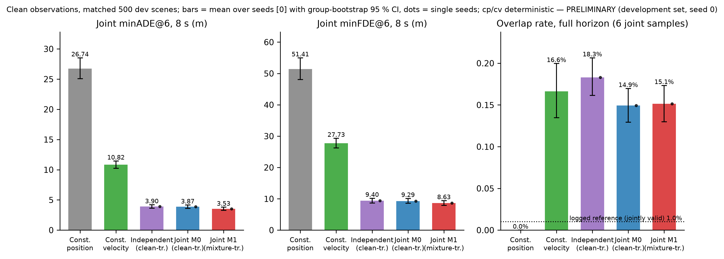
Clean forecasting results
Joint minADE@6 (m), clean, seeds 0
Constant velocity: 10.82 [10.22, 11.44]
Independent: 3.90 [3.63, 4.20]
Joint M0: 3.87 [3.61, 4.17]
Joint M1: 3.53 [3.28, 3.80]
Joint − independent: -0.03 [-0.22, +0.17] (-0.8 %)
Evaluated on the development set (500 scenes) — PRELIMINARY; identical scenes and sampling (6 joint samples, T = 1.0, top-p 0.95) for every learned model; cp/cv are deterministic
Overlap, clean, 32-sample audit: M0 14.8 [13.0, 16.6] % over the full generated horizon; on jointly valid intervals M0 14.6 [12.8, 16.5] % vs logged reference 1.0 [0.2, 2.0] % (same approximate test applied to logs; not a lower bound)
Checkpoints selected on dev by their own criterion (M0: clean jminADE; M1: mean of clean and suite); 12k steps, 1.79 M parameters, d = 128
PRELIMINARY

Slide 7
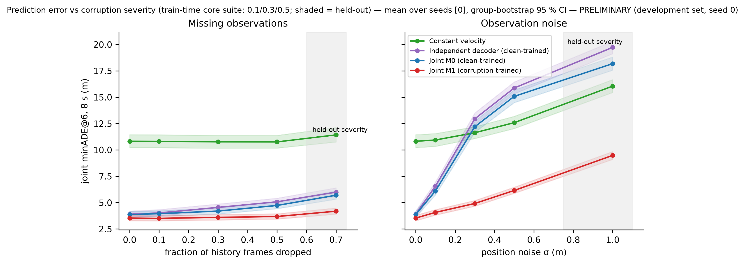
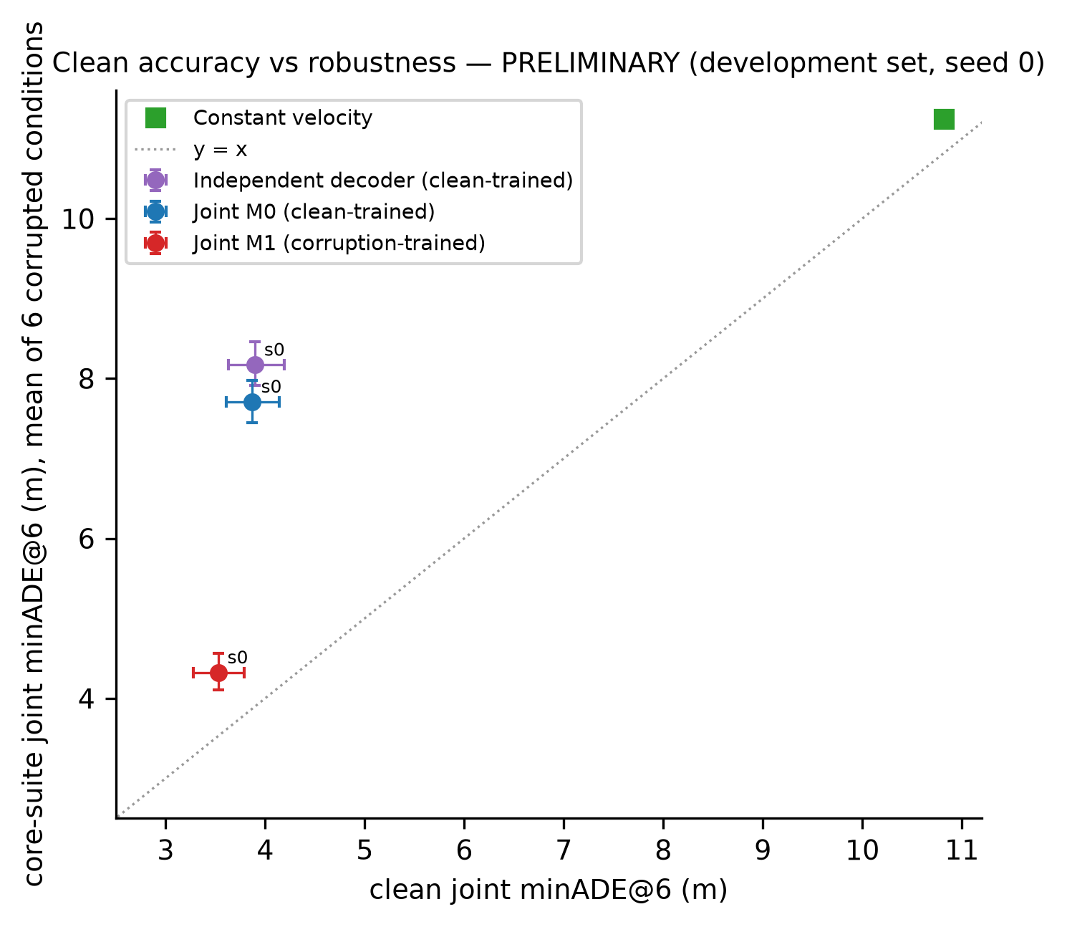
Robustness to missing and noisy observations
seed | core-suite rel. Δ (≤ −5 %) | clean rel. Δ (≤ +3 %) | core overlap Δ pp (≤ +0.5) | verdict
0 | -43.9 % [-46.7, -41.3] | -8.7 % [-13.8, -3.9] | +0.58 [-0.73, +1.84] | FAIL
M1 vs M0 (paired, group bootstrap)
Core suite jminADE: -3.39 [-3.60, -3.18] (-43.9 %)
Held-out suite: -4.91 [-5.22, -4.60] (-43.6 %)
Clean: -0.34 [-0.53, -0.15] (-8.7 %)
Core overlap: +0.58 [-0.73, +1.84] pp
PRELIMINARY

Slide 8
Bounded RL post-training and controls
PENDING — figure not yet generated
RL vs its M1 initialisation (clean, paired)
Controls vs M1 (overlap, 32 samples)
PENDING — post-training stage not yet run. Runs planned: rl_pilot, filtered_sft_pilot, extra_sft_pilot per seed, all initialised from the dev-selected M1 checkpoint.
PENDING — controls run in the same stage. Interpretation rule (frozen before final evaluation): an RL effect counts only if it exceeds both the extra-SFT and reward-filtered-SFT controls under identical sampling.
PRELIMINARY

Slide 9
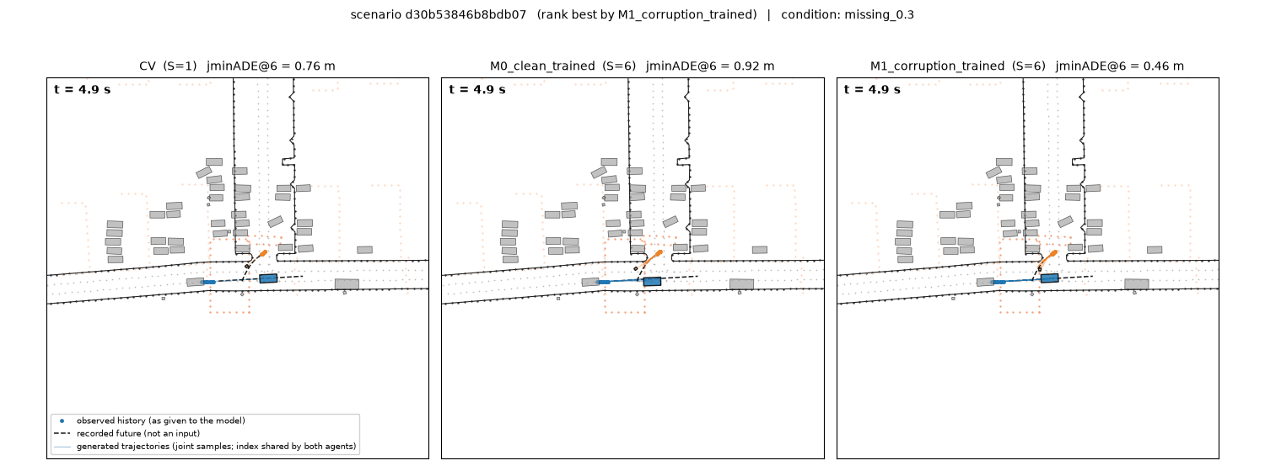
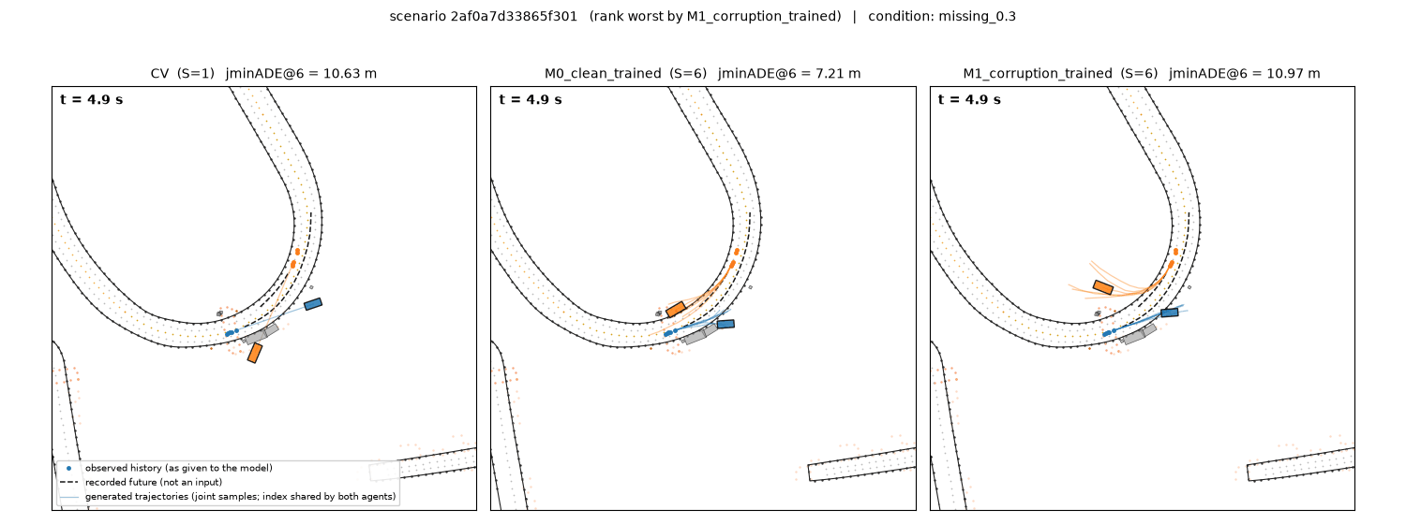
Qualitative examples and failures
Success case — scenario d30b53846b8bdb07, condition missing_0.3 — CV 0.76 m, M0_clean_trained 0.92 m, M1_corruption_trained 0.46 m
Failure case — scenario 2af0a7d33865f301, condition missing_0.3 — CV 10.63 m, M0_clean_trained 7.21 m, M1_corruption_trained 10.97 m
Selection rule (not hand-picked): pool = first 64 manifest scenes; select 'mixed' by M1_corruption_trained joint minADE@6; identical scenes/corruption/sampling across methods
Each panel shows the identical scene, corruption realisation and sampling; dots = observed history as given to the model, black dashed = recorded future (never an input), coloured = generated joint samples with one shared sample index for both agents
Animations (GIF + MP4, synchronized, fixed camera): reports/demos/<set>/<scenario>_<condition>.{gif,mp4}
PRELIMINARY (development set, seed 0)

Slide 10
Conclusions, limitations, remaining work
Clean: joint M0 3.87 [3.61, 4.17] m vs CV 10.82 [10.22, 11.44] m; joint − independent -0.03 [-0.22, +0.17] (-0.8 %)
Robustness: M1 − M0 on the core suite -3.39 [-3.60, -3.18] (-43.9 %); clean -0.34 [-0.53, -0.15] (-8.7 %); verdicts: seed 0 FAIL
RL and controls: pending
Limitations: compact model and ~9k training scenes (not a leaderboard reproduction); official metrics package unavailable (custom metrics audited on oracles); the 2 Hz box-overlap test is approximate (logged reference 1 % on jointly valid intervals; RL reward = approximate geometric consistency, not verified safety); source-segment grouping is heuristic; synthetic corruptions are stress tests, not sensor models
Remaining: finish seeds, dev evaluation, RL + controls, freeze, single locked final evaluation, report
Notes:
Regenerate: python scripts/build_slide_content.py --dev-eval /media/jarettpoliner/extradrive1/recovered_seagate_files/Waymo_AV_data/runs/eval_dev_prelim --seeds 0 --label PRELIMINARY (development set, seed 0) --figures reports/figures/dev_prelim --demos reports/demos/prelim_M0_vs_M1_missing_0.3 reports/demos/prelim_M0_vs_M1_noise_0.5 reports/demos/prelim_independent_vs_joint_clean && node slides/build_deck.js
GPU-hours used at build time: 1.49

