Slide 1
Robust Joint Motion Forecasting Under Missing and Noisy Observations
Compact MotionLM-style joint forecaster on the Waymo Open Motion Dataset — corruption-aware training and bounded RL post-training
Status: FINAL (locked held-out set, 3 seeds). Development numbers use manifests/dev.json; held-out numbers use the locked manifests/final.json.
Notes:
Deck generated from saved results only: slides/content.json, built by scripts/build_slide_content.py and slides/build_deck.js. Regenerate: python scripts/build_slide_content.py --dev-eval /media/jarettpoliner/extradrive1/recovered_seagate_files/Waymo_AV_data/runs/eval_dev --final-eval /media/jarettpoliner/extradrive1/recovered_seagate_files/Waymo_AV_data/runs/eval_final --seeds 0,1,2 --label FINAL (locked held-out set, 3 seeds) --figures reports/figures/final --demos reports/demos/prelim_M0_vs_M1_missing_0.3 reports/demos/prelim_M0_vs_M1_noise_0.5 reports/demos/prelim_independent_vs_joint_clean reports/demos/final_M1_vs_selection_vs_RL_clean reports/demos/final_M1_vs_RL_overlap_cases && node slides/build_deck.js

Slide 2
Research question and motivation
Question
Why it matters
Approach
Does a joint two-agent autoregressive forecaster keep its accuracy and physical consistency when the observed history is incomplete or noisy — and can training on corrupted observations, plus bounded reward post-training, make it more robust without hurting clean accuracy?
Deployed trackers drop frames and jitter. Forecasters trained only on clean logs can degrade sharply; robustness must be measured with the same evaluator on the same scenes, with uncertainty, before claiming an improvement.
Reproduce a compact MotionLM-style joint model (M0), train a matched corruption-aware variant (M1) and an independent-agent ablation, then post-train M1 with REINFORCE + KL + replay against simpler controls. Preregistered thresholds; paired group bootstrap.
Preregistered success rule (PLAN.md): ≥ 5 % relative reduction of core-suite joint minADE@6, ≤ 3 % clean worsening, ≤ 0.5 pp overlap increase
Scope kept to forecasting, robustness and bounded RL — no observation selection, no architecture expansion
FINAL

Slide 3
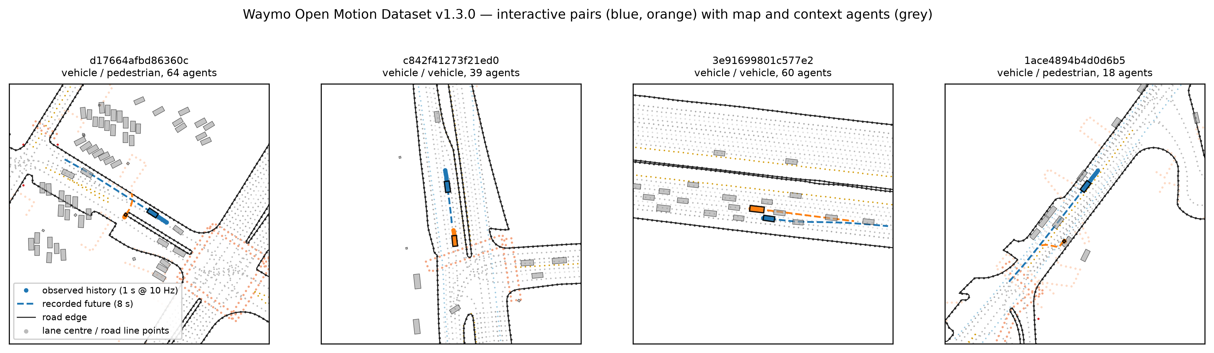
Task and dataset
9,144
500
1,000
1 s → 8 s
2
training windows (9,144 after removing scenes that share a source segment with dev)
development scenes (selection, tuning, sampling freeze)
final held-out scenes, LOCKED (official validation shards)
history @ 10 Hz → 16 joint steps @ 2 Hz
interacting targets per scene (objects_of_interest)
WOMD v1.3.0 scenario format, 48 training + 12 validation shards; 1.7 % of pair scenarios excluded by the 10 Hz timing rule (dropped frames, not interpolated)
Calibration on dev: tokenizer saturation 0.08 %, reconstruction 0.092 m; offroad convention validated by log playback (0.98 % offroad); logged-future overlap reference 1 % on jointly valid intervals (audit v2)
FINAL

Slide 4
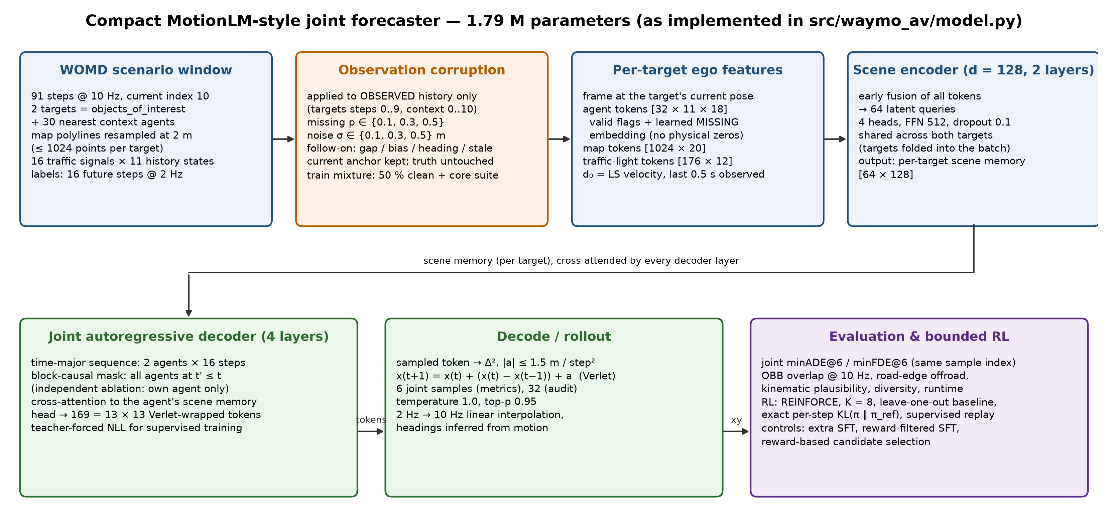
Implemented architecture
FINAL

Slide 5
Experimental design and baselines
Method | Training observations | Role
Constant position / constant velocity | — (deterministic, 1 sample) | non-learned floor; CV uses the model's own d₀ estimator
Independent decoder (Mind) | clean | ablation: same model, no cross-agent attention
Joint M0 | clean | clean-trained baseline (reference for all paired deltas)
Joint M1 | 50 % clean + core corruption suite | corruption-aware model
M1 + extra SFT | as M1, matched extra steps | control: more supervised training
M1 + reward-filtered SFT | own samples, reward-filtered | control: reward signal without policy gradient
M1 + bounded RL | REINFORCE, K = 8, LOO baseline, KL, replay | post-training (reward: overlap, offroad, kinematics)
Corruption suite (observations only)
Core: missing 10/30/50 % of history frames; Gaussian position noise σ = 0.1/0.3/0.5 m.
Held-out severities: missing 70 %, σ = 1.0 m, compound.
The current anchor frame is kept; ground truth is never corrupted.
Measurement
Joint minADE@6 / minFDE@6 over the same sample index (6 samples; 32-sample audit for overlap/diversity).
OBB overlap at 10 Hz, road-edge offroad (vehicles), kinematic plausibility, diversity.
Paired bootstrap over heuristic source-segment groups; 3 seeds; checkpoints chosen on dev only; final set evaluated once after freeze.
FINAL

Slide 6
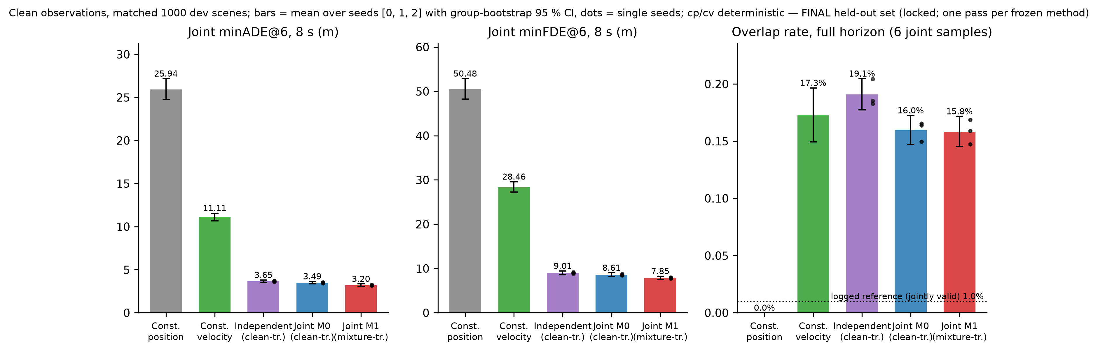
Clean forecasting results
Joint minADE@6 (m), clean, seeds 0,1,2
Constant velocity: 11.11 [10.68, 11.56]
Independent: 3.65 [3.51, 3.81]
Joint M0: 3.49 [3.35, 3.64]
Joint M1: 3.20 [3.06, 3.35]
Joint − independent: -0.16 [-0.24, -0.08] (-4.3 %)
Evaluated on the FINAL held-out set (1,000 locked scenes); identical scenes and sampling (6 joint samples, T = 1.0, top-p 0.95) for every learned model; cp/cv are deterministic
Overlap, clean, 32-sample audit: M0 15.9 [14.7, 17.1] % over the full generated horizon; on jointly valid intervals M0 15.7 [14.6, 16.9] % vs logged reference 1.0 [0.4, 1.6] % (same approximate test applied to logs; not a lower bound)
Checkpoints selected on dev by their own criterion (M0: clean jminADE; M1: mean of clean and suite); 12k steps, 1.79 M parameters, d = 128
FINAL

Slide 7
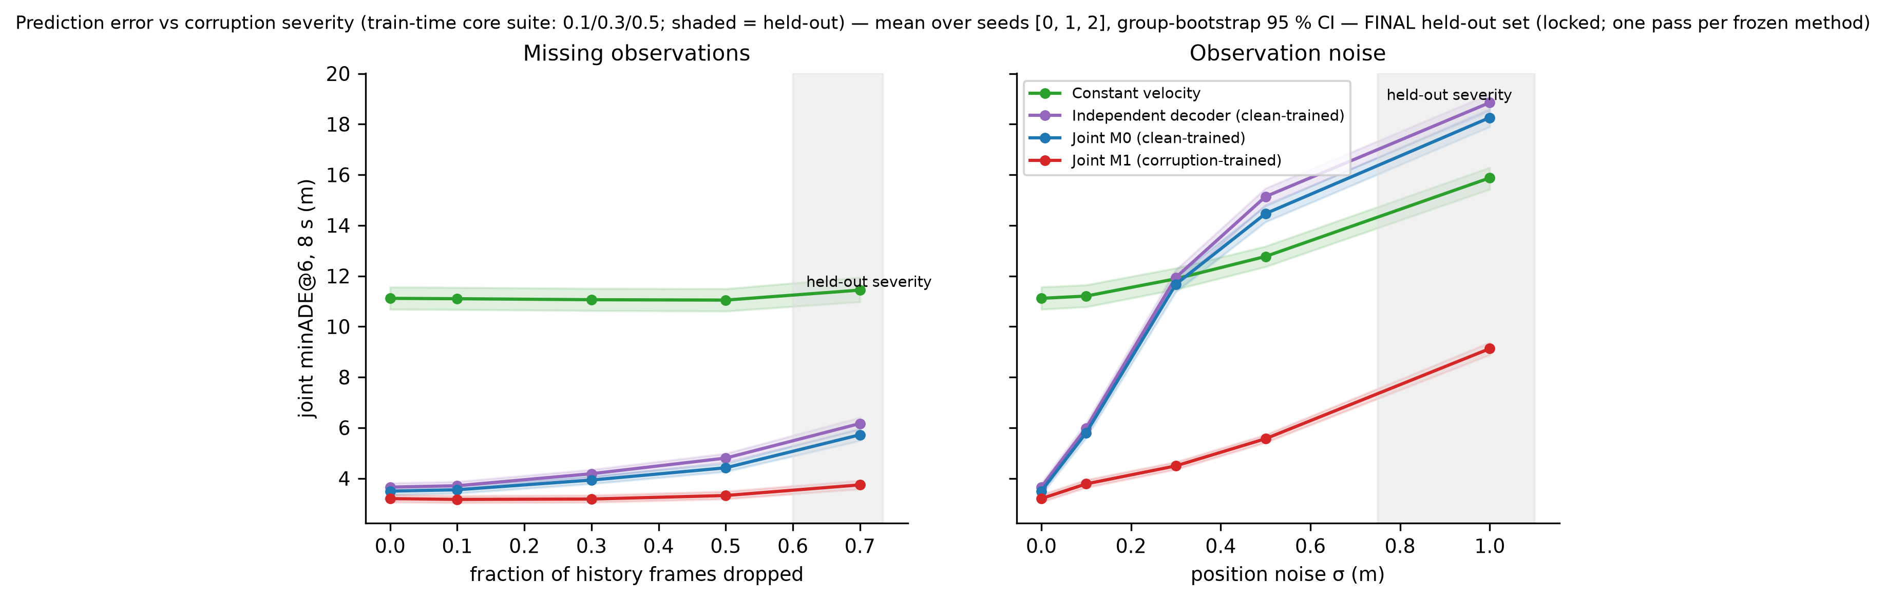
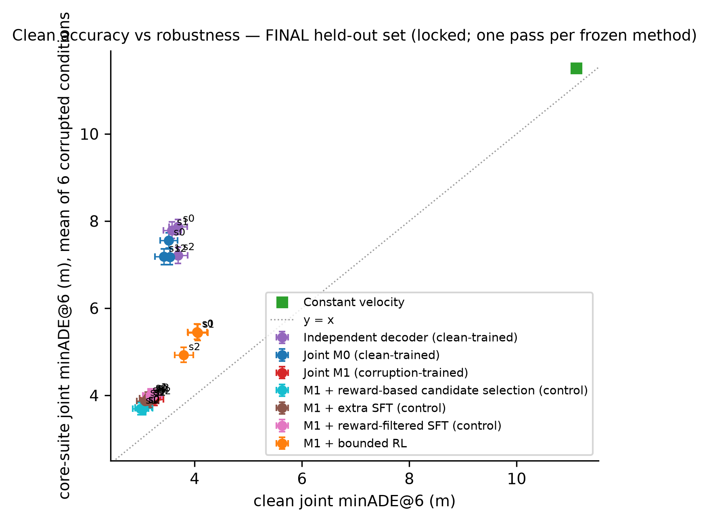
Robustness to missing and noisy observations
seed | core-suite rel. Δ (≤ −5 %) | clean rel. Δ (≤ +3 %) | core overlap Δ pp (≤ +0.5) | verdict
0 | -47.7 % [-49.5, -45.9] | -9.0 % [-13.0, -5.3] | -0.26 [-1.16, +0.62] | PASS
1 | -45.8 % [-47.6, -43.8] | -8.2 % [-11.8, -4.6] | +1.72 [+0.77, +2.67] | FAIL
2 | -45.5 % [-47.7, -43.4] | -8.2 % [-11.8, -4.6] | +0.06 [-0.91, +1.08] | PASS
M1 vs M0 (paired, group bootstrap)
Core suite jminADE: -3.39 [-3.50, -3.28] (-46.4 %)
Held-out suite: -5.46 [-5.63, -5.29] (-47.9 %)
Clean: -0.30 [-0.38, -0.22] (-8.5 %)
Core overlap: +0.51 [-0.19, +1.19] pp
FINAL

Slide 8
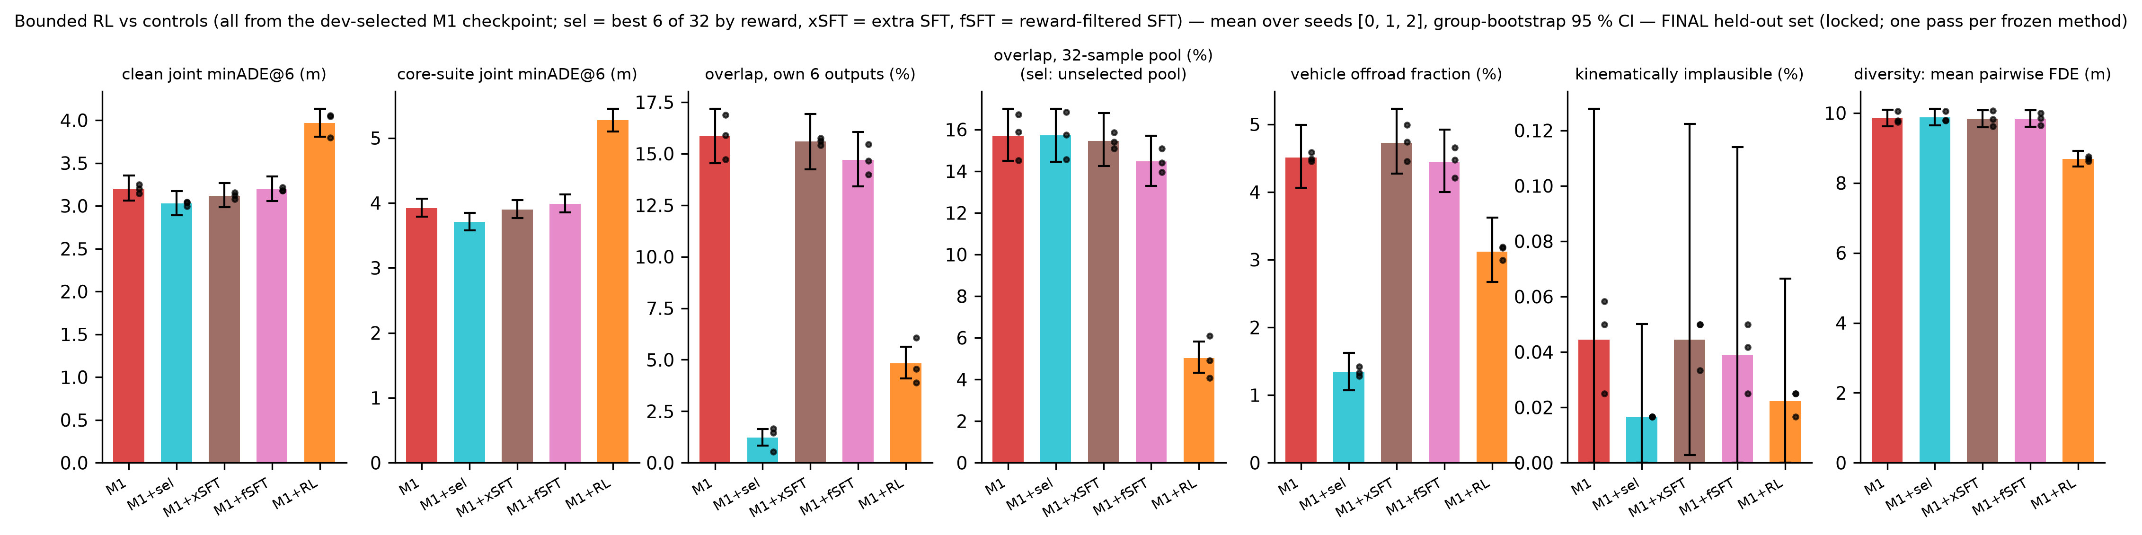
Bounded RL post-training and controls
RL vs its M1 initialisation (clean, paired)
Controls vs M1
Clean jminADE@6: +0.77 [+0.67, +0.86] (+24.0 %)
Overlap, 32 samples: -10.67 [-11.60, -9.80] pp
Offroad: -1.39 [-1.63, -1.16] pp
Diversity, pairwise FDE: -1.17 [-1.29, -1.05] m
Excessive stopping: RL 3.49 % vs M1 0.43 % (dev diagnostic)
ends < 1 m when logged motion > 5 m, per agent-sample
Frozen rule: does not count in seeds 0, 1, 2
needs: beat both SFT controls on overlap, clean Δ ≤ +3 %
Reward-filtered SFT, overlap32: -1.23 [-1.53, -0.91] pp
Extra SFT (matched steps), overlap32: -0.26 [-0.56, +0.03] pp
Reward-based selection, best 6 of 32:
own-output overlap -14.62 [-15.80, -13.52] pp
clean jminADE -0.17 [-0.22, -0.12] (-5.4 %)
cost: 32 rollouts + reward scoring per scene
Reward = approximate geometric consistency, not verified safety
FINAL

Slide 9
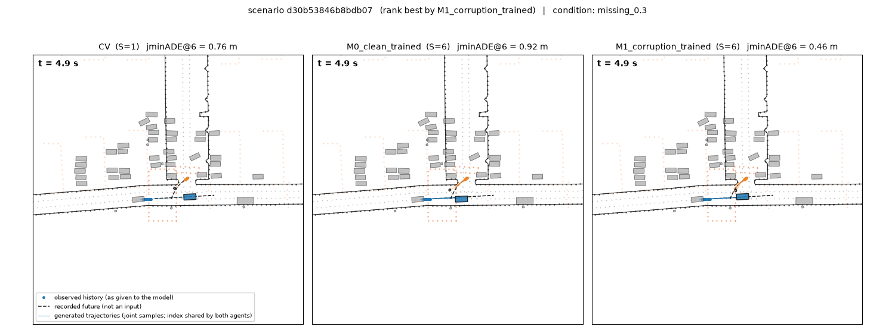
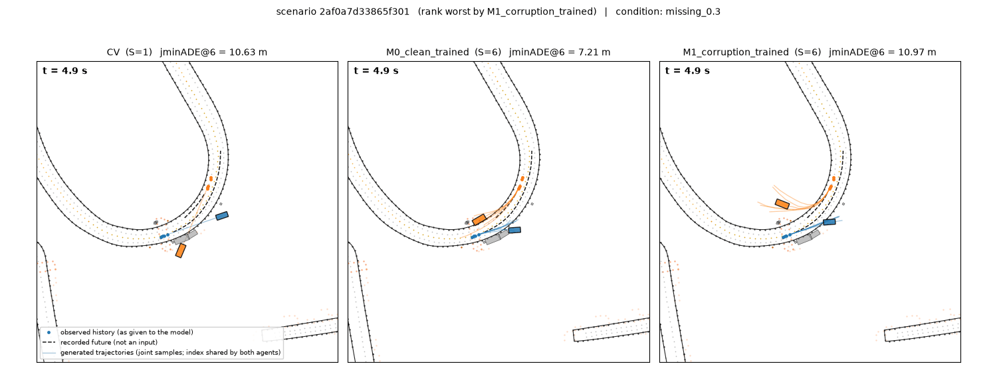
Qualitative examples and failures
Success case — scenario d30b53846b8bdb07, condition missing_0.3 — CV 0.76 m, M0_clean_trained 0.92 m, M1_corruption_trained 0.46 m
Failure case — scenario 2af0a7d33865f301, condition missing_0.3 — CV 10.63 m, M0_clean_trained 7.21 m, M1_corruption_trained 10.97 m
Selection rule (not hand-picked): pool = first 64 manifest scenes; select 'mixed' by M1_corruption_trained joint minADE@6; identical scenes/corruption/sampling across methods
Each panel shows the identical scene, corruption realisation and sampling; dots = observed history as given to the model, black dashed = recorded future (never an input), coloured = generated joint samples with one shared sample index for both agents
Animations (GIF + MP4, synchronized, fixed camera): reports/demos/<set>/<scenario>_<condition>.{gif,mp4}
FINAL (locked held-out set, 3 seeds)

Slide 10
Conclusions, limitations, remaining work
Clean: joint M0 3.49 [3.35, 3.64] m vs CV 11.11 [10.68, 11.56] m; joint − independent -0.16 [-0.24, -0.08] (-4.3 %)
Robustness: M1 − M0 on the core suite -3.39 [-3.50, -3.28] (-46.4 %); clean -0.30 [-0.38, -0.22] (-8.5 %); verdicts: seed 0 PASS, seed 1 FAIL, seed 2 PASS
RL (mixed/negative): overlap -10.67 [-11.60, -9.80] pp vs M1 but clean jminADE +0.77 [+0.67, +0.86] (+24.0 %), diversity -1.17 [-1.29, -1.05] m, excessive stopping 3.49 % vs 0.43 %; frozen rule: seed 0 DOES NOT COUNT, seed 1 DOES NOT COUNT, seed 2 DOES NOT COUNT; the best-6-of-32 selection control dominates RL on every axis at 32-sample cost
Limitations: compact model and ~9k training scenes (not a leaderboard reproduction); official metrics package unavailable (custom metrics audited on oracles); the 2 Hz box-overlap test is approximate (logged reference 1 % on jointly valid intervals; RL reward = approximate geometric consistency, not verified safety); source-segment grouping is heuristic; synthetic corruptions are stress tests, not sensor models
Final held-out evaluation done once per frozen method; see report for full tables
Notes:
Regenerate: python scripts/build_slide_content.py --dev-eval /media/jarettpoliner/extradrive1/recovered_seagate_files/Waymo_AV_data/runs/eval_dev --final-eval /media/jarettpoliner/extradrive1/recovered_seagate_files/Waymo_AV_data/runs/eval_final --seeds 0,1,2 --label FINAL (locked held-out set, 3 seeds) --figures reports/figures/final --demos reports/demos/prelim_M0_vs_M1_missing_0.3 reports/demos/prelim_M0_vs_M1_noise_0.5 reports/demos/prelim_independent_vs_joint_clean reports/demos/final_M1_vs_selection_vs_RL_clean reports/demos/final_M1_vs_RL_overlap_cases && node slides/build_deck.js
GPU-hours used at build time: 2.27

